Slide 1
EER Model – Generalization and Specialization
University Case Study
Prepared by: Niveditha S 192421440L

Slide 2
6.Prepare a presentation on the EER model, demonstrating
generalization and specialization with a University case study.?
Introduction to EER Model
EER (Enhanced Entity Relationship) Model is an extension of the ER Model.
It represents complex database structures.
It includes Generalization and Specialization.
It helps organize data efficiently.

Slide 3
University Case Study
Superclass: Person
Person ID
Name
Address
Subclasses
Student: Roll No, Course, Semester
Faculty: Employee ID, Department
Staff: Staff ID, Job Role

Slide 4
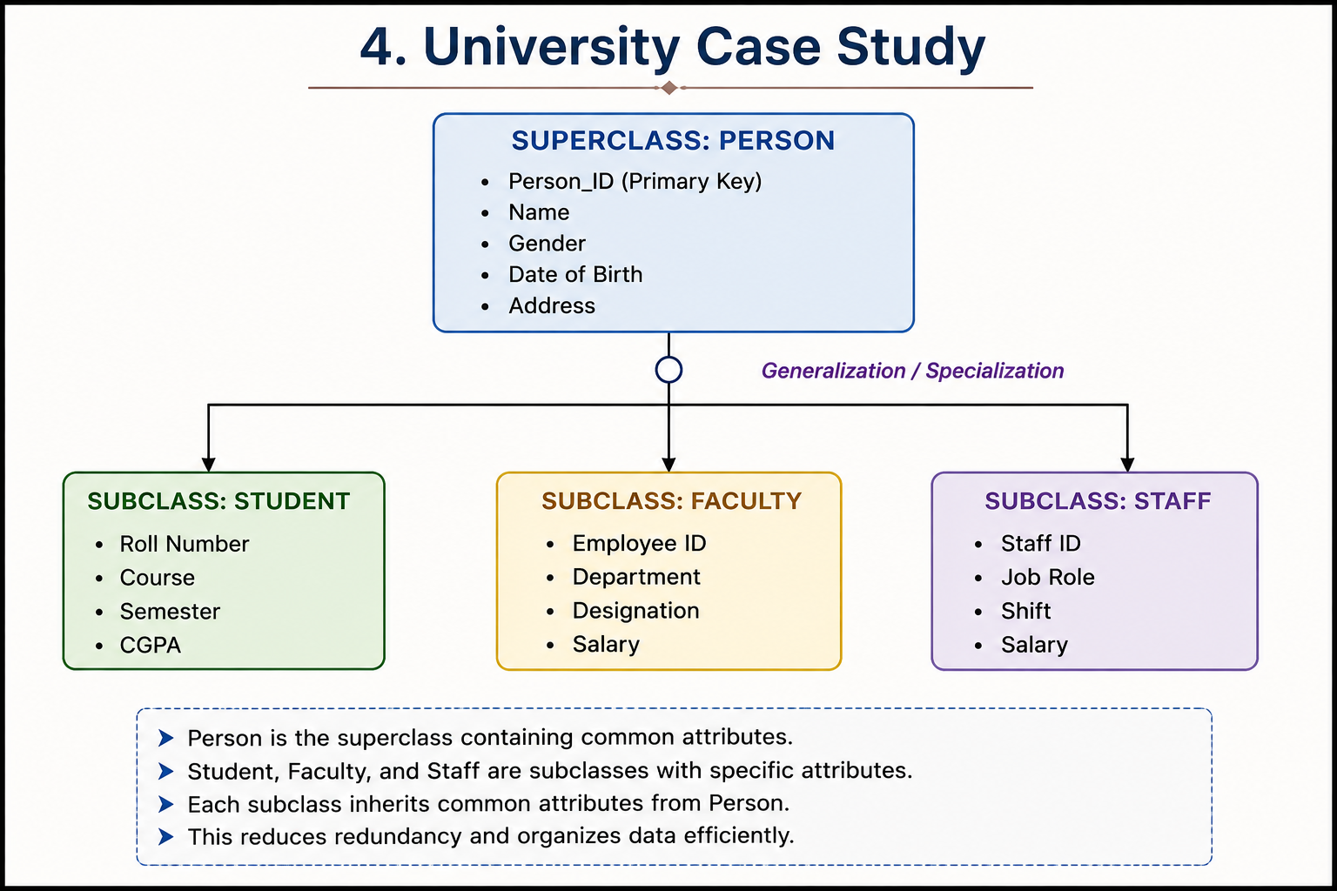

Slide 5
Explanation
Person is the superclass.
Student, Faculty, and Staff are subclasses.
All subclasses inherit common details from Person.
This reduces duplicate data.

Slide 6
Advantages
Reduces redundancy.
Improves database design.
Easy to manage data.
Supports inheritance.
Increases flexibility.

Slide 7


