Slide 1
Comparison of Strong and Weak Entities in ER Modeling
With Real-World Examples
Prepared by: Niveditha S 192421440L

Slide 2
9.What is an Entity?
Introduction:
An entity is a real-world object in a database.
ER Model uses Strong and Weak entities.
They help represent different types of data relationships.

Slide 3
Strong Entity
Definition
A strong entity has its own Primary Key.
It can exist independently.
It does not depend on another entity.
Example
Student
Student_ID (PK)
Name
Department

Slide 4
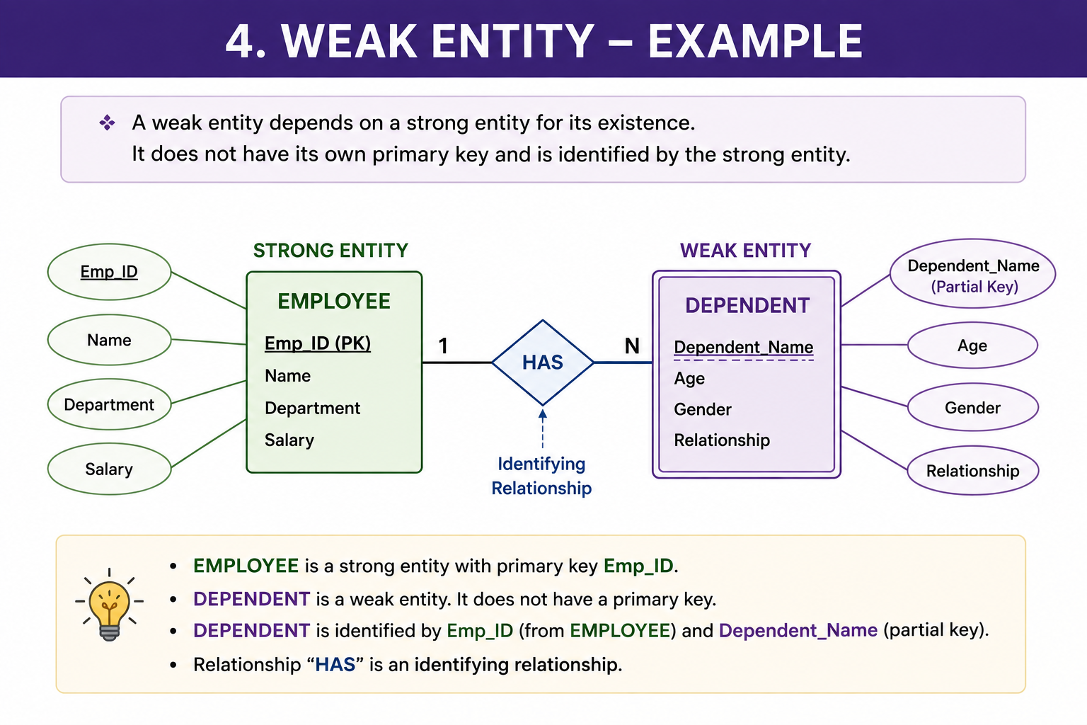

Slide 5
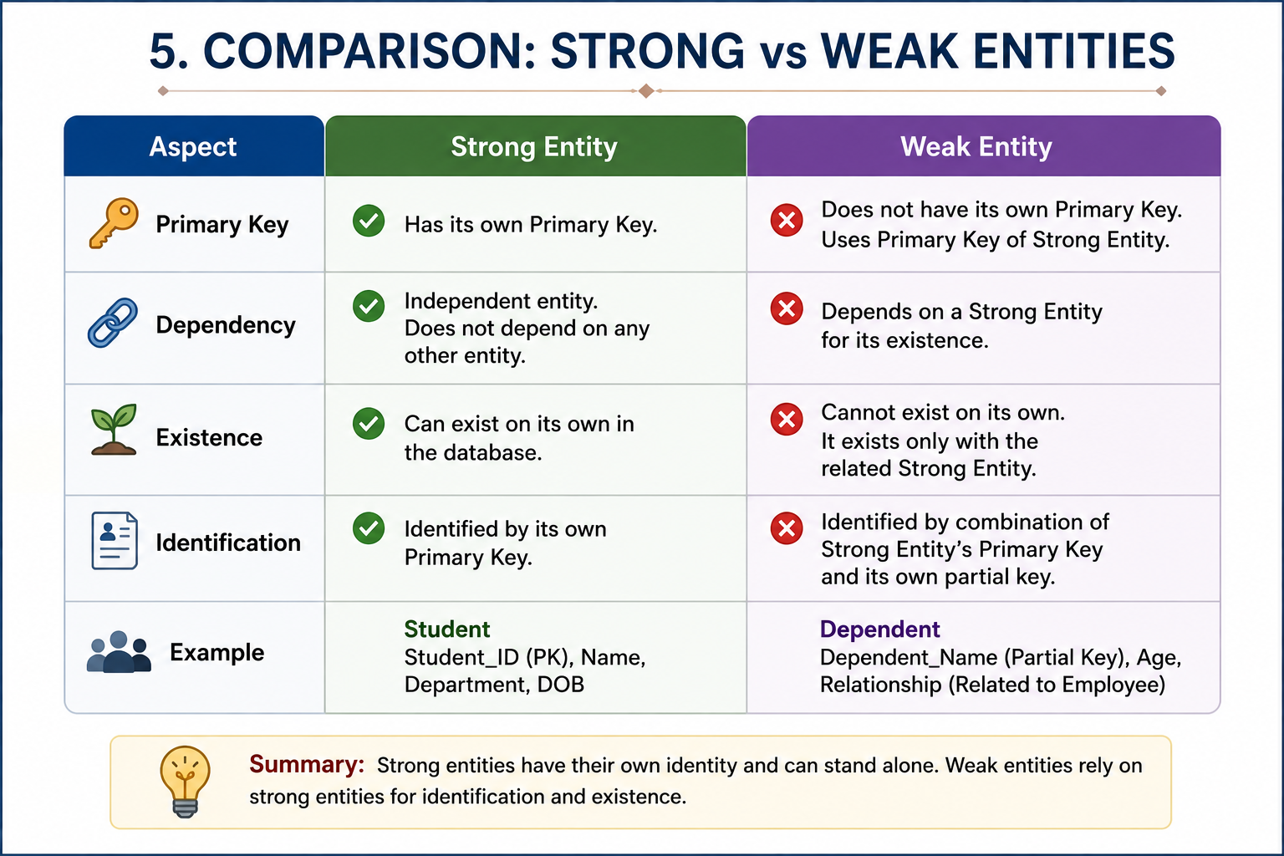

Slide 6
Conclusion:
Strong entities have their own identity.
Weak entities depend on strong entities.
Both are important in ER modeling.
They help design efficient and accurate databases.

Slide 7


