Slide 1
4.Present the Different Data Models (Hierarchical, Network, Relational) with Diagrams and Industry Use Cases
Introduction to Data Models
A data model defines how data is organized, stored, and related in a database.
It helps in designing and managing databases effectively.
Different data models are used based on application requirements.
The three major data models are Hierarchical, Network, and Relational.
Each model has its own structure, advantages, and applications.

Slide 2
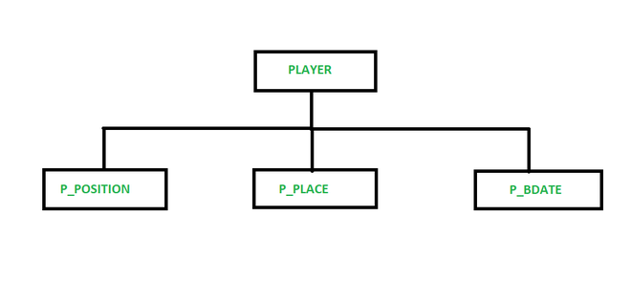
Hierarchical Data Model
Data is organized in a tree-like structure.
Each child record has only one parent.
Supports one-to-many relationships.
Data is accessed from the root to the child
nodes.
It is simple and fast for hierarchical data.

Slide 3
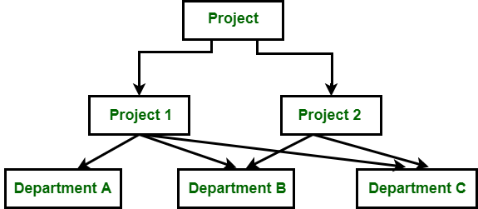
Network Data Model
Data is organized as a graph structure.
A child can have multiple parent records.
Supports many-to-many relationships.
Records are connected using links or pointers.
More flexible than the hierarchical model.

Slide 4
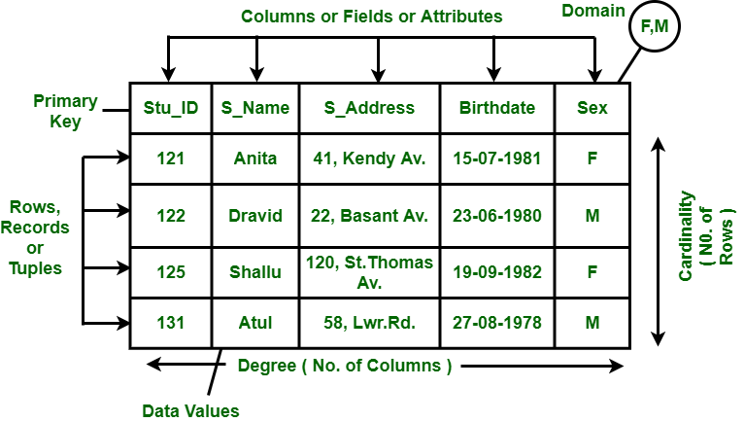
Relational Data Model
Data is stored in tables (rows and columns).
Tables are related using Primary Keys
and Foreign Keys.
Uses SQL (Structured Query Language).
Reduces data redundancy.
Most widely used database model today.

Slide 5
Advantages and Applications
Advantages
Hierarchical Model: Fast data access for tree structures.
Network Model: Supports complex relationships.
Relational Model: Easy to maintain and query using SQL.
Different models suit different application requirements.
The relational model is the most widely used in modern database systems.
Applications
Hierarchical: Organization charts, XML, File systems.
Network: Telecom, Transport, Manufacturing.
Relational: Banking, Healthcare, Education, E-commerce.

