Slide 1


Autonomous Driving System: Vision-Based Road Sign Recognition
And Obstacle Detection Using YOLOv8 and OpenCV
DSA0204 - Computer Vision With Open CV
Supervised by
Dr.G.A. SENTHIL
Presented by
K.L.V.S.KARTHIK(192424177)
R SAITEJA(192424352)
K.VENKATESH(192424326)

Slide 2
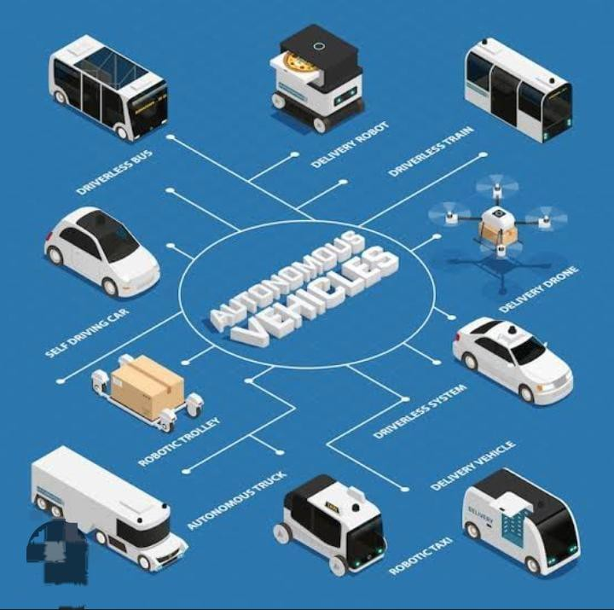
Introduction
Autonomous vehicles use cameras and computer vision to understand the road.
Road sign recognition helps the vehicle follow traffic rules like stop and speed limits.
Obstacle detection helps identify pedestrians, vehicles, and other objects.
Lane detection helps the vehicle stay in the correct lane while driving.
Advanced AI models like YOLO and CNN make the system fast and accurate.

Slide 3
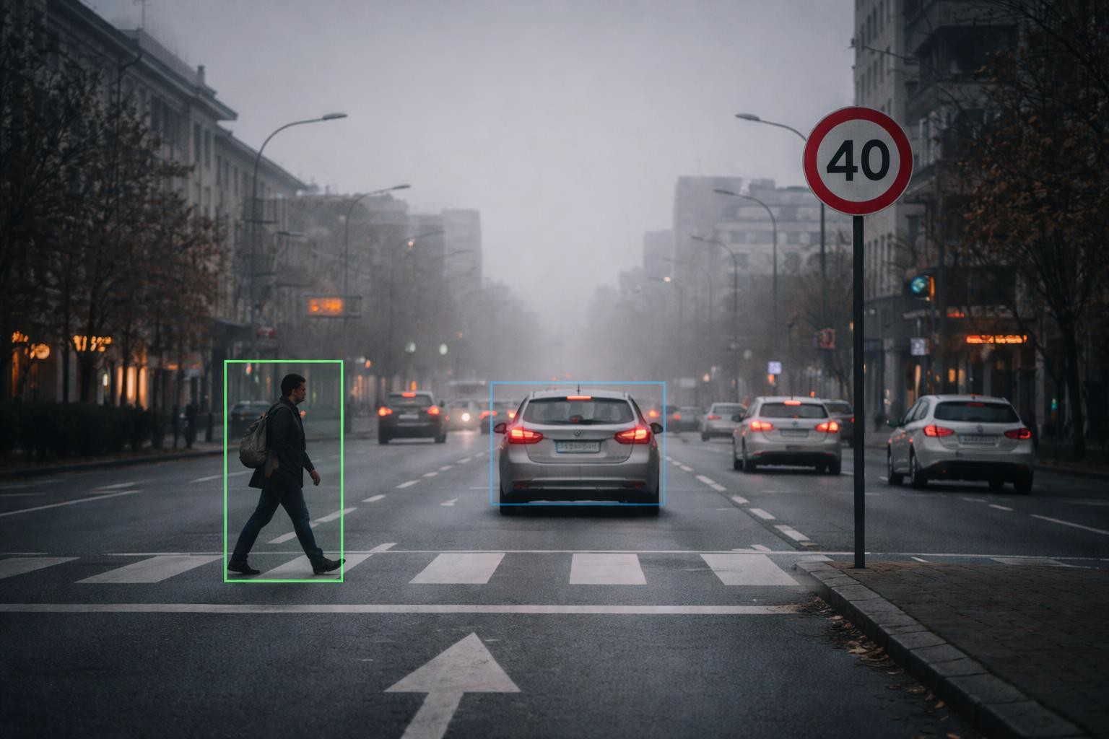
PROBLEM STATEMENT
Autonomous vehicles must understand road signs, lanes, and obstacles to drive safely.
Current systems sometimes fail in bad lighting, rain, fog, or heavy traffic conditions.
Wrong detection of road signs can cause incorrect speed control or unsafe turns.
Failure to detect pedestrians, vehicles, or barriers may lead to accidents.
Therefore, we need a reliable vision-based
system that can detect road signs, obstacles, and lanes in real time and help the vehicle make safe
decisions.

Slide 4
LITERATURE REVIEW
Author / Year | Method | Focus | Result
Smith et al., 2025 | CNN | Road sign recognition | Good accuracy
Kumar et al., 2025 | YOLOv3 | Obstacle detection | Reliable detection
Lee et al., 2024 | MobileNet | Traffic sign classification | Fast processing
Ahmed et al., 2025 | Optical Flow | Hazard detection | Works for moving objects
Patel et al., 2025 | YOLOv8 | Sign + obstacle detection | High performance

Slide 5
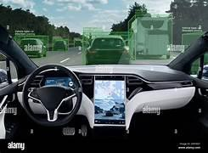
Objectives
To identify and locate obstacles such as vehicles, pedestrians, and barriers for safe navigation.
To enhance driving safety by providing timely alerts or automated vehicle responses.
To reduce human errors by assisting or replacing manual interpretation of road signs and surroundings.
To integrate road sign recognition and
obstacle detection into a unified autonomous driving pipeline.
To support decision-making for lane
keeping, speed control, and collision avoidance.

Slide 6

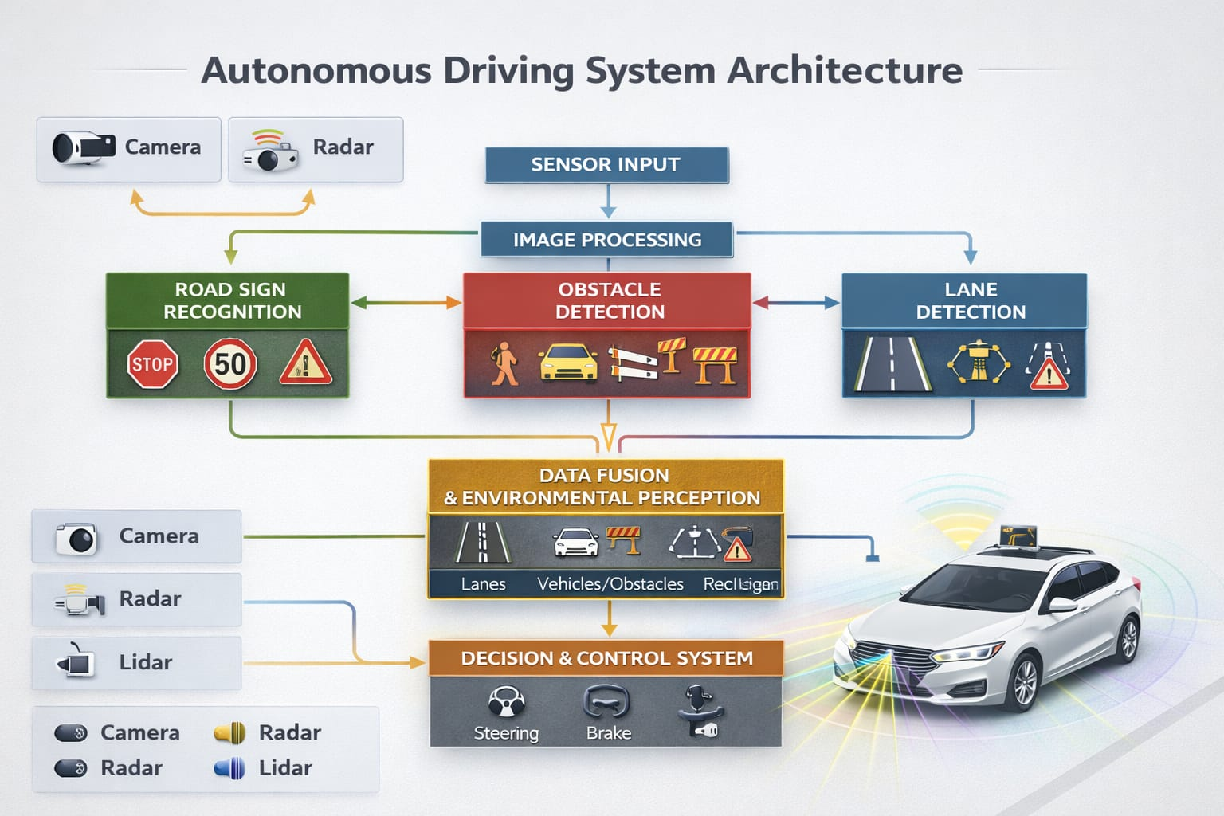
System Architecture

Slide 7
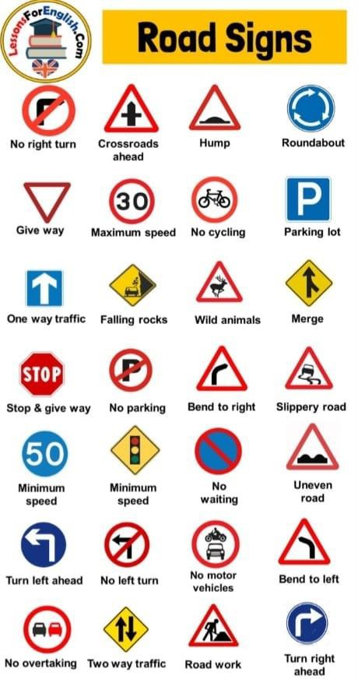
MODULE-1
ROAD SIGN RECOGNITION
This module detects traffic signs from camera or dashcam video.
It helps the vehicle understand road rules like stop signs and speed limits.
It uses deep learning models like YOLO and CNN to detect signs quickly and
accurately.
Color detection helps identify signs based on colors like red, blue, and yellow.
OCR is used to read numbers or text on signs, especially speed limits.

Slide 8
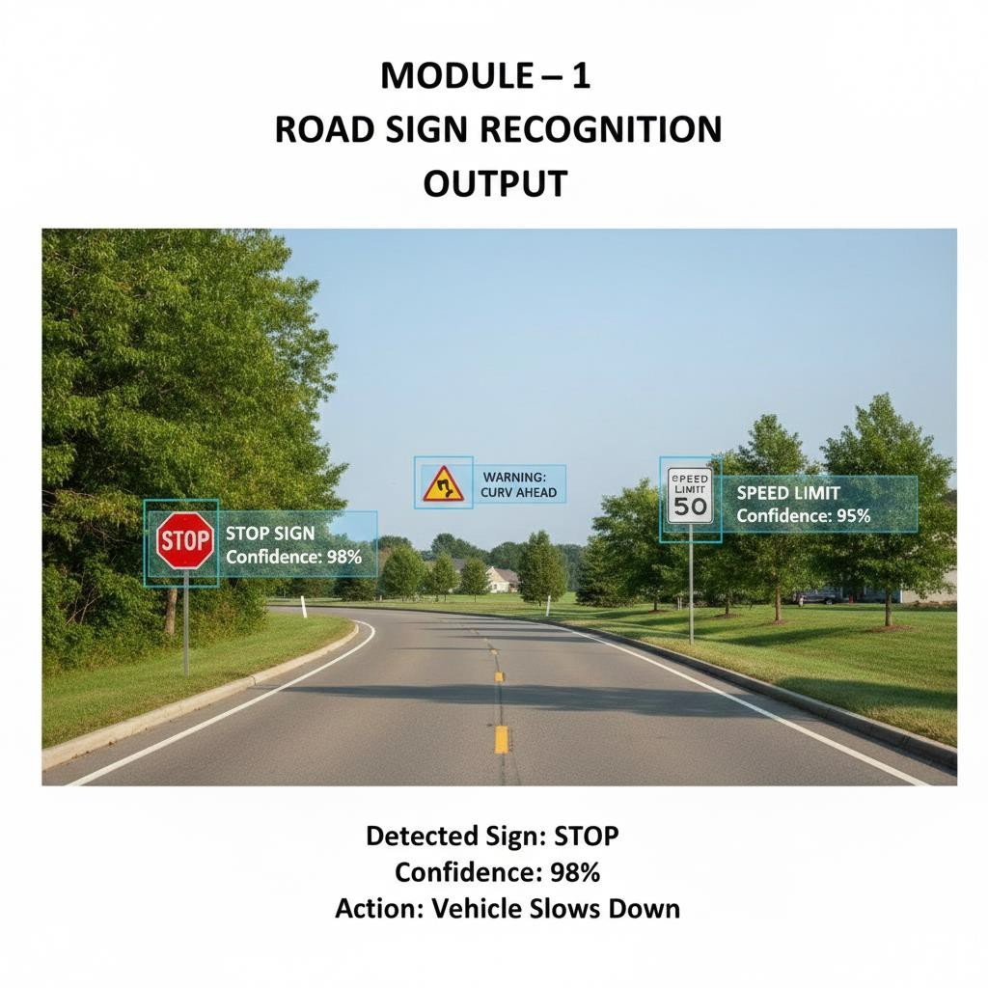

Slide 9
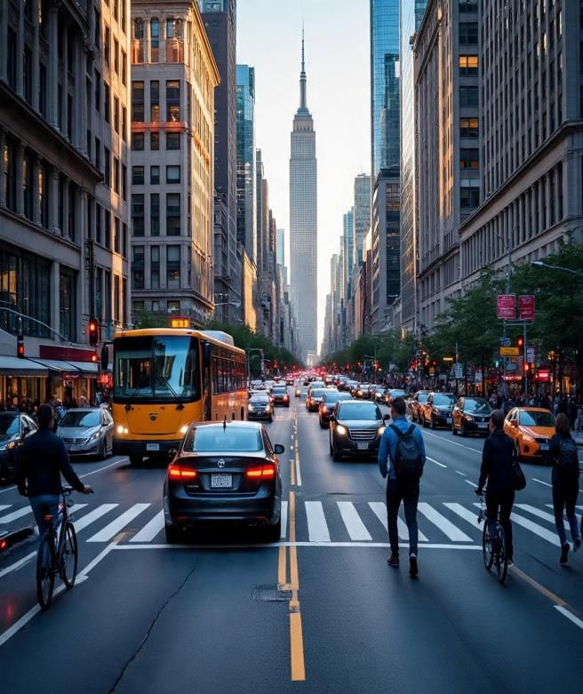
MODULE-2
OBSTACLE DETECTION AND AVOIDANCE
➤ This module detects obstacles like pedestrians, vehicles, and barriers on the road.
➤ It helps the vehicle avoid accidents by identifying objects in real time.
➤ Deep learning models like YOLO and R-CNN are used for fast and accurate
detection.
➤ The system estimates the distance between the vehicle and the obstacle.
➤ Based on distance, the vehicle can brake, slow down, or change direction.

Slide 10
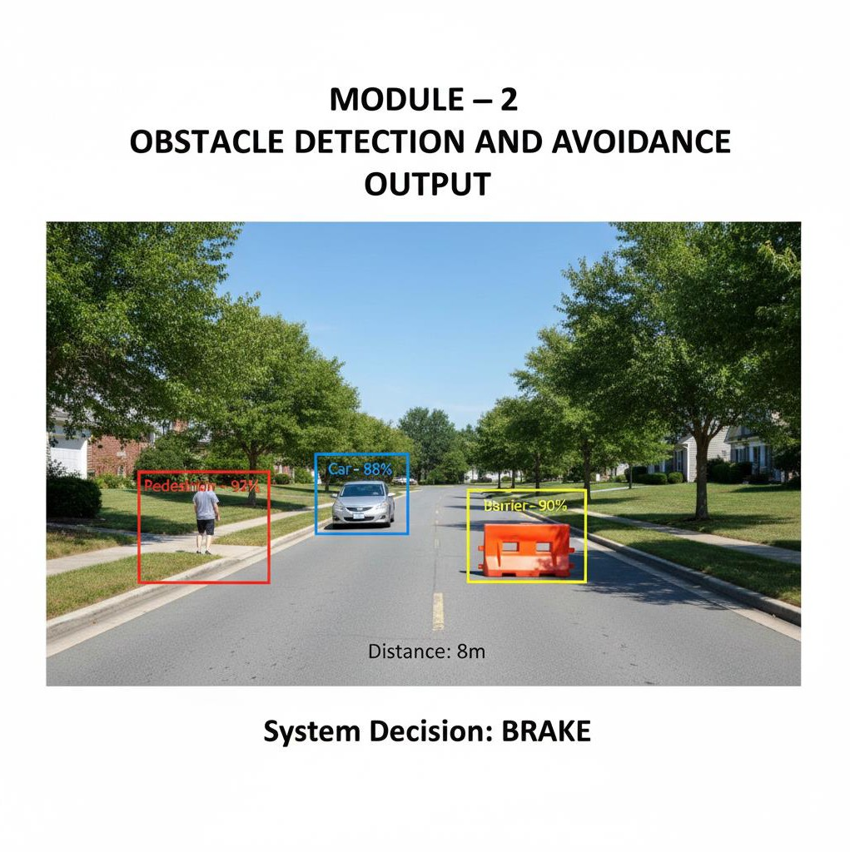

Slide 11
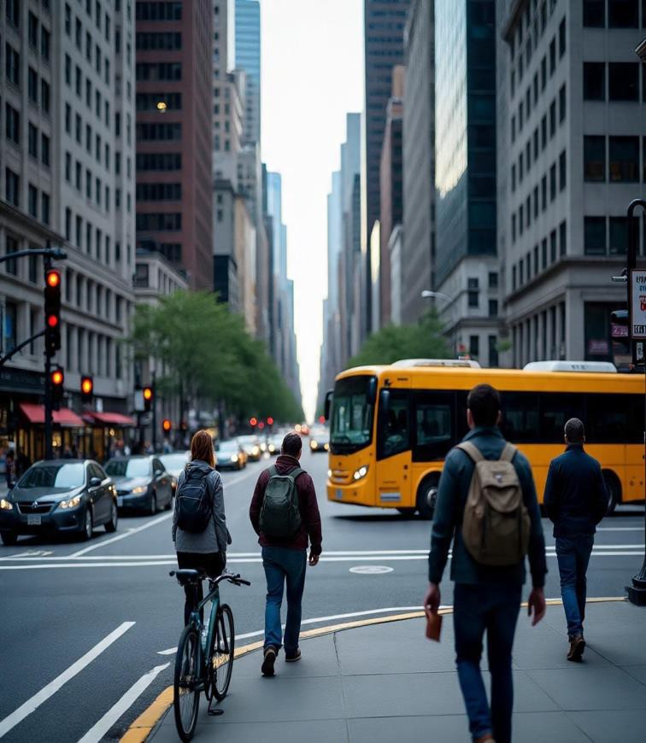
MODULE-3
LANE DETECTION AND LANE DEPARTURE WARNING
➤ This module detects lane markings on the road using camera images.
➤ It helps the vehicle stay in the correct lane while driving.
➤ Techniques like Canny edge detection and Hough Transform are used to find lane lines.
➤ Advanced CNN models improve detection in curved or faded lanes.
➤ The system gives a warning if the vehicle moves out of the lane.

Slide 12
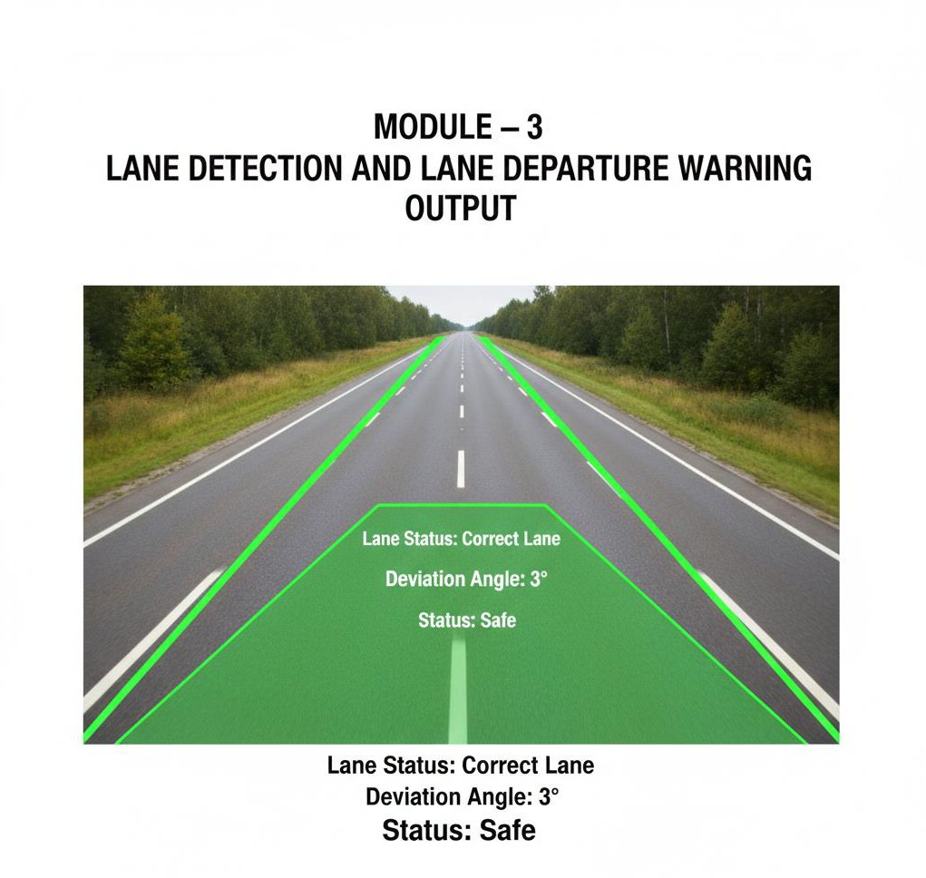

Slide 13

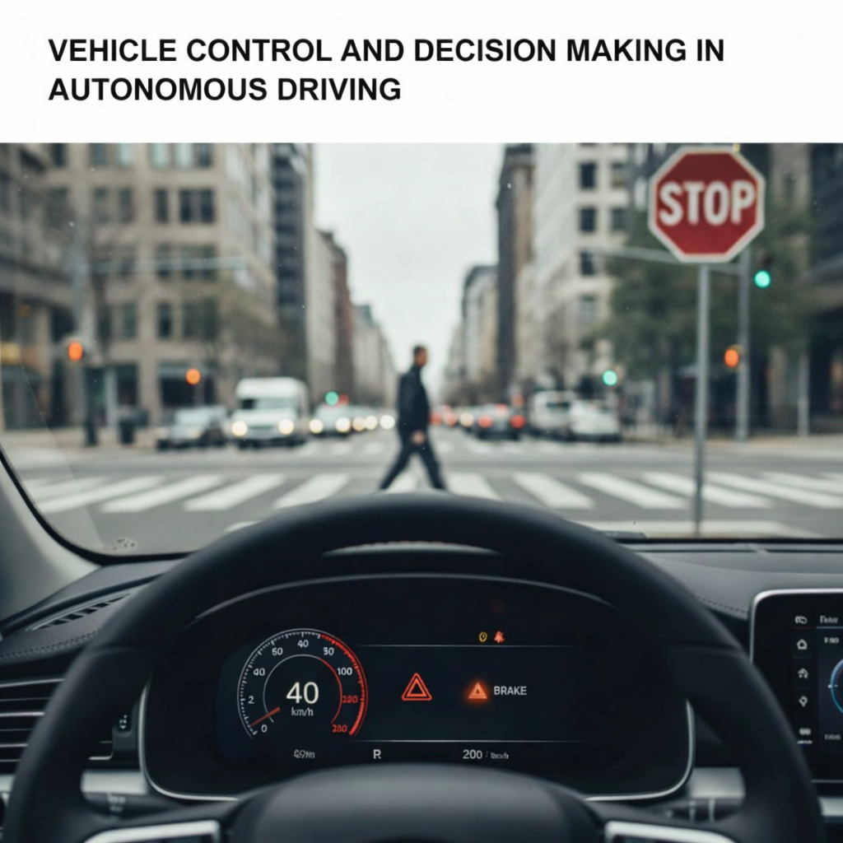
MODULE – 4
VEHICLE CONTROL AND DECISION MAKING
This module makes driving decisions based on detected signs and obstacles.
It decides whether to brake, slow down, or maintain speed.
It controls steering to keep the vehicle in the correct lane.
It calculates risk level before taking action.
This module acts as the brain of the autonomous system.

Slide 14

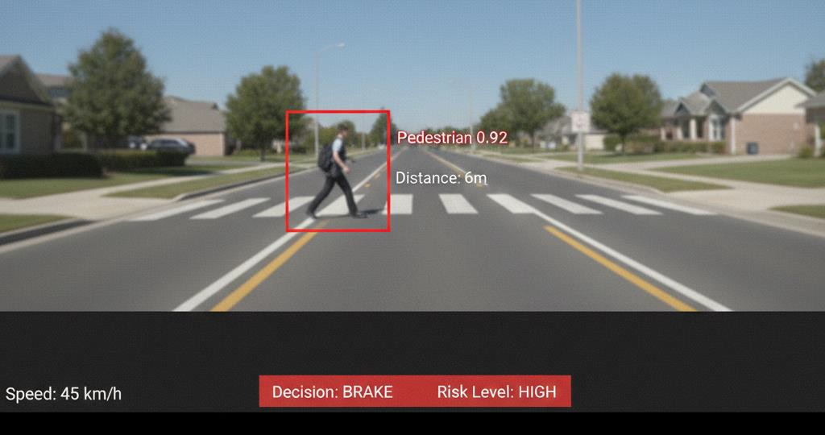
MODULE-4 OUTPUT

Slide 15
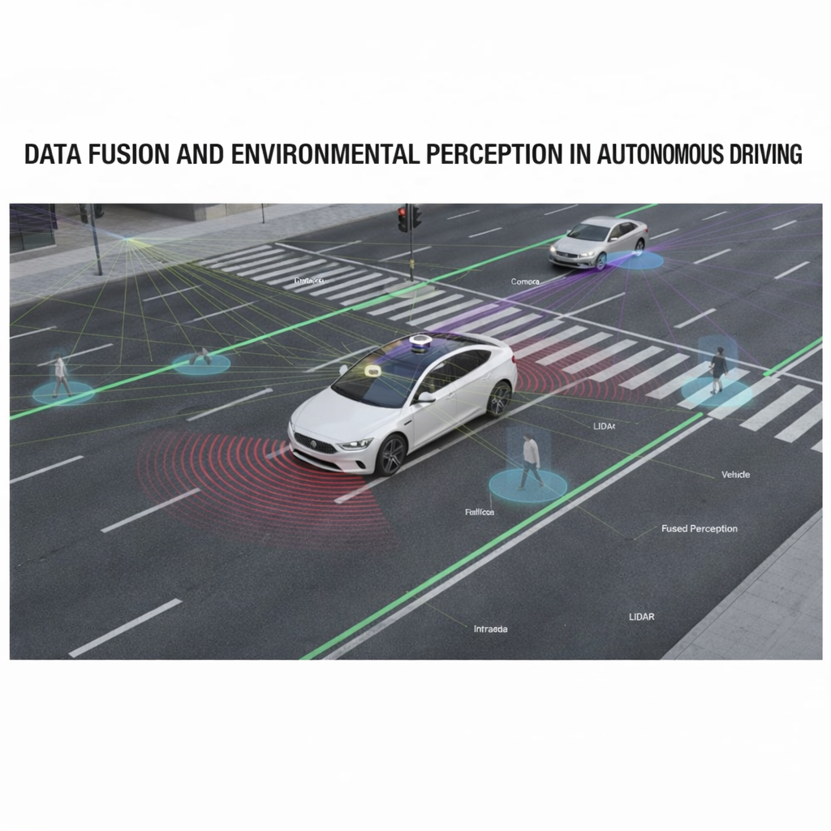
MODULE – 5
DATA FUSION AND ENVIRONMENTAL PERCEPTION
This module combines data from all detection modules.
It improves accuracy by reducing false detections.
It creates a complete understanding of the road environment.
It tracks multiple objects at the same time.
It ensures reliable performance in different lighting and weather condition

Slide 16
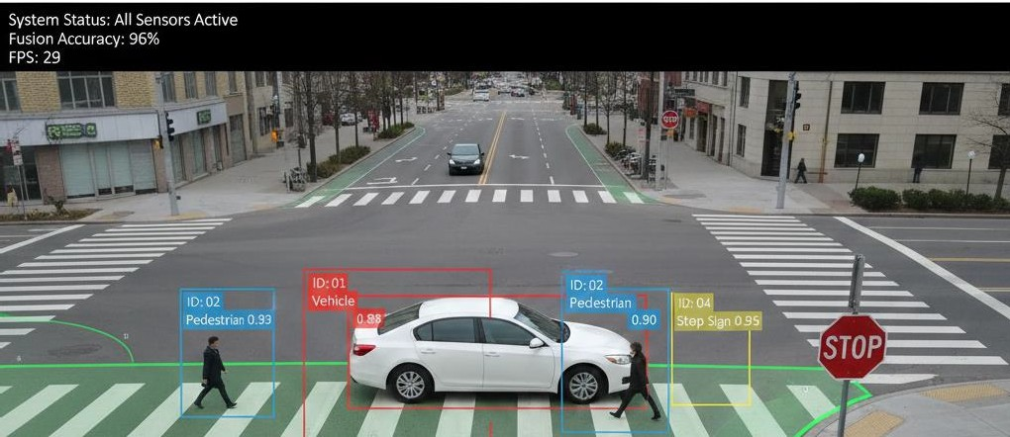
MODULE - 5 DATA FUSION AND ENVIRONMENTAL PERCEPTION - OUTPUT

Slide 17
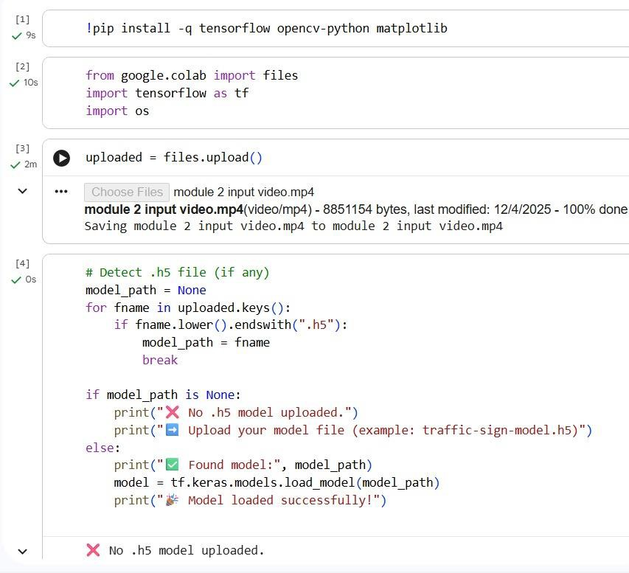
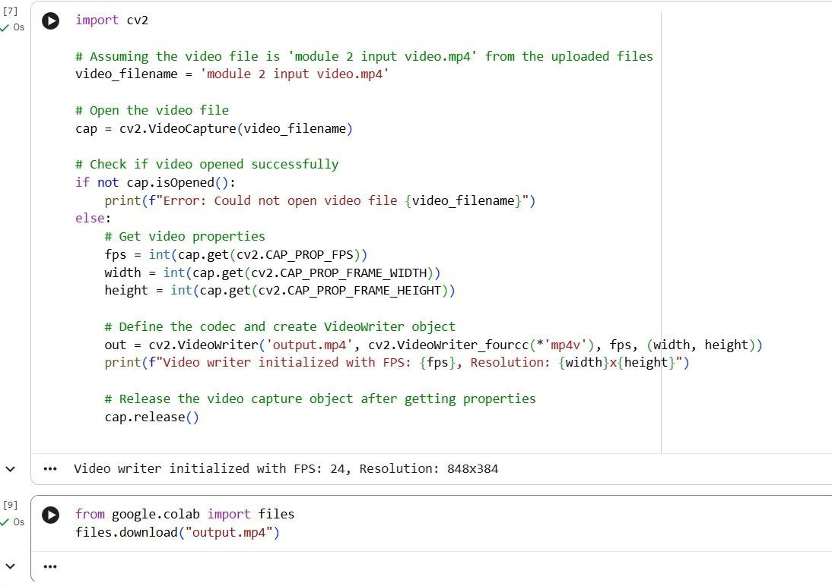
IMPLEMENTATION

Slide 18
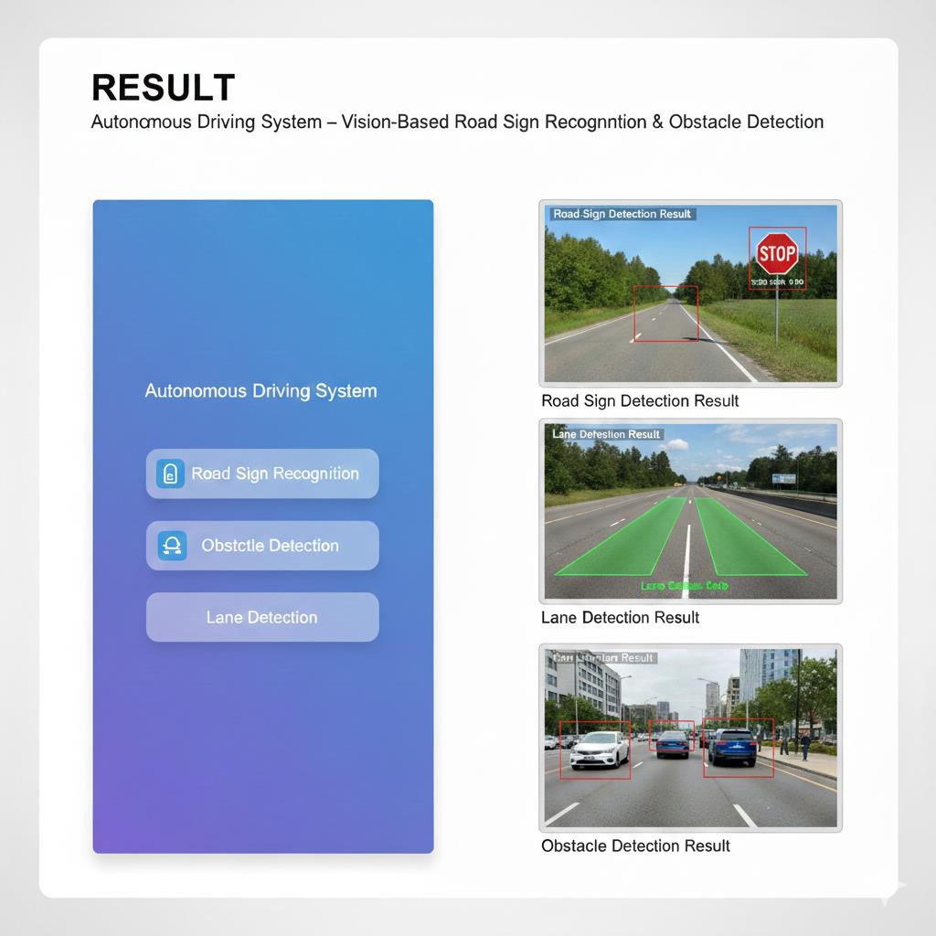
RESULT
The system successfully detected road signs like stop and speed limit signs in real time.
It correctly identified obstacles such as pedestrians and vehicles using object detection models.
The lane detection module accurately highlighted lane markings and helped maintain the correct lane.
The decision-making module generated appropriate actions like brake, slow down, or maintain speed.
Overall, the system showed fast processing speed and good accuracy in different road conditions.

Slide 19
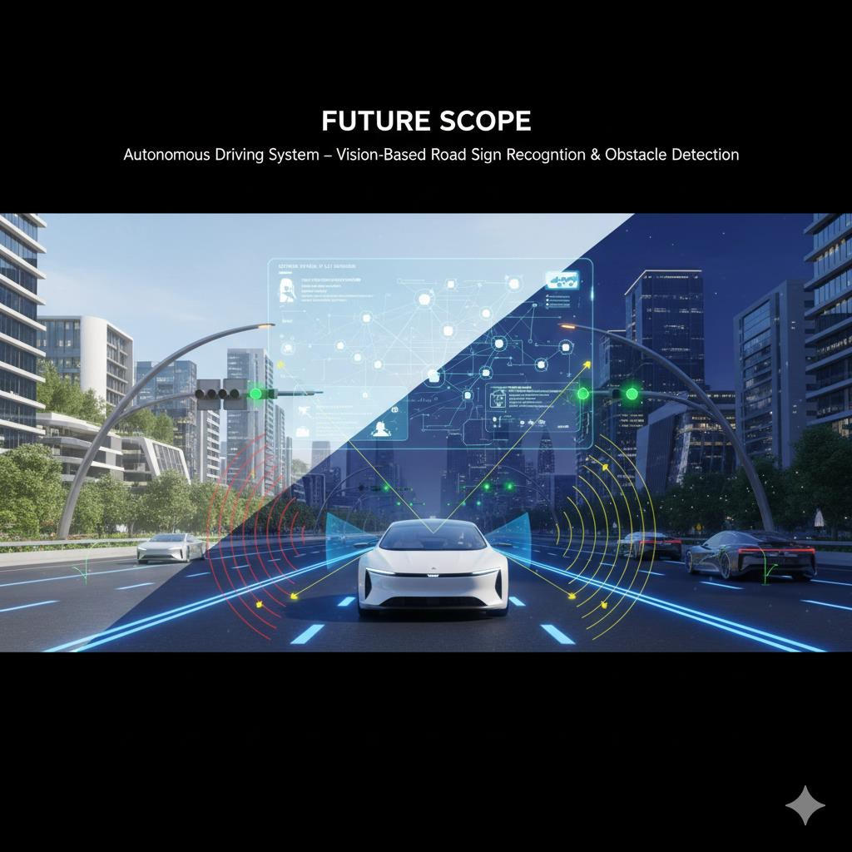
FUTURE SCOPE
The system can be improved by using larger and more advanced training datasets for better accuracy.
It can be integrated with real-time hardware sensors like LiDAR and radar for more reliable detection.
The system can be enhanced to work better in night, rain, and fog conditions.
Future versions can support full autonomous driving without human intervention.
The vehicle can communicate with traffic signals and other vehicles for smarter and safer navigation.

Slide 20
CONCLUSION
The system successfully detects and recognizes road signs in real time, helping the vehicle understand driving rules.
Vision-based methods improve driving safety by providing accurate identification of obstacles and potential hazards.
Using deep-learning models like YOLO and MobileNet, the system achieves fast and reliable performance
even in dynamic environments.
Obstacle detection supports safer navigation by alerting or assisting the vehicle in avoiding collisions.
Overall, the combined road sign recognition and obstacle detection system contributes to smarter, safer, and more autonomous driving.

Slide 21
REFERENCES
Redmon, J., & Farhadi, A. "YOLO: Real-Time Object Detection." arXiv:1506.02640. This work introduced YOLO, a very fast object detection method for real-time use.
Sandler, M. et al. "MobileNetV3: Searching for Mobile Architecture." arXiv:1905.02244.
This paper presents MobileNetV3, a lightweight model designed for efficient mobile performance.
Dalal, N., & Triggs, B. "Histograms of Oriented Gradients for Human Detection." CVPR, 2005. This paper proposed HOG features, a strong method for detecting humans in images.
Suryawanshi, P. et al. "Traffic Sign Recognition Using Deep Learning Techniques." IJCA, 2020. This study applied deep-learning methods to improve traffic sign recognition accuracy.

