Slide 1

CSA15 | Cloud Computing and Big Data Analytics
CSA15 Cloud Computing and Big Data Analytics
Presenter Details
Student Name: U. Vishnu Mohan Reddy
Register Number:192425107
Class / Section / Slot: c
Capstone Title: Virtualization: The Backbone of Cloud Computing
Selected SDG Goal(s): SDG 9: Industry, Innovation and Infrastructure Cloud Platform / Tools: VMware Workstation, Oracle VirtualBox, Microsoft Hyper-V, Docker, AWS EC2
Capstone Cloud Technical Presentation
Individual Student Presentation Deck
Presentation Focus
Present your capstone as a cloud-backed product. Explain the problem, architecture, service choices, evidence, and CO1 learning clearly.
Individual student submission template | Department of Computer Science and Engineering
CO1 AT3 | 01
Notes:
Open by naming the capstone problem and the cloud product objective. Keep the title slide uncluttered and clearly identify the individual presenter.

Slide 2
CSA15 | Cloud Computing and Big Data Analytics
Problem Context and Stakeholder Mapping
Our capstone begins with a real problem to solve
Problem Statement
Target Users
Organizations need multiple servers for different applications, leading to high hardware costs, increased power consumption, and poor resource utilization.
Cloud Service Providers, IT Companies, Data Centers , Universities, Software Developers
SDG Fit
Product Boundary
Supports SDG 9 by improving computing infrastructure and enabling innovation.
Demonstrate virtualization, Explain VM creation, Resource sharing, Benefits over traditional servers
Individual student submission template | Department of Computer Science and Engineering
CO1 AT3 | 02
Notes:
Do not start with technology. First make the need clear, then connect it to cloud-enabled scale, reach, or reliability.

Slide 3
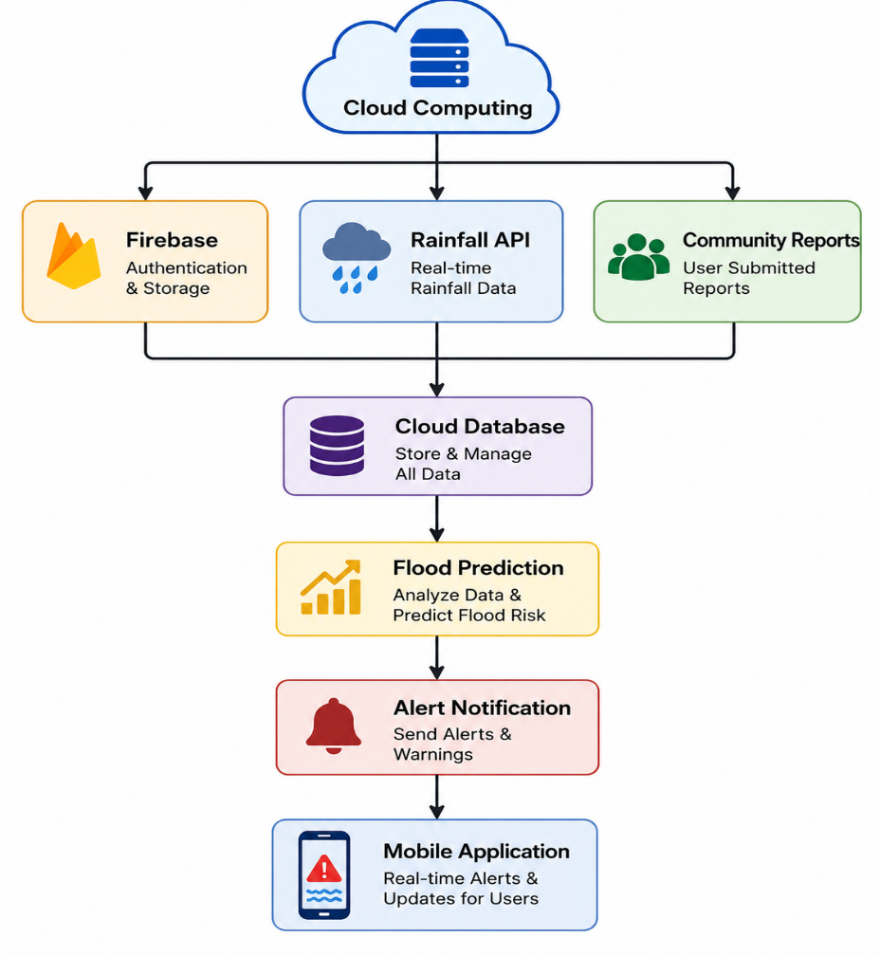
CSA15 | Cloud Computing and Big Data Analytics
Cloud Adoption Rationale and Concept Map
The problem needs cloud support to become a usable product
Cloud Definition
Cloud Concept Map
Cloud computing delivers computing resources over the internet using virtualized infrastructure.
Cloud Characteristics
Elasticity, Scalability, Resource Pooling, On-demand Service, Measured Service.
Individual student submission template | Department of Computer Science and Engineering
CO1 AT3 | 03
Notes:
Students should explain the concept map as a reasoning artifact, not as decoration.

Slide 4
CSA15 | Cloud Computing and Big Data Analytics
Capstone Cloud Architecture
Our cloud architecture connects the user action to services
Scaling point
Presentation Points
Web Browser
User
API Gateway
Virtual Machine
Security boundary
Storage
Physical Server
Hypervisor
Individual student submission template | Department of Computer Science and Engineering
CO1 AT3 | 04
Notes:
Walk from user request to API, compute, data, storage, analytics, monitoring, and security boundary.

Slide 5
CSA15 | Cloud Computing and Big Data Analytics
Cloud Service Model Responsibility Matrix
Each service model defines what we control and what cloud manages
Service area
Model
Provider manages
Student team manages
Why this fits
Frontend hosting
IaaS Physical servers operating system provides full control over VM
IaaS
Hypervisor software
Create
Enables multiple VMs on one physical server
Backend/API
PaaS
Runtime environment
Application code and business logic
Simplifies deployment without managing infrastructure
Database
StaaS
Cloud storage
Organize VM files
Reliable and scalable storage for virtual machines
Storage
IAM
Authentication service
Define user roles
Ensures secure access to cloud resources
Security / IAM
Individual student submission template | Department of Computer Science and Engineering
CO1 AT3 | 05
Notes:
Ask the student to defend provider responsibility and student responsibility for the selected service models.

Slide 6
CSA15 | Cloud Computing and Big Data Analytics
Data Flow and Analytics Pipeline
The product data moves from user activity to useful insight
Python Monitoring Script
User Request
Virtual Machine
Hypervisor
Performance Dashboard
Data Requirements
Analytics Requirement
Proof Required
User login information, Virtual Machine status, CPU utilization, RAM usage, Disk storage usage, Network traffic, System logs.
Monitor CPU and memory usage, Alert administrators when resource usage exceeds thresholds
Sample input, sample output, and one insight generated.
Individual student submission template | Department of Computer Science and Engineering
CO1 AT3 | 06
Notes:
Big data analytics is optional, but a thoughtful data path is expected.

Slide 7
CSA15 | Cloud Computing and Big Data Analytics
Python / AI Module Integration
Python or AI adds intelligence where the product needs it
Python Role
Input and Output
Virtual Machine Performance Monitoring
Virtual Machine status, System Logs, RAM Usage.
Execution Point
Product Value
Python script runs on a cloud server or virtual machine.
Helps administrators make better resource allocation decisions
Individual student submission template | Department of Computer Science and Engineering
CO1 AT3 | 07
Notes:
If AI is not required, students can present a Python automation or analytics module instead.

Slide 8
CSA15 | Cloud Computing and Big Data Analytics
Security, Scalability, Privacy and Cost Design
Security, scale, privacy and cost shape the final design
Security
Privacy
IAM Authentication
Data Encryption
Scalability
Cost Awareness
Auto Scaling
Resource Optimization
Individual student submission template | Department of Computer Science and Engineering
CO1 AT3 | 08
Notes:
This slide is where students show engineering judgment instead of simply listing services.

Slide 9
CSA15 | Cloud Computing and Big Data Analytics
Implementation Stack and Deployment Evidence
Our implementation stack shows how the design will be built
Mobile / Web Layer
Cloud Services
Web Browser
AWS EC2, VMware ESXi, VirtualBox.
Evidence
Version Control
VM Dashboard, Performance Logs
GitHub Repository
Individual student submission template | Department of Computer Science and Engineering
CO1 AT3 | 09
Notes:
Evidence should be specific and inspectable, not a generic list of tools.

Slide 10
CSA15 | Cloud Computing and Big Data Analytics
Demo Storyboard and User Journey
A complete user journey proves the product flow
Scene 1
Scene 2
Scene 3
User Accesses Cloud Portal
Virtual Machine Created
Application Deployed
Scene 4
Scene 5
Scene 6
Resources Monitored
Performance Analyzed
Dashboard Updated
Individual student submission template | Department of Computer Science and Engineering
CO1 AT3 | 10
Notes:
A storyboard helps the faculty see whether the cloud architecture is connected to actual use.

Slide 11
CSA15 | Cloud Computing and Big Data Analytics
Evaluation Readiness Checklist
Our evidence confirms that the presentation is ready
Cloud ecosystem and service model explained
Elasticity and scalability decisions are visible
REST/SOAP/API role connected to capstone
GitHub and cloud evidence are inspectable
Architecture has compute, data, storage, security, monitoring
References and integrity statement are included
Evaluator Focus
Virtualization concepts are verified through cloud architecture, service models (IaaS/PaaS/SaaS), hypervisor design, scalability, security, monitoring, and individual explanation..
Individual student submission template | Department of Computer Science and Engineering
CO1 AT3 | 11
Notes:
Students can use this as the self-check slide before presenting the conclusion.

Slide 12
CSA15 | Cloud Computing and Big Data Analytics
Conclusion, Limitations and Future Scope
We close with learning, limitations and next steps
Learning Outcome
Limitations
Learned virtualization, hypervisors, cloud service models, and resource management.
Performance overhead and hardware dependency.
Future Improvement
Integrity Statement
AI-based resource allocation and container virtualization.
Built using VMware, VirtualBox, AWS EC2, Python, GitHub, and official cloud documentation.
Individual student submission template | Department of Computer Science and Engineering
CO1 AT3 | 12
Notes:
The ending should synthesize learning, not just say thank you.

