Slide 1

VESTIGE
GIVE TECHNOLOGY
A SECOND LIFE
One connected journey for assessment, repair, recycling and rewards.
EVALUATION DECK • 2026

Slide 2
01 / THE PROBLEM
A broken journey for old electronics
THE DECISION GAP
Repair, recycle, or leave it unused?
Owners face uncertain repair value, scattered providers and weak follow up. Vendors receive fragmented requests. Administrators lack a joined view of outcomes.
VESTIGE connects those steps in one traceable workflow.
VESTIGE / EVALUATION PRESENTATION
02

Slide 3

02 / THE EXPERIENCE
A product built around the decision
LIVE CAPTURE • VESTIGE LANDING PAGE
VESTIGE / EVALUATION PRESENTATION
03

Slide 4
03 / STAKEHOLDERS
Three perspectives. One shared record.
OWNER
VENDOR
ADMINISTRATOR
Understand the next step
Manage assigned work
Oversee the system
Assess the device, book a service, track its progress and view eligible rewards.
See structured intake details and update repair or recycling request status.
Review users, vendors, bookings, payments, rewards and platform activity.
VESTIGE / EVALUATION PRESENTATION
04

Slide 5
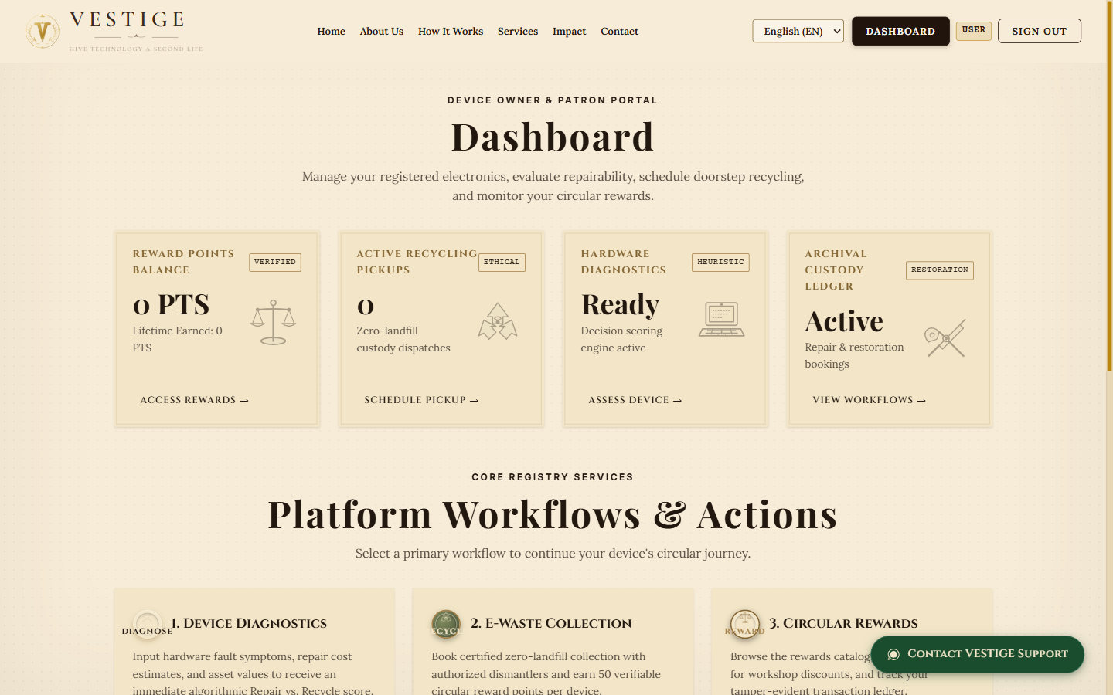
04 / OWNER EXPERIENCE
Owner portal: the circular journey starts here
01
One entry point
The dashboard connects diagnostics, collection, bookings and rewards.
LIVE CAPTURE • USER DASHBOARD
VESTIGE / EVALUATION PRESENTATION
05

Slide 6
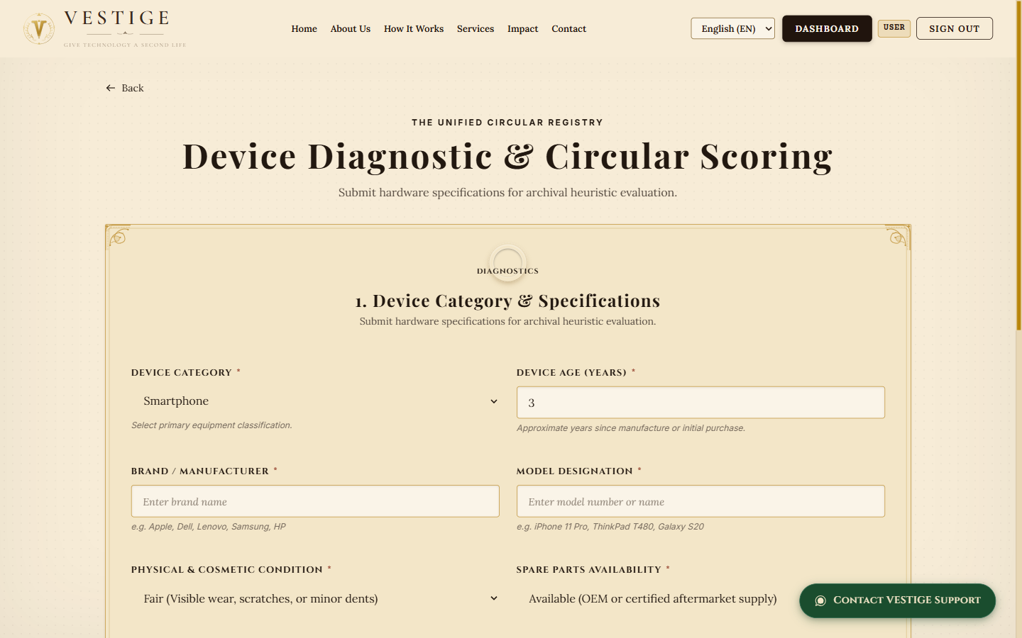
05 / DECISION SUPPORT
Transparent, rules based assessment
INPUTS
Age
Condition
Repair cost / value
Parts availability
Known faults
Score 5–95 · Repair at ≥50
LIVE CAPTURE • DEVICE ASSESSMENT
VESTIGE / EVALUATION PRESENTATION
06

Slide 7
06 / WORKFLOW
From assessment to a recorded outcome
01
02
03
04
ASSESS
SUBMIT
PROCESS
REWARD
Enter details and receive a reasoned suggestion.
Save the device and request repair or recycling.
Vendor manages the assigned request and status.
Owner sees applicable points and history.
Recommendation = decision support. A technician must confirm the actual service route.
VESTIGE / EVALUATION PRESENTATION
07

Slide 8
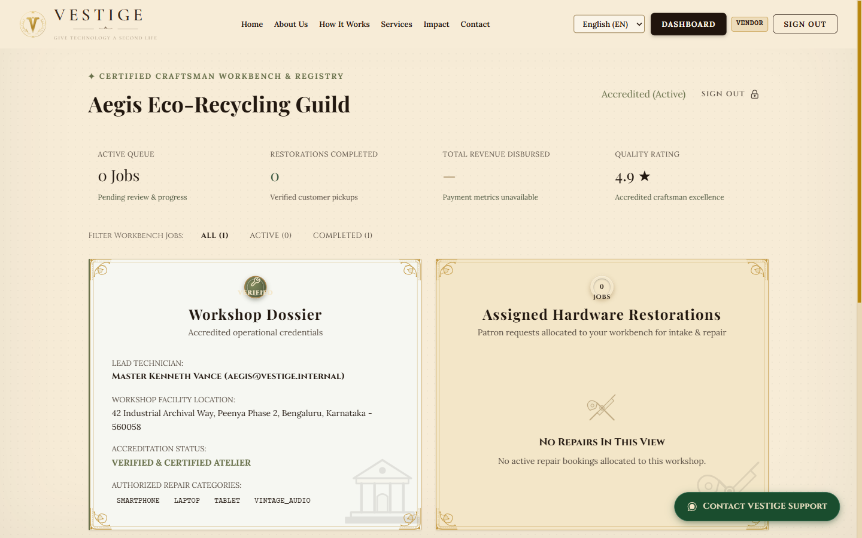
07 / SERVICE OPERATIONS
Vendor portal: work stays visible
02
Assigned work
Repair and recycling requests appear with customer details, status and next actions.
LIVE CAPTURE • VENDOR DASHBOARD
VESTIGE / EVALUATION PRESENTATION
08

Slide 9
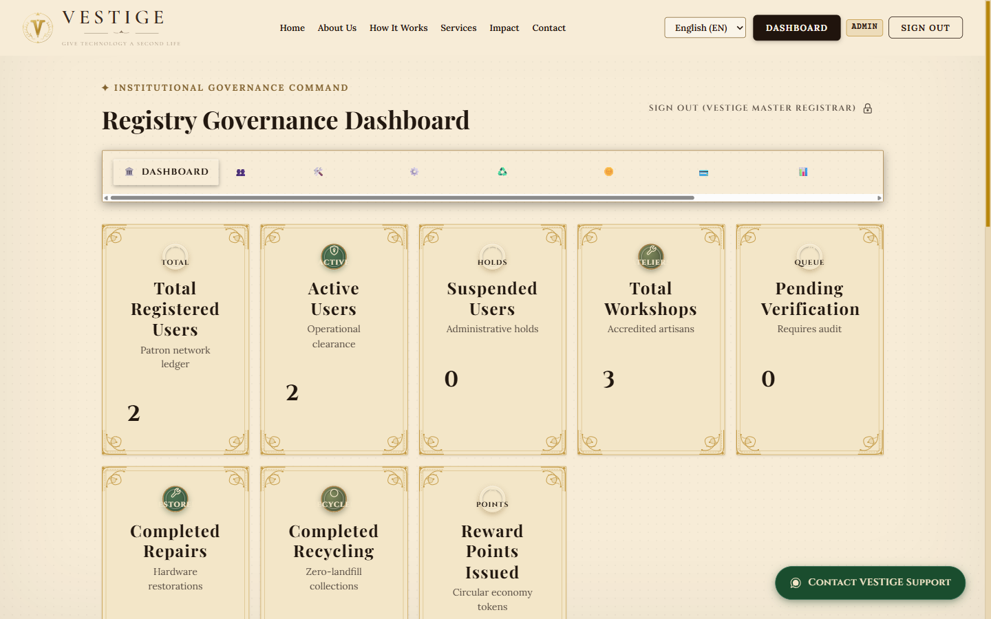
08 / GOVERNANCE
Administrator portal: operational oversight
03
Joined view
User, vendor, request, reward and payment records support review and follow up.
LIVE CAPTURE • ADMIN DASHBOARD
VESTIGE / EVALUATION PRESENTATION
09

Slide 10
09 / ARCHITECTURE
The system behind the experience
WEB EXPERIENCE
APPLICATION API
DATA + SERVICES
→
→
React 19 • Vite 8 • role based routes
Java 21 • Spring Boot 3.4.3 • JWT
H2 demo • PostgreSQL schema • Razorpay
SECURITY + TRACEABILITY
Signed tokens, role and ownership checks, persisted request status and administrative audit actions.
VESTIGE / EVALUATION PRESENTATION
10

Slide 11
10 / EVIDENCE
What is verified in the local build
LIVE LANDING PAGE
LIVE ASSESSMENT FORM
57 backend tests passed • frontend build passed • lint exited successfully
VESTIGE / EVALUATION PRESENTATION
11

Slide 12
11 / READINESS
Honest boundaries of the prototype
LIVE PAYMENTS
Gateway credentials and a real checkout verification are pending.
PRODUCTION DATA
PostgreSQL migrations and deployed services need target environment checks.
IMPACT ESTIMATES
Device mass and CO₂e values are assumptions, not measured results.
FIELD OPERATIONS
Vendor qualification, pickup and recycling proof need real processes.
VESTIGE / EVALUATION PRESENTATION
12

Slide 13
12 / ROADMAP
The next step: validate with real outcomes
01 / PILOT
02 / CALIBRATE
03 / VERIFY
Observe real jobs
Improve the rules
Document impact
Test intake and status tracking with repair and recycling partners.
Tune assessment thresholds against actual diagnoses and repair costs.
Add chain of custody and traceable, device specific environmental methods.
VESTIGE / EVALUATION PRESENTATION
13

Slide 14
VESTIGE
ASSESS → REPAIR →
REUSE → RECYCLE →
REWARD
Problem statement + full project details in the repository
github.com/Jaswanth300/vestige

