Slide 1

Regular Expressions for Real-World Text Processing
M.V. Prasanth (192472219)
DSA0302- Natural Language Processing
Course Faculty : Dr. T. Devi
SIMATS Engineering, Chennai

Slide 2

INTRODUCTION
Regular Expression (Regex) is a pattern used to search, match, and validate text.
It helps computers check whether text is in the correct format.
Commonly used for email, phone number, password, and URL validation.
Regex is widely used in NLP, web development, data cleaning, and search engines.
It makes text processing faster and more accurate.

Slide 3
Common Regex Symbols
Symbol | Meaning | Example
. | Matches any single character | a. c
* | Zero or more (Asterisk) | ab*
+ | One or more | ab+
\d | Digit | \d{10}
^ (caret)$ | Start & End | ^Hello$
Regular Expressions (Regex) are special patterns used to search, match, and manipulate text efficiently. They help computers identify, validate, and extract information from text, such as email addresses, phone numbers, passwords, URLs, and dates. Regex is widely used in web development, data validation, text processing, and Natural Language Processing (NLP) to improve the speed and accuracy of handling textual data.

Slide 4
Examples & Applications
Regular Expressions (Regex) provide an efficient way to identify and manipulate text based on predefined patterns. They are widely used to filter, search, and extract useful information from large datasets. Regex plays an important role in software development, database management, text mining, web applications, and Natural Language Processing (NLP), improving both the speed and accuracy of text processing.
Email: abc@gmail.com
Phone: 9876543210
Date: 15/07/2026
URL: https://example.com

Slide 5
Email Validation
import re
email = "abc@gmail.com"
pattern = r'^[A-Za-z0-9._%+-]+@[A-Za-z0-9.-]+\.[A-Za-z]{2,}$'
if re.match(pattern, email):
print("Valid Email")
else:
print("Invalid Email")
Output:
Valid Email

Slide 6
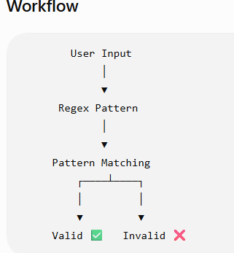
Working Process of Regex
Steps
✔ Step 1: User enters the text.
✔ Step 2: Regex pattern is applied.
✔ Step 3: Pattern matches the input.
✔ Step 4: If matched → Valid ✅
✔ Step 5: If not matched → Invalid ❌

Slide 7
Result
The implementation of Regular Expressions (Regex) significantly improves the accuracy and efficiency of text processing by validating input against predefined patterns. It reduces manual errors, saves processing time, and ensures consistent, high-quality data across applications. Regex enables fast and reliable pattern matching, making it an essential tool in web development, data validation, search engines, and Natural Language Processing (NLP) Key Results:
High accuracy in pattern matching and input validation.
Faster data processing with reduced computational effort.

Slide 8
CONCLUSION
Regular Expressions (Regex) are an essential technique for efficient text processing and pattern matching. They help developers process large amounts of textual data quickly and accurately. Because of their simplicity, speed, and wide range of applications, Regex remains a fundamental tool in programming, web development, data analysis, and Natural Language Processing (NLP). Understanding Regex is an important step toward building intelligent and efficient software applications.

Slide 9
Future Scope
Regular Expressions (Regex) will continue to play an important role in text processing and Natural Language Processing (NLP). They will be widely used in Artificial Intelligence (AI), chatbots, machine learning, cybersecurity, and big data analytics for faster and more accurate text analysis. As digital data continues to grow, Regex will remain an essential tool for automating text validation, information extraction, and data processing.

Slide 10
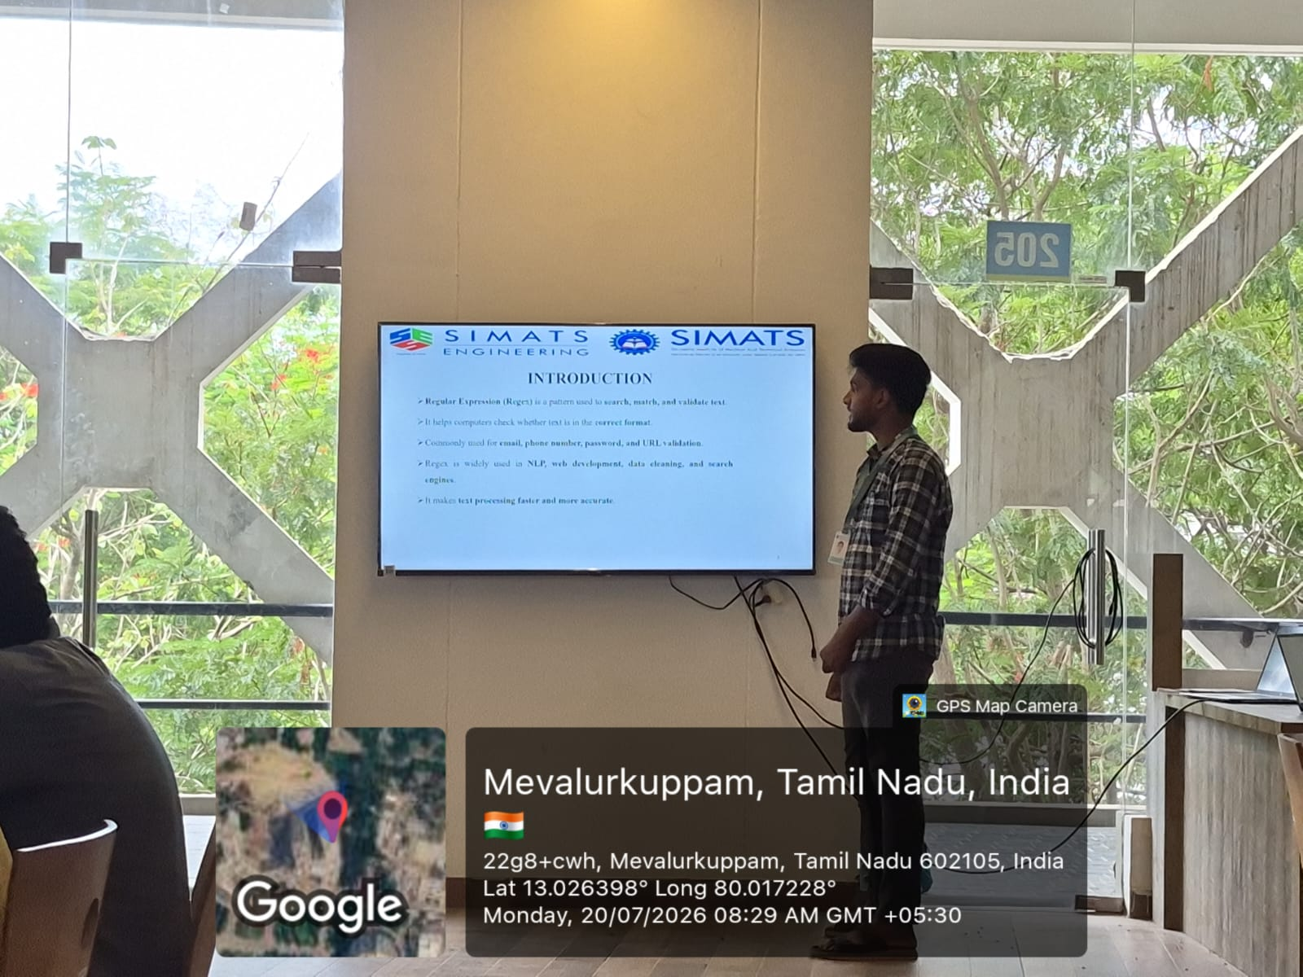
IMAGE

Slide 11
THANK YOU

