Slide 1
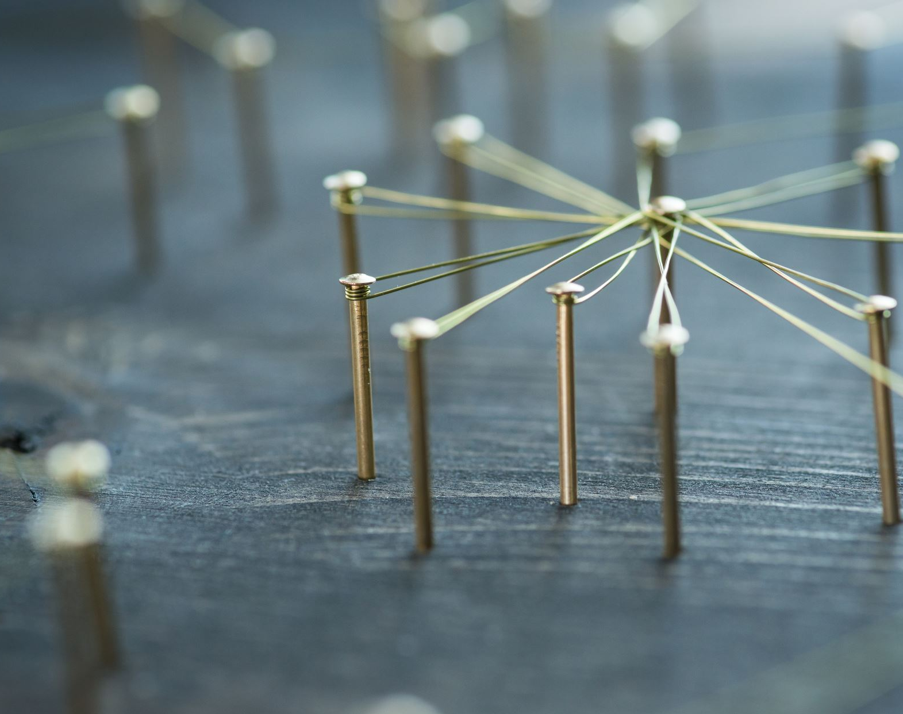
INDUSTRIAL APPLICATIONS OF ADVANCED REINFORCEMENT LEARNING
MLA0369-REINFORCEMENT LEARNING
TECHNICAL PRESENTATION
PRESENTING BY
M. MEGHANA - 192472351

Slide 2
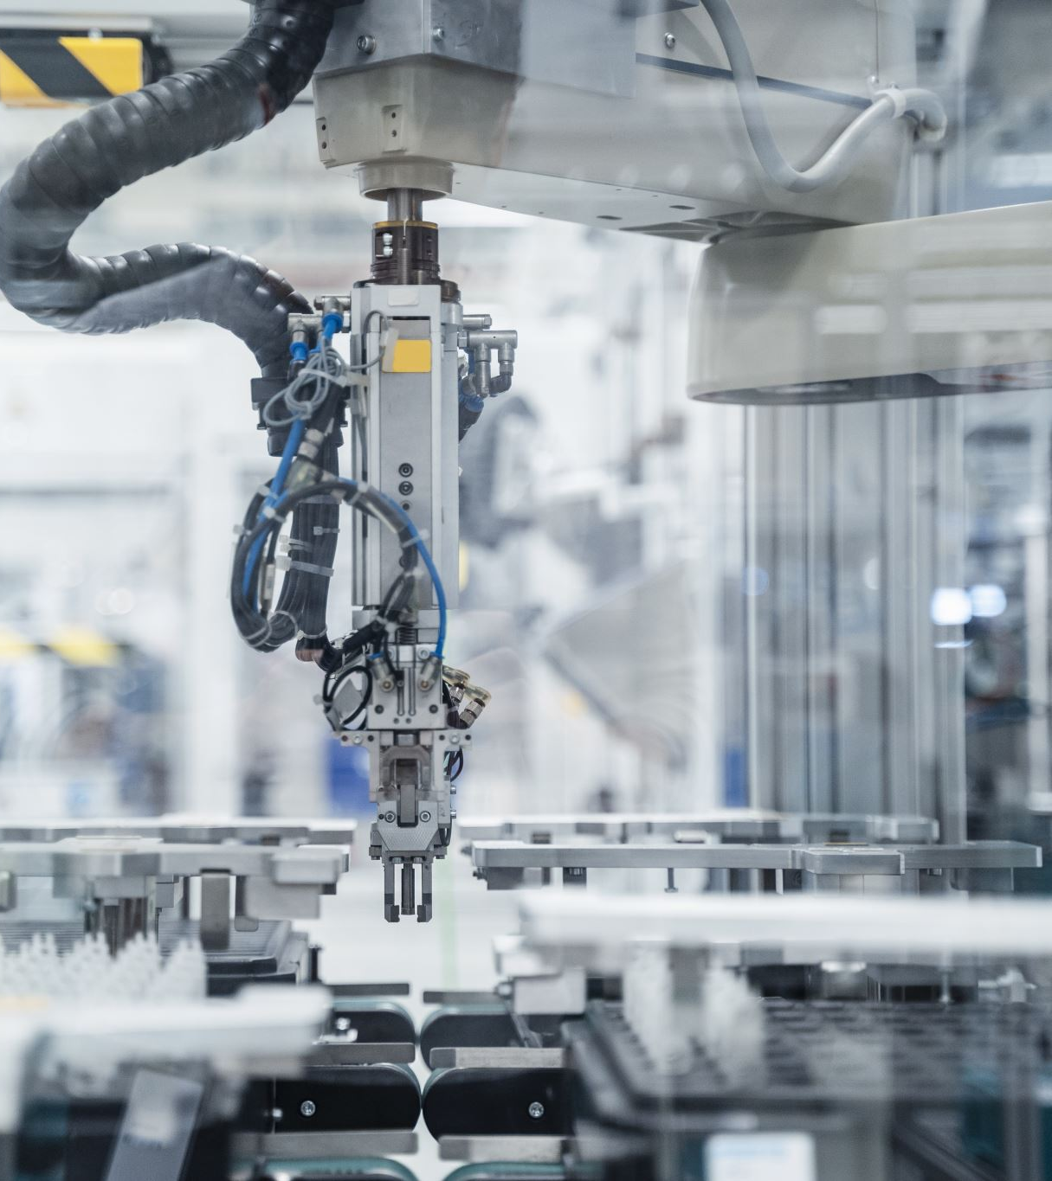
Smart Manufacturing
Reinforcement Learning (RL) enables intelligent decision-making in manufacturing systems.
RL agents learn optimal actions through interaction with machines and production environments.
Used for production scheduling and resource allocation.
Optimizes the operation of industrial robots and automated machinery.
Supports predictive maintenance by learning machine operating patterns.
Helps reduce machine downtime and production delays.
Dynamically adjusts production parameters according to changing conditions.
Improves product quality by optimizing manufacturing processes.
Reduces energy consumption and operational costs.
Example: An RL agent can automatically select the best production schedule based on machine availability and workload.

Slide 3
Autonomous Vehicles
RL enables autonomous vehicles to make real-time driving decisions.
The vehicle acts as an agent, while roads and traffic form the environment.
Learns optimal actions such as steering, acceleration, braking, and lane changing.
Used for autonomous navigation and path planning.
Helps vehicles respond to changing traffic conditions.
Supports collision avoidance and safe driving decisions.
Can optimize driving speed to reduce fuel or battery consumption.
Learns from different road, weather, and traffic conditions.
Improves driving efficiency and passenger safety.
Example: An RL-based vehicle learns the safest action when another vehicle suddenly changes lanes.

Slide 4
Healthcare Decision Support
RL can support healthcare professionals in making sequential treatment decisions.
The patient condition represents the state, while treatment actions represent possible decisions.
Learns suitable treatment strategies from patient responses and outcomes.
Used for personalized treatment planning.
Helps optimize medication dosage and treatment schedules.
Supports continuous patient monitoring and adaptive care.
Can assist in allocating hospital resources efficiently.
Helps identify treatment strategies that maximize long-term patient outcomes.
Can adapt decisions when the patient's health condition changes.
Example: An RL system can recommend the next treatment action based on a patient's changing health status.

Slide 5
Smart Grid Energy Management
RL provides intelligent control for modern electrical power grids.
Learns how to balance energy generation, storage, and consumption.
Optimizes electricity distribution according to real-time demand.
Supports integration of renewable energy sources such as solar and wind.
Used for battery charging and discharging optimization.
Helps reduce peak electricity demand.
Supports demand-response management.
Improves grid stability and reliability.
Reduces energy wastage and operational costs.
Example: An RL agent decides when to charge or discharge a battery based on energy demand and renewable energy availability.

Slide 6
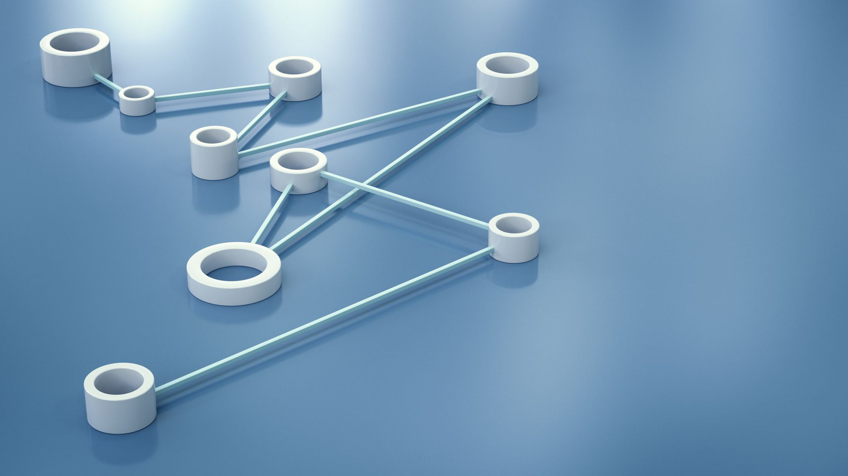
Wireless Communication and Network Optimization
RL enables communication networks to make adaptive resource-management decisions.
Network conditions are continuously monitored by the RL agent.
Used for channel and spectrum allocation.
Optimizes bandwidth distribution among multiple users.
Helps reduce network congestion.
Supports efficient routing and traffic management.
Can optimize transmission power and reduce interference.
Improves network throughput and communication quality.
Reduces latency and improves Quality of Service (QoS).
Example: An RL agent dynamically allocates available channels to users according to network traffic and channel conditions.

