Slide 1
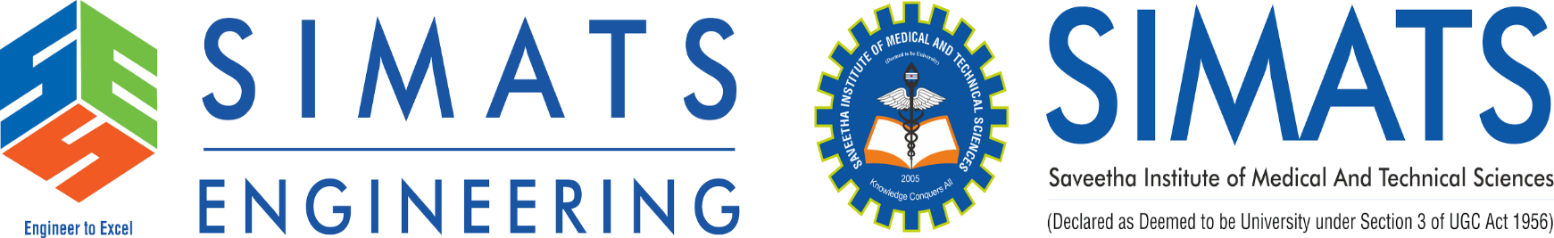
Blockchain IP Ethics: Smart Contract Failures in NFT Royalties
Course Name: UBA2836-Professional Ethics and Legal practices
Presented By:
P.Varshini(192472372)
Guided by :
Dr.P.Thamizhvalavan

Slide 2


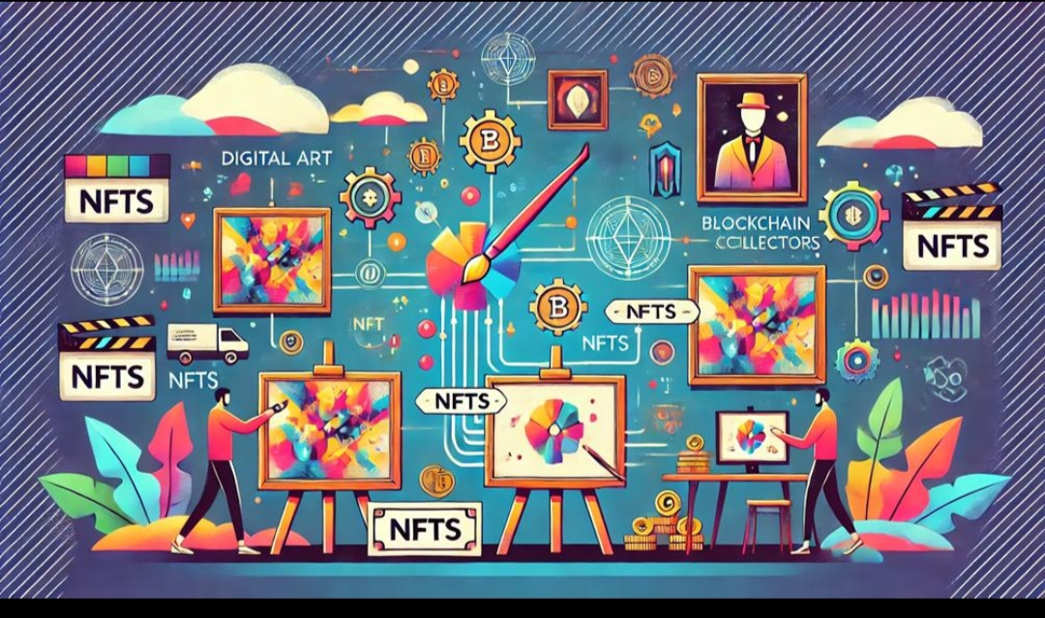
Introduction
This project focuses on how blockchain technology, NFTs, and smart contracts work together, and the ethical and intellectual property issues that arise when smart contracts fail to enforce NFT royalty payments.
Blockchain:
Blockchain is a decentralized digital ledger that securely records transactions. It is transparent, secure, and difficult to alter.
NFT (Non-Fungible Token):
An NFT is a unique digital asset that represents ownership of items such as digital art, music, videos, or collectibles.
Smart Contract:
A smart contract is a self-executing program on the blockchain. It automatically carries out actions, such as transferring ownership and paying royalties, when predefined conditions are met.
Fig 1: Non-Fungible Tokens

Slide 3

Background
Blockchain is a secure and decentralized digital ledger.
NFTs (Non-Fungible Tokens) represent unique digital assets such as art, music, videos, and collectibles.
Smart contracts automate NFT transactions and royalty payments.
NFT royalties help creators earn income from future resales of their digital assets.
Some NFT marketplaces do not fully enforce royalty payments.
Smart contract bugs or vulnerabilities can cause royalty payment failures.
Fig. 1: Smart Contract

Slide 4
Literature Review / Existing Systems
Previous studies show that blockchain provides secure, transparent, and decentralized record-keeping.
Researchers found that NFTs enable creators to prove ownership of unique digital assets.
Studies explain that smart contracts automate NFT sales and royalty payments without intermediaries.
Several researchers reported that smart contract bugs and coding errors can lead to payment failures and security risks.
Research shows that some NFT marketplaces bypass or do not enforce creator royalties, reducing creators' income.
Many studies highlight intellectual property (IP) issues, including copyright infringement and unauthorized NFT minting.

Slide 5
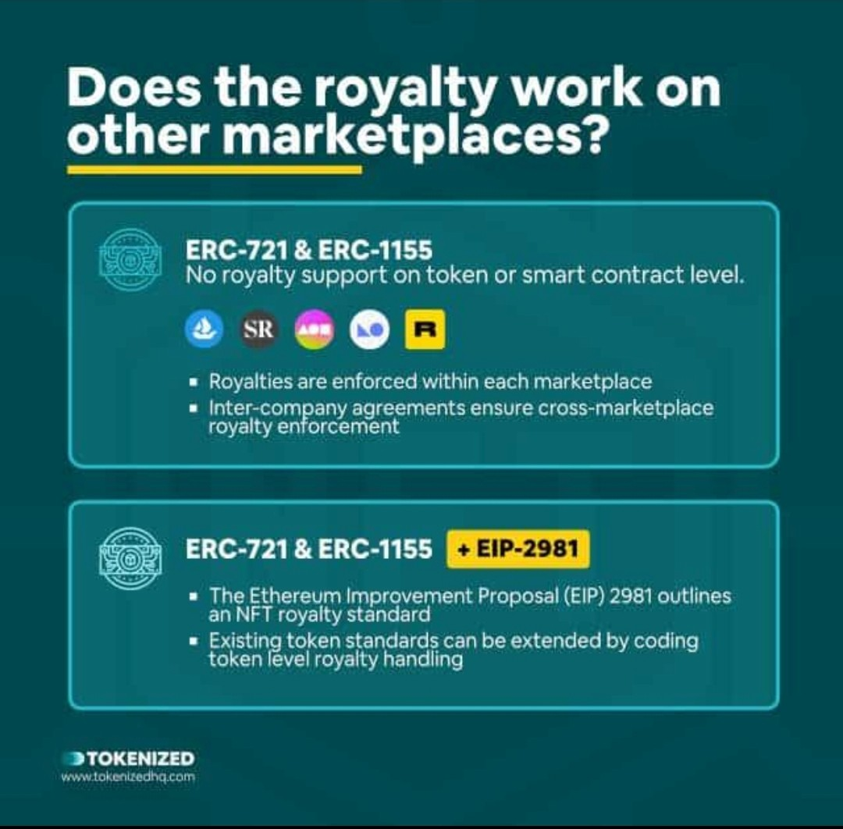
Core Issue
Smart contract loopholes can allow users to avoid paying creator royalties.
Creators lose expected revenue from secondary NFT sales.
Fixing smart contract errors often requires additional development and auditing costs.
Disputes between platform policies and creator rights can lead to legal and administrative expenses.
Poor royalty enforcement reduces trust in NFT markets, creating financial and ethical concerns for all stakeholders.

Slide 6
Problem Statement
The main problem is that some NFT marketplaces do not enforce royalties, or smart contracts contain bugs or security vulnerabilities. As a result, creators may not receive the royalty payments they are entitled to.
This creates:
Financial loss for creators
Copyright and ownership disputes
Ethical concerns about fairness
Reduced trust in NFT platforms

Slide 7
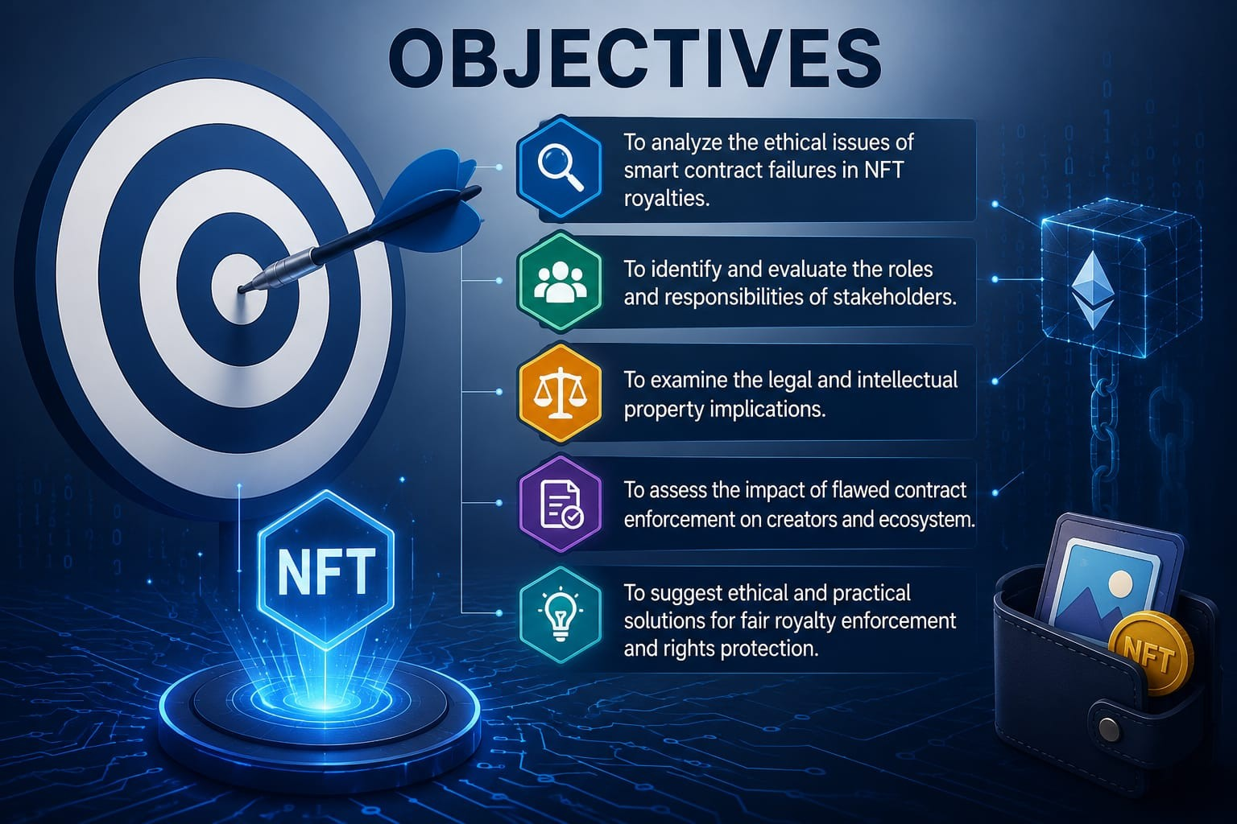
Objectives
To understand blockchain and NFTs.
To study how smart contracts manage royalty payments.
To identify failures in smart contracts.
To analyze intellectual property and ethical issues.
To suggest ways to improve creator protection.

Slide 8

Stakeholders
NFT Creators
Collectors / Buyers
Marketplace Operators
Blockchain Developers
Regulators and IP Authorities
Regulators and IP Authorities

Slide 9
Creator Concerns
Loss of royalty income due to non-enforcement of smart contract rules.
Weak protection of intellectual property rights in digital NFT assets.
Reduced trust in NFT marketplaces and blockchain-based systems.
Difficulty in enforcing creator rights across multiple platforms.
Uncertainty in long-term earnings and sustainability of digital content ownership.

Slide 10
Management View
NFT marketplaces focus on remaining competitive and attracting more users to their platforms.
There is pressure to reduce transaction costs to encourage higher trading activity.
Platforms must balance creator royalty rights with market flexibility and user demand.
Different marketplaces adopt varying policies for royalty enforcement and compliance.
Managing regulatory, technical, and governance challenges is essential for sustainable platform growth.

Slide 11

Legal Framework
Copyright laws protect digital content and apply to blockchain assets like NFTs.
Smart contracts must follow governance rules and be properly audited.
Consumer protection laws prevent fraud and scams in digital assets.
Governments regulate cryptocurrencies using legal and financial rules like KYC and AML.
Disputes in blockchain are solved through courts, arbitration, or digital governance systems.
Notes:
ythis the

Slide 12
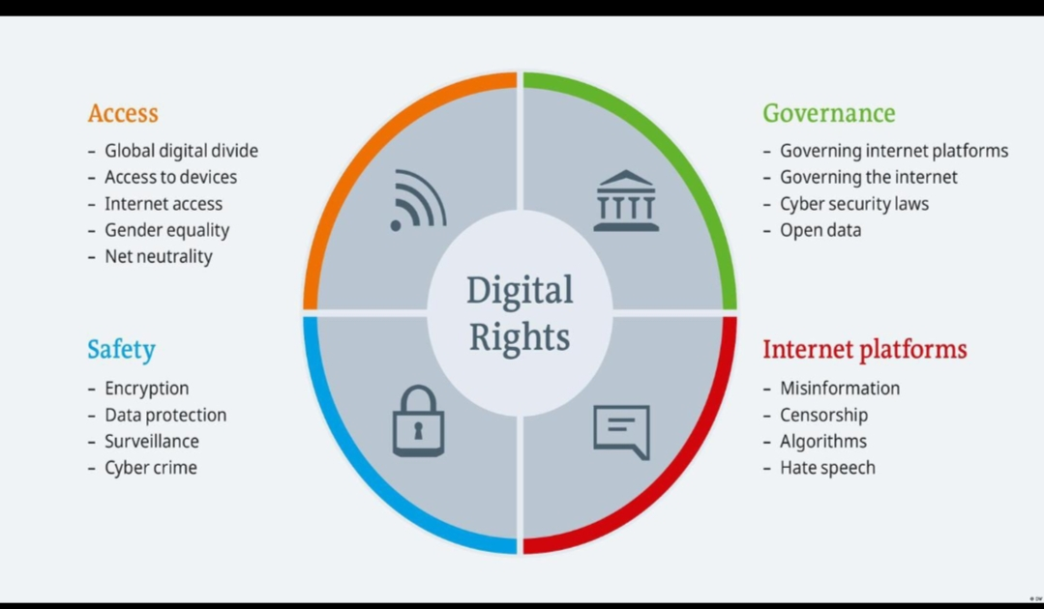
Ethical Issues
Ensure transparent royalty enforcement for digital creators.
Provide audit mechanisms to check and verify smart contracts.
Establish governance policies that support and protect creators.
Promote fairness in all blockchain transactions and systems.
Maintain accountability and build trust among all stakeholders.

Slide 13

.
Conclusion
blockchain and NFTs have changed digital ownership, but smart contract failures can create ethical and intellectual property challenges. Improving smart contract security and royalty enforcement will help protect creators and build trust in the NFT ecosystem.

Slide 14
THANK YOU

