Slide 1

Interactive Tree Simulator Using VisuAlgo
CSA0306-DATA STRUCTURES
Guided By:
Presented By:
Dr Shakila M
Manoj M(192511060)
Date:10.08.2026

Slide 2
Objective
To explore an interactive tool for generating trees.
To visualize different tree operations step-by-step.
To understand Binary Search Tree (BST) operations through animation.
To observe AVL tree insertion and balancing.

Slide 3
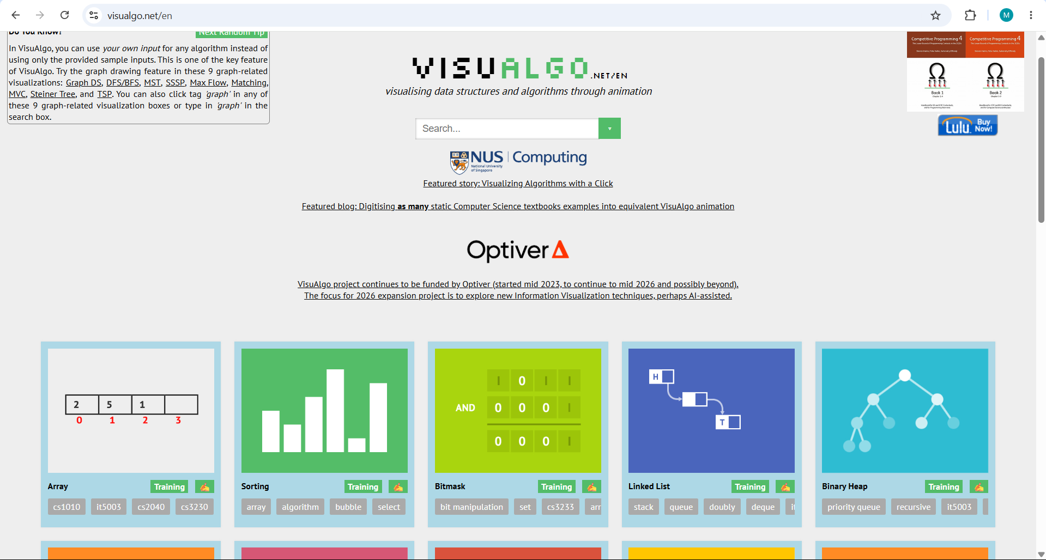
Tool Selected
Generates and visualizes Binary Search Trees
Supports AVL Trees
Allows custom node insertion
Provides animated operations
Displays the algorithm/pseudocode during execution

Slide 4


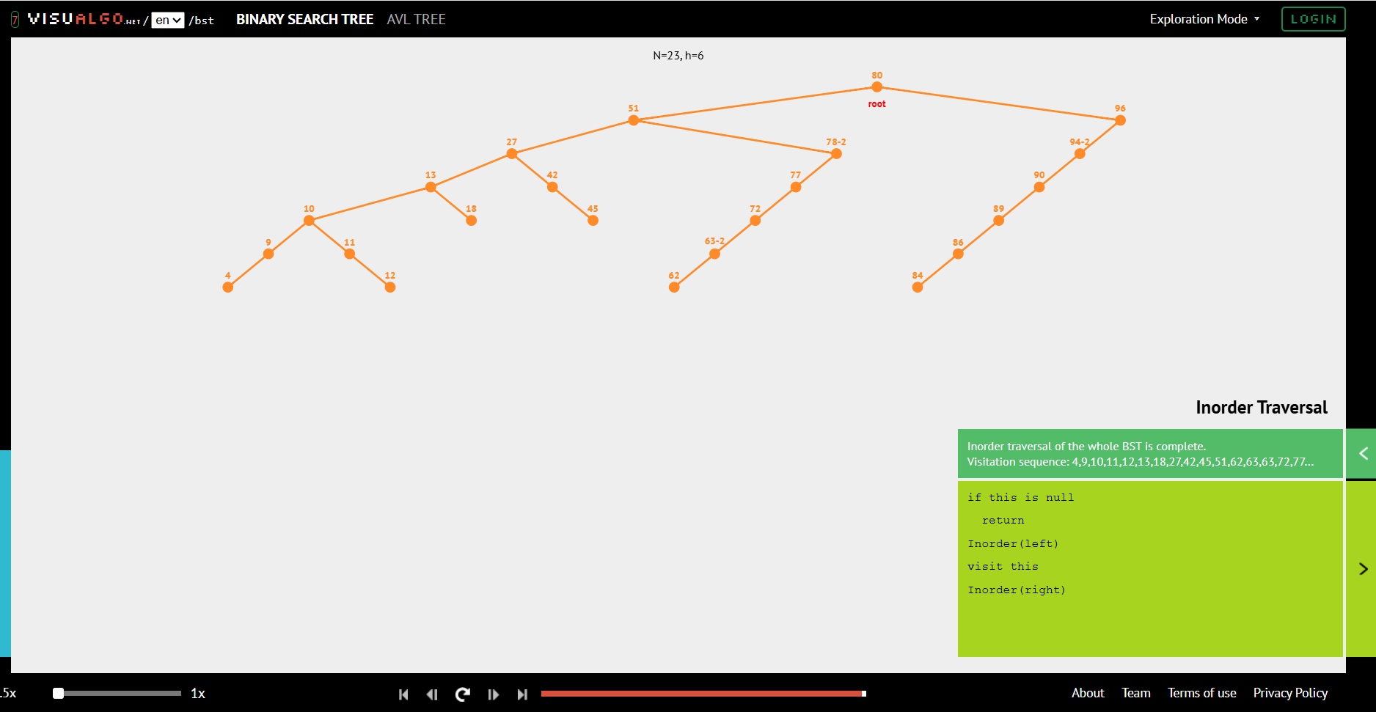
BST Traversal: Inorder
Visits nodes in the order Left → Root → Right
In a BST, Inorder Traversal produces elements in ascending order
Uses recursion
Time Complexity: O(n)
Space Complexity: O(h)
Example: 4 → 9 → 10 → 11 → 12 → 13 → ...

Slide 5
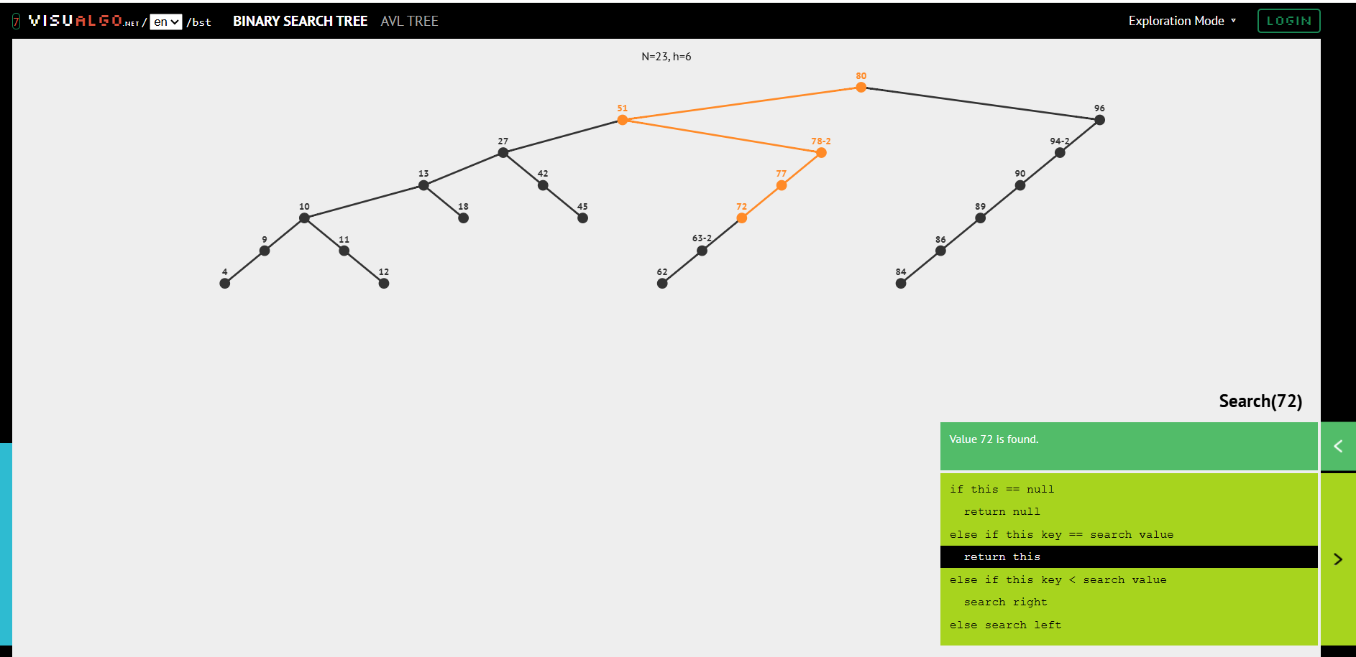
Binary Search Tree – Search Operation
Compare the target with the current node.
If target is smaller → move left.
If target is larger → move right.
If equal → element found.
Average Time Complexity: O(log n)
Worst Case: O(n)

Slide 6
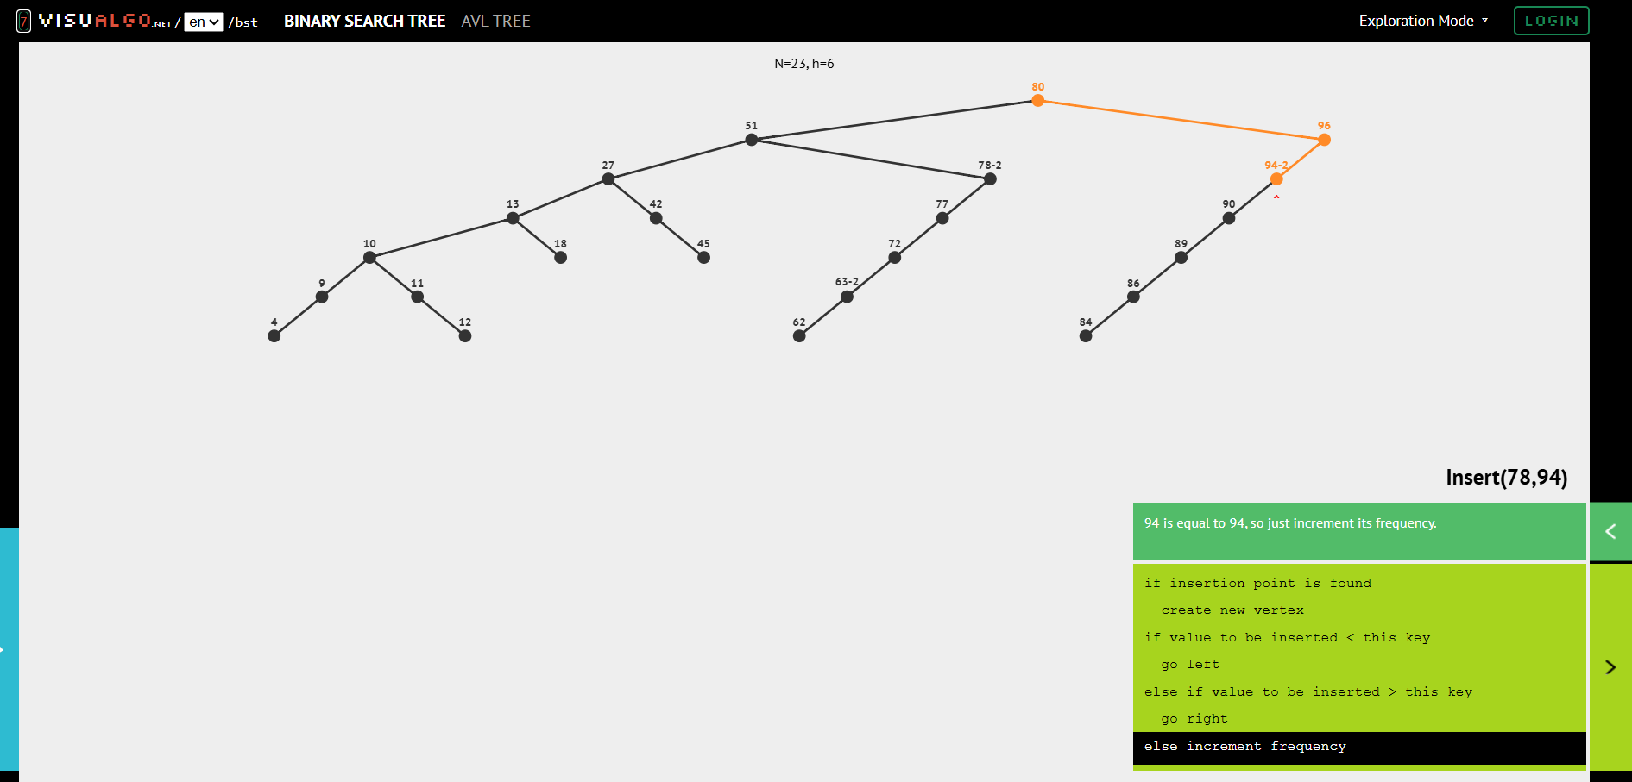
Binary Search Tree – Insertion
Compare the new value with the current node.
Smaller value → left subtree.
Larger value → right subtree.
Continue until an empty position is found.
Insert the new node there.

Slide 7
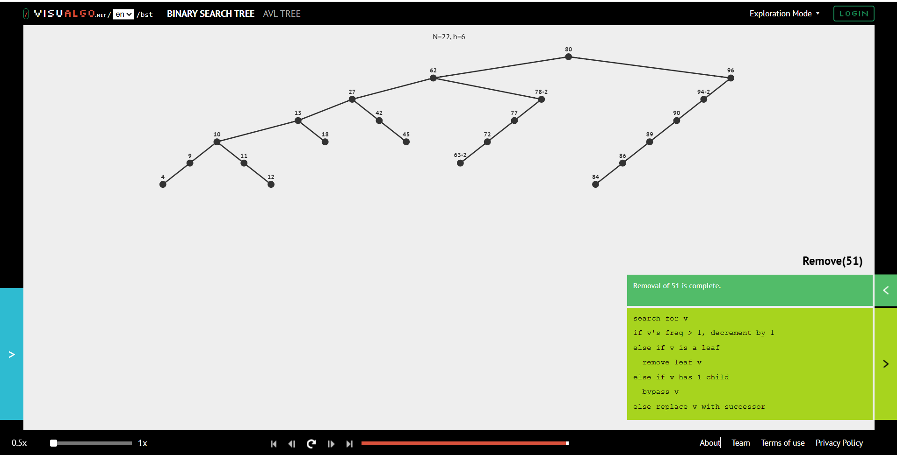
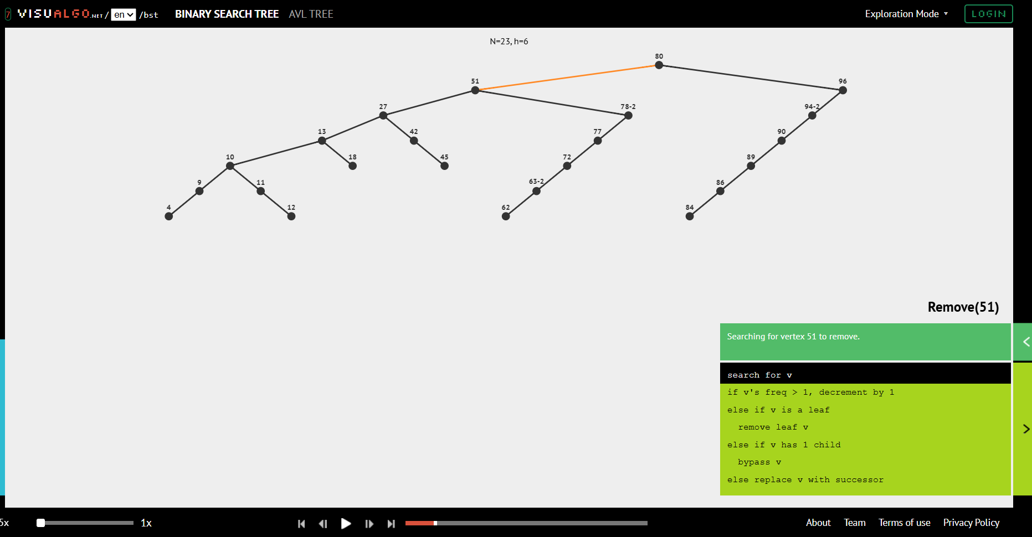
Binary Search Tree – Deletion

Slide 8
Co
Conclusion
VisuAlgo provides an interactive way to generate and visualize trees.
Binary Search Tree operations such as insertion, searching, deletion, and traversal were performed and observed step-by-step.
AVL Tree visualization helped understand self-balancing and tree operations.

