Slide 1
Choosing the Right Data Structure: Arrays vs Linked Lists
Guided By:
Dr M Shakila
Presented By:
Manoj(192511060)

Slide 2

Introduction
What is a data structure?
Organised way to store and manage data for efficient access and modification.
Why it matters
Impacts speed, memory and maintainability of programs.
Real-world motivation
Selecting the right structure solves performance bottlenecks and simplifies code.

Slide 3
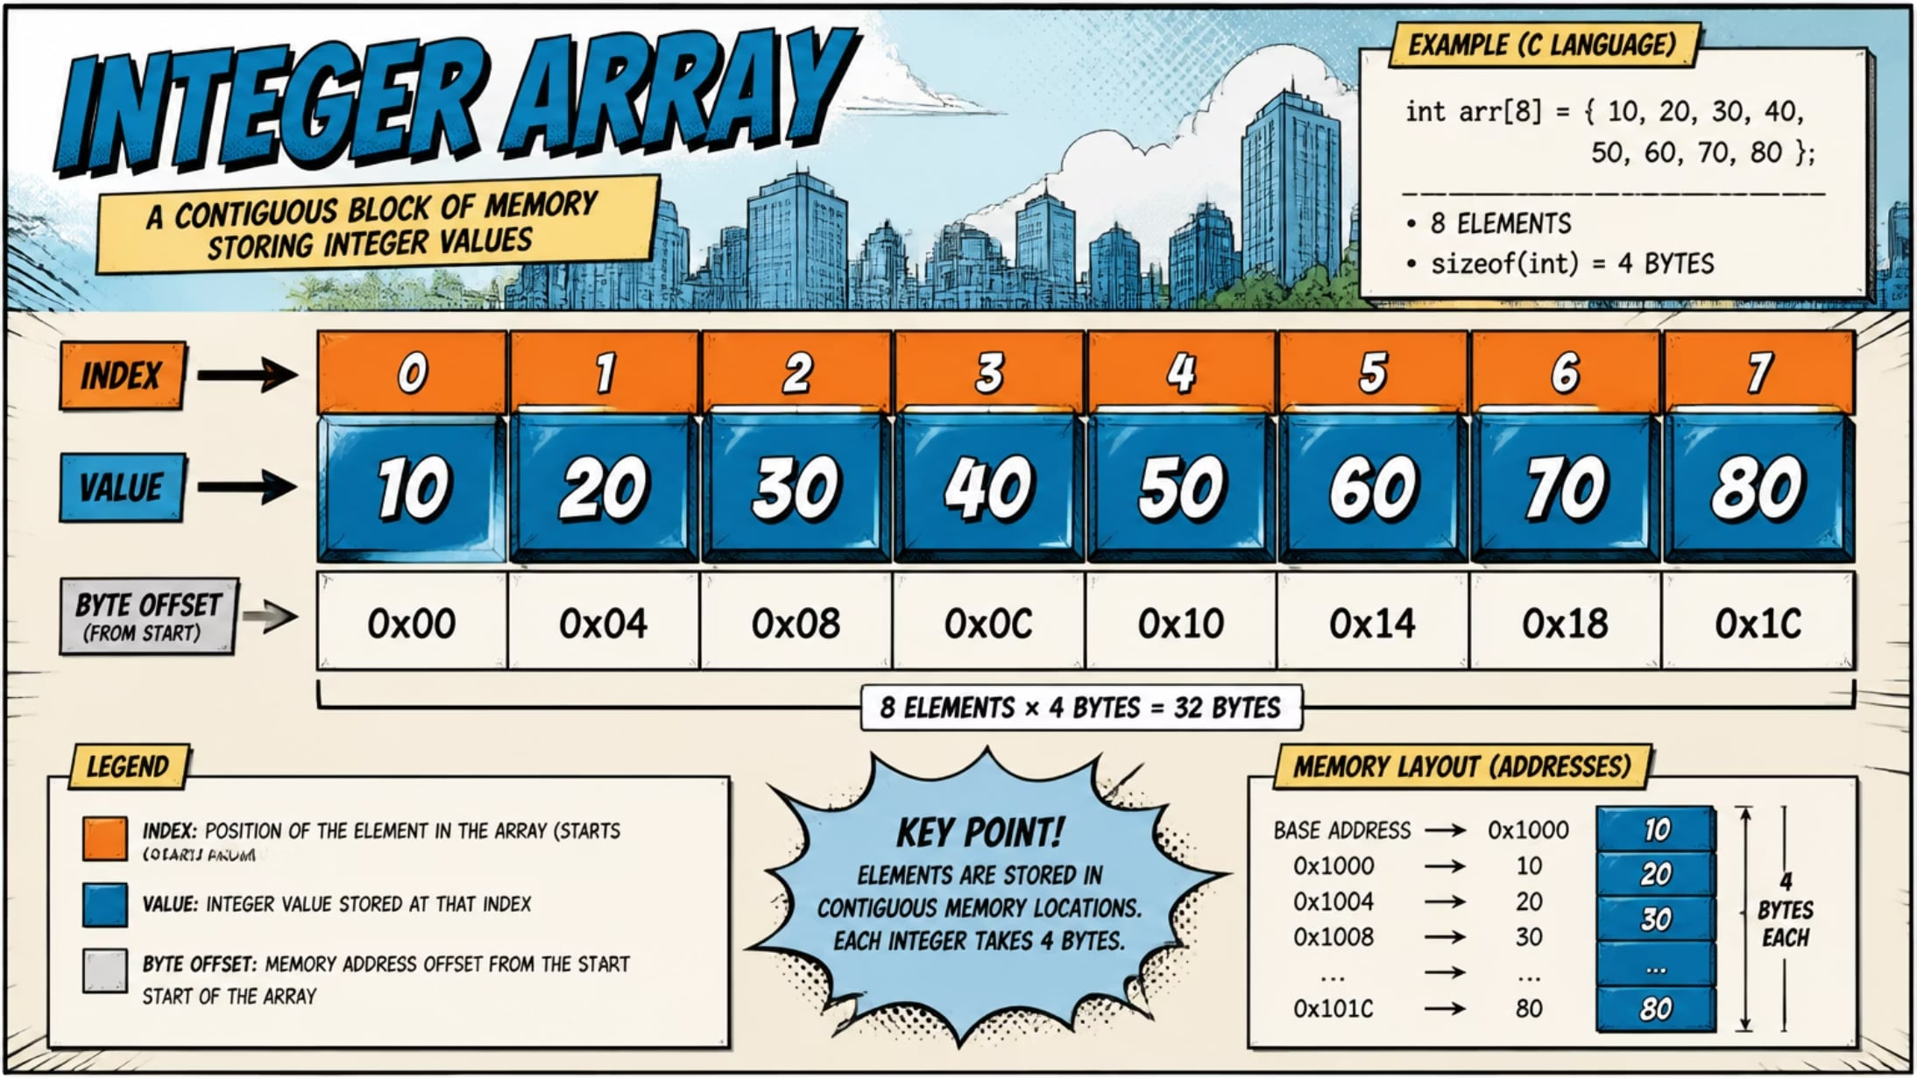
Understanding Arrays
Definition
Collection of elements stored in contiguous memory and accessed by index.
Advantages
O(1) random access by index
Memory locality — cache friendly
Simple implementation
Disadvantages
Fixed size (static arrays) or costly resize
Insertion/deletion in middle is O(n)

Slide 4
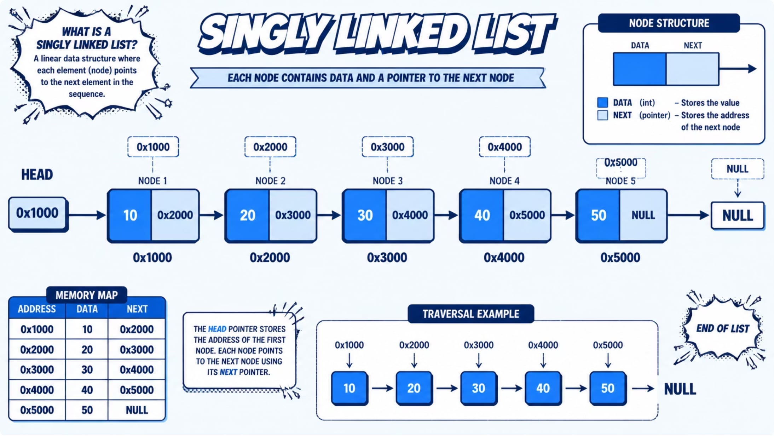
Understanding Linked Lists
Memory layout
Nodes allocated non-contiguously; each has a pointer to the next node.
Definition
A collection of nodes where each node contains data and a pointer to the next node.
Node structure
Typically: { data, next }
Advantages
Dynamic size — easy to grow
O(1) insertion/deletion given a node reference
Disadvantages
O(n) access by index
Poor locality — more pointer overhead

Slide 5
Arrays vs Linked Lists — Side-by-side
Aspect
Memory allocation
Access speed
Insertion
Deletion
Ease of implementation
Arrays
Contiguous
O(1)
O(n) (shift elements)
O(n)
Simple
Linked Lists
Non-contiguous (nodes)
O(n)
O(1) with pointer
O(1) with pointer
Moderate — pointers required

Slide 6
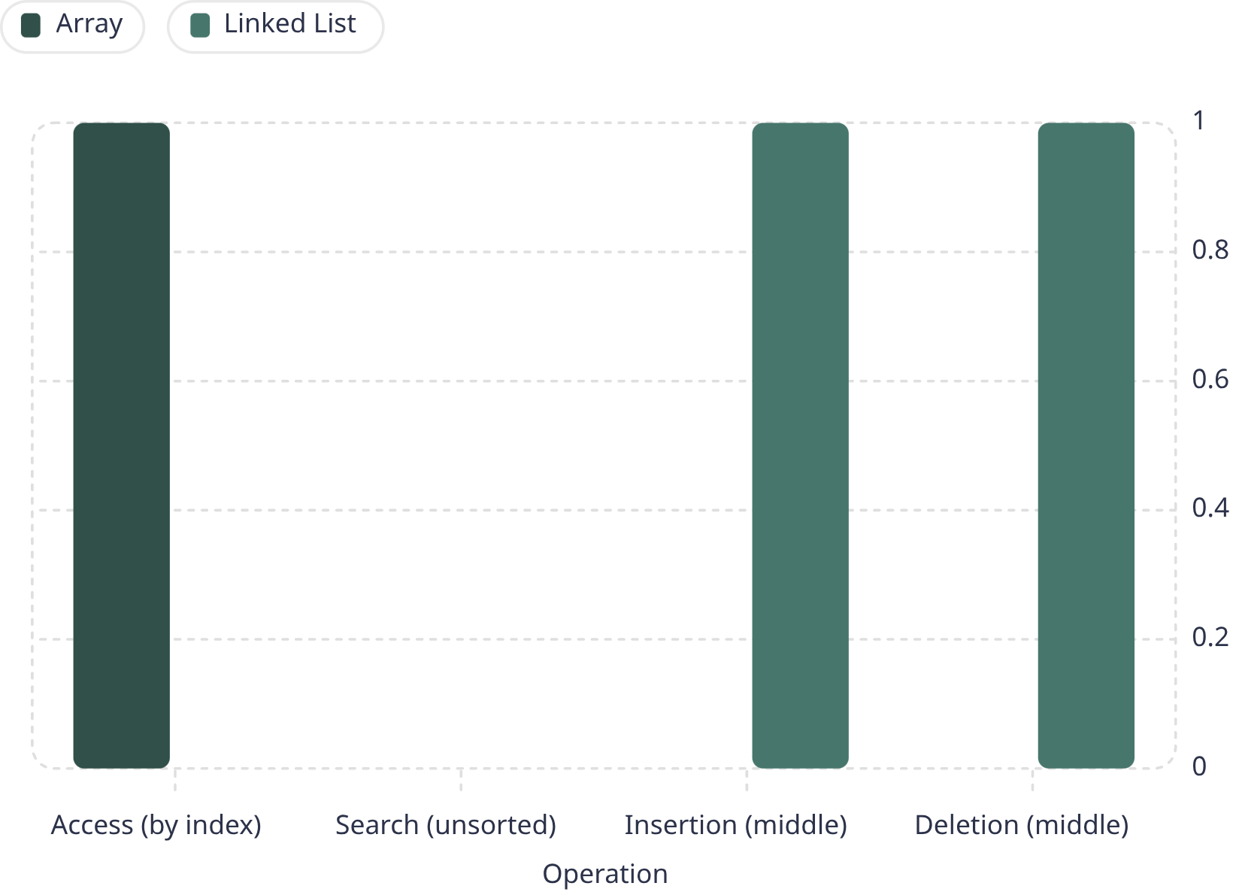
Time Complexity (Big O)
Brief notes:
Access: arrays O(1) due to indexing; lists require traversal O(n).
Search: linear time for unsorted data in both structures.
Insert/Delete: linked lists excel when you already have a node pointer.
Resizing arrays can add amortised cost (dynamic arrays).

Slide 7





Real-World Applications
Image processing
Student records
Music playlist
Browser history
Arrays (2D) store pixel grids for fast indexed access and cache efficiency.
Arrays for indexed lookup; linked lists for flexible insertion in streaming systems.
Linked lists (or dynamic arrays) handle reorder and insert operations smoothly.
Doubly linked lists enable back/forward traversal with O(1) insertions.
Undo / Redo
Often implemented with linked structures or arrays depending on access patterns.

Slide 8

Choosing the Right Data Structure
Choose Structure
Array, Linked List, or Vector
Frequent Middle Inserts?
Consider insertion cost
Fast Random Access?
Prioritise access speed
Start
Choose data structure

Slide 9
Live Code Example (C)
Array (static)
Singly Linked List (insert head)
#include <stdio.h>
int arr[5] = {1,2,3,4,5};
printf("%d\n", arr[2]); // O(1) access
struct Node { int data; struct Node* next; };
void push(struct Node** head, int val) {
struct Node* n = malloc(sizeof(*n));
n->data = val; n->next = *head; *head = n;
} // O(1) insert
Highlighted differences: indexing vs pointer traversal; memory allocation and deallocation required for lists.

Slide 10

Conclusion & Q&A
Key takeaways
Best practices
Questions?
Arrays: best for random access and contiguous storage. Linked lists: best for dynamic size and frequent insert/delete.
Choose by access patterns: prefer arrays for indexing-heavy tasks and linked lists when pointer-based operations dominate.
Thank you — open for Q&A.

