Slide 1

AI-Driven Retail Analytics for Customer Segmentation and Demand Prediction Using Transaction Mining and Market Basket Analysis
Presented by : H.Ashwaq hussain - 192425331
    : K.Sadiq hussain 192425108
    : G.Irtiza Imad 192511405
    : B.Manikanteswara reddy 192372225
Subject code : CSA1613
Subject : DATA WAREHOUSING AND DATA MINING
Guide name : RENUGA S

Slide 2


ABSTRACT
Retail businesses generate large volumes of transaction data, but much of it remains unused.
Understanding customers, predicting demand, and finding buying patterns manually is slow.
The proposed system uses data mining and AI to segment customers, forecast demand, and find product associations.
Transaction data is cleaned and analyzed using RFM clustering, time-series forecasting, and market basket analysis.
The results identify valuable customer groups, predict future demand, and recommend products bought together.
The approach supports inventory planning, targeted marketing, and increased sales.

Slide 3
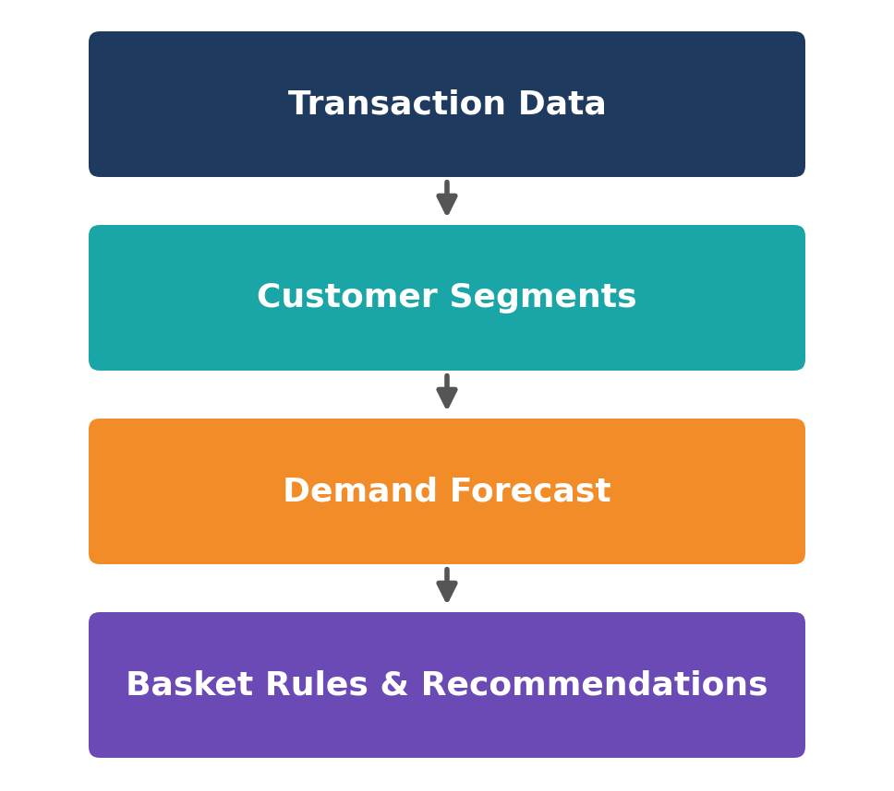
INTRODUCTION
Retail stores record millions of customer transactions.
Data mining finds hidden patterns in transaction data.
Customer segmentation groups similar shoppers.
Demand prediction forecasts future sales.
Market basket analysis finds products bought together.

Slide 4

PROBLEM STATEMENT
Retailers collect huge transaction data but struggle to turn it into useful insights.
Treating all customers alike leads to ineffective marketing and lost sales.
Inaccurate demand estimation causes stock-outs or overstocking of products.
Buying patterns across thousands of products are difficult to find manually.
An AI-driven system is needed to segment customers, predict demand, and recommend products.

Slide 5
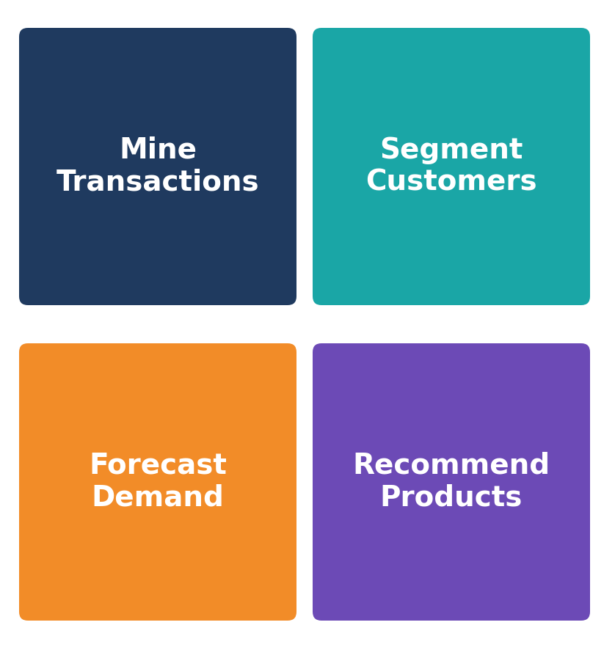
OBJECTIVE
Collect and clean retail transaction data.
Segment customers using RFM analysis and clustering.
Forecast product demand using time-series and machine learning models.
Find frequent itemsets and association rules.
Evaluate segmentation, forecasting, and recommendation results.

Slide 6
LITERATURE REVIEW
Year | Author / Work | Key Ideas | Relevance / Gap
1994 | R. Agrawal & R. Srikant (Apriori Algorithm) | Introduced the Apriori algorithm to find frequent itemsets and association rules. | Foundation for market basket analysis, but candidate generation is costly on large data.
2000 | J. Han et al. (FP-Growth) | Proposed the FP-tree to mine frequent patterns without candidate generation. | Faster rule mining, but not combined with segmentation or demand forecasting.
2012 | D. Chen et al. (RFM Customer Segmentation) | Used RFM features and clustering on online retail transactions to group customers. | Useful for customer groups, but does not include demand prediction.
2016 | T. Chen & C. Guestrin (XGBoost) | Scalable gradient boosting that performs strongly on tabular prediction tasks. | Suitable for demand prediction, but needs well-engineered retail features.
2018 | S. J. Taylor & B. Letham (Prophet) | Decomposable trend, seasonality and holiday model for business forecasting. | Handles retail seasonality, but is not linked to basket analysis.

Slide 7
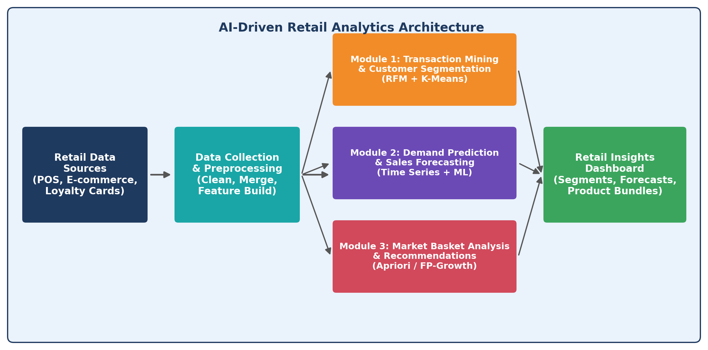
ARCHITECTURE DIAGRAM

Slide 8
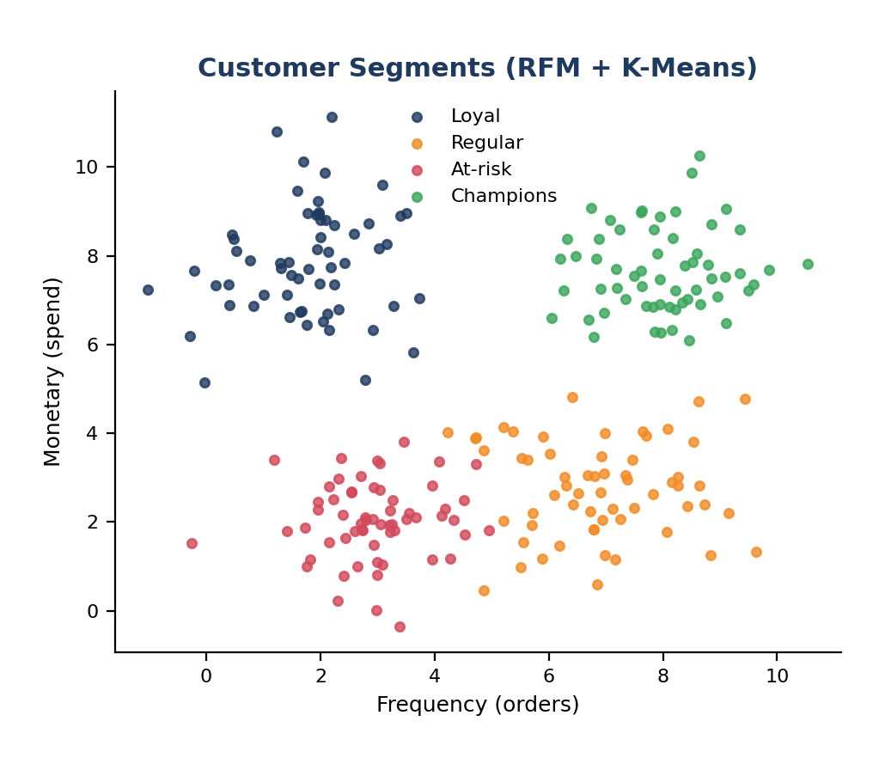
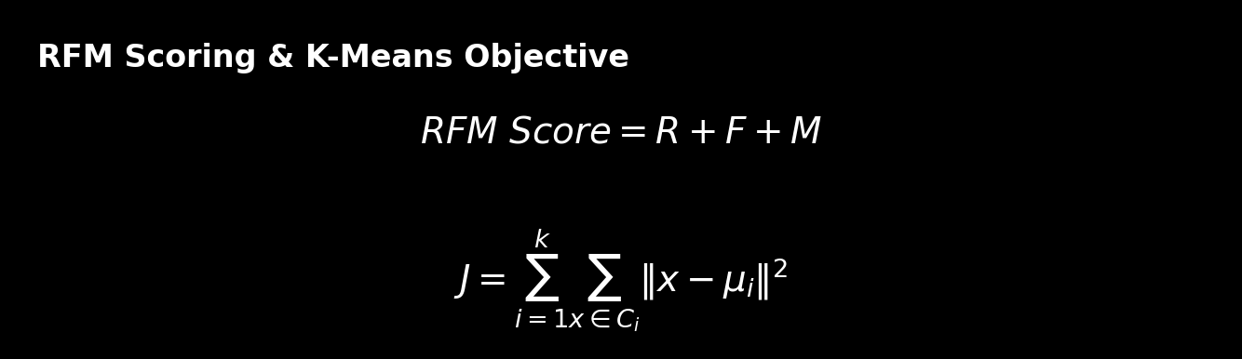
Module 1 : Transaction Data Mining & Customer Segmentation
Collect POS and online sales data.
Remove duplicates and missing values.
Build RFM features per customer.
Apply K-Means to group customers.
Label segments like Loyal, At-risk.

Slide 9
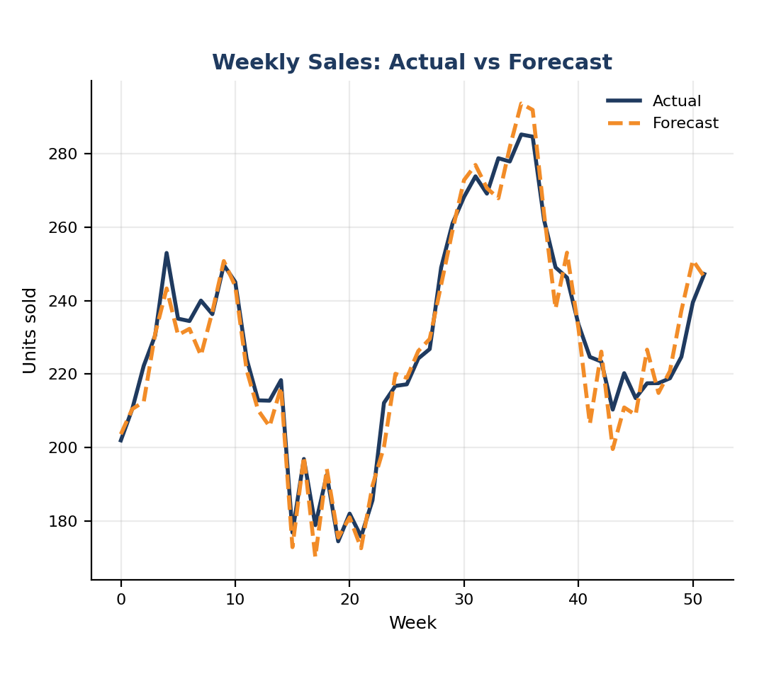
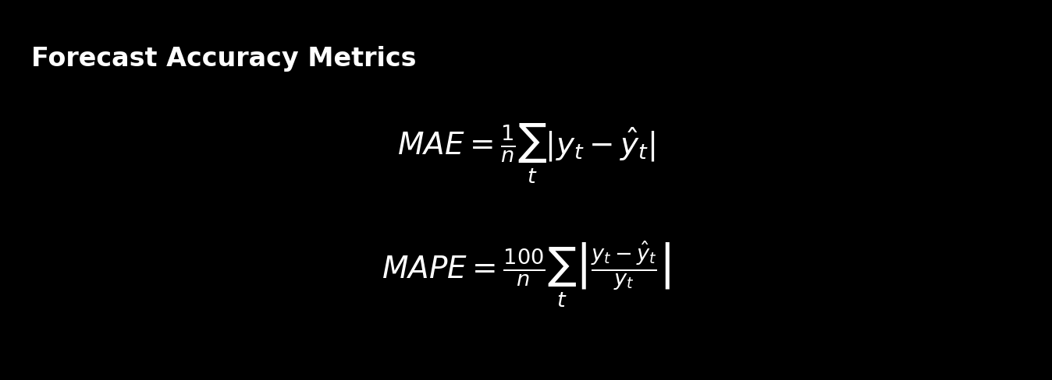
Module 2 : Demand Prediction & Sales Forecasting
Prepare weekly sales per product.
Identify trend and seasonality.
Build ARIMA and Prophet models.
Train ML models like XGBoost.
Compare models, predict demand.

Slide 10
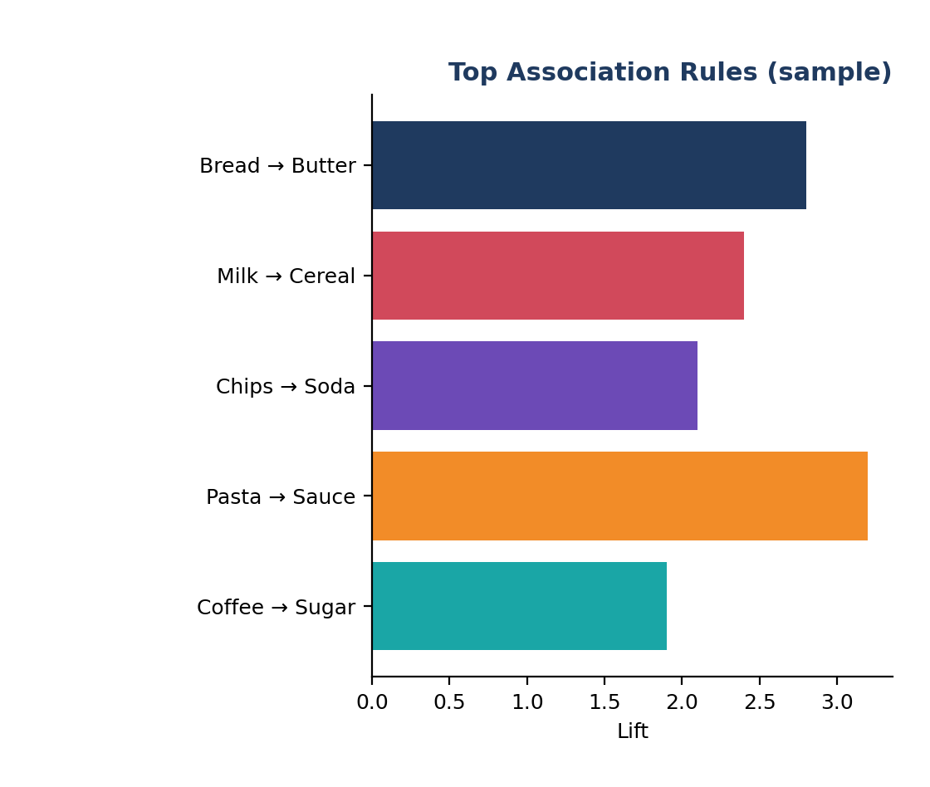
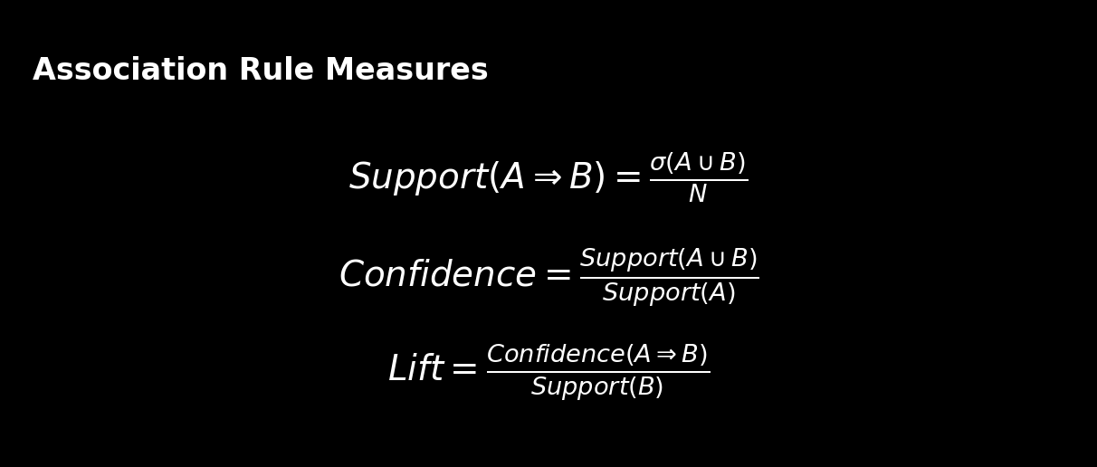
Module 3 : Market Basket Analysis & Retail Recommendations
Convert data to basket format.
Find itemsets with Apriori / FP-Growth.
Generate rules (support, confidence).
Rank rules using lift.
Recommend bundles and cross-sell.

Slide 11
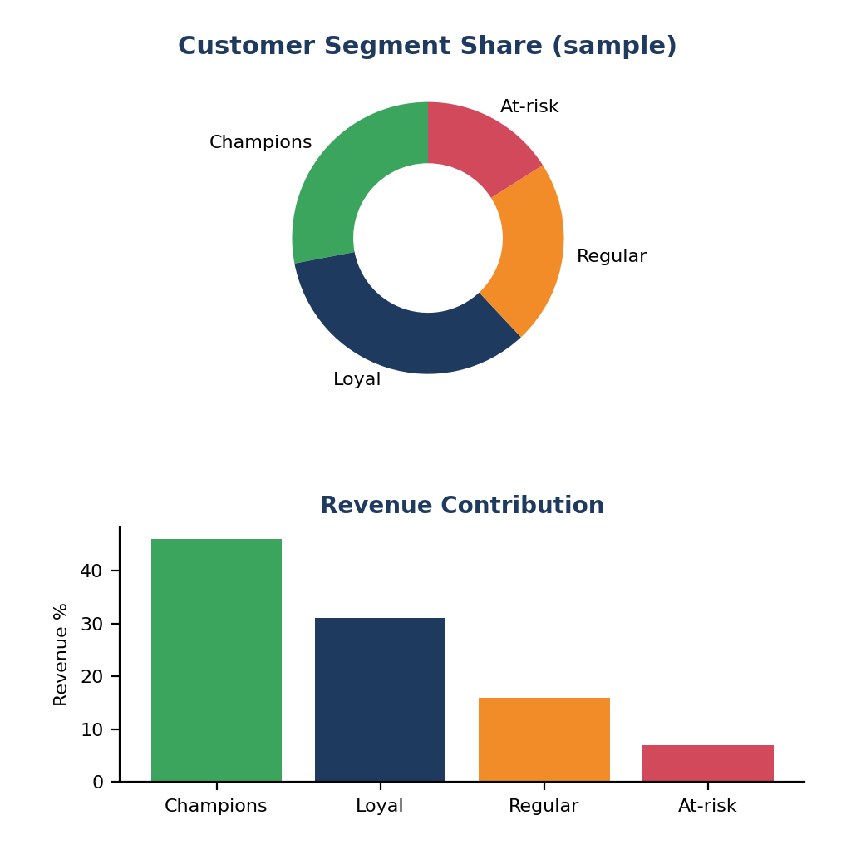
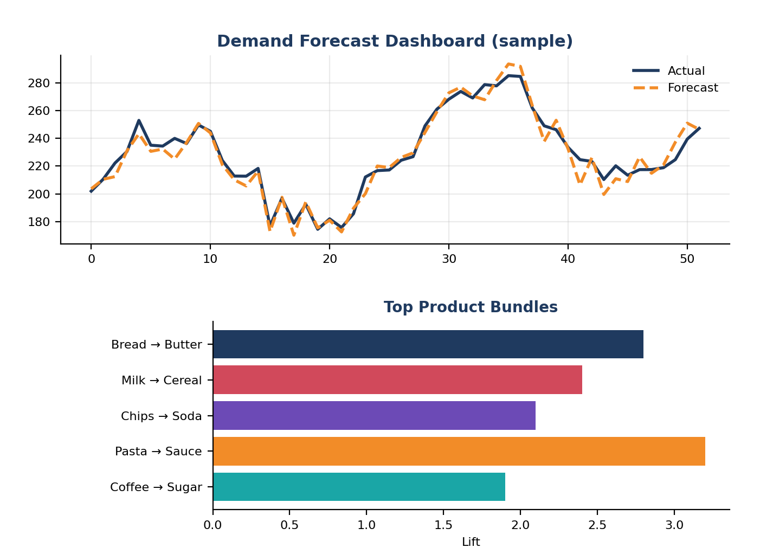
IMPLEMENTATION

Slide 12
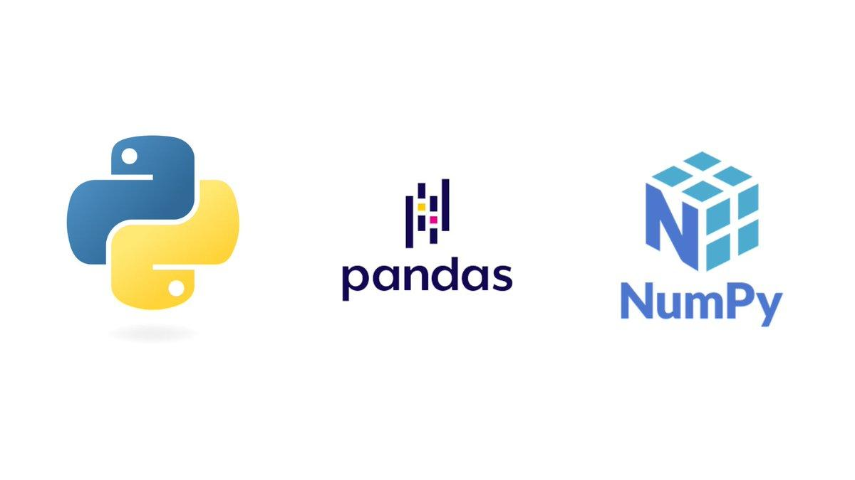
TOOLS & TECHNOLOGIES
Frontend
Streamlit – To build the interactive retail analytics dashboard.
Plotly – For interactive charts of segments, sales, and rules.
HTML & CSS – For designing and structuring the web pages.
Backend
Python – For data mining, forecasting, and recommendation logic.
SQL / SQLite – To store and query retail transaction data.
Data & Machine Learning
Pandas & NumPy – For data cleaning, RFM features, and calculations.
Scikit-learn – For K-Means clustering and XGBoost-style models.
Statsmodels / Prophet – For time-series sales forecasting.
mlxtend – For Apriori, FP-Growth, and association rules.

Slide 13
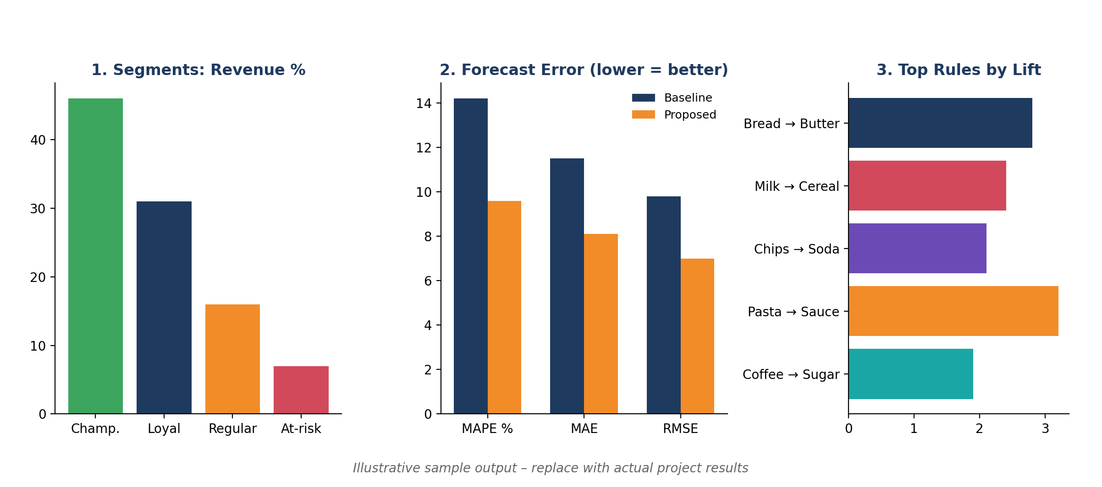
RESULTS

Slide 14

FUTURE ENHANCEMENTS
Real-time retail data can improve accuracy.
Deep learning (LSTM) can improve forecasting.
Personalized recommendations per customer.
Dynamic pricing and auto stock replenishment.
Extension to mobile and cloud retail platforms.

Slide 15
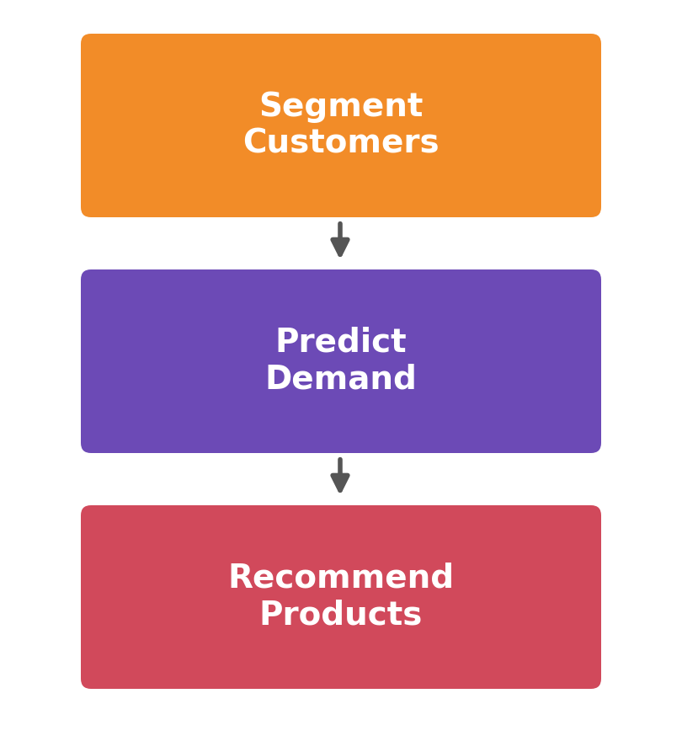
CONCLUSION
The proposed system uses data mining and AI to turn retail transaction data into useful business insights.
Customer segmentation using RFM and clustering identifies valuable and at-risk customer groups.
Demand prediction and sales forecasting help in better inventory planning and stock management.
Market basket analysis discovers product associations that support cross-selling and targeted recommendations.

Slide 16
REFERENCES
R. Agrawal and R. Srikant (1994), “Fast Algorithms for Mining Association Rules,” Proc. 20th International Conference on Very Large Data Bases (VLDB), pp. 487–499.
J. Han, J. Pei, and Y. Yin (2000), “Mining Frequent Patterns without Candidate Generation,” Proc. ACM SIGMOD International Conference on Management of Data, pp. 1–12.
D. Chen, S. L. Sain, and K. Guo (2012), “Data Mining for the Online Retail Industry: A Case Study of RFM Model-Based Customer Segmentation Using Data Mining,” Journal of Database Marketing & Customer Strategy Management, Vol. 19, No. 3, pp. 197–208.
T. Chen and C. Guestrin (2016), “XGBoost: A Scalable Tree Boosting System,” Proc. 22nd ACM SIGKDD International Conference on Knowledge Discovery and Data Mining, pp. 785–794.
S. J. Taylor and B. Letham (2018), “Forecasting at Scale,” The American Statistician, Vol. 72, No. 1, pp. 37–45.

Slide 17


