Slide 1

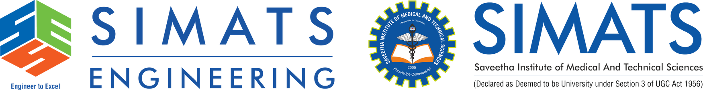
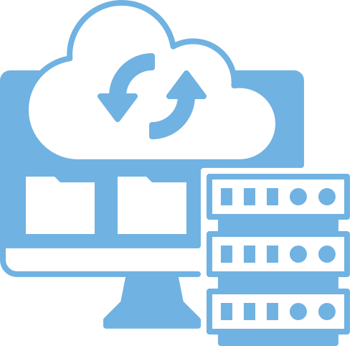
ROLE OF DATA CENTERS IN CLOUD COMPUTING
CSA1516 - CLOUD COMPUTING AND BIG DATA ANALYTICS
GUIDE: SANTHIYA LAKSHMI K
Name : R.MOHANRAM
Reg No: 192521117

Slide 2

OBJECTIVE:
To understand the concept of data centers.
To analyze their role in cloud computing
EXPLANATION
A data center is a physical facility that contains servers and storage systems
It stores, processes, and manages cloud data
Cloud service providers use multiple data centers worldwide
Acts as the backbone of cloud computing

Slide 3
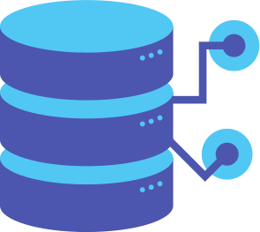
DATA CENTER ARCHITECTURE
Front End: User devices (mobile, laptop)
Internet: Communication medium
Back End (Data Center):Servers (compute resources)
Storage systems
Networking equipment
Power and cooling systems
INTERNET

Slide 4

REAL-WORLD USE CASE
Industry Example:
Major companies: Google, Amazon, Microsoft
Services like Gmail, YouTube, AWS use data centers
Data is stored and accessed globally
Ensures high availability and performance

Slide 5

CONCLUSION
Data centers are essential for cloud computing
Provide storage, processing, and networking
Enable scalability and reliability
Support global access to cloud services

Slide 6
REFERENCES
Suciu, G., et al. (2015). Basic Internet Foundation and Cloud Computing. IEEE Conference.
Sen, J., et al. (2017). Cloud Computing – Architecture and Applications.
Pahl, C., et al. (2017). Cloud Container Technologies: A State-of-the-Art Review. IEEE Transactions on Cloud Computing.
Kyi, P., & Me, M. (2019). Cloud Computing Basics: Features and Services. International Journal.
Li, Z., et al. (2017). Performance Comparison of Virtualization Technologies.
Srinivasan, S. (2014/Used widely in later studies). Cloud Computing Basics. Springer.
Surbiryala, J., & Rong, C. (2019). Cloud Computing: History and Overview. IEEE.
Springer (2023). Essentials of Cloud Computing.
Noor, J., et al. (2023–2024). Cloud Performance & Security Studies.
Baitha, M. K., et al. (2025). Cloud Computing: Evolution and Trends.
Kadve, D., et al. (2026). Cloud Computing Evolution to Serverless.
IEEE Transactions on Cloud Computing (2015–2026 issues).

