Slide 1
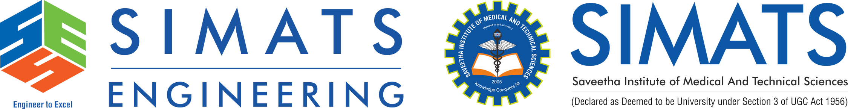
Federated Learning-Based Privacy- Preserving Big Data Analytics on Cloud
CSA1516-CLOUD COMPUTING AND BIG DATA ANALYTICS
PRESENTED BY
GUIDED BY
Dr.SANTHIYA LAKSHMI K
192521117-R MOHANRAM
192573009-JOTHIPRAKASH M
DEPARTMENT
DEPARTMENT
Electronics and Communication Engineering
B.tech INFORMATION TECHNOLOGY
&
BE CSE-DATA SCIENCE

Slide 2
Introduction
Federated Learning-Based Privacy-Preserving Big Data Analytics on Cloud combines:
Federated Learning for decentralized machine learning.
Big Data Analytics for analyzing distributed datasets.
Cloud Computing for centralized storage of models and results.
Privacy Preservation by keeping raw client data local.
Federated Averaging (FedAvg) for global model aggregation.
Explain:
Traditional machine learning usually requires collecting data from multiple sources into a central location. This can create privacy and data-transfer concerns.
In the proposed system, each client performs local training using its own dataset. Only model parameters/updates are communicated to the federated server. The server aggregates the updates using FedAvg and produces a global model.
The global model, analytics results and prediction results are then stored in Azure Blob Storage.
01
Client 1 Dataset
Local edge data collection
02
Local Training
On-device model training
03
Model Update
Local weights optimization
04
Federated Server
Central node orchestration
07
Azure Blob Storage
Secure cloud persistence bucket
06
Global Model
Consolidated operational weights
05
FedAvg Aggregation
Secure multi-party weights averaging

Slide 3
Problem Statement
TRADITIONAL APPROACH
Centralized machine learning requires data from multiple clients to be collected and transferred to a common server.
This creates several challenges:
Raw data privacy concerns
Data transfer overhead
Distributed data ownership
Security risks associated with centralized data storage
Difficulty in performing analytics across distributed datasets
Need for scalable cloud-based storage
Need to verify the global model after cloud deployment
Proposed Solution
Develop a privacy-preserving federated learning system where clients train models locally, model updates are aggregated using FedAvg, and the global model, analytics and prediction results are stored and managed using Azure Blob Storage.
Client 1
Local Node
Central Server
Centralized Data Collection & ML Processing Model
Client 2
Local Node
Client 3
Local Node
Raw Data(Exposed Transfer)
PROPOSED FEDERATED LEARNING PIPELINE
Client 1
Edge Node
Model Update
Weights Only
FedAvg
Secure Parameter Aggregation
Client 2
Edge Node
Model Update
Weights Only
Global Model
Updated Master Model
Azure Storage
Blob Container Vault

Slide 4
Literature Review
Source / Year / Paper Title | Authors | Module / Concept Used | Drawback / Limitation
Elsevier, 2026 – Federated Learning for Big Data: A Survey on Opportunities, Applications, and Future Directions | Thippa Reddy Gadekallu, Quoc-Viet Pham, Thien Huynh-The, Hailin Feng, Kai Fang, Sharnil Pandya, Madhusanka Liyanage, Wei Wang, Thanh Thi Nguyen | Big Data Analytics, FL Architecture, Cloud/Big Data Integration | Highlights challenges including communication overhead, system/statistical heterogeneity, privacy and security issues in FL-Big Data systems. (ScienceDirect)
MDPI Computers, 2026 – Federated Learning: A Survey of Core Challenges, Current Methods, and Opportunities | Madan Baduwal, Priyanka Paudel, Vini Chaudhary | Client Selection, Aggregation, Optimization, Privacy Preservation | Identifies heterogeneity, computation overhead, communication bottlenecks, client selection and privacy as major challenges affecting practical FL deployment. (MDPI)
MDPI Electronics, 2026 – A Fairness Perspective on Client Selection and Aggregation Methods for Non-IID Mitigation in Federated Learning: A Survey | Mohannad Alsofyani, Isra Alturaiki, Hassan Mathkour | Client Selection, Non-IID Data, Model Aggregation | Non-IID data can cause client drift, slower convergence and unfair client participation/influence. (MDPI)
MDPI Electronics, 2026 – Heterogeneity-Aware Poisoning Attacks and Mitigation in Federated Learning: A Comprehensive Survey and Taxonomy | Aimen Djemaa, Djamel Djenouri, Phil Legg | FL Security, Model Aggregation, Attack Detection | Heterogeneous clients make poisoning attacks harder to detect and make mitigation more difficult while preserving legitimate client diversity. (MDPI)
MDPI Electronics, 2026 – Blockchain-Enabled Federated Learning: A Survey on System Design, Key Challenges, and Future Directions | Lingzi Zhu, Bo Zhao, Rao Peng | Privacy, Security, Trust, Decentralized FL | Traditional centralized FL can face trust and single-point-of-failure concerns; blockchain integration introduces additional efficiency and storage overhead. (MDPI)
IEEE TNNLS, 2025 – Threats and Defenses in the Federated Learning Life Cycle: A Comprehensive Survey and Challenges | Yanli Li, Zhongliang Guo, Nan Yang, Huaming Chen, Dong Yuan, Weiping Ding | Privacy & Security, Secure Aggregation, FL Threats | FL remains exposed to threats such as privacy leakage, malicious updates and attacks across different stages of the FL lifecycle. (PubMed)
Elsevier, 2026 – Intent-Based Agentic AI Framework for Privacy-Preserving Cross-Cloud Federated Learning and Green Big Data Analytics in Edge-Cloud Networks | Sheng Guo, Lei Yang, Zhi Wang | Cross-Cloud FL, Privacy Preservation, Cloud Integration, Big Data Analytics | Cross-cloud coordination, communication overhead, heterogeneous resources and energy-efficient orchestration remain challenging. (ScienceDirect)

Slide 5
Objective
01
02
03
04
05
Implement a Federated Learning system with multiple clients.
Perform local model training without transferring raw client datasets.
Aggregate client model updates using Federated Averaging (FedAvg).
Store federated results and analytics in Azure Blob Storage.
Perform Big Data Analytics on distributed client datasets.
06
07
08
09
Store and retrieve the global federated model from Azure.
Independently evaluate the downloaded global model.
Develop a Streamlit dashboard for visualization and live prediction.
Demonstrate privacy preservation by keeping raw client data local.

Slide 6
SYSTEM ARCHITECTURE
CLIENT LAYER
Actual Streamlit Implementation Screenshots
🟦 Client 1
🟦 Client 2
1. AZURE STATUS CAPTURE
Local Dataset (N=227)
Local Dataset (N=228)
☁️ Azure Blob Storage: Connected / Results Loaded
Local Training
Local Training
Model Updates
2. FEDERATED ACCURACY CAPTURE
FEDERATED LAYER
📈 Federated Learning Accuracy
⚙️ Federated Server
Rounds
Final Accuracy
Initial Accuracy
Improvement
Flower Framework • FedAvg • Global Model Aggregation
3
93.41%
92.97%
+0.44%
92.97%
92.97%
93.41%
Global Model
CLOUD LAYER
Round 1
Round 2
Round 3
☁️ Microsoft Azure Blob Storage
📁 results/results.json
📁 analytics/analytics_results.json
3. BIG DATA ANALYTICS CAPTURE
📁 models/global_model.pth
📁 predictions/azure_prediction_results.json
📊 Big Data Analytics
Total Clients
Training Samples
Test Samples
Features
2
455
228
30
Data / Model Retrieval
Global Dataset Class Distribution
ANALYTICS LAYER
🟢 Class 0 Samples: 169
📊 Big Data Analytics
🔴 Class 1 Samples: 286
• Round Accuracy (92.97% ➔ 93.41%)
• Client Analytics (N1=227, N2=228)
• Class Distribution (Class 0: 169 | Class 1: 286)
• Azure Model Evaluation (88.16% Accuracy)
4. AZURE GLOBAL MODEL PREDICTION CAPTURE
🎯 Live Prediction (Trained Global Model)
DASHBOARD LAYER
Feature 1: -0.44
Feature 2: -0.13
Feature 3...30: 0.21
📈 Streamlit Dashboard Application
Prediction Result: Predicted Class 1 (Confidence: 54.83%)
☁️ Azure Status
📈 Visualizations
🎯 Live Prediction
⚙️ System Status
☁️ Azure Storage Evaluation Accuracy: 88.157% (201 / 228 correct predictions)
Model Blob: models/global_model.pth | Local Model: azure_global_model.pth

Slide 7
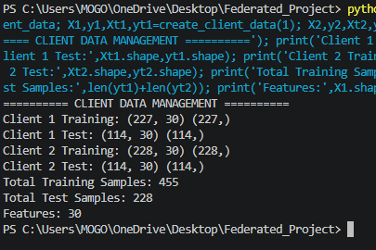
Module 1 : Client Data & Preprocessing
Purpose:
Generate/prepare distributed client datasets.
Maintain client data locally.
Separate training and testing data.
Prevent raw client data from being transferred to the server.
Implementation:
Python
data_utils.py
2 clients
30 features
455 training samples
228 test samples

Slide 8
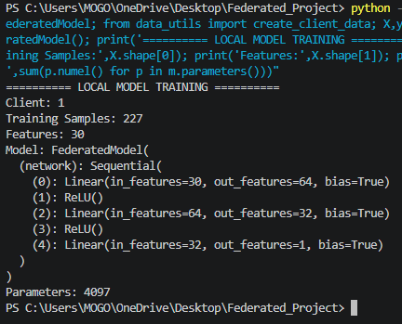
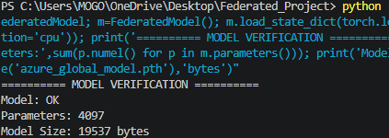
Module 2 : Local Model Training
Purpose:
Train the model independently at each client.
Keep raw data within the client.
Generate local model parameters.
Implementation:
Python
PyTorch
FederatedModel
Model parameters:
4,097

Slide 9
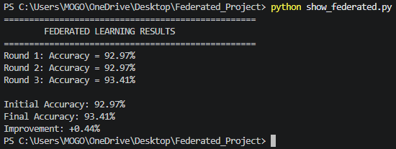
Module 3 : Federated Learning & FedAvg
Purpose:
Coordinate training between clients and server.
Receive model updates instead of raw data.
Aggregate local models using Federated Averaging.
Produce the global federated model.
Technology:
Flower
PyTorch
FedAvg
Implementation Result:

Slide 10
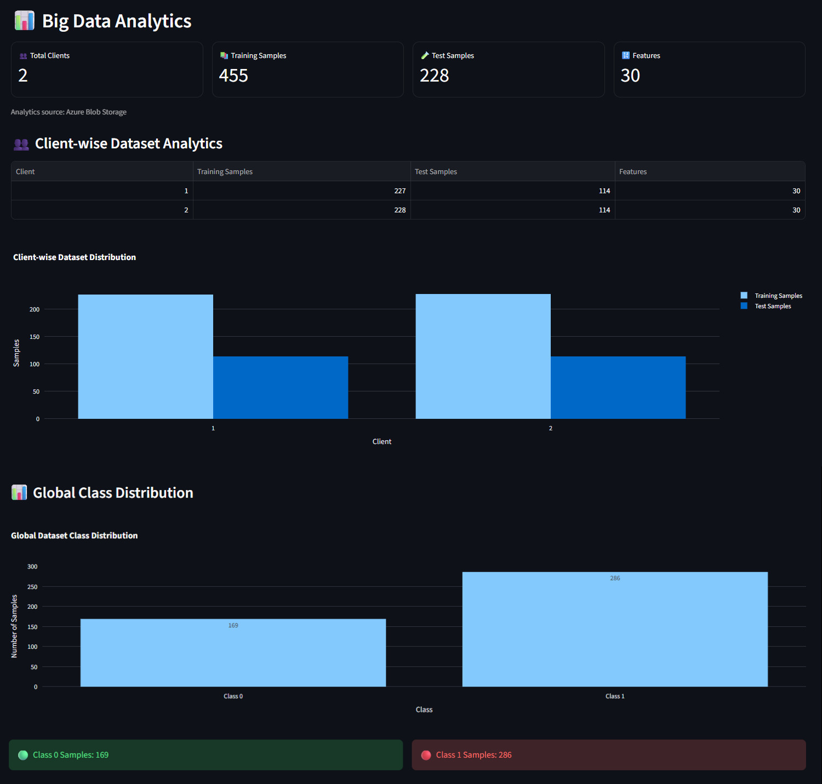
Module 4 : Big Data Analytics
Purpose:
Analyze distributed client datasets.
Calculate training/test sample counts.
Analyze feature dimensions.
Analyze class distribution.
Generate global analytics results.
Actual Results:
Parameter | Value
Clients | 2
Training Samples | 455
Test Samples | 228
Features | 30
Class 0 | 169
Class 1 | 286
Output file:
analytics_results.json

Slide 11
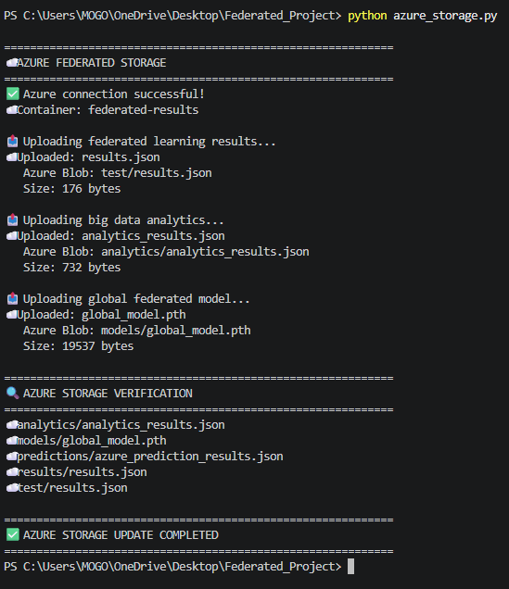
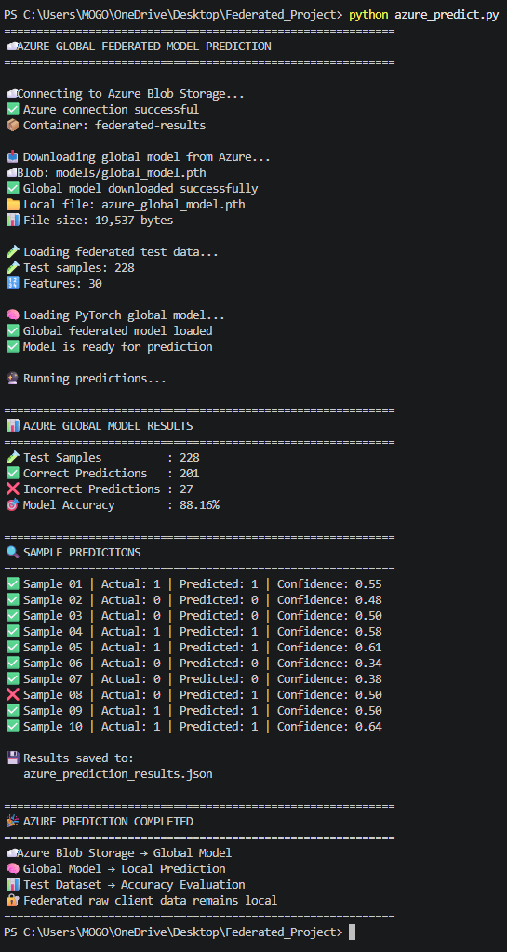
Module 5 : Azure Cloud Storage & Model Prediction
This is important because your project is specifically cloud-based.
Purpose:
Store federated learning results in Azure.
Store analytics results.
Store global model.
Download the global model from Azure.
Perform independent model evaluation.
Store prediction results back in Azure.
Azure structure
federated-results
│
├── results/
│ └── results.json
│
├── analytics/
│ └── analytics_results.json
│
├── models/
│ └── global_model.pth
│
└── predictions/
└── azure_prediction_results.json

Slide 12
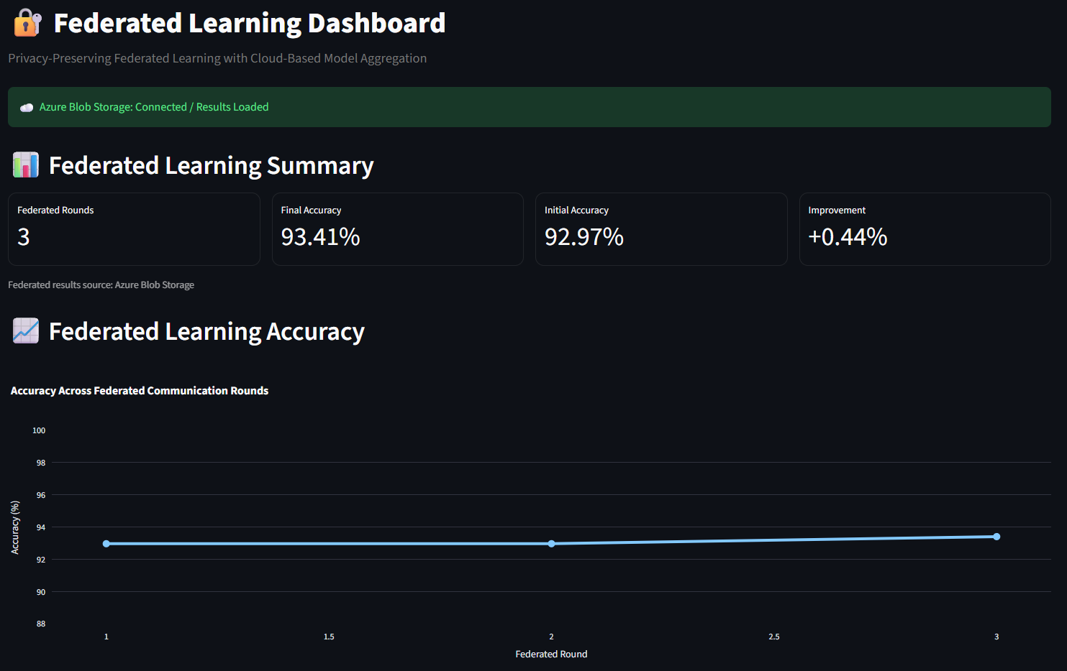
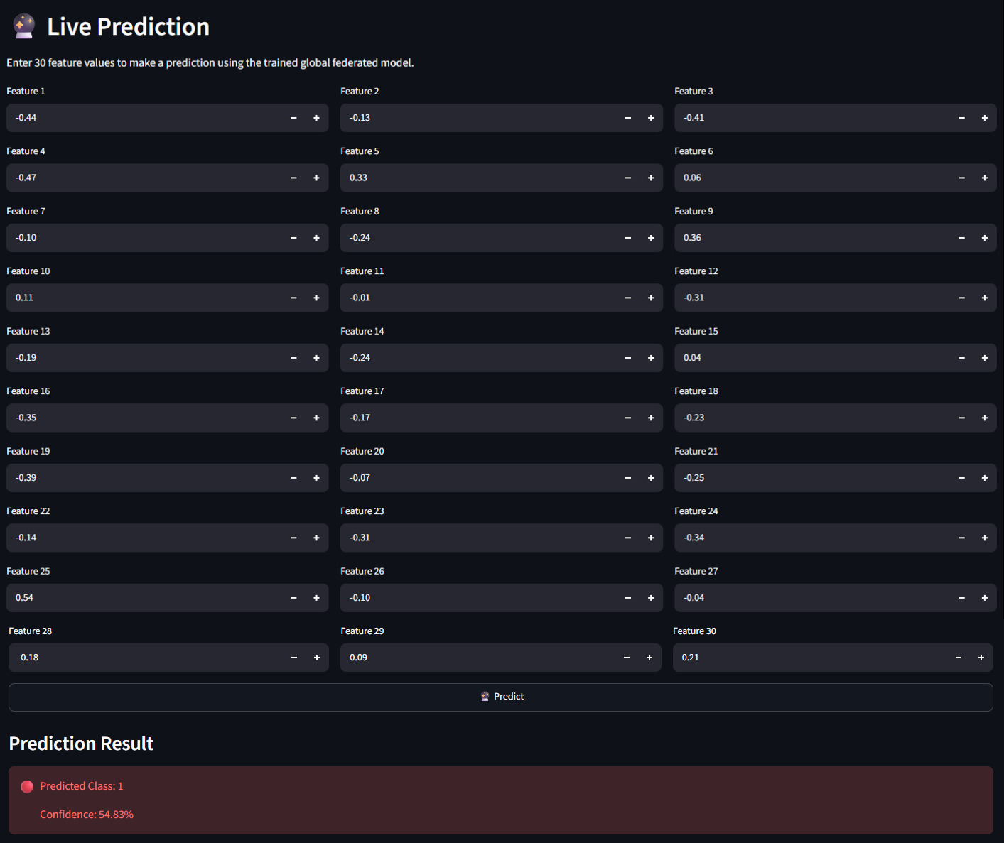
Module 6 : Streamlit Dashboard & Live Prediction
Purpose:
Provide a visual interface for the complete system.
Display federated learning results.
Display Big Data analytics.
Display Azure model status.
Perform live predictions using the global model.
Dashboard features:
Federated Learning Summary
Accuracy Graph
Round-wise Results
Client Analytics
Class Distribution
Azure Global Model Prediction
Model Integrity Verification
Live Prediction
System Status
Project Conclusion
Technology:
Streamlit
Python
Plotly
PyTorch
Azure Blob Storage

Slide 13
Conclusion
The project successfully demonstrates a Federated Learning-Based Privacy-Preserving Big Data Analytics on Cloud system.
The implementation:
Uses 2 federated clients
Performs local training
Uses FedAvg aggregation
Completes 3 federated rounds
Achieves 93.41% final federated accuracy
Processes 455 training samples
Uses 228 test samples
Uses 30 features
Stores results and the global model in Azure Blob Storage
Downloads and independently evaluates the Azure global model
Achieves 88.16% independent test accuracy
Provides an interactive Streamlit dashboard
Keeps raw client data local

Slide 14
Future Scope
1. More Clients
Expand from 2 clients to many distributed clients.
2. Larger Datasets
Use larger real-world datasets for stronger validation.
3. Advanced Privacy
Integrate:
Differential Privacy
Secure Aggregation
Homomorphic Encryption
4. Cloud Deployment
Deploy the complete dashboard and federated server to Azure.
5. Advanced Models
Experiment with:
CNN
LSTM
Transformer-based models
6. Real-Time Analytics
Add real-time monitoring of:
Client participation
Training performance
Model accuracy
Communication metrics

Slide 15
References
[1] T. R. Gadekallu, Q.-V. Pham, T. Huynh-The, H. Feng, K. Fang, S. Pandya, M. Liyanage, W. Wang, and T. T. Nguyen, “Federated learning for big data: A survey on opportunities, applications, and future directions,” Engineering Applications of Artificial Intelligence, vol. 166, Part B, Art. no. 113614, 2026, doi: 10.1016/j.engappai.2025.113614.
[2] M. Baduwal, P. Paudel, and V. Chaudhary, “Federated Learning: A Survey of Core Challenges, Current Methods, and Opportunities,” Computers, vol. 15, no. 3, Art. no. 155, 2026, doi: 10.3390/computers15030155.
[3] M. Alsofyani, I. Alturaiki, and H. Mathkour, “A Fairness Perspective on Client Selection and Aggregation Methods for Non-IID Mitigation in Federated Learning: A Survey,” Electronics, vol. 15, no. 14, Art. no. 3178, 2026, doi: 10.3390/electronics15143178.
[4] A. Djemaa, D. Djenouri, and P. Legg, “Heterogeneity-Aware Poisoning Attacks and Mitigation in Federated Learning: A Comprehensive Survey and Taxonomy,” Electronics, vol. 15, no. 13, Art. no. 2876, 2026, doi: 10.3390/electronics15132876.
[5] L. Zhu, B. Zhao, and R. Peng, “Blockchain-Enabled Federated Learning: A Survey on System Design, Key Challenges, and Future Directions,” Electronics, vol. 15, no. 8, Art. no. 1572, 2026, doi: 10.3390/electronics15081572.
[6] Y. Li, Z. Guo, N. Yang, H. Chen, D. Yuan, and W. Ding, “Threats and Defenses in the Federated Learning Life Cycle: A Comprehensive Survey and Challenges,” IEEE Transactions on Neural Networks and Learning Systems, vol. 36, no. 9, pp. 15643–15663, 2025, doi: 10.1109/TNNLS.2025.3563537.
[7] S. Guo, L. Yang, and Z. Wang, “Intent-based agentic AI framework for privacy-preserving cross-cloud federated learning and green big data analytics in edge-cloud networks,” Computer Communications, vol. 257, Art. no. 108611, 2026, doi: 10.1016/j.comcom.2026.108611.

Slide 16

A
Project
From
MR
Thank You!
2026

