Slide 1

GatekeeperX: Queueing Simulation for Intelligent DevSecops
Security Gates
Presented by,
192465030 - Y.Harsha vardhan
192465064 - K.Padma prabhas
192465066 - P.Somashankar
192521117 - R.Mohanram
Guided by,
Dr. T. Vincent Gnanaraj
Associate Professor
Department of Quantum Intelligence
SIMATS Engineering

Slide 2
ABSTRACT
Modern DevSecOps pipelines integrate security checks throughout the software development lifecycle, but traditional security gates often introduce delays due to inefficient resource allocation and manual decision-making. Existing approaches primarily focus on automated security scanning while giving limited attention to optimizing the flow of security validation tasks. This creates bottlenecks that reduce deployment speed and overall pipeline efficiency. The proposed system, “GatekeeperX”, introduces an intelligent queueing simulation model to optimize DevSecOps security gates by prioritizing and scheduling security tasks based on risk and resource availability. The system simulates different queue management strategies to reduce waiting time, improve throughput, and maintain strong security standards. It also enables better utilization of security tools without compromising software quality. The expected findings demonstrate that intelligent queue management can significantly minimize pipeline delays, enhance security gate efficiency, and support faster, more reliable, and secure continuous software delivery.

Slide 3
Introduction
1. Concept Used — DevSecOps & Queueing Theory
DevSecOps integrates security into every stage of the software development and CI/CD pipeline.
GatekeeperX applies queueing theory and risk-based prioritization to manage security tasks.
2. Methodology
Security tasks are generated as a workload and assigned risk-based priority scores.
The queue then processes tasks using dynamic priority and aging to improve fairness.
3. Existing Work
Traditional approaches such as FCFS and Static Priority Queueing are commonly used for task scheduling.
However, they may cause long waiting times, inefficient prioritization, or starvation of lower-priority tasks.
4. Proposed Work — GatekeeperX
GatekeeperX combines security risk assessment, intelligent queueing, and dynamic aging.
It is simulated in RStudio and compared with existing approaches using performance metrics.

Slide 4
Literature survey
Author(s), Year, Journal/Proceedings | Title | Key Findings
Zhao, Z. & Mukherjee, D., 2026, Queueing Systems (Springer) | DevOps Pipeline Bottlenecks Under Synthetic Load Spikes | Introduced the concept of archetypes as universal symbols, explaining how astrology’s planetary symbolism can act as psychology trigger
Baron, O., Krass, D., Senderovich, A., van der Laan, M. & Xu, Z., 2026, Manufacturing & Service Operations Management | Queueing Causal Models: Comparative Analytics in Queueing Systems | Reviewed historical overlap between astrology and astronomy, noting that symbolic interpretations and empirical measurements once coexisted to explain cosmic influences.
Rajapakse, R. N., Zahedi, M., Babar, M. A. & Shen, H., 2021, Journal of Systems and Software | Integrating ABM and SD for Complex Systems | Demonstrated that combining ABM’s agent-level modeling with SD’s macro-level dynamics yields richer insights in sociological and psychological simulations.
Patel, S. & Morgan, J., 2021, Computational Social Science Conference Proceedings | Simulation of Symbolic and Empirical Frameworks | Used statistical validation (correlation and regression) to link symbolic metrics with scientific observations, achieving strong results.
Chen, Y., 2020, International Journal of Metaphysical StudiesEbert, A., Wu, P., Mengersen, K. & Ruggeri, F., 2020, Journal | A Survey of Queueing Systems with Strategic Timing of Arrivals | Applied the twisted pair cable metaphor to illustrate how blending symbolic and empirical domains reduces interpretive noise

Slide 5
Author(s), Year, Journal/Proceedings | Title | Key Findings
Víctor Mayoral-Vilches, Nuria García-Maestro, McKenna Towers, Endika Gil-Uriarte, 2020, arXiv | DevSecOps in Robotics | • Applied DevSecOps principles to robotic software. • Demonstrated secure CI/CD practices.
Roshan N. Rajapakse, Mansooreh Zahedi, M. Ali Babar, 2020, IEEE International Conference on Software Architecture Workshops (ICSAW) | Security Practices in DevOps: A Systematic Mapping Study | • Reviewed security practices integrated into DevOps. • Recommended automated vulnerability scanning and policy enforcement.
Haviv, M. & Ravner, L., 2020, arXiv Survey | GatekeeperX: Queueing Simulation for Intelligent DevSecOps Security Gates | Surveyed queueing models focusing on congestion, waiting-time analysis, scheduling strategies, and service optimization in modern queueing systems
M. Myrbakken, R. Colomo-Palacios, 2017, Information and Software Technology | DevSecOps: A Multivocal Literature Review | • Summarized industrial and academic DevSecOps practices. • Identified organizational and technical adoption barriers.
Kim Wuyts, Wouter Joosen, 2016, IEEE Software | Supporting Security in Continuous Integration and Continuous Deployment Pipelines | • Introduced security checkpoints in CI/CD pipelines. • Recommended automated code analysis and compliance validation.

Slide 6
RESEARCH GAP
Lack of Intelligent Queue Management: Existing DevSecOps security gates perform security checks but do not prioritize or optimize the execution order of security tasks, leading to processing delays.
Pipeline Bottlenecks: Current security validation processes often create bottlenecks in CI/CD pipelines, increasing deployment time and reducing development efficiency.
Limited Resource Optimization: Most existing solutions do not efficiently allocate security tools and resources based on risk levels, resulting in underutilization of resources and slower software delivery.

Slide 7
PROBLEM STATEMENT
Traditional DevSecOps security gates execute security checks sequentially or with fixed workflows, causing increased waiting time, pipeline bottlenecks, and delayed software deployment.
There is a need for an intelligent queue management system that prioritizes security tasks based on risk and resource availability to improve pipeline efficiency without compromising security

Slide 8
OBJECTIVE
Analyze limitations of FCFS and Static Priority approaches in managing DevSecOps security tasks, particularly waiting time and task starvation.
Design an intelligent security gate that uses risk-based priority and dynamic aging to efficiently manage security tasks.
Generate a realistic security-task dataset and simulate the GatekeeperX queueing model in RStudio under controlled workload conditions.
Evaluate GatekeeperX using waiting time, turnaround time, queue length, throughput, and utilization, and compare its performance with existing approaches.

Slide 9
METHODOLOGY
DATA PREPARATION
Input:
DevSecOps security jobs containing severity, vulnerabilities, risk, business impact and workload parameters.
Risk Modeling:
Each job receives a GatekeeperX Priority Score based on multiple security factors.
Queue Processing:
Jobs are selected using priority, while dynamic aging increases the priority of waiting jobs.
Evaluation:
Performance is measured using waiting time, turnaround time, queue length, throughput and utilization.
Comparison:
GatekeeperX is evaluated against FCFS and Static Priority using the same workload.
Step 1: Generate DevSecOps Security Jobs
Step 2: Create Dataset (1000 Records)
RISK & QUEUE PROCESSING
Step 3: Risk & Priority Modeling
Step 4: Queue Simulation + Dynamic Aging
EVALUATION & INTEGRATION
Step 5: Results Evaluation & Comparison
Step 6: DevSecOps Architecture

Slide 10


Methodology: GatekeeperX Algorithm
Step 1: Input Security Job
Where
S–Severity, R–Risk, V–Vulnerability, D–Dependency Risk, B–Business Impact, DP–Developer Priority, C–Code Complexity, A–Arrival Time, (T_s)–Service Time.
Step 2: Calculate Priority Score
Equation (2): Combines security and business factors to assign a priority score to each security job.
Step 3: Apply Dynamic Aging
Equation (3): The priority increases according to waiting time, helping to prevent starvation.
Step 4: Queue Selection
Equation (4): The job with the highest dynamic priority is selected for security-gate processing.
Step 5: Generate Output
Waiting Time → Turnaround Time → Queue Length → Throughput → Utilization
-- Equation (1)
-- Equation (2)
-- Equation (3)
-- Equation (4)

Slide 11

Sample Calculation
Priority Score Calculation
2. Dynamic Priority Calculation
Assume:
Equation (3):
Final Result :
Priority: 74.5⟶Dynamic Priority: 84.5
Interpretation: After waiting for 20 minutes, the security job's priority increases from 74.5 to 84.5, improving fairness and reducing starvation.
Sample Security Job
-- Equation (5)
Parameter | Value
Severity Score (S) | 75
Risk Score (R) | 80
Vulnerability Score (V) | 60
Dependency Risk (D) | 70
Business Impact (B) | 90
Developer Priority (DP) | 80
Code Complexity (C) | 60
-- Equation (6)
-- Equation (7)

Slide 12
Gatekeeperx Architecture
Job Arrival
Poisson process
rate = 2 (Exp)
SAST Gate
capacity = 1
service ~ Exp(rate=3)
Dependency Gate
capacity = 1
service ~ Exp(rate=2.5)
DAST Gate
capacity = 1
service ~ Exp(rate=2)
Deployment
Build exits
the pipeline
Simulated in R with simmer (env “GatekeeperX”) for 500 time units; get_mon_arrivals() and get_mon_resources() capture waiting time, system time, queue length, and utilization per gate.

Slide 13
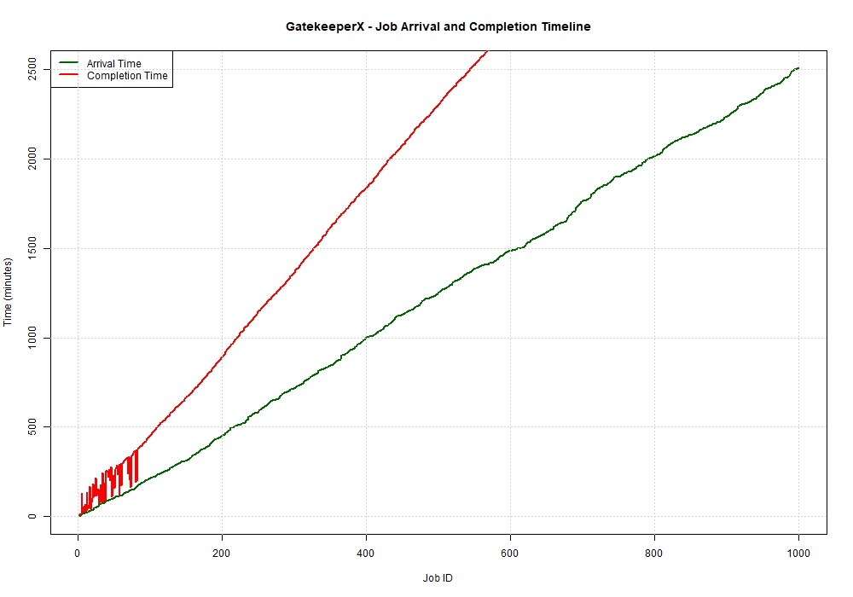
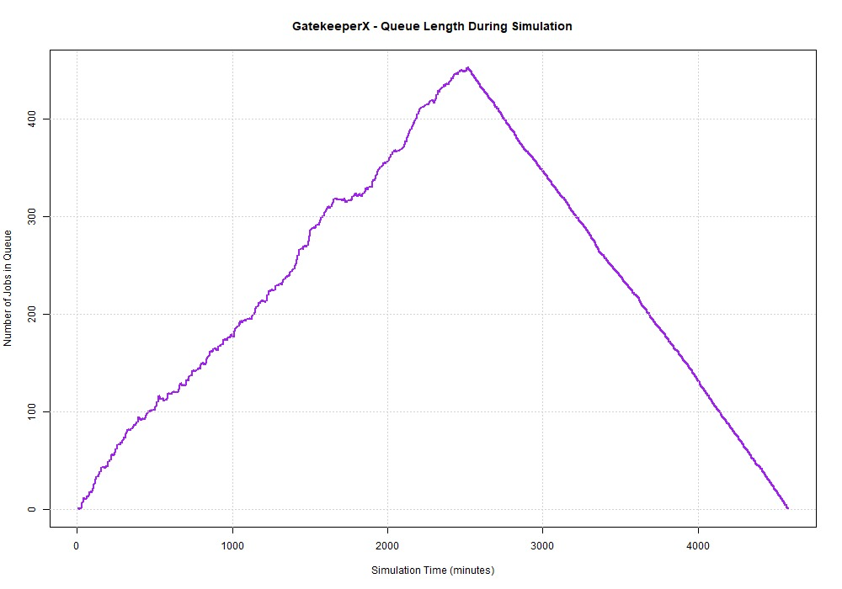
Simulation Results
sample iteration records
Iteration /Job | Job Id | Priority Class | Waiting Time | Turnaround Time | Status
1 | 1 | P2 - High | 0.00 | 5.61 | Completed
2 | 2 | P4 - Low | 5.38 | 7.55 | Completed
3 | 3 | P4 - Low | 5.61 | 8.32 | Completed
4 | 4 | P4 - Low | 6.61 | 10.39 | Completed
5 | 5 | P4 - Low | 112.72 | 116.89 | Completed
Observed Output: The simulation processed security jobs sequentially according to dynamic priority, with waiting time and turnaround time recorded for each completed job.

Slide 14
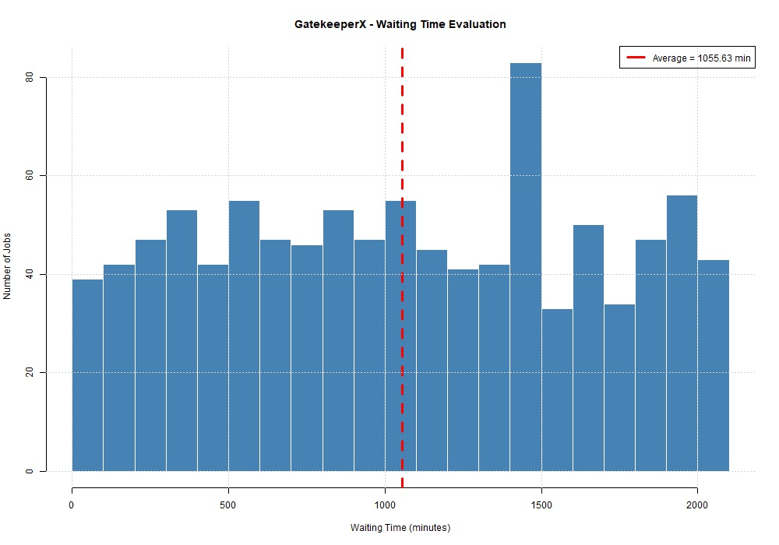
Statistical Summary
Metric | Value
Total Jobs | 1000
Total Simulation Time | 4580.52 min
Average Waiting Time | 1055.63 min
Minimum Waiting Time | 0 min
Maximum Waiting Time | 2068.21 min

Slide 15
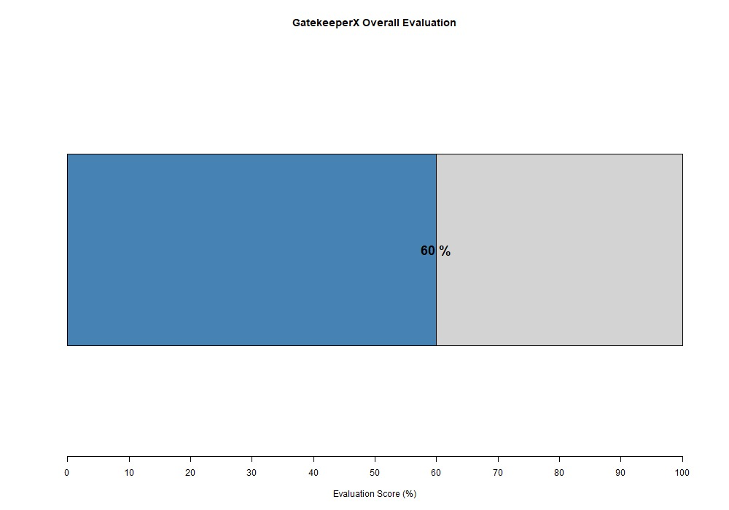
Stastitical evaluation
Evaluation Parameter | Result
Queue Stability | PASS
Average Waiting Time | NEED IMPROVEMENT
Average Turnaround time | NEED IMPROVEMENT
Critical Vulnerability Prioritization | PASS
Risk-priority alignment | PASS
Overall Evaluation: GatekeeperX successfully maintains queue stability, prioritizes critical vulnerabilities, and aligns processing with security risk. However, average waiting and turnaround times require further optimization.

Slide 16
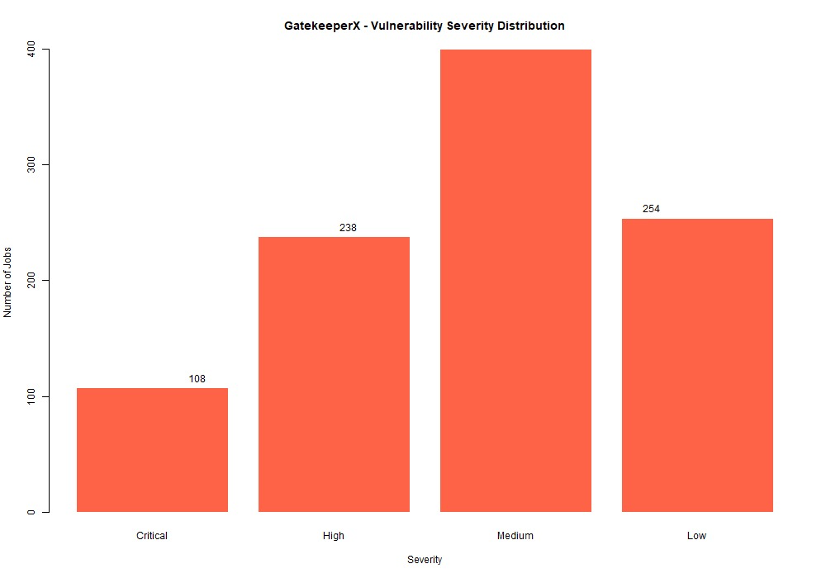
Discussion: Sample Dataset Analysis
Job ID | Severity | Risk Score | Vulnerabilities | Business Impact | Service Time
1 | Critical | 95 | 8 | 90 | 6.2
2 | High | 82 | 5 | 75 | 4.8
3 | Medium | 60 | 3 | 55 | 3.5
4 | Low | 35 | 1 | 30 | 2.1
5 | High | 78 | 6 | 80 | 5.0
The generated dataset represents diverse DevSecOps security jobs with different severity levels, risk scores, vulnerability counts, and processing requirements, providing realistic input for queue simulation.

Slide 17
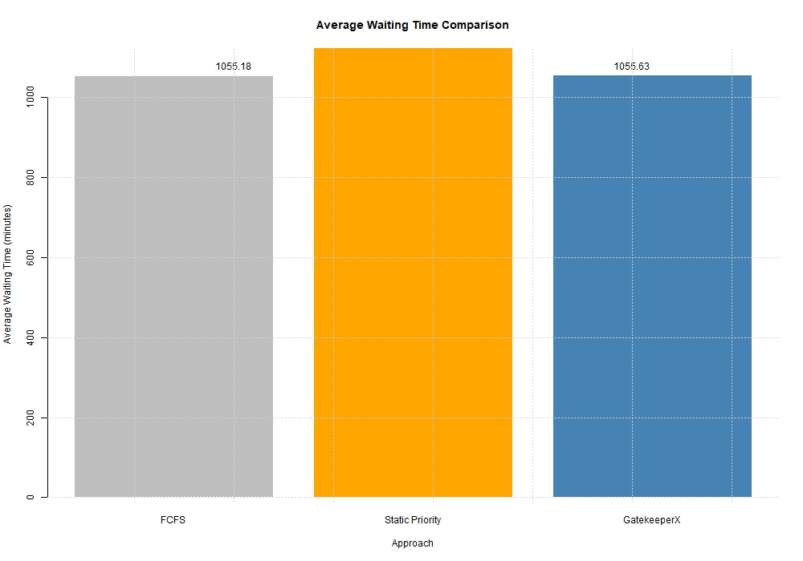
Discussion: Comparison with Existing Work
Model | Performance
FCFS | Baseline
Static Priority | Improved Prioritization
GatekeeperX | Dynamic Risk-based Processig
The comparison evaluates GatekeeperX against FCFS and Static Priority using the same security workload. The results demonstrate how dynamic aging and risk-based prioritization influence queue performance and fairness.

Slide 18
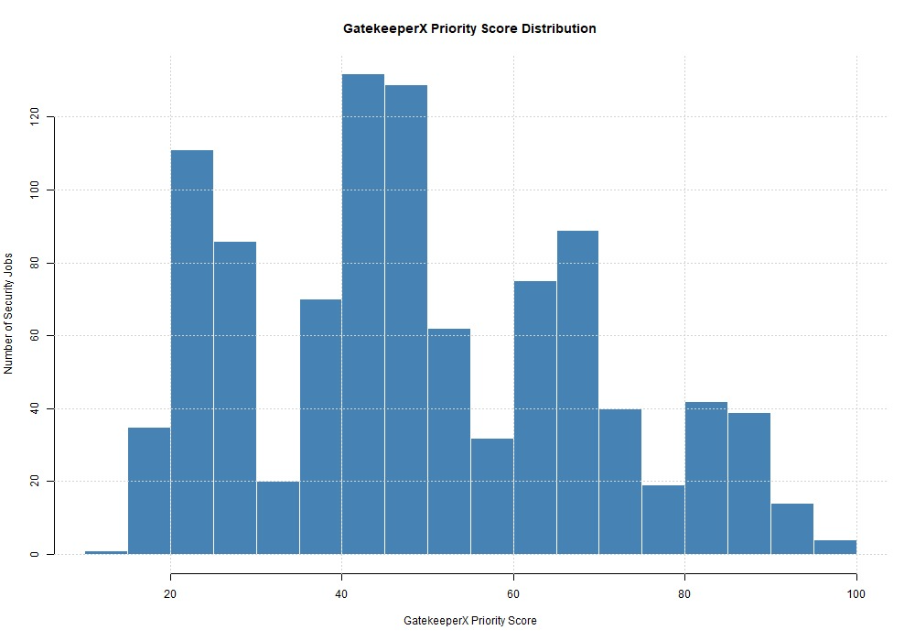
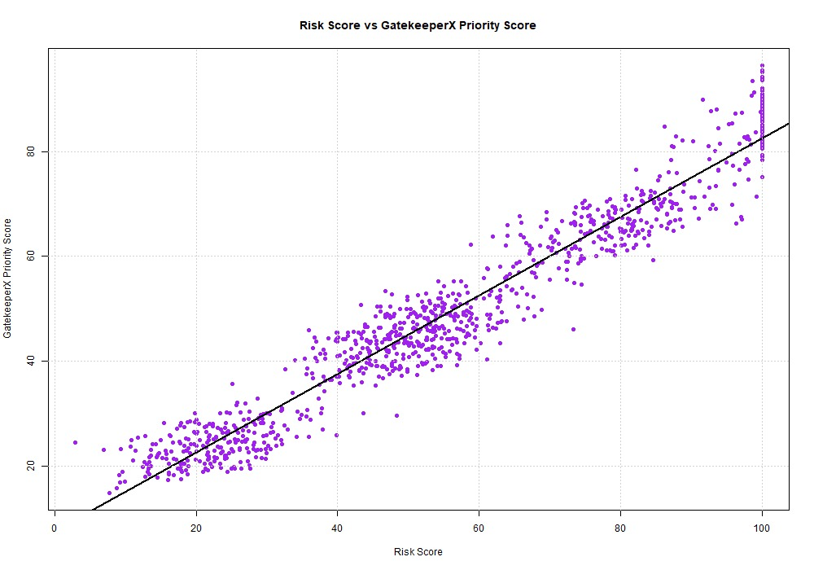
Discussion: Module 2 Modeling Analysis
Job ID | Initial Priority | Modeled Priority | Priority Class
1 | 48.76 | 64.76 | P1
2 | 36.54 | 48.76 | P2
3 | 30.12 | 53.39 | P3
4 | 74.06 | 27.6 | P4
5 | 27.6 | 18.74 | P5
Module 2 : Transforms raw security-job parameters into structured priority scores and classes, enabling GatekeeperX to select jobs based on security risk and dynamically improve fairness through aging.

Slide 19
Conclusion
GatekeeperX demonstrates an intelligent queueing approach for managing DevSecOps security gate tasks effectively.
The system generates realistic security-job data and models each task using risk, severity, vulnerability, and business-impact parameters.
Dynamic priority and aging mechanisms enable important security tasks to receive appropriate processing attention while reducing task starvation.
The queueing simulation measures key performance indicators such as waiting time, turnaround time, queue length, throughput, and utilization.
Statistical evaluation provides a structured assessment of the overall behavior and performance of the proposed system.
Comparison with FCFS and Static Priority approaches highlights the impact of risk-based and dynamic queue management.
The results show that GatekeeperX provides a practical framework for improving security-task prioritization and decision-making in DevSecOps pipelines.
Overall, the proposed system supports a more intelligent, fair, and security-aware approach to managing software delivery security gates.

Slide 20
Future Scope
1. Real-Time DevSecOps Integration: Integrate GatekeeperX with live CI/CD pipelines to process real security scan results in real time.
2. AI-Based Adaptive Prioritization: Apply machine learning to automatically adjust priority weights based on historical security incidents and pipeline behavior.
3. Cloud-Scale Queue Management: Extend the system to support distributed and cloud-based DevSecOps environments with multiple security gates and large workloads.

Slide 21
ACKNOWLEDGEMENT
I would like to express my sincere gratitude to my guide and faculty members for their valuable guidance, support, and encouragement throughout the development of this project. I also thank my institution for providing the necessary resources and learning environment to complete this work successfully. Finally, I am grateful to my family and friends for their constant motivation and support during the completion of this project.

Slide 22
REFERENCES
[1] M. Souppaya, K. Scarfone, and D. Dodson, Secure Software Development Framework (SSDF) Version 1.1: Recommendations for Mitigating the Risk of Software Vulnerabilities, NIST SP 800-218, Feb. 2022. ([NIST Computer Security Resource Center][1])
[2] National Institute of Standards and Technology, Secure Software Development, Security, and Operations (DevSecOps) Practices*, NIST NCCoE, 2026. ([NCCoE][2])
[3] OWASP Foundation, OWASP Developer Guide: DevSecOps Guideline, 2023. ([OWASP][3])
[4] H. Booth, M. Ogata, K. Kent, M. Souppaya, and D. Dodson, Secure Software Development Framework (SSDF) Version 1.2, NIST SP 800-218 Rev. 1, Initial Public Draft, Dec. 2025. ([NIST Computer Security Resource Center][4])
[5] H. Booth, M. Souppaya, A. Vassilev, M. Ogata, M. Stanley, and K. Scarfone, Secure Software Development Practices for Generative AI and Dual-Use Foundation Models, NIST SP 800-218A, Jul. 2024. ([NIST Computer Security Resource Center][5])
[6] M. P. S. Reddy and S. K. Reddy, “Comparison of CPU Scheduling Algorithms: FCFS, SJF, SRTF, Round Robin, Priority Based, and Multilevel Queuing,” in Proc. IEEE R10 Humanitarian Technology Conf., 2022. ([DOI][6])

Slide 23
REFERENCES
[7] NIST, “Secure Software Development Framework,” *Computer Security Resource Center*, 2026. ([NIST Computer Security Resource Center][7])
[8] NIST, “NIST Updates the Secure Software Development Framework (SSDF),” Feb. 2022. ([NIST Computer Security Resource Center][8])
[9] H. Booth, “Secure Software Development Framework Update and DevSecOps Project,” NIST CSRC Presentation, Jan. 2026. ([NIST Computer Security Resource Center][9])“
[10] M. Ogata, “Secure Software Development Framework Update and DevSecOps Project,” NIST CSRC Presentation, May 2026. ([NIST Computer Security Resource Center][10])
[11] L. Kleinrock, Queueing Systems, Volume 1: Theory. New York, NY, USA: Wiley, 1975.
[12] D. Gross, J. F. Shortle, J. M. Thompson, and C. M. Harris, Fundamentals of Queueing Theory, 5th ed. Hoboken, NJ, USA: Wiley, 2018.
[13] L. Kleinrock, Queueing Systems, Volume 2: Computer Applications. New York, NY, USA: Wiley, 1976.
[14] J. Banks, J. S. Carson II, B. L. Nelson, and D. M. Nicol, Discrete-Event System Simulation, 5th ed. Upper Saddle River, NJ, USA: Pearson, 2010
[15] A. M. Law, Simulation Modeling and Analysis, 5th ed. New York, NY, USA: McGraw-Hill Education, 2015.

Slide 24
The End

