Slide 1

COMPARISON OF STRONG AND WEAK ENTITIES IN ER MODELING
NAME : HEMANTH R
REG NO: 1925212327
COURSE : DATABASE MANAGEMENT
Technical Presentation

Slide 2
Introduction
Entity-Relationship (ER) modeling is used to design and represent the structure of a database. Entities are real-world objects or concepts, such as a Student, Employee, or Course.
ER modeling classifies entities into Strong Entities and Weak Entities based on their ability to exist independently.
Understanding the difference between strong and weak entities helps in creating accurate and efficient database designs.
This presentation compares Strong and Weak Entities with their characteristics, differences, and real-world examples.

Slide 3
CORE TECHNICAL EXPLANATION
Strong Entity: A strong entity has its own primary key and can exist independently in a database. Example: Student (Student_ID, Name, Department)
Weak Entity: A weak entity does not have a primary key of its own and depends on a strong entity for identification.
It is identified using a partial key along with the primary key of the owner entity. Example: Dependent (Dependent_Name, Age) depends on Employee (Employee_ID).
Relationship: A weak entity is connected to its owner through an identifying relationship, which ensures the weak entity cannot exist without the strong entity.
ER Diagram Representation: Strong Entity → Single Rectangle
Weak Entity → Double Rectangle
Identifying Relationship → Double Diamond
Partial Key → Dashed Underline
Database Implementation: In relational databases, the primary key of the strong entity becomes a foreign key in the weak entity, and together with the partial key, it forms the composite primary key of the weak entity.

Slide 4
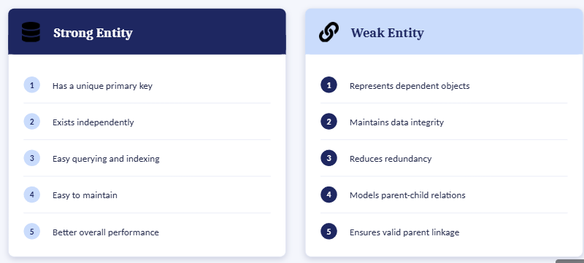
Benefits of Strong and weak entity

Slide 5
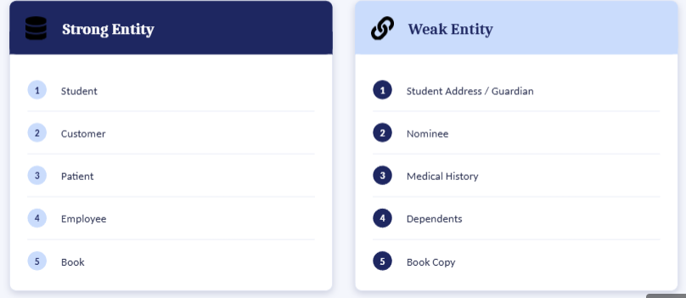
Real World Applications

Slide 6
Conclusion and Key Takeaways
Strong entities have their own primary key and can exist independently, while weak entities depend on strong entities for identification and existence.
Strong entities represent the main objects in a database, whereas weak entities represent dependent or related objects.
Weak entities use a composite key formed by combining the owner's primary key with a partial key.
Using both strong and weak entities improves data integrity, reduces redundancy, and accurately models real-world relationships.
Choosing the appropriate entity type leads to a well-structured, efficient, and reliable database design

Slide 7
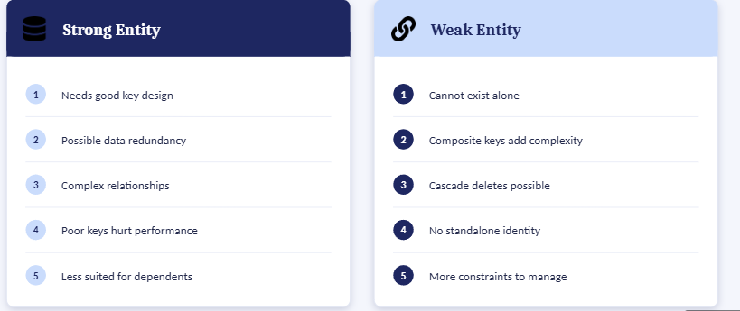
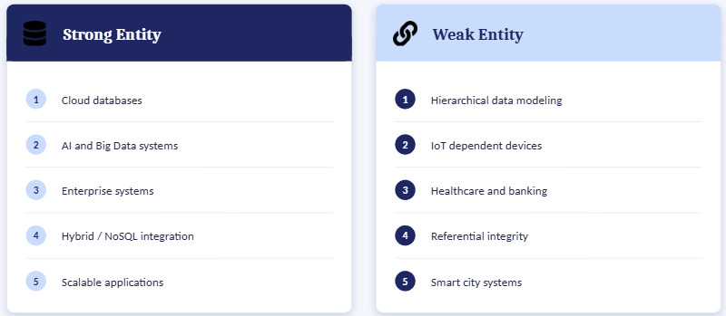
Limitations Future Scope

Slide 8



