Slide 1


CSA1105 • OBJECT ORIENTED ANALYSIS AND DESIGN • TECHNICAL PRESENTATION
Modular Design in a
Hospital Management System
Re-engineering a tightly coupled system with object-oriented principles to improve maintainability, scalability, and reusability.
PRESENTED BY
Tanushri(192521180)
Nithya D(192511376)
Rashmi Naurene(1192521357)
Darshinie(192520033)
TEAM LEADER
RESEARCHER
DESIGNER
PRESENTER
Notes:
[TEAM LEADER opens] Good morning/afternoon everyone. Our topic today is Modular Design in a Hospital Management System — how we took a system with tightly coupled modules and frequent maintenance issues, and redesigned it using object-oriented principles. Quick introductions: I'm [Name], the team leader. With me are [Name] as our researcher, [Name] as our designer, and [Name] as our presenter for the results. Each of us will walk you through one part of this story.

Slide 2
OUR TEAM
Meet the Team & Roles
Four roles, one shared goal — a clear, well-researched, confidently delivered presentation.
★
?
✎
▶
Team Leader
Researcher
Designer
Presenter
Tanushri
Nithya D
Rashmi Naurene
Darshinie
Coordinates the group, keeps the timeline on track, opens and closes the presentation, and makes sure every section connects into one coherent story.
Investigates the real problems tightly-coupled hospital systems face, gathers supporting evidence, and owns the Problem Statement section.
Designs the object-oriented redesign, builds the class diagram, and explains the Methodology / Approach section.
Delivers the Results & Findings section, drives audience engagement, and leads the Q&A response.
Notes:
[TEAM LEADER] Before we get into the content, a quick word on how we split the work — because a good technical presentation is also a well-run project. As leader I coordinated the timeline and tie the sections together. Our researcher dug into what actually goes wrong in tightly coupled hospital systems. Our designer worked out the object-oriented redesign and built the class diagram you'll see shortly. And our presenter takes you through the results and will lead the Q&A. Equal parts, equal airtime.

Slide 3
PURPOSE
What You'll Learn & Why We're Here
WHAT THE AUDIENCE WILL LEARN
OUR GOALS FOR THIS TALK
Why tightly coupled modules quietly become a hospital system's biggest maintenance risk.
How class, encapsulation, inheritance, and association translate a fragile design into independent modules.
A concrete before/after view of maintainability, scalability, and reusability.
How to judge whether a redesign decision is actually paying off, not just theoretically "cleaner."
Explain the redesign clearly enough that a non-OOP audience can follow the reasoning, not just the jargon.
Back every claim with a concrete example from the hospital scenario, not abstract theory alone.
Give every team member equal, meaningful speaking time.
Leave time for genuine questions — and answer them with evidence, not guesses.
Notes:
[TEAM LEADER] So what should you walk away with? By the end of this talk you should understand why tightly coupled code is dangerous specifically in a hospital context, and how four familiar OOP concepts — class, encapsulation, inheritance, association — directly fix that. On our side, our goal isn't just to define these terms, it's to show you exactly where they apply in a real scenario, and to back every claim with a concrete example rather than just theory.

Slide 4
ROADMAP
Agenda
01
Introduction
What a Hospital Management System does, and why its software architecture matters.
02
Problem Statement
The real cost of tightly coupled modules and frequent maintenance breakage.
03
Methodology / Approach
Redesigning the system using OOP: classes, encapsulation, inheritance, association.
04
Results / Findings
Before vs. after: maintainability, scalability, and reusability compared.
05
Conclusion
Key takeaways and what this means beyond this one system.
Notes:
[TEAM LEADER] Here's how we'll move through it: I'll open with a short introduction to what a Hospital Management System actually does. Our researcher then lays out the problem in concrete terms. Our designer walks through the redesign and the architecture. Our presenter brings you the results comparing before and after. And I'll close with the key takeaways. Roughly two to three minutes per section, then we'll open the floor to questions.

Slide 5
01 · INTRODUCTION
What Is a Hospital Management System?
A Hospital Management System (HMS) is the software backbone behind patient registration, appointment scheduling, billing, pharmacy dispensing, and medical records. Unlike most business software, it carries a distinct pressure: downtime or a bad update can delay real patient care, not just a sale.
CORE MODULES OF AN HMS
⚕
📅
That pressure is exactly why software architecture is not a back-office concern here — it is a patient-safety concern. A system built as one large, tangled block of code is much harder to change safely than one built from independent, well-defined modules.
Patient
Registration
Appointment
Scheduling
₹
⊕
That is the story of this presentation: a hospital system that grew into a tightly coupled monolith, and how object-oriented design principles were used to pull it apart into something safer to maintain.
Billing &
Insurance
Pharmacy
Dispensing
Notes:
[MEMBER 1 — INTRODUCTION] A Hospital Management System is the software running underneath almost everything a hospital does day to day: registering patients, scheduling appointments, billing and insurance, dispensing medication, and keeping medical records. What makes this different from, say, an e-commerce platform is the stakes. If an online store goes down for an hour, someone waits to buy a product. If a hospital system goes down, or a bad update corrupts a medication record, that can directly delay patient care. That's why we treat software architecture here as a patient-safety issue, not just a technical preference. A system built as one large tangled block of code is inherently harder to change safely than one built from clear, independent modules. That's exactly the story we're about to walk you through: a hospital system that grew into a tightly coupled monolith over time, and how we redesigned it using object-oriented principles.

Slide 6
02 · PROBLEM STATEMENT
When Everything Is Wired to Everything Else
In the existing HMS, Billing reaches directly into Patient Registration's internal fields. Pharmacy depends on Appointment Scheduling code to run. There is no clear boundary between modules.
!
One Change, Many Breakages
⏳
Slow, Risky Releases
A tax-rate fix in Billing silently breaks Appointment Scheduling, because both modules share the same unguarded internal variables.
Every deployment requires re-testing the entire system, since no one can be certain which modules a change actually touches.
⚠
"Fragile Code" Syndrome
✖
Compliance & Audit Risk
Developers become afraid to touch working code, because the smallest edit can ripple into unrelated, untested corners of the system.
Untraceable dependencies make it hard to prove which module accessed or modified sensitive patient data — a real regulatory liability.
Notes:
[MEMBER 2 — PROBLEM STATEMENT] Here's what tightly coupled actually looks like in this system, concretely. The Billing module doesn't go through any defined interface to read a patient's insurance details — it reaches straight into Patient Registration's internal variables. Pharmacy's dispensing logic depends on internal code from Appointment Scheduling, even though the two shouldn't logically need each other at all. The result is four real problems. First, one change breaks many things — a simple tax-rate fix in Billing can silently break Appointment Scheduling, because they share unguarded internal state. Second, releases become slow and risky, because nobody can say with confidence which modules a given change actually touches, so the whole system needs re-testing every time. Third, developers develop what we call fragile code syndrome — they become afraid to touch working code because even a small edit can ripple into unrelated corners of the system. And fourth, this creates real compliance risk: in a regulated healthcare environment, you need to be able to prove which module touched sensitive patient data, and tangled dependencies make that nearly impossible to trace.

Slide 7
03 · APPROACH
Redesigning With Object-Oriented Principles
Instead of one shared block of logic, each hospital concern becomes its own class — with its own data, its own rules, and a clearly defined public interface.
C
E
I
A
Independent Classes
Encapsulation
Inheritance
Association, Not Access
Patient, Appointment, Billing, and Pharmacy each become self-contained classes with their own attributes and methods — no more reaching into each other's internals.
Sensitive fields (balances, medical history) are made private. Other modules interact only through defined public methods, which can validate every request.
A shared StaffMember class holds common attributes; Doctor, Nurse, and Pharmacist inherit from it instead of duplicating the same fields three times.
Where one module needs another (Billing needs a Patient), it holds a reference to that object's public interface — never its raw internal data.
Notes:
[MEMBER 3 — METHODOLOGY, PART 1] To fix this, we applied four core object-oriented principles. First, independent classes: Patient, Appointment, Billing, and Pharmacy each become self-contained classes with their own attributes and their own methods — no module reaches into another's internals anymore. Second, encapsulation: sensitive fields like account balances and medical history are made private, and any other module that needs them has to go through a defined public method, which can validate the request instead of blindly allowing it. Third, inheritance: instead of copying the same staff fields into Doctor, Nurse, and Pharmacist separately, we introduce a shared StaffMember class that holds common attributes like name and staff ID, and the three role classes inherit from it. Fourth, association instead of direct access: when Billing needs data from Patient, it holds a reference to that Patient object and calls its public interface — it never touches Patient's raw internal fields directly. Together, these four principles are what turn a tangled system into a set of modules with clear, enforceable boundaries.

Slide 8
03 · APPROACH
Class Hierarchy — Who Inherits What
△ Solid triangle = inheritance (“is-a”). Attributes shown as − (private) or + (public); operations as +().
«abstract»
Person
− name
− age
− contactNumber
+ updateContact()
▲
▲
Patient
«abstract»
StaffMember
− patientId
− medicalHistory (private)
− bloodGroup
+ viewRecords()
− staffId
− department
+ login()
▲
▲
▲
Doctor
Nurse
Pharmacist
− specialization
− licenseNo
+ diagnose()
− shift
− wardAssigned
+ recordVitals()
− licenseNo
+ dispense()
Notes:
[MEMBER 3 — METHODOLOGY, PART 2] Let's start with the inheritance side of the redesign. At the top, Person is an abstract class — it's never instantiated directly, it only exists to hold what every person in the system has in common: a name, an age, a contact number. Patient inherits from Person and adds what's specific to being a patient: a private medical history and blood group, plus a method to view records. On the other branch, StaffMember also inherits from Person, and is itself abstract — it holds a staff ID, a department, and a login method common to every staff role. Doctor, Nurse, and Pharmacist all inherit from StaffMember, and each adds only what's specific to that role: a doctor's specialization, a nurse's shift and ward assignment, a pharmacist's license number. The solid triangle arrows are the standard UML notation for inheritance, always pointing up toward the parent class. This is what lets us write shared logic exactly once, at the right level, instead of duplicating it three or four times.

Slide 9
03 · APPROACH
How the Modules Connect
Ward
Patient
Doctor
KEY
− roomNumber
+ admit()
admits
− medicalHistory
+ viewRecords()
− specialization
+ diagnose()
Association
◆
Composition ◆
books
authors
owns
writes
Aggregation ◇
receives
conducts
Inheritance △
MedicalRecord
Appointment
Prescription
− diagnosis
− date
− dateTime
− status
− dosage
+ issue()
billed to
◇
references
generates
Billing
Medicine
− amount (private)
+ generateInvoice()
− stock (private)
+ dispense()
Notes:
[MEMBER 3 — METHODOLOGY, PART 3] This is the fuller picture — how these classes are actually wired together, using proper UML relationship types instead of just generic lines. Most of these are plain associations, shown in grey and labeled with the verb that describes the link: a Patient books an Appointment, a Doctor conducts an Appointment, a Doctor writes a Prescription that a Patient receives. Two relationships are more specific. Patient to MedicalRecord is composition, shown with the dark filled-diamond marker at the Patient end — a medical record has no independent existence outside its patient, so if the patient record is deleted, its medical records go with it. Prescription to Medicine is aggregation, shown with the teal open-diamond marker at the Prescription end — a prescription references medicines from the pharmacy's stock, but those medicines exist independently in inventory whether or not this particular prescription exists. Billing pulls from both Patient and Appointment, and Ward admits Patients as a separate association. The reason this looks more elaborate than a single tangled blob is that every one of these lines is a deliberate, typed, bounded relationship — which is exactly the opposite of the uncontrolled coupling we started with.

Slide 10
04 · RESULTS & FINDINGS
Before vs. After the Redesign
Illustrative comparison based on the redesign applied to this system's module boundaries.
ASPECT
BEFORE — TIGHTLY COUPLED
AFTER — MODULAR OOP DESIGN
Maintainability
A billing-rule change risked touching code in 3–4 unrelated modules, since fields were shared directly.
The same change is isolated to the Billing class — other modules are untouched because they only depend on its public interface.
Scalability
Adding a new service (e.g., Telemedicine) meant editing shared logic and re-testing the whole system.
A new module can be added as a new class that talks to existing ones through defined interfaces, without touching their internals.
Reusability
Common staff logic (login, contact info) was copy-pasted separately into Doctor, Nurse, and Pharmacist code.
That logic lives once in StaffMember and is inherited — written once, reused by every staff subclass.
Notes:
[MEMBER 4 — RESULTS & FINDINGS] Let's look at what this redesign actually changes, across the three qualities the assignment asks us to evaluate. On maintainability: before, a billing-rule change risked touching three or four unrelated modules because fields were shared directly; after the redesign, that same change is isolated to the Billing class alone, because every other module only ever depended on its public interface, not its internals. On scalability: before, adding a new service like telemedicine meant editing shared logic and re-testing the whole system end to end; after, a new module can be added as a new class that talks to the existing ones purely through defined interfaces, without needing to touch what already works. And on reusability: before, common staff logic like login and contact details was copy-pasted separately into the Doctor, Nurse, and Pharmacist code; after, that logic exists once, in StaffMember, and every subclass inherits it. To be clear, we're presenting this as an illustrative before-and-after based on the redesign we applied — not as measured production statistics — but the pattern holds up logically in every case: fewer files touched per change, safer scaling, and no duplicated logic.

Slide 11
05 · CONCLUSION
From Tangled to Modular
The core problem was never a single bug — it was a structure that let every module reach into every other module.
Applying encapsulation, inheritance, and association turned that structure into independent, testable, safely-changeable classes.
The payoff shows up directly in maintainability, scalability, and reusability — not as abstract OOP theory, but as fewer files touched per change and less duplicated code.
The bigger lesson: in a system where downtime affects patient care, disciplined object-oriented design is a safety measure, not just good engineering practice.
Notes:
[MEMBER 1 — CONCLUSION] To bring this together: the core problem was never one single bug — it was a structure that let every module reach freely into every other module, so a fix anywhere could break something anywhere else. What we did was apply four familiar OOP concepts — class, encapsulation, inheritance, and association — as the actual mechanism to enforce boundaries between Patient, Appointment, Billing, Pharmacy, and the staff hierarchy. And the payoff isn't abstract: it shows up as fewer files touched per change, safer scaling when new modules are added, and no duplicated staff logic. The bigger point we want to leave you with is this — in a system where downtime or a bad update can delay patient care, disciplined object-oriented design isn't just good engineering practice, it's a patient-safety measure. Thank you — we're happy to take your questions.

Slide 12
Thank You
Modular Design in a Hospital Management System · CSA11 — Object Oriented Analysis and Design

Slide 13
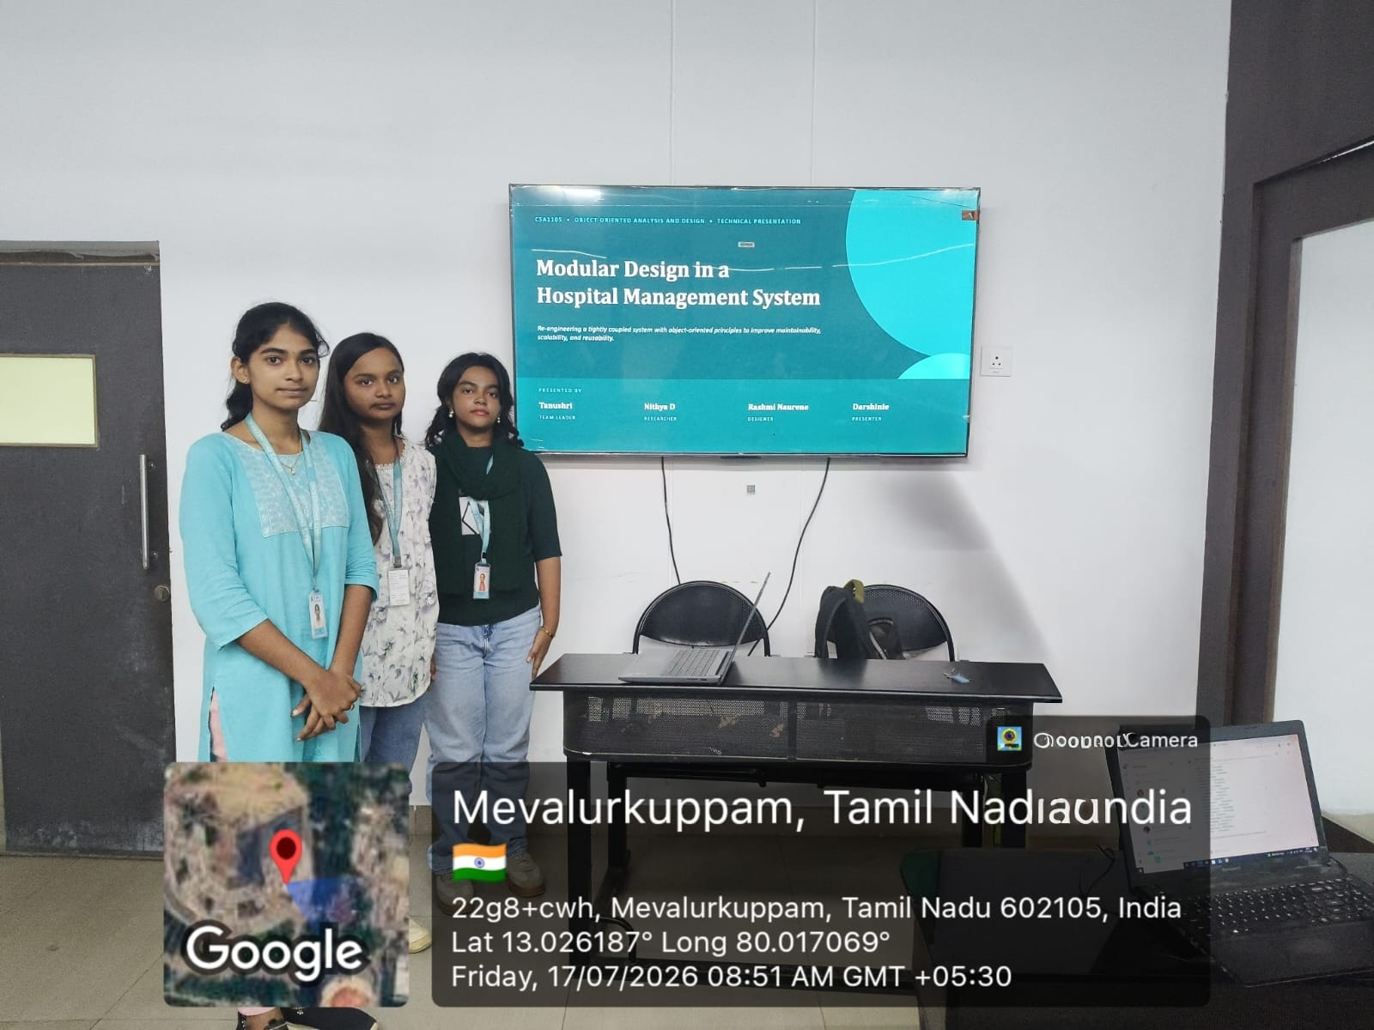
Notes:
[MEMBER 1 — CONCLUSION] To bring this together: the core problem was never one single bug — it was a structure that let every module reach freely into every other module, so a fix anywhere could break something anywhere else. What we did was apply four familiar OOP concepts — class, encapsulation, inheritance, and association — as the actual mechanism to enforce boundaries between Patient, Appointment, Billing, Pharmacy, and the staff hierarchy. And the payoff isn't abstract: it shows up as fewer files touched per change, safer scaling when new modules are added, and no duplicated staff logic. The bigger point we want to leave you with is this — in a system where downtime or a bad update can delay patient care, disciplined object-oriented design isn't just good engineering practice, it's a patient-safety measure. Thank you — we're happy to take your questions.

