Slide 1

ITA 0515 TECHNICAL PRESENTATION
DIGITAL SIGNAL PROCESSING
SAMPLING AND QUANTIZATION: A PROBLEM-DRIVEN EXPLANATION
SUPERVISED BY
DR.CARMEL MARY BELINDA
BY
MOHANARANGAN.S(192511439)
GOKUL RAJ M (192521494)
DILLI BABU N (192521491)

Slide 2


The Problem
Why Can't Computers Use Real-World Signals Directly?
Real-world signals (sound, light, temperature) are continuous in both time and amplitude.
The Challenge
Computers can only store and process finite, discrete numbers.
A continuous signal has infinite points in time and infinite possible values.
The Two-Step Solution
Sampling — discretize the time axis.
Quantization — discretize the amplitude axis.
Get either step wrong, and the digital copy no longer represents the original signal faithfully.

Slide 3
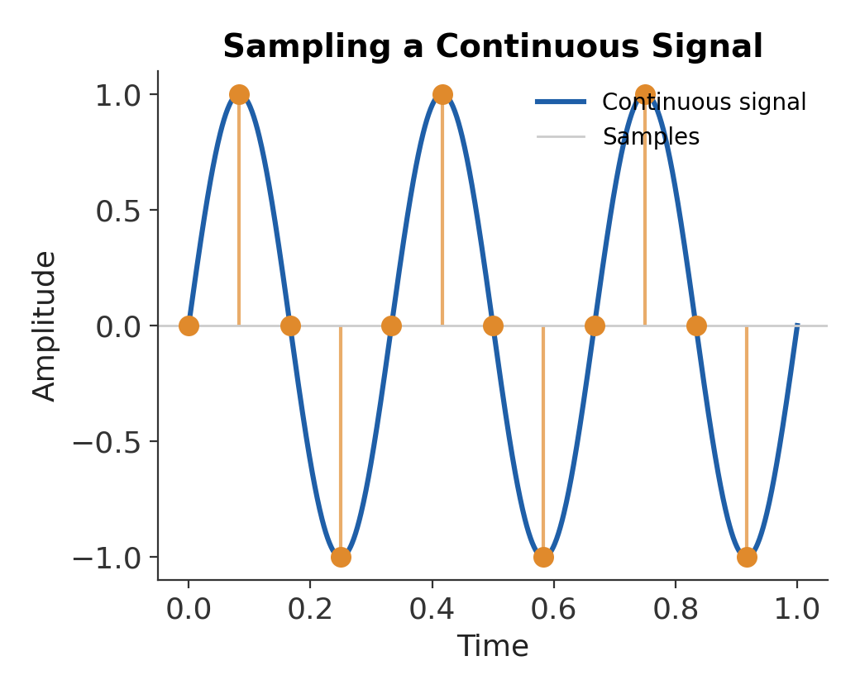
What is Sampling?
Sampling measures the value of a continuous signal at regular time intervals.
Key Points
Sampling rate (fs) is the number of samples taken per second.
The Nyquist rule: fs must be at least 2 times the highest signal frequency.
Correct sampling preserves the shape of the original signal.
Applications
Audio Recording
Digital Cameras
Medical Imaging (ECG, MRI)
Communication Systems

Slide 4
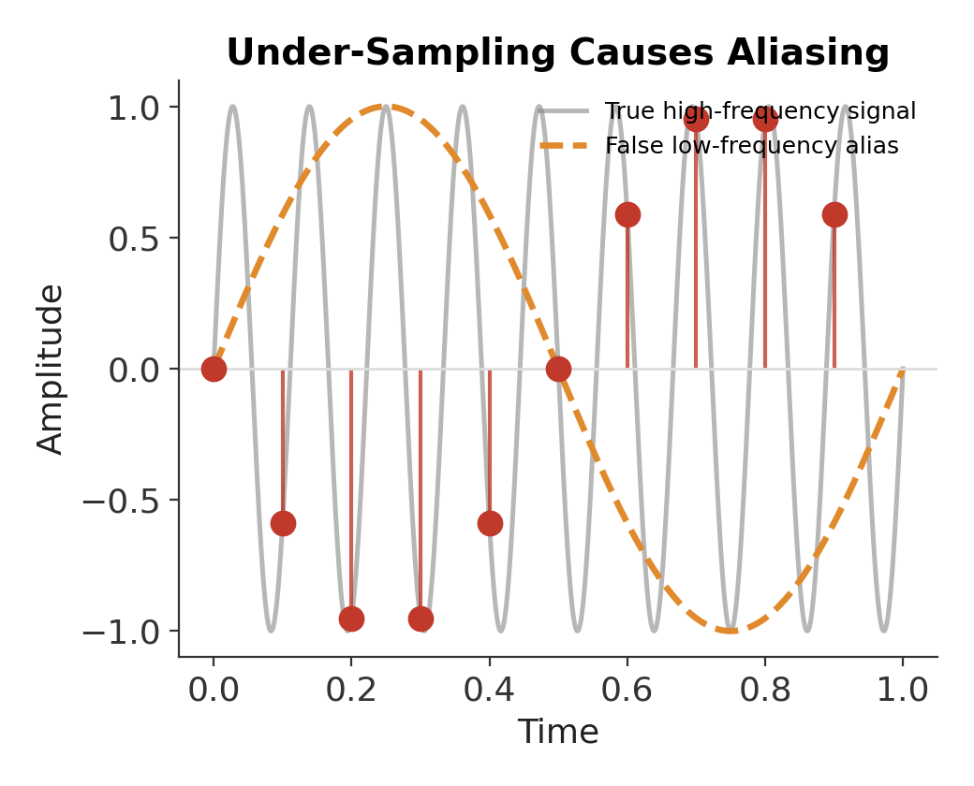
Under-Sampling and Aliasing
What Happens Below the Nyquist Rate?
Under-sampling occurs when fs is too low for the signal's frequency.
Why it Happens
Too few samples are taken per cycle.
Different frequencies can produce identical samples.
A high-frequency signal is mistaken for a low-frequency one.
Real-World Effects
Jagged, wagon-wheel motion in video
False low tones in digital audio
Fix
Sample above the Nyquist rate
Use an anti-aliasing filter before sampling

Slide 5
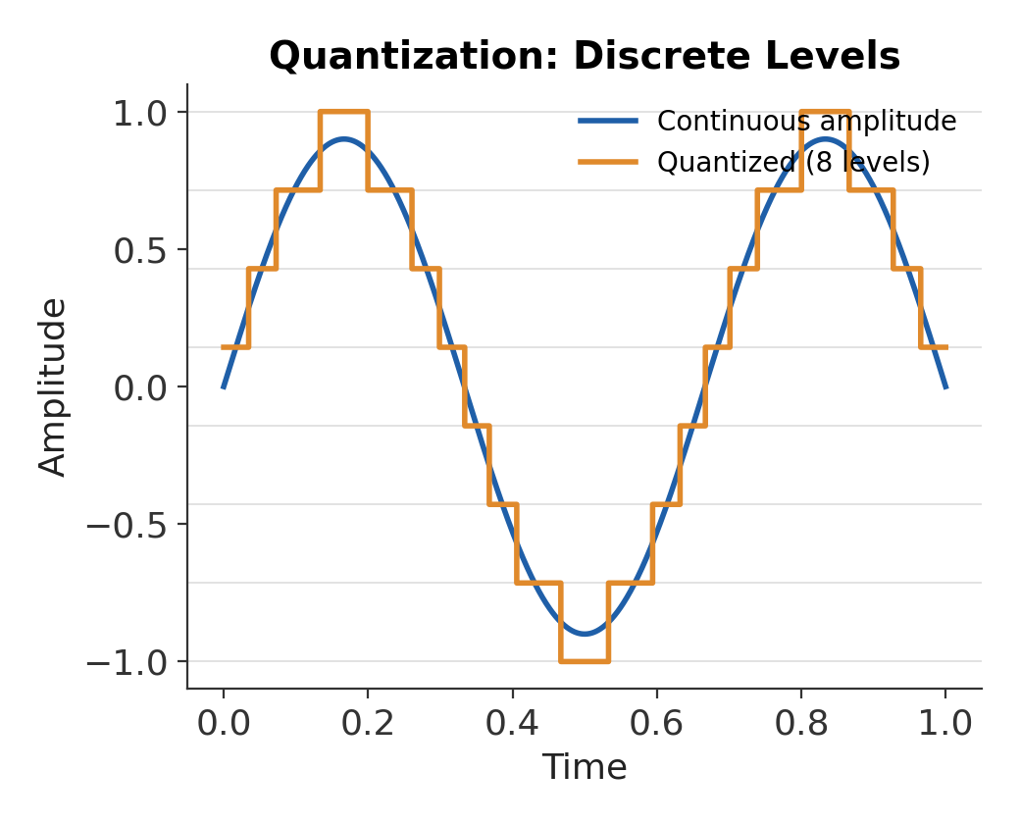
What is Quantization?
Quantization
Quantization rounds each sampled amplitude to the nearest fixed level.
Features
More levels give finer precision.
Levels are set by bit depth (n bits give 2^n levels).
The rounding always introduces a small quantization error.
Example
8-bit audio:
256 possible amplitude levels.
16-bit gives 65536 levels — CD quality.

Slide 6
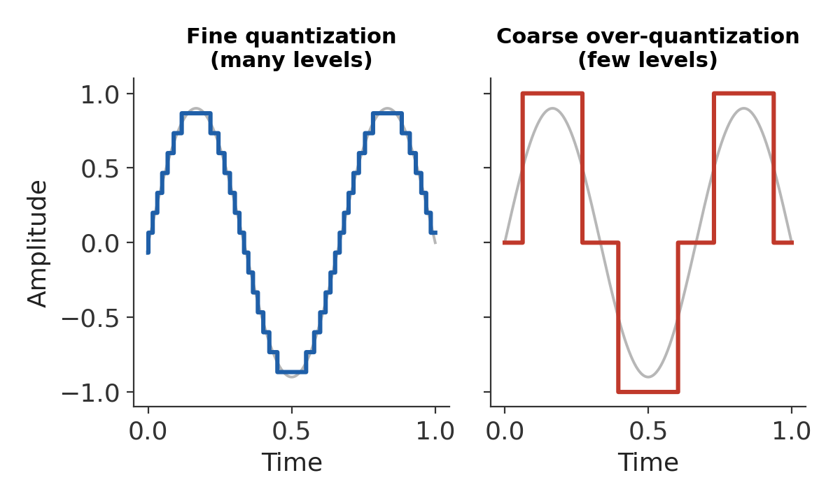
Over-Quantization Effects
Too Few Levels
Over-quantization means using too few levels to represent the signal.
Problems
Coarse quantization
Visible steps ("banding") appear.
Large quantization error
Signal detail is permanently lost.
Increased noise
Audio sounds harsh or grainy.
Solution
Increase bit depth
Use dithering to mask banding
Match levels to the application's needs

Slide 7
Sampling vs. Quantization
Two Independent Trade-offs
Both steps convert a continuous signal into digital data, but they act on different axes.
Sampling
Discretizes the time axis; too little causes aliasing.
Quantization
Discretizes the amplitude axis; too few levels causes banding.
The Common Thread
Both trade signal fidelity for storage and processing efficiency.
Choosing the right rate and levels is a design decision, not a default.

Slide 8
CONCLUSION
Digitizing a signal always requires two steps.
Sampling captures the signal in time.
Quantization captures the signal in amplitude.
Under-sampling produces aliasing and false frequencies.
Over-quantization produces banding and lost detail.
Choosing the right sampling rate and bit depth is essential in audio, imaging, and communication systems.

