Slide 1

Real-Time Emotion Detection Systems
CSA 1710 – ARTIFICIAL INTELLIGENCE
TECHNICAL PRESENTATION
SUPERVISED BY
DR. B. NAGARAJAN
PRESENTED BY
R. AKSHAYA(192524118)

Slide 2

What is Real-Time Emotion Detection?
An AI system that automatically identifies human emotions by analyzing facial expressions, voice, or behavioral signals as they occur — detection happens in real-time during active interaction, not after the fact.
Core Emotions Detected
😀 Happy
Positive engagement and satisfaction
The Flow in Action
😢 Sad
Disappointment or distress
😠 Angry
Frustration or hostility
😨 Fear
Anxiety or concern
Camera Capture
Identify Emotion
Trigger Response
😲 Surprise
AI Analysis
Unexpected reactions
😐 Neutral
Baseline or no strong emotion

Slide 3

How Real-Time Emotion Detection Works
Core Technologies
Computer Vision
Image analysis and interpretation
CNN
Convolutional Neural Networks for pattern recognition in images
Deep Learning
Training models on large emotion datasets
Input
Face Detection
Preprocessing
Feature Extraction
Classification
OpenCV
Real-time video processing
Machine Learning
Continuous model improvement

Slide 4
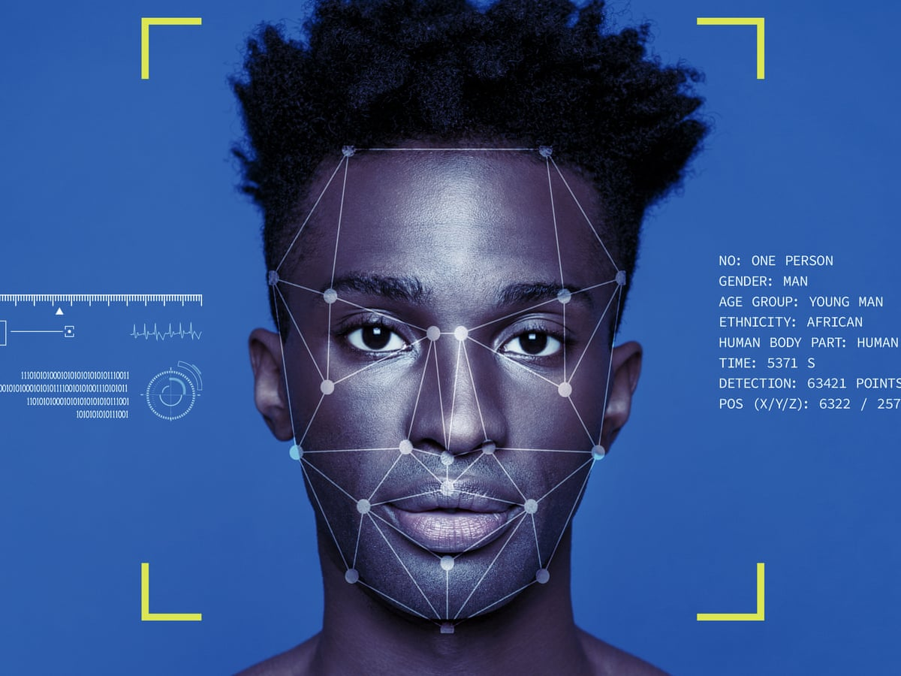

The AI Agent Framework
Emotion detection systems operate as intelligent agents that perceive their environment and respond autonomously:
Perceive
Camera receives and streams facial information continuously
Analyze
AI processes facial features and compares them to learned emotion patterns
Decide
Model determines the most likely emotion with a confidence score
Act
System responds — adapting content, triggering alerts, or logging data
Real-World Example: An adaptive learning platform detects a student's confusion or disengagement and automatically pauses the lesson, offers a simpler explanation, or suggests a break — all without human intervention.

Slide 5






Real-Time Applications Across Industries
🎓 Education
🤖 Human–Computer Interaction
🛍️ Retail & Marketing
🎮 Gaming
Monitor learner engagement, identify confusion, and adapt teaching pace in real-time
Measure authentic customer reactions to products, packaging, or advertisements
Adjust difficulty, pacing, or narrative based on player emotional state
Enable AI assistants to respond to user frustration or confusion with empathy
🚗 Driver Monitoring
🏥 Healthcare & Research
Detect distraction, drowsiness, or stress to prevent accidents
Support clinical analysis of emotional and behavioral responses to treatment

Slide 6
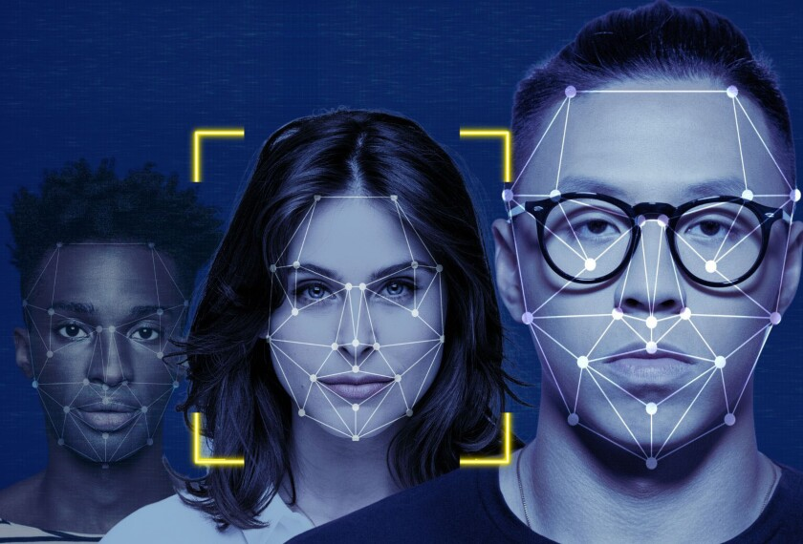
Benefits of Real-Time Emotion Detection
⚡ Speed
Instant analysis without manual observation or delays
🎯 Personalization
Systems adapt interactions based on individual emotional state
📈 Scalability
One system can monitor multiple people simultaneously
⚖️ Objectivity
Reduces bias from subjective human judgment
🔔 Actionability
Enables immediate, data-driven responses

Slide 7
Critical Challenges
Ambiguity
Environmental Factors
The same expression can mean different things across cultures and individuals
Lighting, camera angle, and image quality significantly impact accuracy
Individual Differences
Privacy Concerns
People express emotions differently; some are naturally more expressive than others
Continuous facial monitoring raises ethical questions about consent and data protection
Model Limitations
Context Blindness
AI predictions are probabilistic — false positives and false negatives occur
The system sees facial expressions but not the full context of what caused them

Slide 8

The Future of Emotion Detection
Multimodal Systems
Emotion-Aware Robots
Combine facial expressions + voice tone + text sentiment for richer, more accurate emotion understanding
Physical robots that respond to human emotions with appropriate gestures and tone
Advanced Personalization
Virtual Assistants
AI agents that learn individual emotional baselines and adapt over time
Conversational AI that detects frustration and adjusts communication style in real-time
Improved Accuracy
Ethical Frameworks
Better models trained on diverse datasets, working reliably in real-world conditions
Standardized guidelines for responsible emotion detection and data use
The next frontier is not just detecting emotions — it's responding to them with intelligence, empathy, and accountability.

Slide 9
THANK YOU..!!

