Slide 1

Encryption for Secure Communication
Presented by:
K.Bhavana(192524178)

Slide 2


What is Encryption?
Definition
Encryption is the process of converting plaintext into ciphertext using an encryption algorithm and a key.
Why Encryption is Important
Protects confidential information.
Prevents unauthorized access.
Ensures secure communication over the internet.
Helps maintain user privacy.
Flow: Plaintext → Encryption Algorithm + Key → Ciphertext

Slide 3
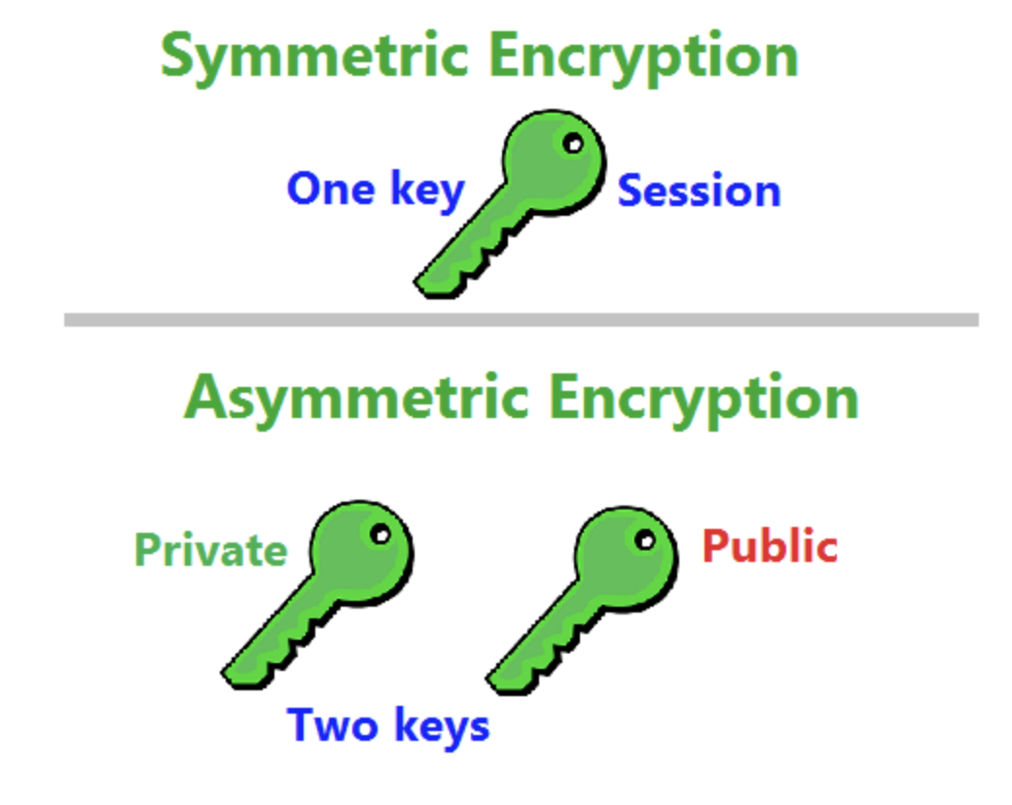
Types of Encryption
Symmetric Encryption
Uses a single key for both encryption and decryption.
Faster and suitable for encrypting large amounts of data.
Commonly used in file and disk encryption.
Example: AES
Asymmetric Encryption
Uses two keys: a Public Key and a Private Key.
More secure for sharing information over networks.
Commonly used in secure websites and digital signatures.
Example: RSA

Slide 4
Applications
Encryption is widely used in many areas, including:
Online Banking and ATM transactions.
E-commerce websites for secure payments.
Secure Email communication.
Cloud storage services.
Virtual Private Networks (VPNs).
Digital Signatures for authentication.
Mobile applications and messaging services.
Advantages
Protects sensitive data.
Prevents cyber attacks.
Ensures privacy and confidentiality.
Builds trust in online communication.

Slide 5
Conclusion
Encryption algorithms play an important role in protecting digital information.
They help secure personal, financial, and business data from unauthorized access.
Among the various algorithms, AES is widely used for data encryption, while RSA is commonly used for secure communication and digital signatures.

Slide 6
Thank You!

