Slide 1
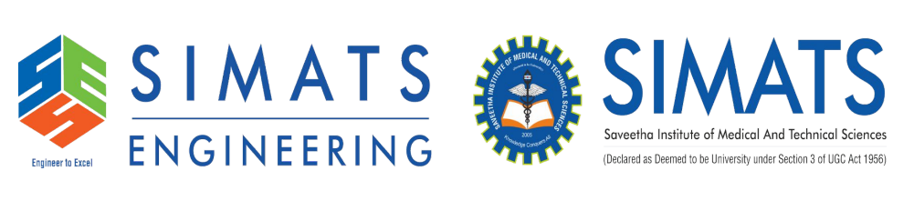
DSA0106 - OBJECT ORIENTED PROGRAMMING WITH C++
BudgetBuddy – An Adaptive Student Expense and Savings Optimization System Using Object-Oriented C++
Guided by:
Presented by:
Dr. Jegadeesh K
Hemalakshmi H (192571049)
Shaffria A (192571047)

Slide 2


Abstract
BudgetBuddy is an adaptive student expense and savings optimization system developed using Object-Oriented C++.
It analyzes students' spending patterns and available allowance to calculate safe-spending limits and support better budgeting decisions.
It identifies unnecessary expenses, prioritizes essential needs, and provides insights into potential savings.
It simulates financial situations, such as unexpected expenses and planned purchases, to help students make informed spending decisions.
It tracks multiple savings goals and helps students optimize contributions while balancing daily expenses.

Slide 3
Problem Statement
Students often struggle to manage their monthly allowance while balancing daily expenses and savings.
Traditional expense trackers record spending but do not provide adaptive spending limits or personalized budgeting guidance.
Unnecessary expenses and poor financial planning can lead to insufficient funds for essential needs and unexpected situations.
Students lack a simple way to evaluate future purchases, adjust budgets, and manage multiple savings goals together.
BudgetBuddy addresses these challenges by providing adaptive budgeting, spending analysis, financial risk simulation, and goal-based savings optimization using Object-Oriented C++.

Slide 4
Objective
To develop an adaptive budgeting system that helps students manage their monthly allowance effectively.
To analyze spending patterns and identify unnecessary expenses and potential savings opportunities.
To evaluate proposed purchases and simulate unexpected expenses to support better financial decisions.
To track multiple savings goals and optimize savings contributions based on available funds.
To implement a modular and efficient student expense management system using Object-Oriented C++.

Slide 5
Proposed System
BudgetBuddy is an Object-Oriented C++ system that helps students manage allowances, track expenses, and plan savings through four integrated modules.
It analyzes 7-day and 30-day spending patterns to calculate adaptive safe-spending limits and distribute available funds effectively.
It identifies spending leakage, compares weekly expenses, and prioritizes essential needs over discretionary spending.
It simulates proposed purchases and unexpected expenses to evaluate affordability and suggest budget adjustments.
Unlike traditional expense trackers, BudgetBuddy combines adaptive budgeting, financial risk simulation, and goal-based savings optimization to support proactive financial planning.

Slide 6
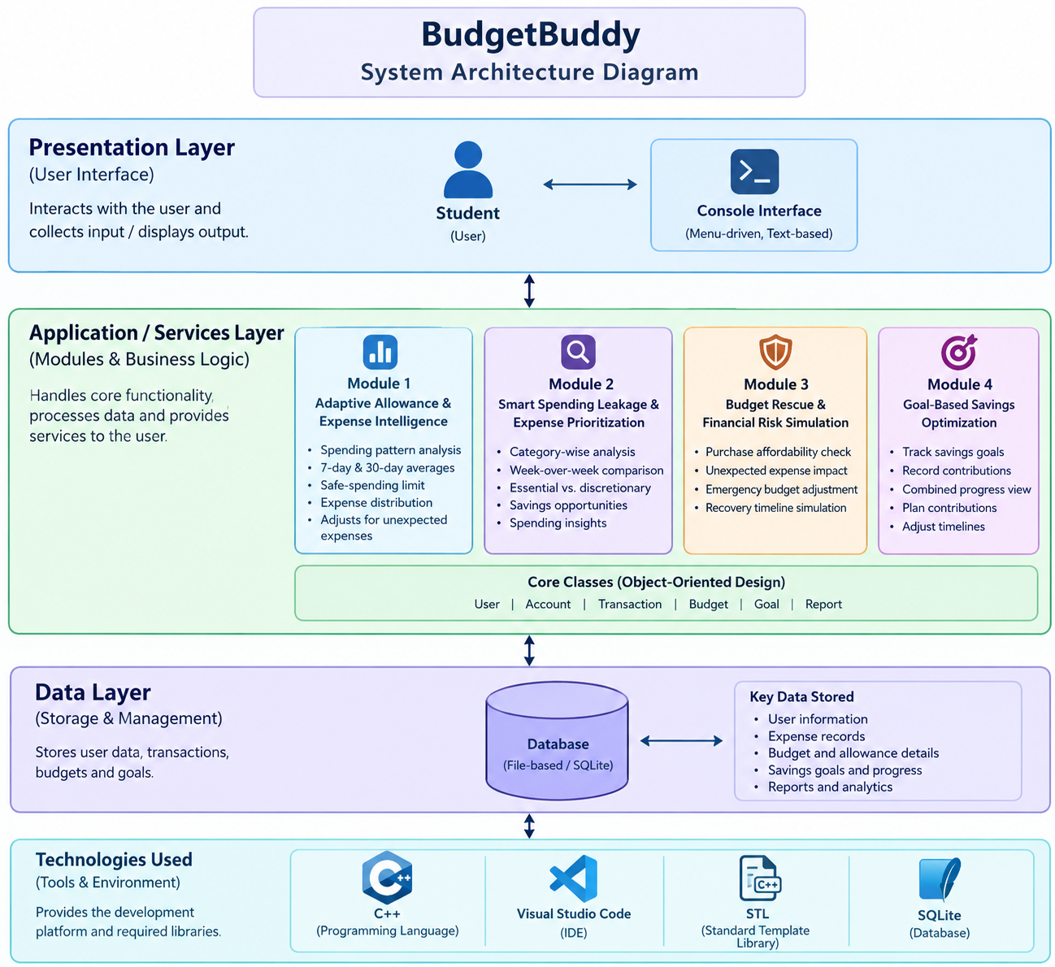
System Architecture Diagram

Slide 7
Module 1: Adaptive Allowance & Expense Intelligence
Analyzes students' daily expenses and monthly allowance.
Calculates 7-day and 30-day average spending to identify spending patterns.
Determines a dynamic safe-spending limit based on the remaining allowance and days left in the month.
Allocates the available budget across different expense categories.
Automatically adjusts spending recommendations when unexpected expenses occur.

Slide 8
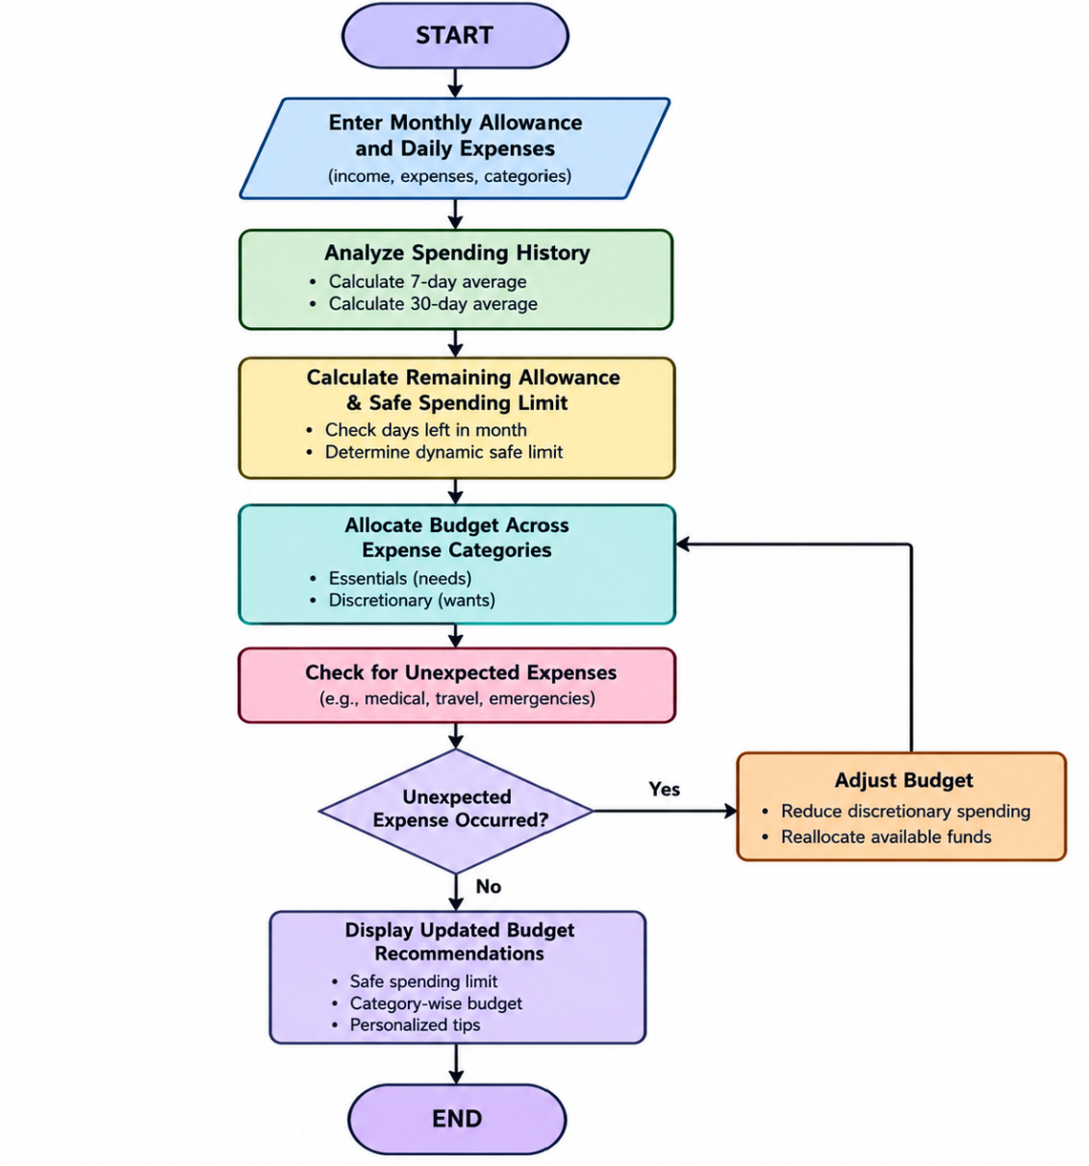

Slide 9
Module 2: Smart Spending Leakage & Expense Prioritization
Category-Wise Spending Analysis: Analyzes expenses across categories such as food, transport, shopping, and entertainment.
Weekly Expense Comparison: Compares current and previous weeks' spending to identify changes in spending habits.
Needs vs. Wants Classification: Categorizes expenses into essential needs and discretionary wants.
Spending Leakage Detection: Identifies frequent, unnecessary, or excessive spending that may reduce savings.
Personalized Savings Insights: Suggests expense priorities and opportunities to reduce avoidable spending.

Slide 10
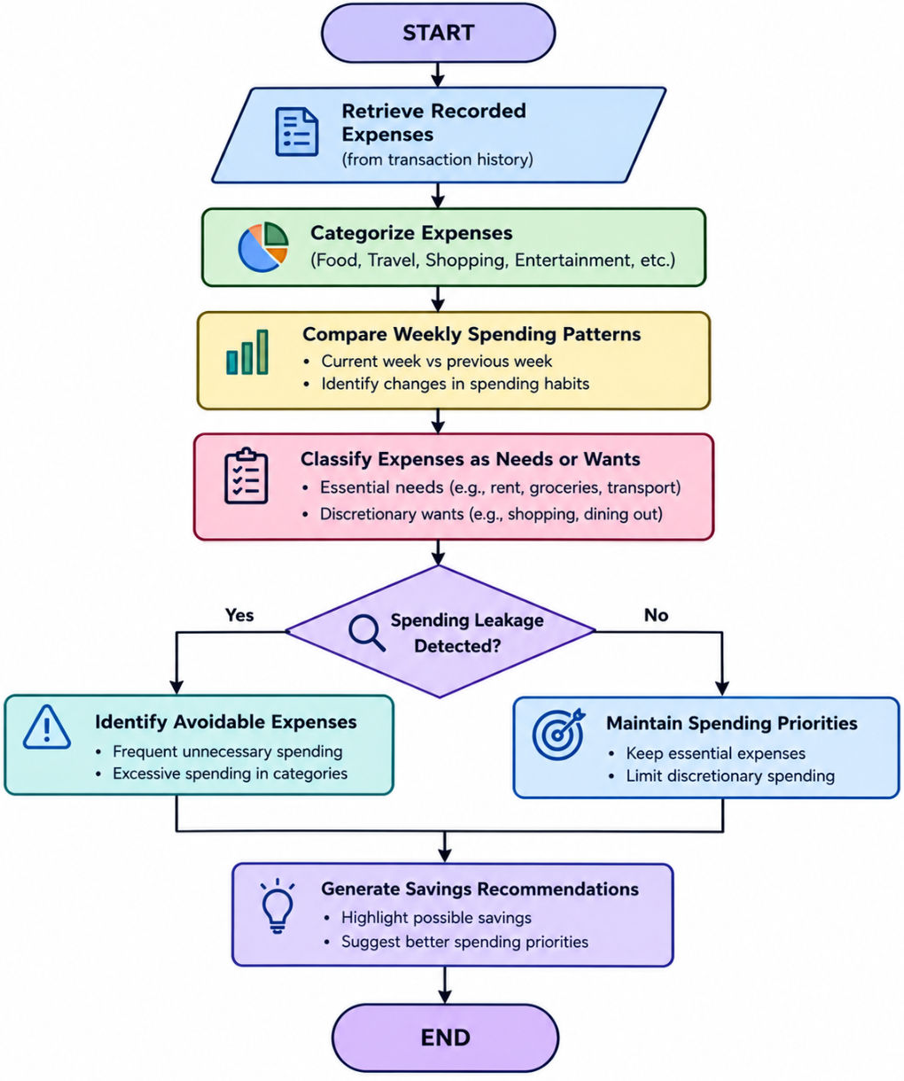

Slide 11
Module 3: Budget Rescue & Financial Risk Simulation
Purchase Affordability Analysis: Evaluates whether a proposed purchase fits within the student's available budget.
Financial Risk Simulation: Predicts the impact of planned purchases and unexpected expenses on the remaining allowance.
Emergency Budget Adjustment: Reallocates available funds and reduces non-essential spending during financial emergencies.
Budget Recovery Planning: Estimates the time required to recover from overspending through adjusted daily spending limits.
Smart Financial Recommendations: Provides suggestions to minimize financial risks and maintain budget stability.

Slide 12
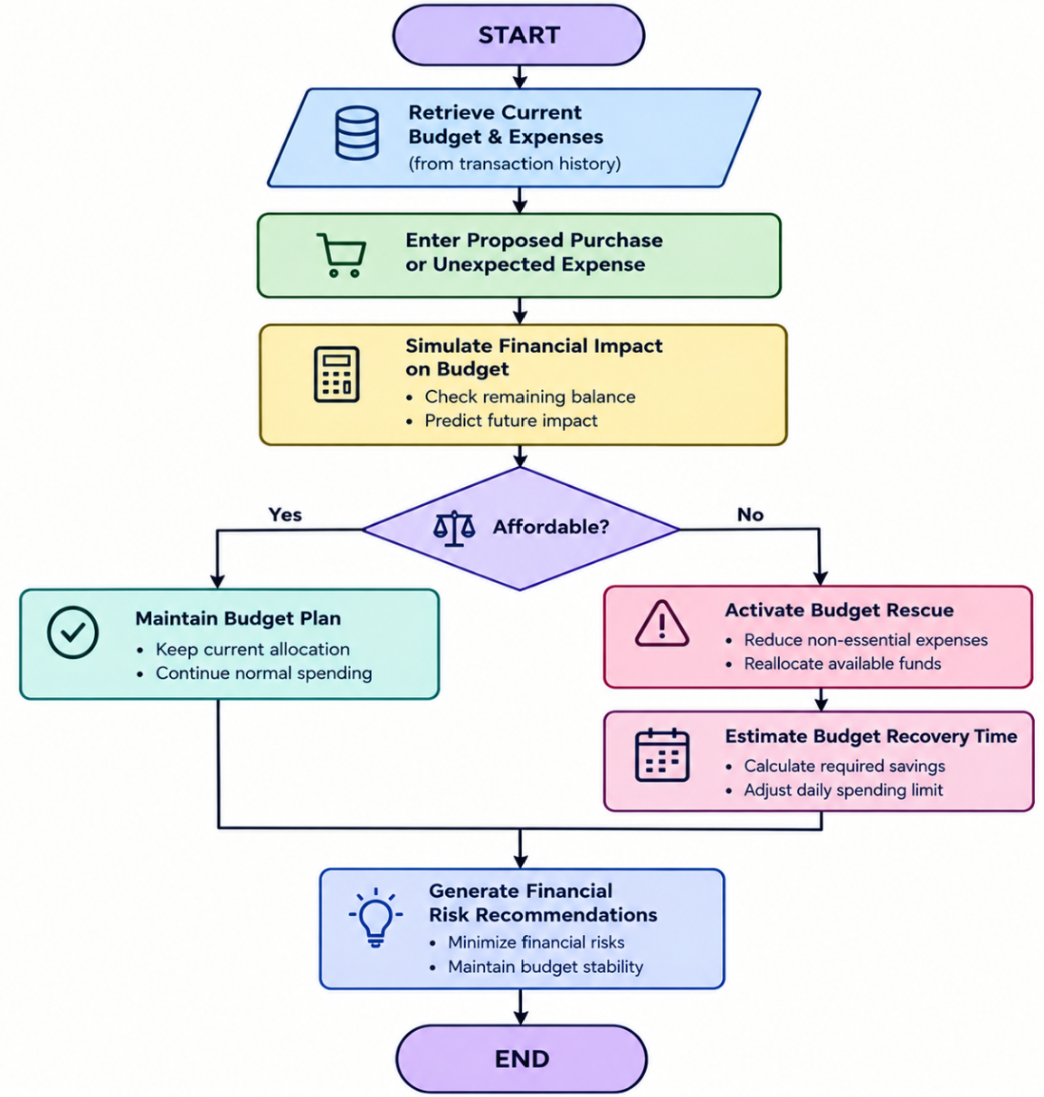

Slide 13
Module 4: Goal-Based Savings Optimization
Multiple Savings Goals: Allows students to create and manage savings goals with target amounts and deadlines.
Savings Progress Tracking: Records contributions and monitors the progress of individual savings goals.
Smart Savings Allocation: Distributes available savings among different goals based on their priorities and deadlines.
Savings Timeline Adjustment: Recalculates estimated completion dates based on contributions and available budgets.
Personalized Savings Recommendations: Suggests affordable contribution amounts to help students achieve their goals without affecting essential expenses.

Slide 14
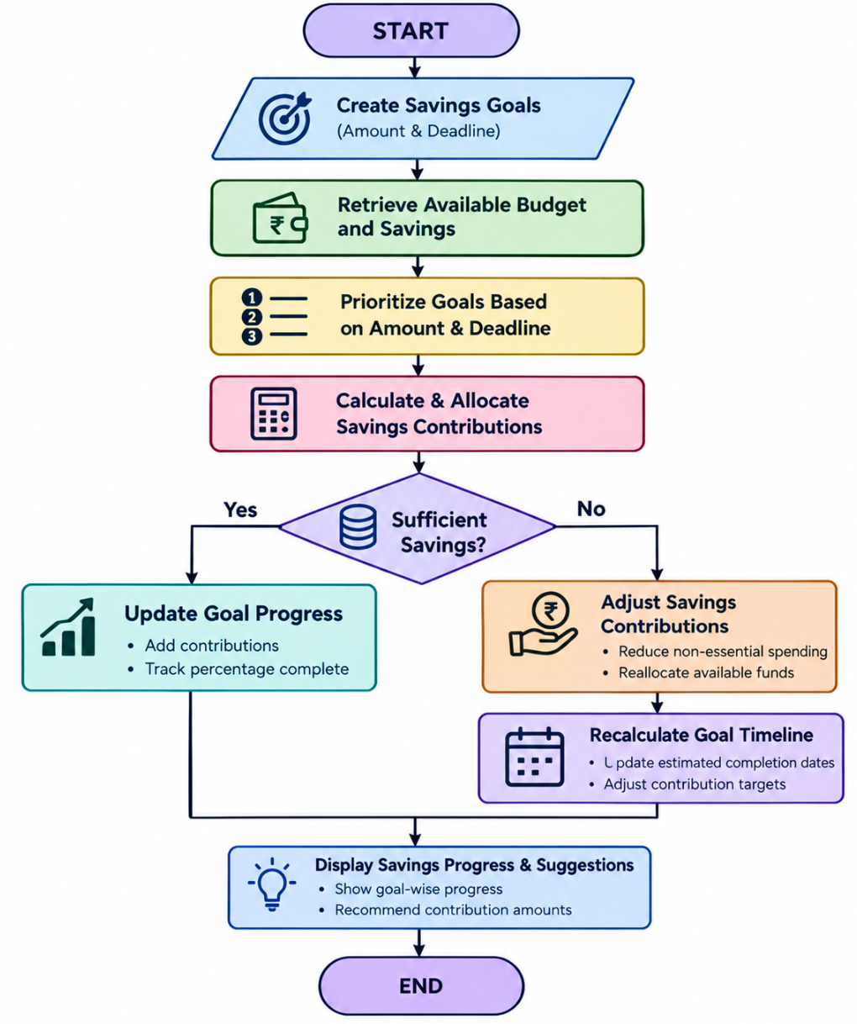

Slide 15
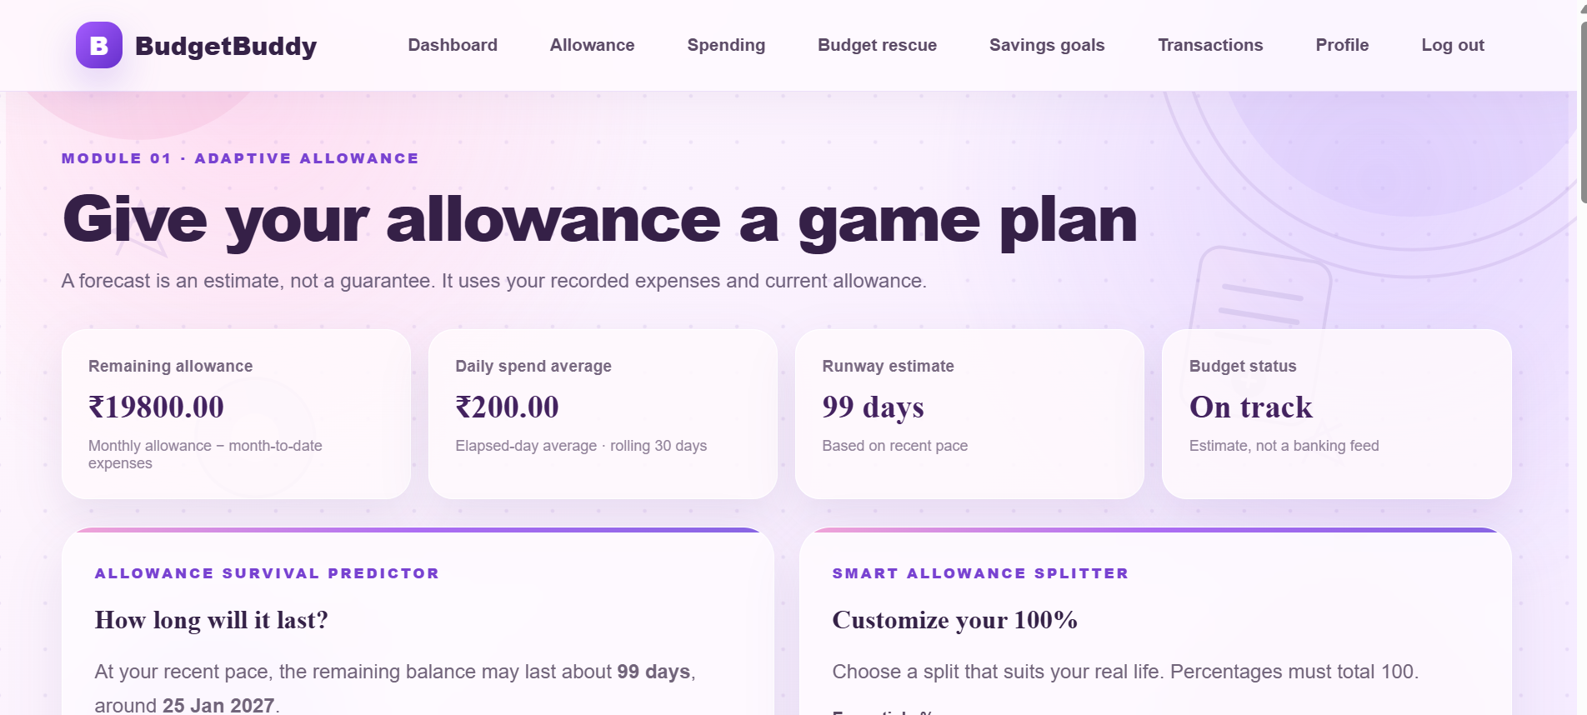
Helps students manage their monthly allowance by analyzing daily expenses and spending patterns. It calculates the remaining balance, average daily spending, and estimated budget duration. The Allowance Survival Predictor and Smart Allowance Splitter help students plan expenses efficiently and maintain financial stability.

Slide 16
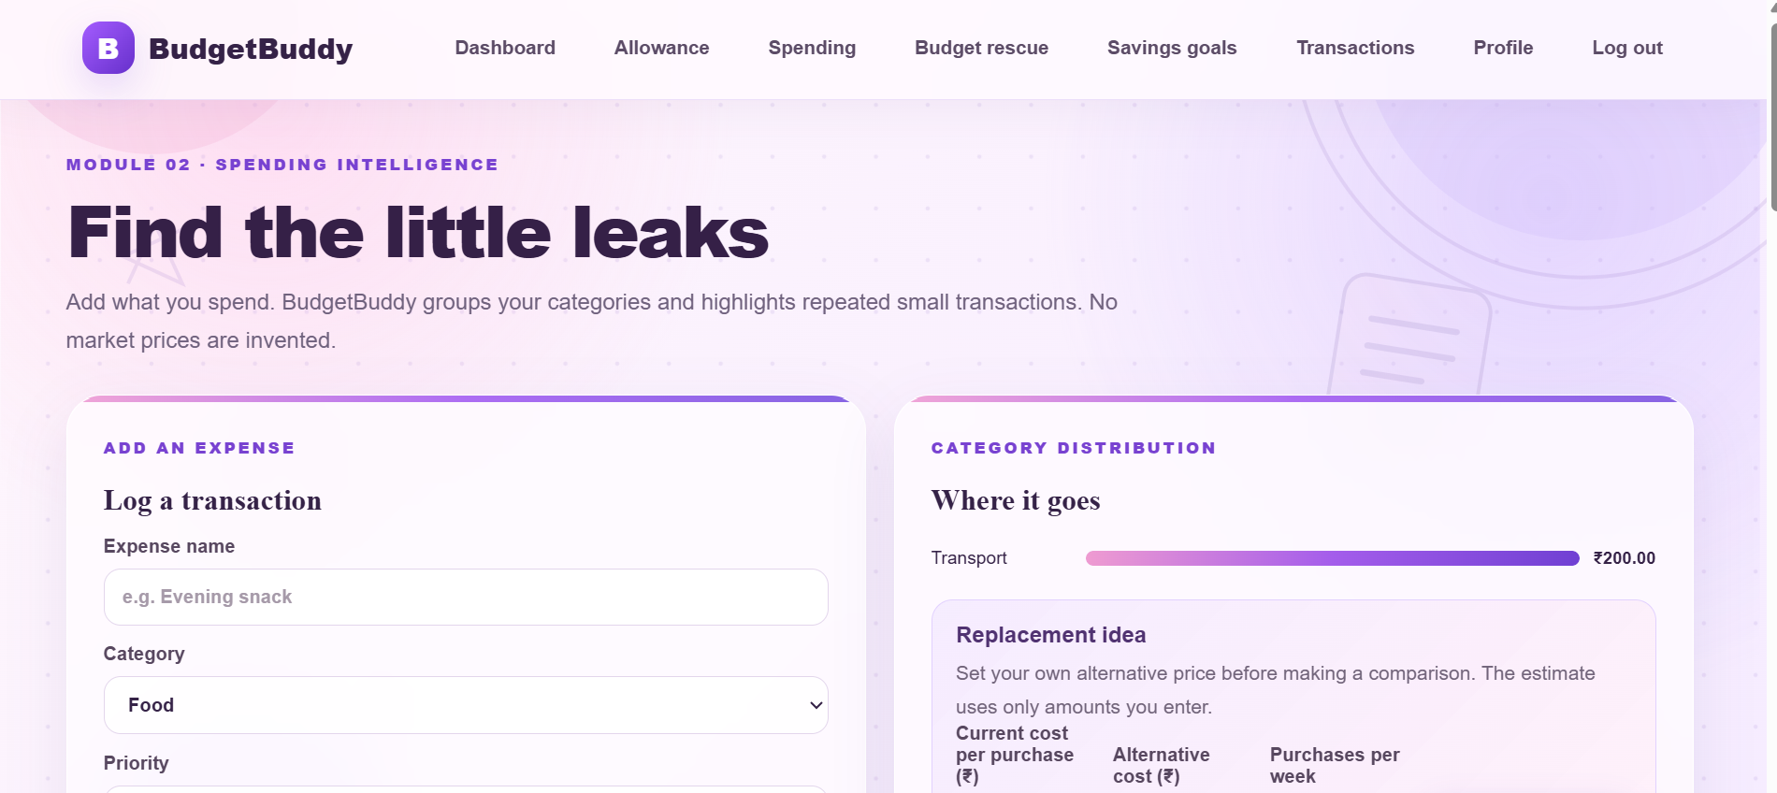
Analyzes category-wise expenses and identifies unnecessary spending habits. It allows students to record transactions, classify expenses based on priority, and compare spending alternatives. The system highlights potential savings opportunities and encourages students to prioritize essential needs over unnecessary wants.

Slide 17
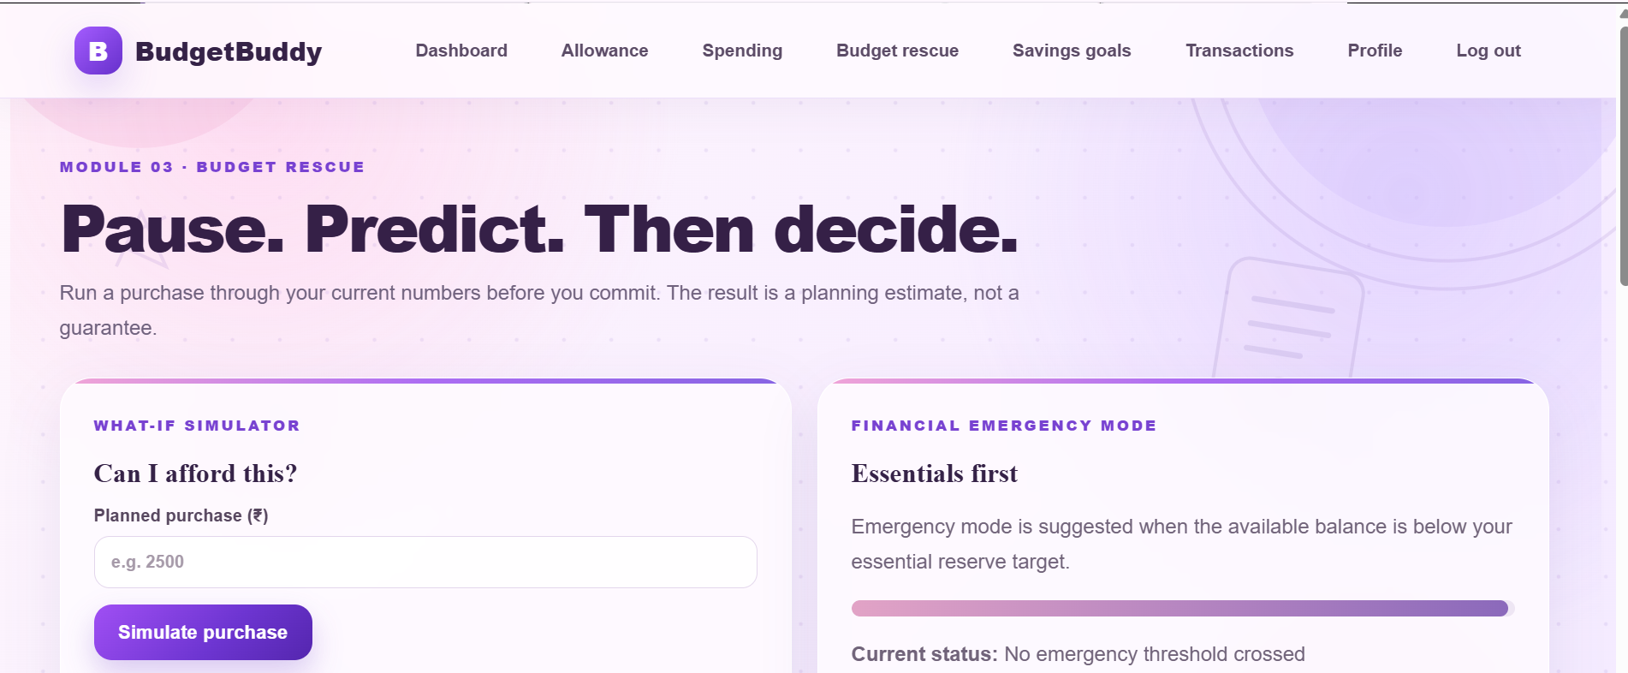
Helps students evaluate financial risks before making purchases. The What-If Simulator estimates the impact of planned expenses on the available budget. Financial Emergency Mode monitors essential expense reserves and provides guidance for adjusting spending decisions to avoid financial difficulties.

Slide 18
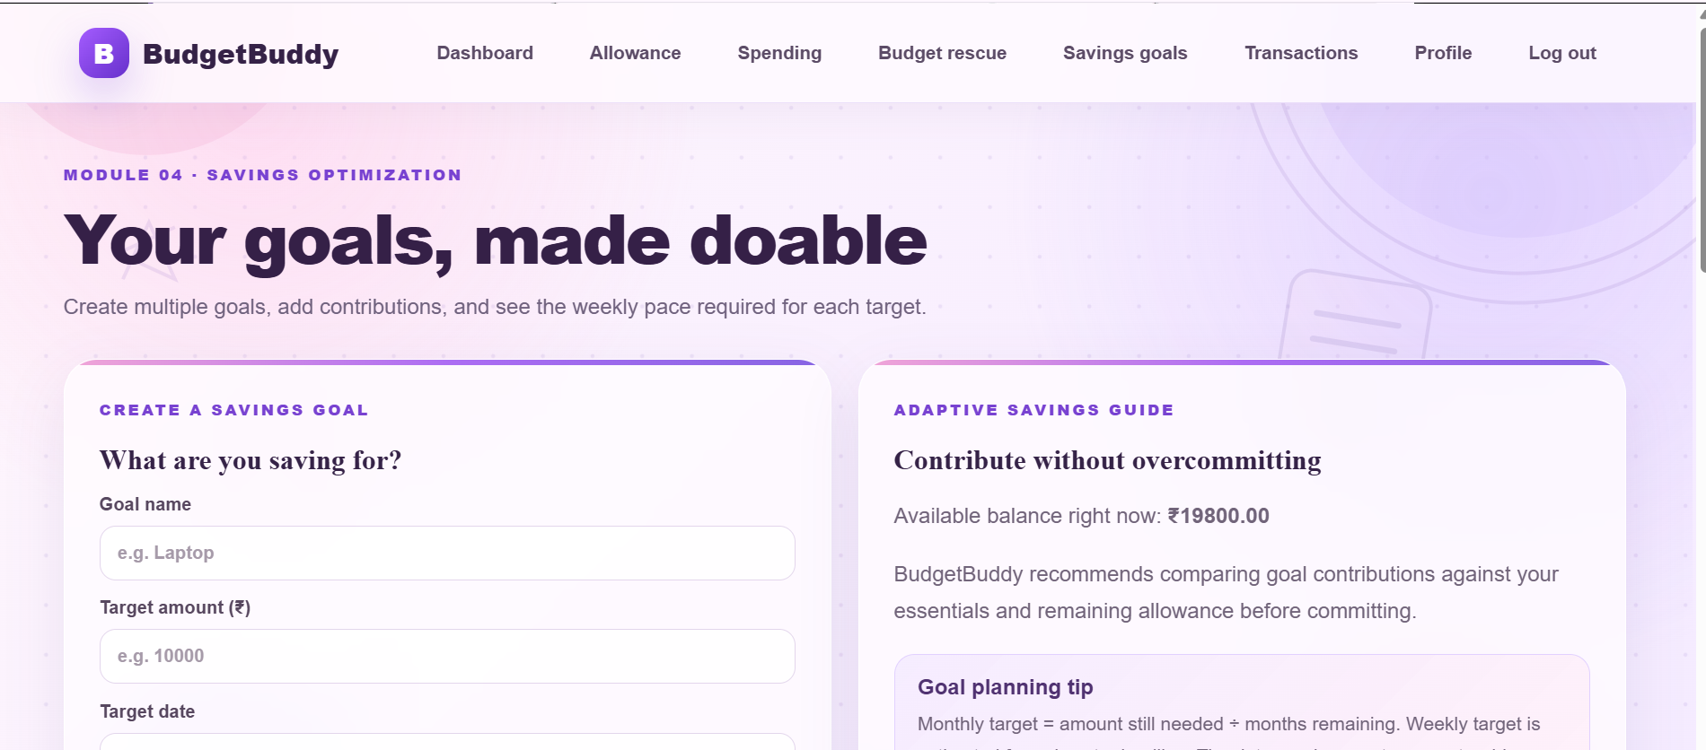
Enables students to create and manage multiple savings goals with specific target amounts and deadlines. The Adaptive Savings Guide calculates weekly and monthly contribution targets based on the available budget. It supports savings progress tracking and encourages students to achieve financial goals without compromising essential expenses.

Slide 19
Advantages of BudgetBuddy
Intelligent Budget Management: Analyzes spending patterns and recommends safe daily spending limits based on available allowance.
Reduced Unnecessary Expenses: Identifies spending leakage and helps students prioritize essential needs over discretionary wants.
Financial Risk Prevention: Simulates the impact of purchases and unexpected expenses to support better financial decisions.
Goal-Based Savings Planning: Helps students manage multiple savings goals, track progress, and adjust contribution timelines.
Adaptive Financial Recommendations: Automatically recalculates budget recommendations when spending patterns or financial conditions change.
Improved Financial Discipline: Encourages responsible spending, consistent saving, and better money management habits.

Slide 20
Conclusion
BudgetBuddy is an adaptive student expense and savings optimization system developed using Object-Oriented C++.
The system integrates four modules for allowance management, spending analysis, financial risk simulation, and goal-based savings optimization.
It goes beyond traditional expense tracking by providing dynamic spending limits, expense prioritization, and personalized budget recommendations.
The system helps students make informed financial decisions, manage unexpected expenses, and plan savings effectively.
Overall Outcome: BudgetBuddy aims to improve students' financial awareness, encourage responsible spending habits, and support long-term financial stability.

Slide 21


