Slide 1
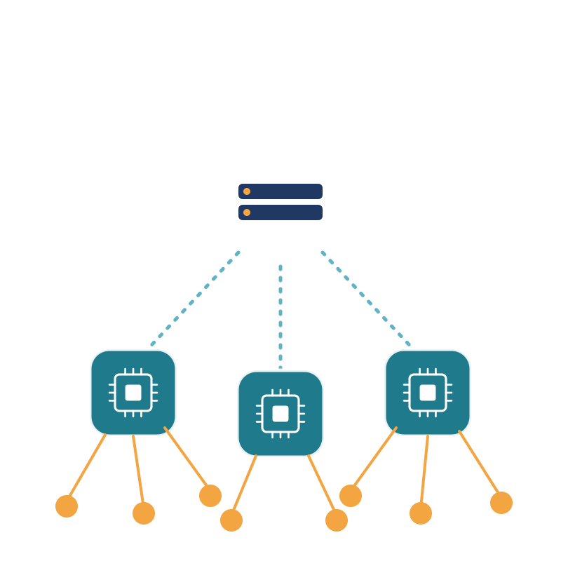
Edge Computing vs Cloud Computing
TECHNICAL PRESENTATION
Choosing the Right Computing Paradigm
SUBJECT CODE : CSA1514
SUBJECT NAME : CLOUD COMPUTING
Faculty : DR.LATHA
Name : ____________________
Reg.NO : ____________________
Notes:
Welcome. This presentation compares edge computing and cloud computing and shows how to choose between them.

Slide 2






What We Will Cover
01
02
03
Cloud Computing
Edge Computing
Architecture
Centralized, scalable services
Processing near the data
How the two are built
04
05
06
Applications
Industry Adoption
Right Choice
Where each one shines
Real-world scenarios
Edge, cloud or hybrid
Notes:
Six parts: the two paradigms, architecture, applications, industry adoption and the decision guide.

Slide 3
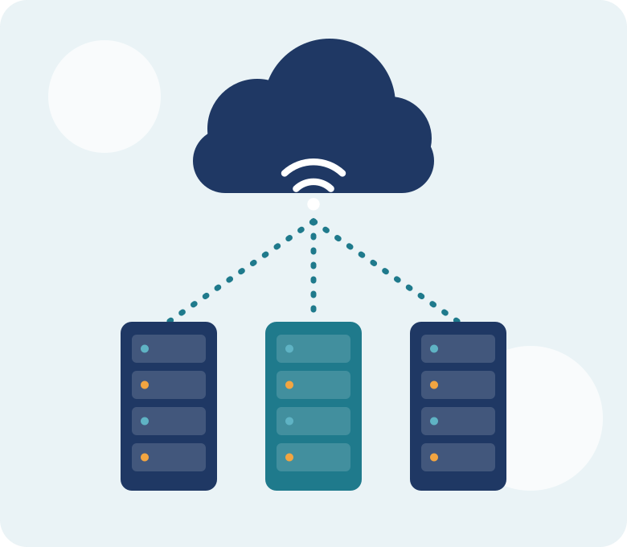




What is Cloud Computing?
Centralized data centers
Compute and storage run in large remote facilities.
On-demand scalability
Add or remove resources in minutes as load changes.
Pay-as-you-go pricing
Pay only for what you use, with no upfront hardware.
Global access
Reach services from any device with an internet link.
Examples: AWS, Microsoft Azure, Google Cloud
Notes:
Cloud computing delivers computing resources over the internet from large centralized data centers.

Slide 4
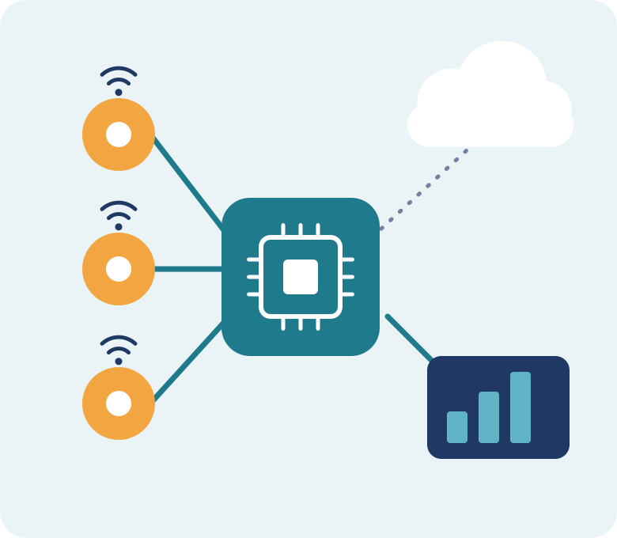



What is Edge Computing?
Processing near the source
Data is handled at or next to the device that makes it.
Ultra-low latency
Responses in milliseconds, with no long network trip.
Less bandwidth used
Only filtered, useful data is sent on to the cloud.
Works with weak links
Sensors, gateways and local servers
Keeps running when connectivity is slow or lost.
Notes:
Edge computing moves processing close to where data is created, such as sensors, gateways and local servers.

Slide 5

Architecture Compared
Cloud Architecture
Higher latency, central control
Devices
Internet
Cloud Data Center
Edge Architecture
Fast local decisions
Devices
Edge Node
Cloud (optional)
Notes:
In the cloud model data travels to a central data center. In the edge model an edge node processes it nearby and may forward a summary to the cloud.

Slide 6
Cloud vs Edge: Key Differences
Feature | Cloud Computing | Edge Computing
Processing | Centralized data centers | Near the data source
Latency | Higher (network round trip) | Very low (local response)
Bandwidth | Raw data sent to cloud | Filtered data sent upstream
Scalability | Virtually unlimited | Bound by local hardware
Privacy | Data travels over networks | Sensitive data stays on-site
Connectivity | Needs a reliable internet link | Works with weak or no link
Notes:
Walk through each row: location, latency, bandwidth, scalability, privacy and connectivity.

Slide 7
Latency: Why Edge Is Faster
1–10 ms
Edge: processing happens beside the device
50–150 ms
Cloud: round trip to a remote data center
Illustrative values; actual latency depends on network and distance.
Notes:
Illustrative figures: processing closer to the device cuts the round-trip delay. Real values depend on network and distance.

Slide 8








Applications of Each Paradigm
Cloud Computing
Edge Computing
Big data analytics
Autonomous vehicles
SaaS and web applications
Smart factories and IoT
Backup and disaster recovery
Real-time video analytics
AI and ML model training
AR/VR and gaming
Notes:
Cloud suits heavy, shared, elastic workloads. Edge suits real-time, local, latency-critical workloads.

Slide 9



Industry Adoption Scenarios
Manufacturing
Healthcare
Hybrid
Hybrid
Edge inspects products and controls machines live; cloud plans and analyzes.
Edge monitors patients at the bedside; cloud stores records and scans.
Retail
Telecom and Smart Cities
Cloud-led
Edge-led
Cloud runs catalogs and orders; edge powers in-store checkout and cameras.
5G edge nodes manage traffic, video and sensors close to users.
Notes:
Most industries land on a hybrid model; the mix depends on latency needs and data volume.

Slide 10

Choosing the Right Paradigm
Choose Edge when
Choose Cloud when
Go Hybrid when
Responses must be in milliseconds
Connectivity is weak or costly
Data is sensitive or must stay local
Workloads need huge, flexible scale
Heavy analytics or AI training
Global access and sharing matter
Real-time action and deep analysis both matter
Edge filters data, cloud stores it
Train in cloud, run models at edge
Edge for speed and locality, cloud for scale and depth. Combine them for the best of both.
Notes:
Use the three columns as a quick checklist. Most real systems end up hybrid.

Slide 11
Key Takeaways
1
Cloud gives scale
Centralized, elastic, pay-as-you-go resources for heavy workloads.
2
Edge gives speed
Local processing for real-time response, privacy and offline work.
3
Architecture differs
Cloud centralizes processing; edge distributes it close to devices.
4
Hybrid is the future
Edge and cloud working together as one continuum.
Notes:
Summarize: two complementary paradigms, choose by latency, scale, privacy and connectivity.

Slide 12




THANK YOU
Edge Computing vs Cloud Computing
Any Questions?
CSA1514 | CLOUD COMPUTING | Faculty: DR.LATHA
Notes:
Thank the audience and invite questions.

