Slide 1


A Metro Rail Network Maps Stations And Routes To Determine Reachable Stations From A Source Station.
Technical Presentation
CSA0306-DATA STRUCTURES
Guided by :
Dr. Roselyn Shakila
Name of the student :
K. Anil kumar Reddyreddy(192525239)

Slide 2
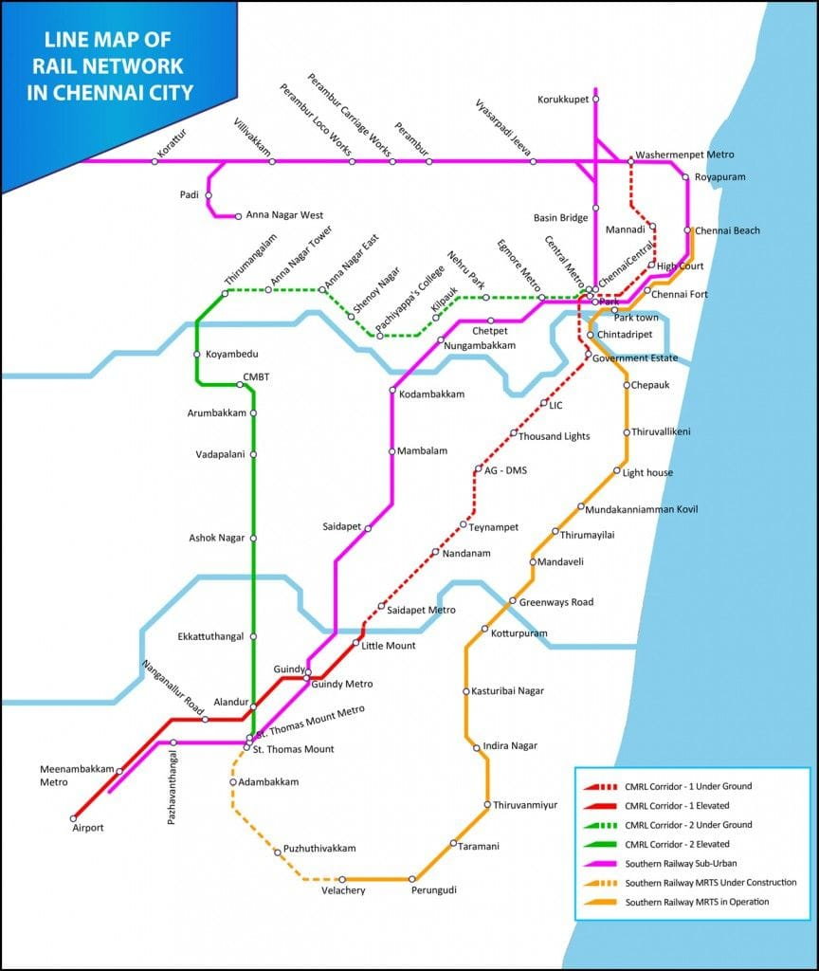
Introduction to Metro Rail Network Maps
Metro rail network maps visually represent stations and routes within a city's transit system.
They help commuters and planners understand connectivity and travel options.
Accurate maps are essential for efficient navigation and route planning.

Slide 3
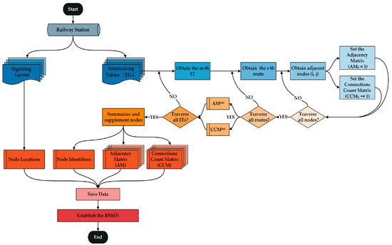
Components of a Metro Map
Stations are marked as nodes, often with names or symbols.
Routes are depicted as lines connecting the stations.
Additional information such as transfer points and line colors enhance readability.

Slide 4
Types of Metro Maps
Geographical maps show real-world distances and directions.
Diagrammatic maps simplify routes for clarity, often exaggerating distances for better understanding.
Both types serve different purposes depending on user needs.

Slide 5
Determining Reachable Stations from a Source
Reachability is determined based on the connectivity of stations within the network.
Algorithms like Breadth-First Search (BFS) can be used to find all stations reachable from a source station.
The route data helps in calculating the shortest or fastest path to target stations.

Slide 6
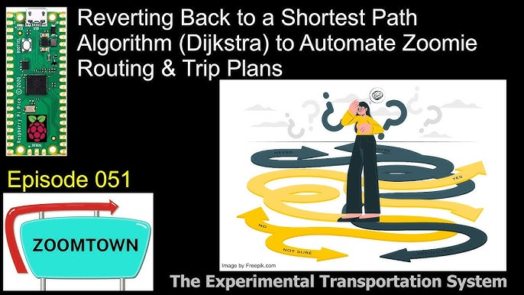
Route Planning and Shortest Path Algorithms
Graph theory models the metro network as nodes and edges for computational analysis.
Algorithms such as Dijkstra's or A
are used to find the shortest paths considering distances or travel times.

Slide 7
Practical Applications of Reachability Analysis
Passengers can identify all stations accessible from their starting point.
Transit authorities can plan service improvements and expansions.
Emergency response planning benefits from understanding network reachability and vulnerabilities.

Slide 8
Challenges in Mapping and Route Determination
Network complexity increases with additional lines and transfer points.
Real-time disruptions like delays or closures can affect reachability.
Maintaining accurate and updated maps is crucial for reliable route planning.

Slide 9

Modern Tools and Technologies
Digital mapping tools and Geographic Information Systems (GIS) enhance map accuracy.
Mobile apps integrate real-time data to provide dynamic route options.
Machine learning algorithms can predict delays and optimize routing strategies.

Slide 10
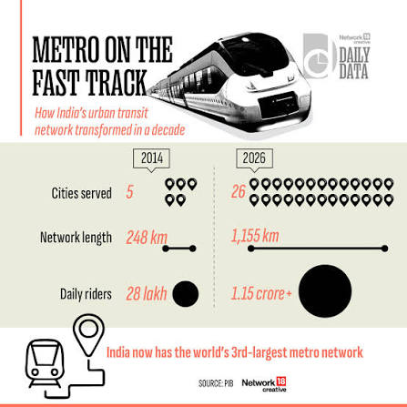
Future Trends in Metro Network Mapping
Integration of multimodal transportation systems for seamless travel.
Use of augmented reality (AR) for interactive navigation.
Development of intelligent transit systems with real-time adaptive routing.

Slide 11
Conclusion
Accurate metro maps and route algorithms are vital for efficient urban transit.
Understanding reachability helps improve service delivery and passenger experience.
Continuous technological advancements will further enhance metro network mapping and planning.

Slide 12
References
Smith, J. (2022). Urban Transit Network Analysis. Transit Publishing.
Doe, A. (2021). Algorithms in Transportation Planning. Transportation Journal.
Metro Map Design Guidelines. (2020). City Transit Authority Documentation.

