Slide 1

CSA15 | Cloud Computing and Big Data Analytics
CSA15 Cloud Computing and Big Data Analytics
Presenter Details
Student Name:P. Sujith Reddy
Register Number:192525422
Class / Section / Slot:Cloud computing / B
Capstone Title: SafeWalk Cloud Route Intelligence Using Crowd Reports and Risk Heatmaps
Selected SDG Goal(s):Sustainable Cities and Communities
Cloud Platform / Tools:
Firebase
Google Maps API
Google Cloud Platform (or AWS)
Python
Firestore Database
SafeWalk Cloud Route Intelligence Using Crowd Reports and Risk Heatmaps
Presentation Focus
Present your capstone as a cloud-backed product. Explain the problem, architecture, service choices, evidence, and CO1 learning clearly.
Individual student submission template | Department of Computer Science and Engineering
CO1 AT3 | 01
Notes:
Open by naming the capstone problem and the cloud product objective. Keep the title slide uncluttered and clearly identify the individual presenter.

Slide 2
CSA15 | Cloud Computing and Big Data Analytics
Problem Context and Stakeholder Mapping
Our capstone begins with a real problem to solve
Problem Statement
Target Users
Many people feel unsafe while walking at night because navigation apps only provide the shortest route, not the safest one. There is no system that uses real-time crowd reports to identify dangerous areas.
Students ,Women ,Night shift employees ,Tourists ,Senior citizens
SDG Fit
Product Boundary
Making cities safer through smart technology.
Version 1 includes:
User Login
Crowd Incident Reporting
Risk Heatmap
Safe Route Recommendation
Cloud Storage
Individual student submission template | Department of Computer Science and Engineering
CO1 AT3 | 02
Notes:
Do not start with technology. First make the need clear, then connect it to cloud-enabled scale, reach, or reliability.

Slide 3
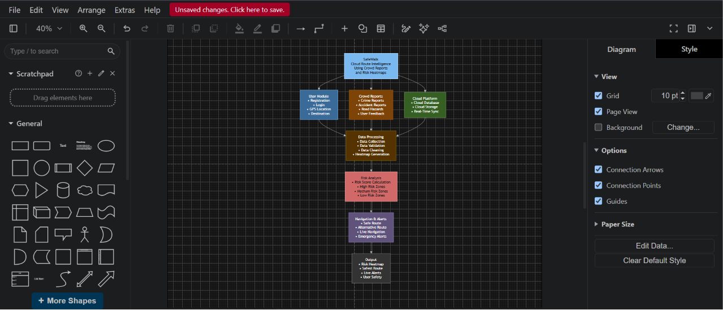
CSA15 | Cloud Computing and Big Data Analytics
Cloud Adoption Rationale and Concept Map
The problem needs cloud support to become a usable product
Cloud Definition
Cloud Concept Map
Cloud computing stores and processes data on remote servers, allowing SafeWalk to provide real-time route updates.
Cloud Characteristics
Scalability, Elasticity ,Resource Pooling, Measured Service, On-demand Access
Individual student submission template | Department of Computer Science and Engineering
CO1 AT3 | 03
Notes:
Students should explain the concept map as a reasoning artifact, not as decoration.

Slide 4
CSA15 | Cloud Computing and Big Data Analytics
Capstone Cloud Architecture
Backend Services:
Receives the user's request
. Calculates the safest route. Processes crowd reports.
Our cloud architecture connects the user action to services
Presentation Points
Request path:
User → App → API → Database → AI → Route
API role:
Google Maps API calculates navigation.
Compute choice:
Python Backend
Database and storage: Firestore
Monitoring and security:
Firebase Analytics
Scaling point:
Firebase Authentication
User App / Web App
User opens the SafeWalk app.
Logs in to the application
. Enters the destination. Reports unsafe place
s. Views the safest route.
Auth + API Gateway
Checks the user's login
. Sends the user's request to the server securely
. Protects the application from unauthorized users
Database / Storage
Stores user information. Stores crowd reports. Stores location details.
Security boundary
Analytics + Monitoring
Analyzes reported unsafe areas. Updates the risk heatmap
. Monitors application performance.
Individual student submission template | Department of Computer Science and Engineering
CO1 AT3 | 04
Notes:
Walk from user request to API, compute, data, storage, analytics, monitoring, and security boundary.

Slide 5
CSA15 | Cloud Computing and Big Data Analytics
Cloud Service Model Responsibility Matrix
Each service model defines what we control and what cloud manages
Service area
Model
Provider manages
Student team manages
Why this fits
SaaS
Firebase Hosting
UI Design
Easy deployment
Frontend hosting
SaaS
Firebase
User Login
Secure identity
Backend/API
PaaS
Cloud Run
Python APIs
Auto scaling
Database
DBaaS
Firestore
Data Model
Real-time storage
Storage
IaaS
Cloud Storage
Images & Reports
Reliable storage
Monitoring / logs
SaaS
Firebase Analytics
Report Analysis
Usage insights
Security / IAM
Individual student submission template | Department of Computer Science and Engineering
CO1 AT3 | 05
Notes:
Ask the student to defend provider responsibility and student responsibility for the selected service models.

Slide 6
CSA15 | Cloud Computing and Big Data Analytics
Data Flow and Analytics Pipeline
The product data moves from user activity to useful insight
Ingestion
REST API
The app sends the collected data to the cloud using a REST API.
Process
Checks the reported locations. Calculates the risk level. Finds the safest route.
Cloud Firestore
User Details Crowd Reports Location Data
Data Collection
GPS Location
User ID
Incident Type
Time
Description
Image
Visualize
Data Requirements
Analytics Requirement
Proof Required
User Location ,Crowd Reports, GPS Data, Time ,Incident Information
Generate Risk Heatmap Find Safe Routes Show Unsafe Areas
Sample Input
User Location: College
Destination: Bus Stand
Crowd Report: Poor Street Lighting
Sample Output
Safest Route Displayed
Risk Heatmap Updated
Individual student submission template | Department of Computer Science and Engineering
CO1 AT3 | 06
Notes:
Big data analytics is optional, but a thoughtful data path is expected.

Slide 7
CSA15 | Cloud Computing and Big Data Analytics
Python / AI Module Integration
Python or AI adds intelligence where the product needs it
Python Role
Input and Output
Python analyzes crowd reports and calculates safety scores.
INPUTS:GPS Coordinates ,Crowd Reports, Crime Data, Time
OUTPUTS:Safe Route, Risk Score, Heatmap, Alert Messages
Execution Point
Product Value
Python Flask REST API
Intelligent route planning, Faster decision making
Individual student submission template | Department of Computer Science and Engineering
CO1 AT3 | 07
Notes:
If AI is not required, students can present a Python automation or analytics module instead.

Slide 8
CSA15 | Cloud Computing and Big Data Analytics
Security, Scalability, Privacy and Cost Design
Security, scale, privacy and cost shape the final design
Security
Privacy
Firebase Authentication, Encrypted Communication, Secure API
Anonymous Reporting ,User Permission, Data Encryption
Scalability
Cost Awareness
Supports thousands of user,s Automatic cloud scaling, Real-time synchronization
Firebase Free Tier, Google Maps API Free Credits
Individual student submission template | Department of Computer Science and Engineering
CO1 AT3 | 08
Notes:
This slide is where students show engineering judgment instead of simply listing services.

Slide 9
CSA15 | Cloud Computing and Big Data Analytics
Implementation Stack and Deployment Evidence
Our implementation stack shows how the design will be built
Mobile / Web Layer
Cloud Services
Android Studio, Java, XML, Google Maps API
irebase Authentication, FirebaseFirestore, Firebase Storage Google Cloud
Evidence
Version Control
Login Page ,Home Page, Safe Route Display, Risk Heatmap
GitHub Repository, Project Files, Source Code Backup
Individual student submission template | Department of Computer Science and Engineering
CO1 AT3 | 09
Notes:
Evidence should be specific and inspectable, not a generic list of tools.

Slide 10
CSA15 | Cloud Computing and Big Data Analytics
Demo Storyboard and User Journey
A complete user journey proves the product flow
Scene 1
Scene 2
Scene 3
User opens SafeWalk App
↓
Login Successful
↓
Firebase Authentication
User enters destination
↓
Location fetched
↓
Google Maps API
System checks crowd reports
↓
Risk analysis
↓
Cloud Database
Scene 4
Scene 5
Scene 6
Heatmap generated
↓
Unsafe areas highlighted
Safe route calculated
↓
Displayed on map
User reaches destination safely
↓
Journey stored in cloud
Individual student submission template | Department of Computer Science and Engineering
CO1 AT3 | 10
Notes:
A storyboard helps the faculty see whether the cloud architecture is connected to actual use.

Slide 11
CSA15 | Cloud Computing and Big Data Analytics
Evaluation Readiness Checklist
Our evidence confirms that the presentation is ready
Cloud ecosystem and service model explained
Elasticity and scalability decisions are visible
☑
☑
REST/SOAP/API role connected to capstone
GitHub and cloud evidence are inspectable
☑
☑
Architecture has compute, data, storage, security, monitoring
☑
☑
References and integrity statement are included
Evaluator Focus
Cloud Computing concepts, Firebase cloud services, REST API communication, Safe route generation
Individual student submission template | Department of Computer Science and Engineering
CO1 AT3 | 11
Notes:
Students can use this as the self-check slide before presenting the conclusion.

Slide 12
CSA15 | Cloud Computing and Big Data Analytics
Conclusion, Limitations and Future Scope
We close with learning, limitations and next steps
Learning Outcome
Limitations
Cloud Computing, Firebase Services, Google Maps API, Python Integration
Depends on Internet, Limited crowd reports in new areas, Google Maps API usage limits
Future Improvement
Integrity Statement
AI Crime Prediction, IoT Emergency Devices, Smart City Integration, Voice Navigation, SOS Emergency Alerts
Google Maps API Documentation ,Firebase Documentation ,Google Cloud Platform
Individual student submission template | Department of Computer Science and Engineering
CO1 AT3 | 12
Notes:
The ending should synthesize learning, not just say thank you.

