Slide 1

REVIEW 1-PRESENTATION
Predictive Wildfire Spread Simulator with Evacuation Route Optimizer
CSA0915– Java Programming
Presented By: Guided By: S.K.Deepa Arathi (192571020) Dr.E.Meganathan
Lochana Sri R S (192521348)
Nitya Priya P M (192572086)

Slide 2


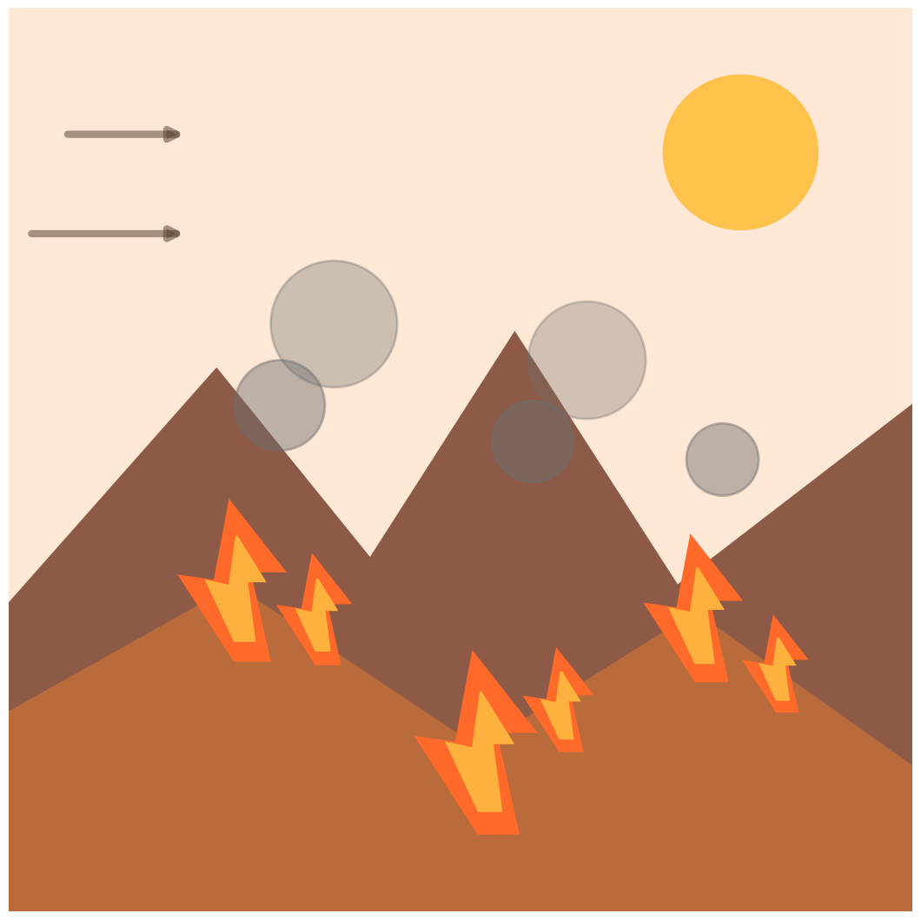
INTRODUCTION
Wildfires are among the most destructive natural disasters, causing loss of life, forests, and property.
Climate change, high temperatures, strong winds, and dry vegetation have increased wildfire frequency and intensity.
Early prediction of wildfire spread is essential to reduce damage and improve emergency response.
FireWatch is an intelligent system that predicts the direction and speed of wildfire spread using environmental data.
The system considers factors such as wind speed, temperature, humidity, vegetation, and terrain.

Slide 3

PROBLEM STATEMENT
Wildfires spread rapidly due to changing weather conditions, making them difficult to predict.
Existing wildfire monitoring systems mainly detect fires after they have already started, limiting response time.
Delayed prediction and evacuation can lead to significant loss of lives, property, forests, and wildlife.
Emergency responders often face challenges in identifying the safest and fastest evacuation routes.
Real-time environmental factors such as wind speed, temperature, humidity, and terrain are not always integrated into decision-making.

Slide 4

PROPOSED SYSTEM
To develop an intelligent system for predicting wildfire spread.
To analyze wind, temperature, humidity, vegetation, and terrain for better accuracy.
To simulate wildfire spread direction and speed in real time.
To identify the safest and shortest evacuation routes.
To provide early warnings for emergency response teams.
To reduce loss of life, property, and forests through timely evacuation.
To improve disaster management via combined prediction and route planning.

Slide 5
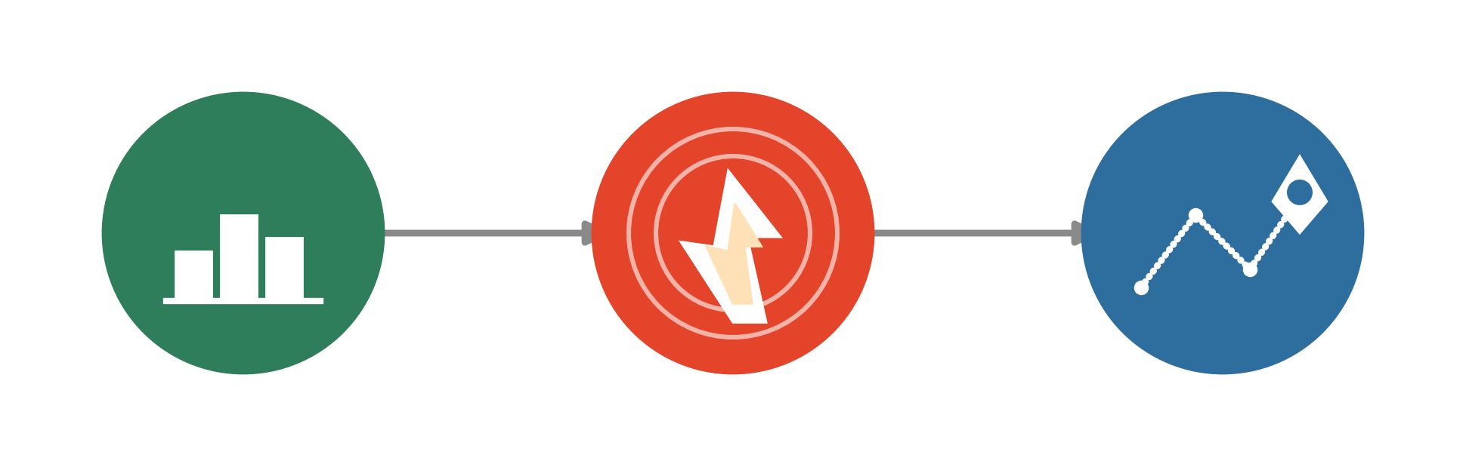
MODULES
Module 1: Data Collection & Wildfire Prediction
Module 2: Wildfire Spread Simulation
Module 3: Evacuation Route Optimization & Alert System

Slide 6
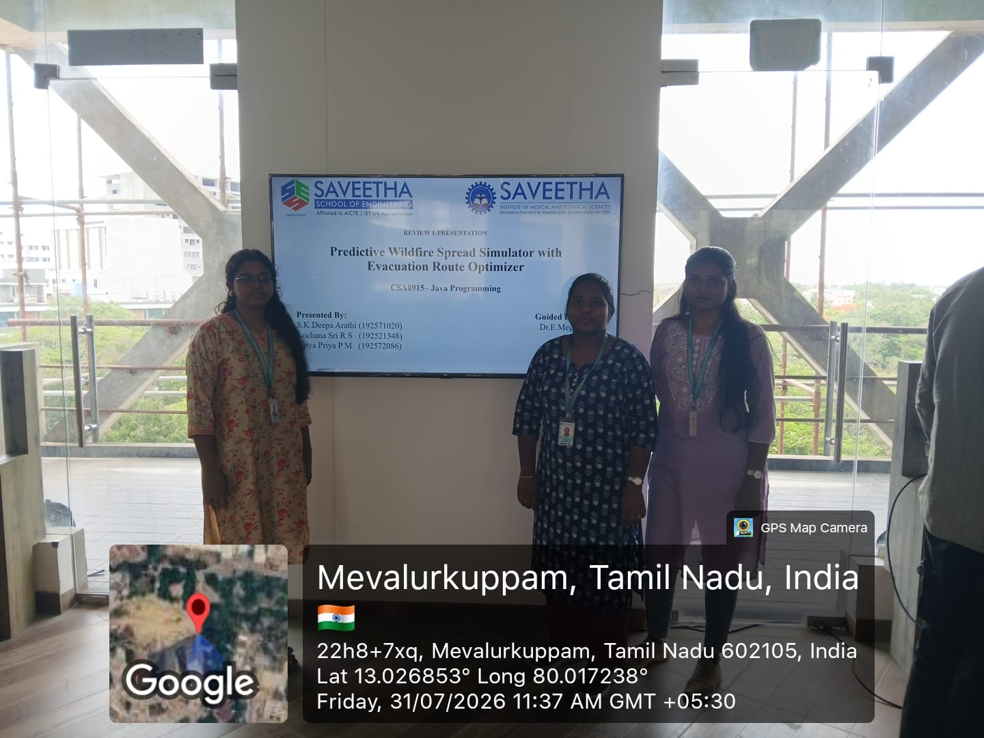
GEO TAG PHOTO

Slide 7
THANK YOU

