Slide 1






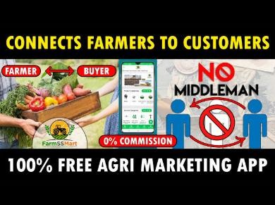



FarmDirect: A Smart Farmer-to-Consumer Marketplace for Agricultural Product Sales
JAVA-BASED WEB DEVELOPMENT – CAPSTONE PROJECT
Presented by
S.YUVASRI ([192511202]) S.SUVATHI([192571064])
B.E / B.Tech – Computer Science
Guided by
Dr .A MOHAN
Dr .E MEGANATHAN
Department of Computer Science

Slide 2

INTRODUCTION
Indian agriculture involves 140+ million farming families with limited market access
Middlemen take 30-40% of the price, reducing farmer income significantly
FarmDirect is a Java-based web marketplace connecting farmers directly with consumers
Platform supports 2,400+ verified farmers and has delivered 95,000+ orders across India

Slide 3
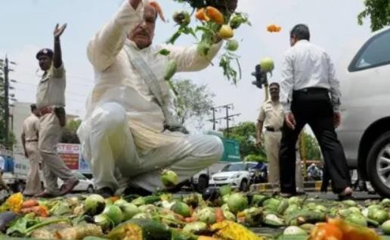
Problem Statement
Farmers lack direct market access and depend on middlemen for product sales
Consumers pay high prices for fresh produce due to long supply chains
Post-harvest losses are high due to delays and poor logistics coordination
Existing e-commerce platforms are not tailored for
agricultural products

Slide 4
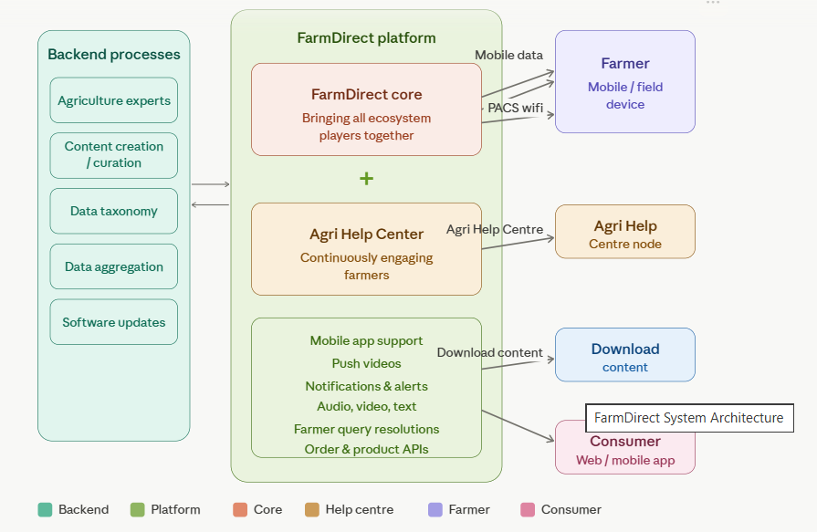
System Architecture
Frontend: HTML5, CSS3, JavaScript ,java with responsive UI design
Backend: Java Spring Boot 3.2 RESTful API (runs on port 8080)
Database: MySQL with JPA/Hibernate ORM for data persistence
Deployment: Maven build tool with Spring Boot embedded Tomcat server

Slide 5
Literature Review
S. No. | Author(s), Year | Title of Study | Problem Addressed | Methodology | Key Findings | Limitations
1. | Ali & Joseph, 2020 | Order Management Module for Agricultural Marketplace Using Java EE (2020) | No systematic order placement and tracking system for farm produce buyers | Java EE with JDBC-backed order workflow: placement, confirmation, and status update | End-to-end order tracking reduced consumer complaints and improved fulfillment | No logistics API integration; delivery status updated manually
2. | Kumar & Patel, 2021 | Product Rating and Review System for Java-Based Agri Marketplace (2021) | Absence of trust mechanism between unknown farmers and consumers online | Java Servlet module with MySQL-stored ratings and aggregate review display per product | Star-rating and feedback system increased consumer trust and repeat purchases | Ratings not verified by purchase history; susceptible to fake reviews
3. | Sharma et al., 2022 | Admin Dashboard for Agricultural E-Commerce Platform Using Java and JDBC (2022) | Platform administrators lacked tools for user management and sales monitoring | Java Servlet admin module with JDBC queries for user control, reports, and moderation | Centralized admin panel improved dispute resolution and platform governance | No automated alerts; admin actions were entirely manual
4.. | Nambiar & Das, 2023 | FarmerConnect: Full-Stack Java Web Marketplace with MVC Architecture (2023) | Fragmented agri marketplace systems lacked scalable and maintainable architecture | MVC pattern with Java Servlets (controller), JSP (view), Java Beans + JDBC (model) | MVC separation improved code maintainability and enabled faster feature addition | No cloud deployment; no mobile app; payment limited to cash on delivery

Slide 6
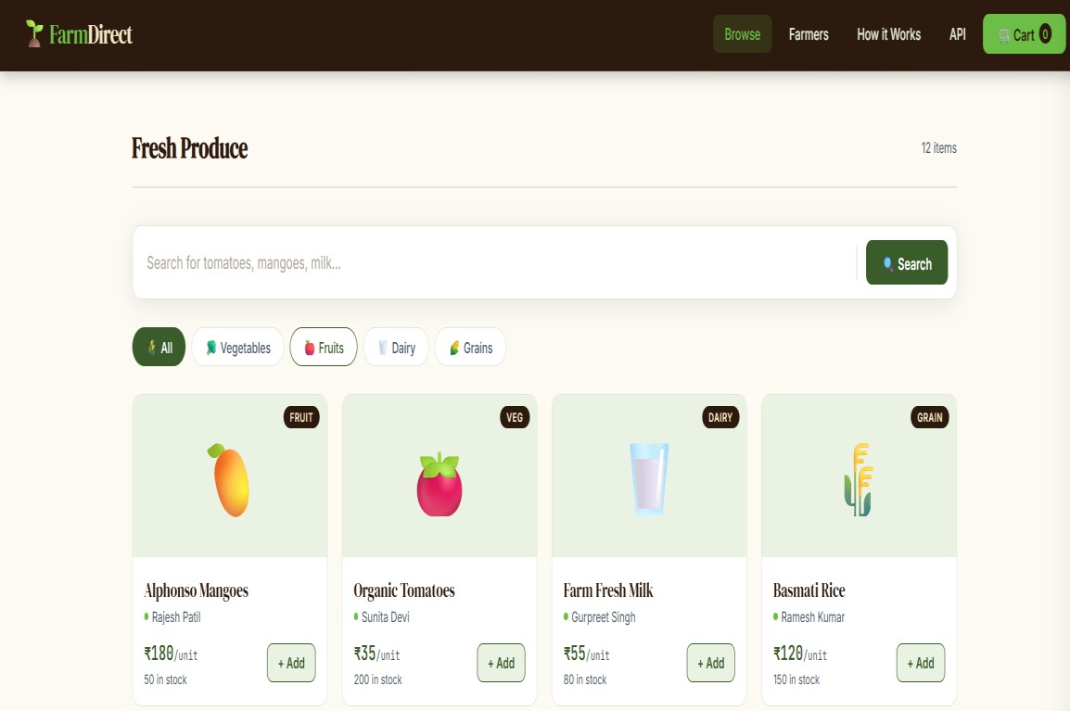
Key Features
Product listing by category: Vegetables, Fruits, Dairy, and Grains
Cart management with price calculation, delivery fee, and checkout
Order lifecycle tracking: PLACED, PACKED, SHIPPED, DELIVERED
Farmer profile pages showcasing verified sellers
and their produce

Slide 7
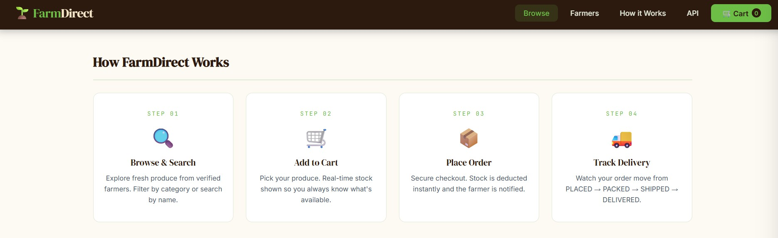
How FarmDirect Works
Step 1: Browse fresh produce from 2,400+ verified farmers by category or search
Step 2: Add items to cart; real-time stock count is shown for each product
Step 3: Secure checkout with instant stock deduction and farmer notification
Step 4: Track order status from PLACED to DELIVERED via the REST API
Step 5: Farmers manage inventory and listings through dedicated endpoints

Slide 8


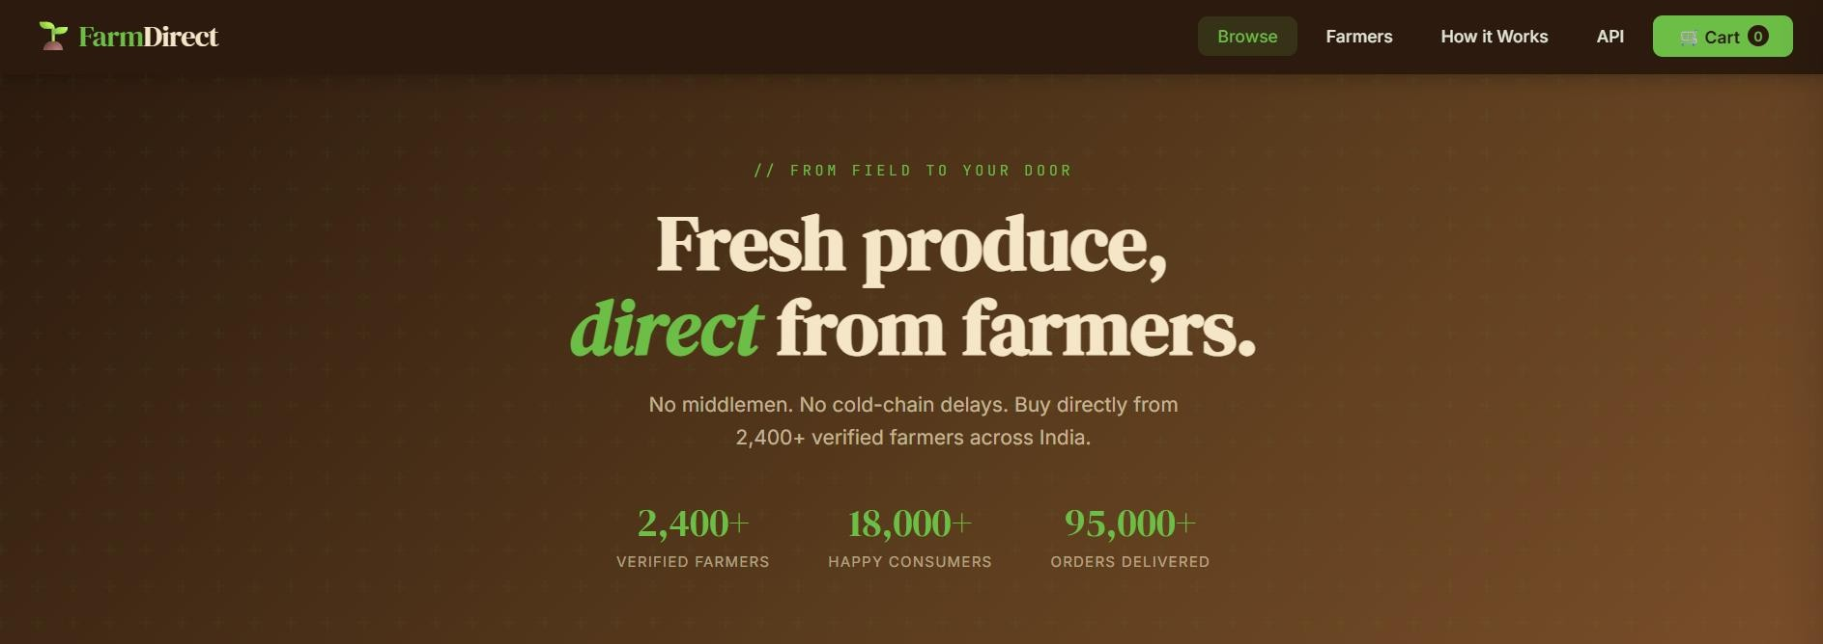
Application – software (JAVA)
Frontend deployed at: index.html (HTML/CSS/JS)

Slide 9
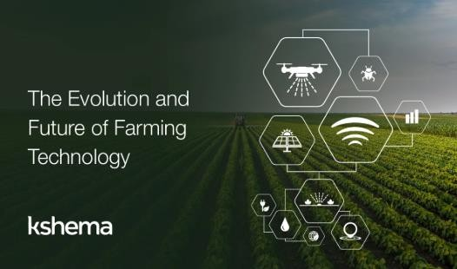
Limitations & Future Scope
Current version runs on localhost; cloud deployment (AWS/GCP) is not yet configured
No user authentication or farmer login panel in the current prototype
Payment gateway integration (Razorpay/UPI) is planned but not implemented
Mobile app version using Android/React Native is a future enhancement
AI-based price recommendation and demand forecasting can be
added in next phase

Slide 10
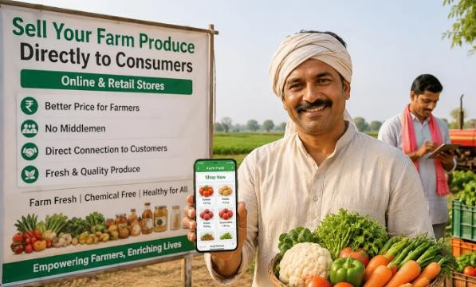
Conclusion
FarmDirect successfully bridges the gap between farmers and consumers using Java web technology.
the rest api architecture ensures scalable maintainable extensible service design..
This project demonstrates how
technology can empower farmers and reduce poverty.

Slide 11
References
Craig Walls, Spring Boot in Action, Manning Publications, 2022.https://www.manning.com/books/spring-boot-in-action
Anghel, Leonard – Java EE 7 Development with NetBeans 8, Packt Publishing,
2023.https://www.packtpub.com/
Spring Framework Docs – Spring Boot 3.2 Reference Guide, 2024.https://docs.spring.io/spring-boot/docs/current/reference/html/
MySQL 8.0 Reference Manual, Oracle Corp, 2024.https://dev.mysql.com/doc/refman/8.0/en/
Haris Gacanin; Mark Wagner, “2022 Artificial Intelligence Paradigm for Customer Experience Management in Next-Generation Networks: Challenges and Perspectives," IEEE Network, Volume: 33 Issue: 2. https://ieeexplore.ieee.org/document/8642802
D. B. Sanches De Oliveira, et al., "Dynamic Pricing for Electric Fleet Vehicle Recharge at Semi-Fast Charging Stations," 2021 IEEE URUCON. https://ieeexplore.ieee.org/document/9841883

Slide 12


Thank You!

