Slide 1
MongoDB for Haskell
Tony Hannan
tony@10gen.com

Slide 2
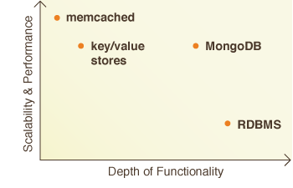
Why MongoDB (“NoSQL”)
Scalability
No joins, no transactions
Denormalized data (documents)

Slide 3
MongoDB business
Open source, free
Lead by commercial company, 10gen
100,000 downloads/month and growing
In production at:
Craigslist, Foursquare, Shutterfly, MTV, …
Several bigger names to be announced soon

Slide 4
MongoDB data model
Database = [Collection]
Collection = [Document]
Document = [Field]
Field = (Label, Value)
Value = primitive | Document | [Value]
[“name” =: “Mike”,
“addr” =: [“city” =: “New York”, “state” =: “NY”],
“scores” =: [10, 20, 35, 25] ]

Slide 5
MongoDB query language
EDSL: query encoded in document
[“name” =: “Mike”]
[“name” =: Regex “mik” “i”]
[“addr.state” =: “NY”, “scores” =: [“$gte” =: 30]]
Create indexes to speed up common queries
index “collection” [“name” =: 1]
index “collection” [“addr.state” =: 1, “scores” =: -1]

Slide 6
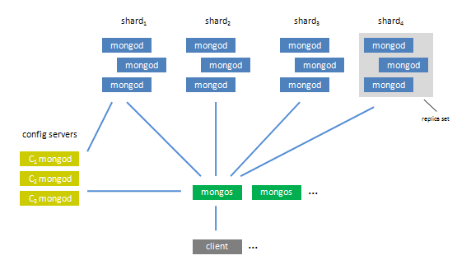
MongoDB deployment

Slide 7
MongoDB driver
Client application uses MongoDB driver library
Drivers exist for most languages
Driver API
Connection
Query/Update
Admin

