Slide 1
ROBUST HYBRIDIZED WATERMARKING USING WALSH
HADAMARD TRANSORM AND SVD
Presented by : CVML BATCH-3
S.LAVANYA(19491A04J6)
S.SURENDRA(19491A04J5)
V.AJAY(19491A04O4)
U.UDAYKIRAN(19491A04O1)
R.NIRANJANLOKESH(19491A04I4)
Under the Guidance of :
Mr. V.JAI KUMAR
M.Tech., (P.hD)
Department of Electronics and Communication Engineering

Slide 2

Outline
ABSTRACT
INTRODUCTION
LITERATURE REVIEW
OBJECTIVE
EXISTING METHOD
PROPOSED METHOD
SOFTWARE INVOLVED
ADVANTAGES AND APPLICATIONS
REFERENCES
PRE REVIEW - PROJECT VIVA-VOCE

Slide 3
Abstract
With the development of Internet communications and multimedia technology, it is of high importance to secure the digital media, including audio, video, speech, and images. In fact, watermarking technique provides an efficient solution to this problem.
In this work, a robust hybridized medical images watermarking approach based on Walsh Hadamard Transform (WHT) and singular value decomposition (SVD) is presented.
KEYWORDS : Watermarking ,Walsh Hadamard Transform , SVD, SSIM, PSNR, Lena Image, Medical Images
PRE REVIEW - PROJECT VIVA-VOCE

Slide 4
Introduction
Nowadays, the growing multimedia information exchange has activated an emerging problem of unauthorized replication and data dissemination. This unavoidably enforces the need for protection of copyrighted multimedia data.
The extraordinary growing use of medical images and sharing sensitive information of the patients necessitate the security and integrity of the information as the corruption of data stored in a medical image can harm the patient’s life.
PRE REVIEW - PROJECT VIVA-VOCE

Slide 5
However, stored medical images on cloud are vulnerable to exposure and attacks over the world wide web.
To negotiate with these impending challenges, digital watermarking systems, which refer to the procedure of hiding information (watermark), can be utilized as a promising tool for copyright protection.
Digital watermarking methods can be implemented either in the spatial domain or in the frequency domain. However, it is more robust In frequency domain, than in spatial domain.
Zeroth Review

Slide 6
Literature Survey
Ref. No | Title & Author | Technique Used | Pros | Cons
1 | A proposed security technique based on watermarking and encryption for digital imaging and communications in medicine. Author : M.M. Abd- Eldayem | DICOM(Digital imaging and communications in medicine) | System autentication service Image integrity service | Number of optional fields that it allows increases the possibility of errors.
2 | Blind image watermarking technique based on differential embedding in dwt and dct domains. Author : K . Benmahammed | DWT,DCT | Good quality image | It Can be expensive.
3 | Chaotic based secure watermarking approach for medical images. Author :S. Thakur, A.K. Singh, A. Mohan | SVD | Robustness Imperceptible Security | Transformed data may be difficult to understand.
4 | Data dimensional reduction and principal components analysis. Author: N. Salem, S. Hussein | SVD,PCA(principal component analysis ) | Helps to extract significant information from bulky data sets | Information Loss.
PRE REVIEW - PROJECT VIVA-VOCE

Slide 7
Literature Survey
Ref. No | Title & Author | Technique Used | Pros | Cons
5 | Svd -based image watermarking using the fast walsh - hadamard transform, key mapping, and coefficient ordering for ownership protection. Author:T. Khanam, J.-M. Kim | FWHT ,SVD , key mapping | High security | Less energy compacting.
6 | hybrid secure watermarking scheme using nonnegative matrix factorization and fast walsh-hadamard transform. Author : E.E. Abdallah, A.E. Abdallah | FWHT,NMF(non negative Matrix Factorization) | High robustness | It fails to consider the geometric structure in the data.
7 | Wavelet-hadamard based blind image watermarking using genetic algorithm and decision tree . Author : E.M. El Houby, N.I. Yassin | DWT, WHT | It is more convenient for offline applications and trusted communications | Lack of directional selectivity.
PRE REVIEW - PROJECT VIVA-VOCE

Slide 8
Motivation
Due to advanced internet systems there is a lack of security to digital data such as audio , video etc., this may cause data duplication and data distraction. Thus, watermarking provide security for the protection of data and ownership protection.
PRE REVIEW - PROJECT VIVA-VOCE

Slide 9
Objective
The Objective of this project is to process the original image into the watermarked image by adding a watermark using Walsh Hadamard Transform(WHT) and Singular Value Decomposition(SVD) and to extract the watermark from the watermarked image.
PRE REVIEW - PROJECT VIVA-VOCE

Slide 10
Existing Method
Walsh Hadamard Transform & SVD:
Walsh Hadamard Transform (WHT ), also known as Walsh−Fourier Transform, is an orthogonal function that consists of only two values +1 and −1, and it is widely used in image processing and speech processing for its unique sequence values, simplicity, and low−computational complexity.
However, the inverse (WHT ) can be used to recover and reconstruct the original image.
Singular Value Decomposition (SVD) involves breaking down a matrix A into the form, which allows us to retain the important singular values that the image requires.
Also, artificial neural network (ANN) approach was applied for extracting the features of the medical image to distinguish the region of interest from the region of no interest and (RGB) classification.
PRE REVIEW - PROJECT VIVA-VOCE

Slide 11
Proposed Method
Watermark Embedding :
In the embedding process, watermarks are inserted onto the cover image intended to be protected.
The cover image in which the watermark is inserted is known as the host image and the watermark which is to be inserted is a Lena image.
Watermark Extraction :
In the extraction process, the watermarked image is retrieved from the original image.
PRE REVIEW - PROJECT VIVA-VOCE

Slide 12
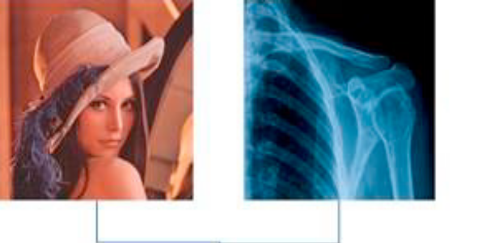
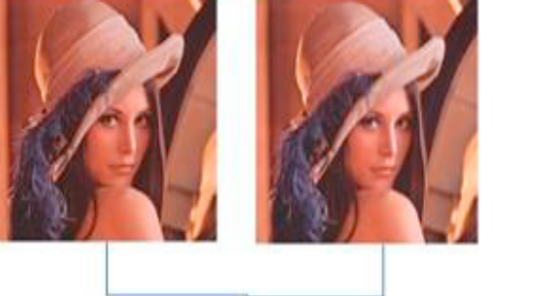
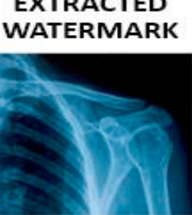
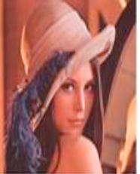
Block diagram
Fig. The watermark embedding algorithm
Fig : The watermark extraction algorithm
Host
Watermarked
Host
Watermark
Separate RGB
Apply 2D FWHT
Apply SVD
Apply 2D FWHT
Subtract singular values of both images
Apply SVD
Extracted Watermark
Modify singular values of both images
Watermarked
Inverse SVD
Inverse FWHT
Inverse SVD
Inverse FWHT
PRE REVIEW - PROJECT VIVA-VOCE

Slide 13
Explanation of Proposed Method
Watermark Embedding :
In the embedding process, watermarks are inserted onto the cover image intended to be protected. The proposed algorithm for the watermark−embedding process is illustrated in Fig. 1a. For a host image and a watermark image, each with a dimension of (512 X_x0003_512), the algorithm’s procedures are as follows:
Partition the host image and so the watermark image into three channels or blocks: (red, green, blue).
Apply the (FWHT ) on each channel of the host image and similar for the watermark image.
Apply the (S VD) on each channel and convert it into three U, S, and V matrices, each is with (512X512)dimensions.
Find the singular values of the host image and then modify them by the singular values of the watermark image using the following equation:
Snew = Shost + α *Swatermark (where α is set to a value of 0.10.)
Apply the inverse (S VD) as follows:
Wnew = UhostSwatermark VT
Find the inverse (FWHT ) to acquire the watermarked image.
Combine the three channels: (red, green, blue).
Repeat all the above procedures for another watermark image
PRE REVIEW - PROJECT VIVA-VOCE

Slide 14
Watermark Extraction :
In the extraction process, the watermarked image is retrieved from the original image. The proposed process of the watermark extraction is demonstrated in Fig. 1b. This extraction process is a non-blind watermarking, given the fact that it uses and copies both the original image and the embedded watermark image that are necessary for the extraction. The process steps are as follows:
Apply the (FWHT ) on the watermarked image and on the host image.
Apply the (SVD) on the (FWHT ) transformed watermarked image.
Subtract the singular values of the host image from the singular values of the watermarked image, as follows:
Swnew = Swatermark −Shost
Apply the inverse (SVD) to acquire the extracted watermark image, as follows:
Wext = UwSwnewVT
5. Apply the inverse (FWHT)
Zeroth Review

Slide 15
Software Involved
MATLAB is a programming platform designed specifically for engineers and scientists to analyze and design systems and products that transform our world.
version 1.8.0.0 (10.1 MB) by Francesco Pizzo.
PRE REVIEW - PROJECT VIVA-VOCE

Slide 16
Applications
The applications of watermarking are :
1. ownership protection.
2. broadcast monitoring.
3. ownership identification.
4. transaction tracking.
5. copy control.
PRE REVIEW - PROJECT VIVA-VOCE

Slide 17
Advantages
The advantages of watermarking are :
1. This method ensures better imperceptibility of the watermarked image.
2. It provides improved robustness against noise
3. This method is designed for protecting copyright applications.
Zeroth Review

Slide 18
References
1. M.M. Abd-Eldayem “A proposed security technique based on watermarking and encryption for digital imaging and communications in medicine”
Egyptian Informatics Journal, 14 (1) (2013), pp. 1-13
2. S. Singh, R.K. Arya, H. Sharma, “A robust deinterlacing multiple image watermarking technique in dwt”,
in: 2016 International Conference on Computational Techniques in Information and Communication Technologies (ICCTICT), IEEE, 2016, pp. 8–13.
3. A. Benoraira, K. Benmahammed, N. Boucenna “Blind image watermarking technique based on differential embedding in dwt and dct domains”
EURASIP Journal on Advances in Signal Processing, 2015 (1) (2015), p. 55
4. P.K. Dhar, T. Shimamura, “ A blind lwt-based audio watermarking using fast walsh hadamard transform and singular value decomposition”
, in: 2014 IEEE International Symposium on Circuits and Systems (ISCAS), IEEE, 2014, pp. 125–128.
5. R. Bamal, S.S. Kasana”Dual hybrid medical watermarking using walsh-slantlet transform”
Multimedia Tools and Applications, 78 (13) (2019), pp. 17899-17927
6. S.M. Darwish, O.F. Hassan “A new colour image copyright protection approach using evolution-based dual watermarking”
Journal of Experi-mental & Theoretical Artificial Intelligence (2020), pp. 1-23
7. N. Salem, S. Hussein “Data dimensional reduction and principal components analysis”
Procedia Computer Science, 163 (2019), pp. 292-299
PRE REVIEW - PROJECT VIVA-VOCE

Slide 19
8. T. Khanam, P.K. Dhar, S. Kowsar, J.-M. Kim “Svd-based image watermarking using the fast walsh-hadamard transform, key mapping, and coefficient ordering for ownership protection”
Symmetry, 12 (1) (2020), p. 52
9. E.E. Abdallah, A.F. Otoom, A.E. Abdallah, M. Bsoul, S. Awwad “A hybrid secure watermarking scheme using nonnegative matrix factoriza-tion and fastwalsh-hadamard transform”
Journal of Applied Security Research, 15 (2) (2020), pp. 185-198
10. E.M. El Houby, N.I. Yassin “Wavelet-hadamard based blind image watermarking using genetic algorithm and decision tree”
Multimedia Tools and Applications, 79 (37) (2020), pp. 28453-28474
11. M.K. Abdmouleh, A. Khalfallah, M.S. Bouhlel, “ A new watermarking technique for medical image using hierarchical encryption”,
arXiv preprint arXiv:1409.4587 (2014).
12. Y. Wu, J.P. Noonan, S. Agaian, et al. “Npcr and uaci randomness tests for image encryption”,
Cyber journals: multidisciplinary journals in science and technology Journal of Selected Areas in Telecommunications (JSAT), 1 (2) (2011), pp. 31-38
13. S. Thakur, A.K. Singh, S.P. Ghrera, M. Elhoseny “Multi-layer security of medical data through watermarking and chaotic encryption for tele-health applications”
Multimedia tools and Applications, 78 (3) (2019), pp. 3457-3470
14. S. Thakur, A.K. Singh, S.P. Ghrera, A. Mohan “Chaotic based secure watermarking approach for medical images”
Multimedia Tools and Applications, 79 (7) (2020), pp. 4263-4276
Zeroth Review

Slide 20
THANK YOU
PRE REVIEW - PROJECT VIVA-VOCE

