Slide 1

WorkShop hyperledger

Slide 2
Overview
What are we going to do?
Where will we do it?
How will we do it?
What will we need to do it?
Extras (Docker commands, Tools configuration, glossary)

Slide 3
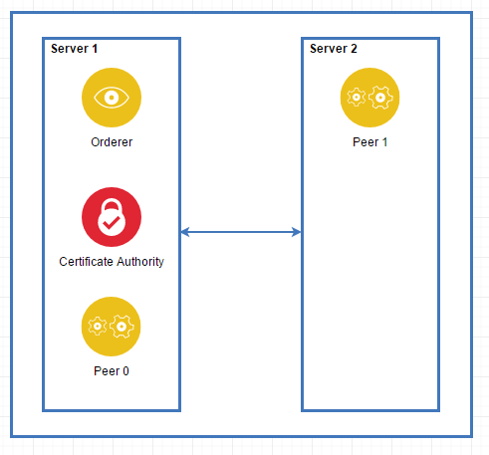
What are we going to do?
General Overview
Architecture
Hyperledger Fabric v1.2
2 DigitalOcean's Droplets
Hyperledger Composer
2 Organizations
Orderer Organization
Peer Organization

Slide 4

Where will we do it?
DigitalOcean's Droplets
Ubuntu v16.04
Docker v17.12
We will install some tools later

Slide 5

How will we do it?
Github Repository
Markdown
Example code
Hyperledger Fabric Example
Basic-Network

Slide 6
What will we need to do it?
Knowledge
Tools
No Hyperledger knowledge required.
Some linux commands
(Very basic commands)
Basics of Blockchain
What is a blockchain?
How it works?
For Windows
GitBash
Filezilla
If you have better tools, you can use them!

Slide 7
Extras
Tools configuration
FileZilla
Docker Commands
Docker ps, Docker rm, Docker-compose, etc.
Glossary
Hyperledger Fabric, Hyperledger Composer, Orderer, Peer, etc.

Slide 8
Questions?

