Slide 1



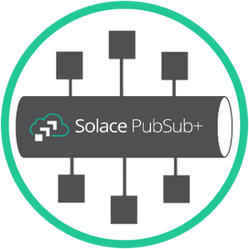








SQS Queue
SNS Topic
Lambda
Function
S3 bucket
w/ objects
Kinesis
Streams

Slide 2

Open/Messaging
Protocols
Solace
message broker
AWS APIGateway
Web Hook
Interface
REST
Delivery
Endpoint
Solace
Queue
AWS Resource

Slide 3


Internal APIGateway
w/ VPC endpoint in
closed security group
IAM Role generated
Allowing specific resource access
Can be across AWS account
Application
send/receive
JMS for example
Data written to SQS
for example
Solace message broker
w/ Rest Delivery Endpoint

Slide 4
IAM Role generated
Allowing specific resource access
Can be across AWS account
External APIGateway
Secured with App Token
Application
send/receive
JMS for example
Data written to SQS
for example
Solace message broker
w/ Rest Delivery Endpoint

