Slide 1

Review of Graph Theory
Difficulty level: basic

Slide 2
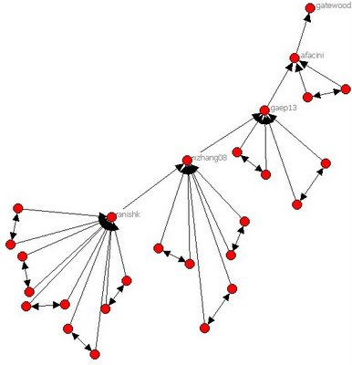
Networks (Graphs) are Everywhere!
Transportation
Economics
Society / Friendships and Interest groups
Information sources
Biology
Computing
...
May be implicit (we compute links) or explicit (we can observe links)
For our running example: we’ll look at the LinkedIn connection network
Figure by Bruce Hoppe, Creative Commons Licensed
Notes:
We’re all familiar with social networks. But on a daily basis we navigate road networks, and we interact with others on computer networks.
Our brains have internal neural connectivity in a network known as the connectome.

Slide 3
Refresher: Graph Theory Basics
label
n1
n2
Graph G = (V,E)
V is a set of vertices or nodes, possibly with properties E is a set of tuples of vertices, called edges, and may have labels or other data
V(node, label, prop1) e.g., (n1, “bob”, 20) E(source, label, target) e.g. (n1, ‘friend_of’, n2)
Notes:
This graph includes a directed and labeled edge, showing that we can get from n1 to n2 via an edge with a label. Imagine, e.g., that this represents a plane flight from city n1 to city n2.
We can also have undirected edges where we can always go in either direction. Edges may optionally have labels, costs, weights, distances, and the like. Nodes may have optional properties (such as your name and occupation in a social network).

Slide 4
Some Terminology
u,v are adjacent if there’s an edge between u and v
degree (u) = # adjacent vertices
indegree or outdegree
path = sequence of adjacent vertices
u,v are connected if path between u and v
Connected component: Set of vertices connected to each other, that is not part of a larger connected set.
Triangle: 3 vertices that are pairwise adjacent.
Clique: Any set of vertices that are all pairwise adjacent.
Notes:
The most important notions here are the degree (how connected a node is) and a notion of a path, a sequence of edge traversals (thus, adjacent vertex traversals).

Slide 5
Encoding Graphs as Data Structures
Graph G
c
d
a
b
Notes:
Two ways of encoding a graph: adjacency list.

Slide 6
Encoding Graphs as Data Structures
Graph G
c
d
a
b
Adjacency list L(G)
a →
c
c, d
b, a, d
c, b
b →
c →
d →
Notes:
Two ways of encoding a graph: adjacency list.

Slide 7
Encoding Graphs as Data Structures
This edge
relation can
be encoded in a dataframe
Graph G
c
d
a
b
(a,c)
(b,c) (b,d)
(c,b) (c,a) (c,d)
(d,c) (d,b)
Adjacency list L(G)
a →
c
c, d
b, a, d
c, b
b →
c →
d →
Notes:
We’ll focus on the set of edges as a dataframe.

Slide 8
Encoding Graphs as Data Structures
This edge
relation can
be encoded in a dataframe
Graph G
c
d
Adjacency matrix A(G)
a
b
 | a | b | c | d
a | 0 | 0 | 1 | 0
b | 0 | 0 | 1 | 1
c | 1 | 1 | 0 | 1
d | 0 | 1 | 1 | 0
(a,c)
(b,c) (b,d)
(c,b) (c,a) (c,d)
(d,c) (d,b)
Adjacency list L(G)
a →
c
c, d
b, a, d
c, b
b →
c →
This can be
encoded in
a Python matrix
d →
Notes:
The third version is an adjacency matrix, which we will use later in the course.

Slide 9
Summary
Graphs are useful in a number of contexts, describing connectivity among individuals or entities
They may be directed or undirected, and there is a set tof basic terminology
They may be encoded using adjacency lists, equivalent relations (dataframes), and adjacency matrices

Slide 10
A Brief Intro to Graph Analysis, aka Network Science

Slide 11
“Network Centrality”
The general question:
How do we measure the important nodes in a graph?
aka the “central” nodes
Several methods proposed in network science literature:
Degree centrality: for a node, how many other nodes is it connected to
Betweenness centrality: for a node, how many shortest paths go through the node
Eigenvector centrality: very similar to PageRank, which we’ll discuss shortly

Slide 12
Simplest Version: Degree Centrality
For each node, compute its degree, i.e., the number of edges it connects to
In a directed graph suppose we want outdegree centrality, i.e., the number of edges coming out from each node n
How to write in Pandas, given a dataframe edges(from, to)?
Notes:
Hint: we can call edges.groupby([‘from’]).count().reset_index() and the ‘to’ column will now include a count of outdegree for each from node.

Slide 13
Beyond Degree Centrality
Degree centrality is moderately useful
citation counts in academia
number of followers in Twitter
number of commits in GitHub
But we may want to look at relationships to more distant nodes!
To get there, let’s look at how to reason about what’s nearby in a graph

Slide 14
Exploring a Graph
We will want to start at some node (set) and look at connected nodes in the graph
How far away is X from Y?
How many nodes are within distance k?
What are the odds I can start at X and end up at Y?
(Some of these are the basis of ranking + recommendations)
So how can we do this?

Slide 15
Computing Distance in a Graph via Breadth-First Search
How far apart are two nodes?
Distance between two nodes =
number of edges on the shortest path between them.
Breadth-First Search: Algorithm “pattern” for exploring at successively greater distances
Needs to remember two things:
What you have already visited (don’t want to backtrack)
What places you’ve learned about but haven’t visited
Notes:
BFS is a very simple algorithm that allows you to to traverse a graph at increasingly greater distances from the starting node.
There are also other algorithms to traverse the entire graph, e.g. Depth-First Search.

Slide 16
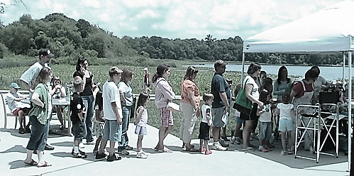

Breadth-First Search (BFS) for Undirected or Directed Graphs
"The line for face painting" by be OH be is licensed under CC BY-NC 2.0
Unexplored
vertices
Queue of Frontier Vertices
Visited
vertices
Frontier
vertices
Notes:
Start at some node, and look at outgoing edges. The nodes at the end of these edges are called the “frontier” (shown in red, the visited nodes are in blue). Once the red nodes become blue, the white nodes become red. Make sure we don’t backtrack by making sure that the frontier nodes have not already been visited.

Slide 17
BFS – Centralized, Loop-Based Algorithm
Initialize a frontier queue with the origin node
While the frontier queue has a vertex in it
Pick a vertex v from the front of the queue
Put each unexplored neighbor of v in queue
Note closer edges are always considered before more distant edges.
Efficiency: Each edge is examined once (undirected: in each direction) (if graph given as adjacency list).
Just a small amount of work is required to examine each edge.
Running time is proportional to the number of edges.
Let’s see it in Python…
Notes:
Here is the centralized algorithm. Visit nodes in order of the queue, will always visit closer nodes before nodes that are further away.

Slide 18
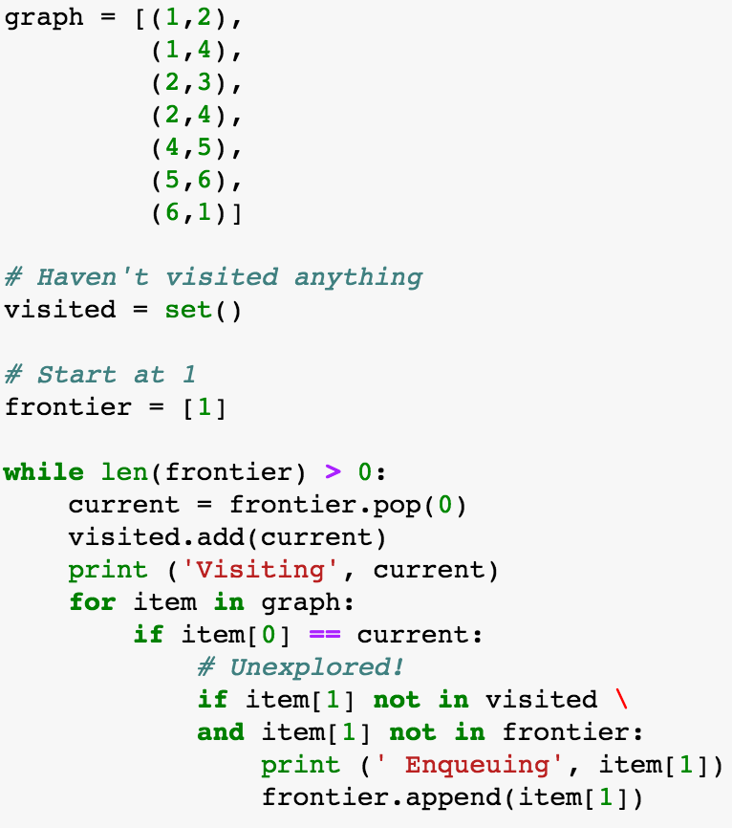
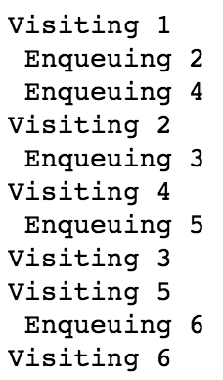
1
2
4
3
5
6
Notes:
See this in action on the graph shown in red.

Slide 19
Breadth-First Search Summarized, on a Single Computer
In a centralized algorithm, we rely on two things:
The frontier queue guarantees we visit closer nodes before we visit further-away nodes
The visited set lets us avoid back-tracking to a previous node
Notes:
If appropriate, tease the notion of trying to do a parallel breadth-first search. This is in the Scalable Data Processing module.

Slide 20
A Few Applications of BFS

Slide 21
A Common Question
How far away is V from A?
“Shortest path”
Let’s assume that
the graph is directed and may have cycles
all edges have equal (“unit”) cost
Can BFS help?
O
N
H
G
P
F
M
B
Q
A
E
W
D
L
I
V
C
K
J
U
R
S
T

Slide 22
Adding Connections in Social Networks
One’s friends tend to become each other’s friends.
This is called Triadic Closure.
A node A violates the Triadic Closure Property if it has two friends B and C who are not each other’s friends.
We often look to complete triangles to recommend
friends – prioritize by the number of incomplete triangles
B
A₂
A₁
C
Notes:
Friend recommendations.

Slide 23
Adding Connections in Social Networks
One’s friends tend to become each other’s friends.
This is called Triadic Closure.
A node A violates the Triadic Closure Property if it has two friends B and C who are not each other’s friends.
We often look to complete triangles to recommend
friends – prioritize by the number of incomplete triangles
B
A₂
A₁
C
Discuss: How can we use BFS/Shortest Path here?
Hint: consider a set of start nodes and the (min) depths
Notes:
Friend recommendations.

Slide 24
A Sketch of a Solution
Run BFS from “us” to find friends (nodes at depth 1) and friends of our friends (nodes with min depth 2)
Run BFS from FoF to depth 1
For each FoF n, count how many of our friends are in common
Rank each FoF n by how many friends we have in common
Notes:
For many years, this was the basic scheme for friend recommendation used by Facebook.

Slide 25
Other Common Path-based algorithms
Sometimes our goal is to compute information about the paths (sets of paths) between nodes
Edges may be annotated with cost, distance, or similarity
Examples of such problems (see algorithms courses):
Shortest path from one node to another (we saw)
Minimum spanning tree (minimal-cost tree connecting all vertices in a graph)
Steiner tree (minimal-cost tree connecting certain nodes)
Topological sort (node in a graph without cycles comes before all nodes it points to)
Other times we want to visit all nodes, all edges, …

Slide 26
Summary
Degree centrality is a simple measure of importance in a network
Breadth-first search provides a building block for many kinds of graph traversals

