Slide 1

Unsupervised Machine Learning
Notes:
Framing: unsupervised, supervised, reinforcement learning.

Slide 2
Machine Learning Basics
Data is typically comprised of features – values that might be useful in predicting the output
Red, green, blue values of pixels in an image
Keywords in a document
Purchases of a customer
These are used in machine learning, which either finds commonality among features, or finds a function between features and a prediction
“Not all features are created equal”
Some are easier to learn from
Some are correlated with others!
Notes:
Before we talk about supervised and unsupervised machine learning, it’s important to start with understanding the machine learning problem formulation and setup.

Slide 3
Two Flavors of Machine Learning
1. Find the structure in the data (unsupervised)
2. Find a function mapping from data features to classes (supervised)
x
x
x
x
x
x
Input data: x₁, x₂, x₃, …, x_{n}
x
x
x
x
x
x
x
x
x
Input data: x₁, x₂, x₃, …, x_{n}
x
o
x
x
o
+ Labels: y₁, y₂, y₃, …, y_{n}
o
x
x
o
o

Slide 4
A Workflow for ML: Unsupervised → Supervised Learning
Often, start with unsupervised learning, which can:
Reduce number of dimensions
Provide insights into natural clusters
Generate more natural features
Then run supervised learning methods!
Notes:
The two kinds of ML are often used together in a “pipeline”…

Slide 5
Outline
Background: representing data for machine learning
Unsupervised machine learning (the main part of this lecture)
Supervised machine learning (next lecture)

Slide 6
Representing Data for Machine Learning
(Also see companion lecture notebook)

Slide 7
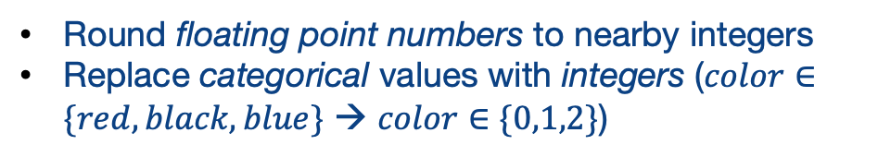
Matrices for Machine Learning
We have used Dataframes (relations) for our data
Machine learning typically works best using matrices
Map from a row in the dataframe → a row in a numeric matrix
customer | phone_color | purchase_amt
1 | blue | $30.90
2 | black | $55.22
Matrices have one type of data; change representations, e.g.:
1 | 2 | 31
2 | 1 | 56
Round floating point numbers to nearby integers
Replace categorical values with integers ($color∈\{red,black,blue\}$ → $color∈\{0,1,2\}$)
But perhaps more than that. Let’s explore with a more realistic example!
Notes:
When we go from a dataframe, which allows for heterogeneous fields, to a matrix, we often need to change our representation of the data.

Slide 8
Matrices in Python
Most commonly: numpy arrays
Recall that arrays have all elements of the same type, so must be floating-point- or integer-valued
# Basics of arrays: Numpy
import numpy as np
# We start with a simple array, initialized with random values
arr = np.ndarray((4,2))
# Show dimensions
arr.shape
Notes:
ndarray takes a tuple specifying the number of items in each dimension.
By default, it does not initialize the values in the array, so they are whatever is left in memory
You can use np.zeros or np.ones to preconfigure the data to 0’s or 1’s.

Slide 9
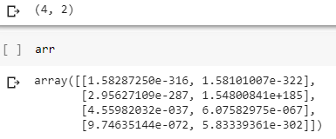
Matrices in Python
Most commonly: numpy arrays
Recall that arrays have all elements of the same type, so must be floating-point- or integer-valued
# Basics of arrays: Numpy
import numpy as np
# We start with a simple array, initialized with random values
arr = np.ndarray((4,2))
# Show dimensions
arr.shape
Notes:
ndarray takes a tuple specifying the number of items in each dimension.
By default, it does not initialize the values in the array, so they are whatever is left in memory
You can use np.zeros or np.ones to preconfigure the data to 0’s or 1’s.

Slide 10
Matrices in Python
Most commonly: numpy arrays
Recall that arrays have all elements of the same type, so must be floating-point- or integer-valued
# Basics of arrays: Numpy
import numpy as np
# We start with a simple array, initialized with random values
arr = np.ndarray((4,2))
# Show dimensions
arr.shape
arr = np.zeros((4,2))
arr = np.ones((4,2))
Notes:
ndarray takes a tuple specifying the number of items in each dimension.
By default, it does not initialize the values in the array, so they are whatever is left in memory
You can use np.zeros or np.ones to preconfigure the data to 0’s or 1’s.

Slide 11
Matrices as Inputs to Machine Learning
Each row represents an instance or observation
Each column represents a feature
Again, all data is integer or float!
Requires us to think about feature extraction!
x1 | x2 | x3 | x4 | x5 | x6
instance (row, sample, observation)
extracted feature
Notes:
We need to make sure each row represents one observation or instance, and we need to populate the feature values as columns, all in the same type…

Slide 12
From DataFrames to Features: Some Simple Ideas
Replace string or categorical data with integer codes
e.g., for US states: {0: ‘Alabama’, 1: ‘Alaska’, 2: ‘Arizona’, …, 49: ‘Wyoming’}
Also: is there linear relationship between values?
categorical data items are generally not related
some data, e.g., geocodes, may be better off mapped into zones and treated as categorical
One-hot encoding: turn a set of potential values into a set of disjoint features – in a bit vector
Alabama | Alaska | … | Wyoming
0 | 0 | … | 1
1 | 0 | … | 0

Slide 13
One-Hot Encoding in Pandas
 | city | state
0 | New York | NY
1 | Los Angeles | CA
2 | Chicago | IL
3 | Houston | TX
4 | Phoenix | AZ
5 | Philadelphia | PA
6 | San Antonio | TX
addresses_df = \ pd.DataFrame([{'city': 'New York', 'state': 'NY'},\
{'city': 'Los Angeles', 'state': 'CA'},\
{'city': 'Chicago', 'state': 'IL'},\
{'city': 'Houston', 'state': 'TX'},\
{'city': 'Phoenix', 'state': 'AZ'}, \
{'city': 'Philadelphia', 'state': 'PA'}, \
{'city': 'San Antonio', 'state': 'TX'}])
 | AZ | CA | IL | NY | PA | TX
0 | 0 | 0 | 0 | 1 | 0 | 0
1 | 0 | 1 | 0 | 0 | 0 | 0
2 | 0 | 0 | 1 | 0 | 0 | 0
3 | 0 | 0 | 0 | 0 | 0 | 1
4 | 1 | 0 | 0 | 0 | 0 | 0
5 | 0 | 0 | 0 | 0 | 1 | 0
6 | 0 | 0 | 0 | 0 | 0 | 1
pd.get_dummies(addresses_df['state'])
pd.get_dummies(addresses_df['state’]).\ to_numpy()
Notes:
The Pandas get_dummies function takes a field and automatically expands it into a one-hot encoding with a Boolean value for each categorical attribute. Calling to_numpy() will turn it into an array.

Slide 14
Sometimes We Want Only a Subset of Features -- Slicing a Matrix
NumPy lets you specify, for each dimension, a range of values to “slice” out…
Negative numbers mean “dimension size minus the number”
# In each dimension you can give a left:right
# range. Ranges are left-inclusive and right exclusive
arr[1:3,1]
X = input[:,0:-1]
Notes:
We can “slice” each dimension from a:b (non-inclusive). If b is negative that is the number of columns from the upper bound.

Slide 15
Where this Is Frequently Useful in Machine Learning
We may have data in which the last column is the label for whether the data belongs to a class
We may split this into the matrix X (features) and vector y (class labels)
array([[0, 0, 0, 1, 0, 0, False], [0, 1, 0, 0, 0, 0, True], [0, 0, 1, 0, 0, 0, False], [0, 0, 0, 0, 0, 1, False], [1, 0, 0, 0, 0, 0, True], [0, 0, 0, 0, 1, 0, True], [0, 0, 0, 0, 0, 1, False]], dtype=object)
# All rows, last column
y = data[:,-1]
# All rows, all but last column
X = data[:,0:-1]
Notes:
We will cluster on X, or use X for testing a supervised machine learning algorithm (classifier), or use X and y together as inputs to train a classifier.

Slide 16
Where this Is Frequently Useful in Machine Learning
y (labels): [False True False False True True False] X (training data): [[0 0 0 1 0 0] [0 1 0 0 0 0] [0 0 1 0 0 0] [0 0 0 0 0 1] [1 0 0 0 0 0] [0 0 0 0 1 0] [0 0 0 0 0 1]]
We may have data in which the last column is the label for whether the data belongs to a class
We may split this into the matrix X (features) and vector y (class labels)
array([[0, 0, 0, 1, 0, 0, False], [0, 1, 0, 0, 0, 0, True], [0, 0, 1, 0, 0, 0, False], [0, 0, 0, 0, 0, 1, False], [1, 0, 0, 0, 0, 0, True], [0, 0, 0, 0, 1, 0, True], [0, 0, 0, 0, 0, 1, False]], dtype=object)
# All rows, last column
y = data[:,-1]
# All rows, all but last column
X = data[:,0:-1]
Notes:
We will cluster on X, or use X for testing a supervised machine learning algorithm (classifier), or use X and y together as inputs to train a classifier.

Slide 17
Summary: The Basics of Data Representation
Machine learning algorithms typically take an input 2D matrix
Rows = instances or samples
Columns = features
We may need to extract or encode values from a DataFrame
Encodings for non-numeric data
One-hot encodings
We can use slicing to restrict the set of instances or features we consider
Notation: Often, the matrix for machine learning is simply referred to as the X matrix!

Slide 18
Unsupervised Machine Learning

Slide 19
Unsupervised Machine Learning
Technique 1: Dimensionality Reduction
Principal Component Analysis (PCA)
Reduce high number of correlated features to a lower number of uncorrelated features
New features are weighted combinations of originals
t-Distributed Stochastic Neighbor Embedding (t-SNE)
Technique 2: Clustering
Find groupings in the data

Slide 20
Reducing Dimensionality: Principal Component Analysis (PCA)

Slide 21
What Is PCA?
An unsupervised method that takes X from p dimensions down to k dimensions
Why is this helpful?
Reduces noise in the data for supervised learning
Reduces data
Simpler to visualize data (though dimensions may be unintuitive!)

Slide 22
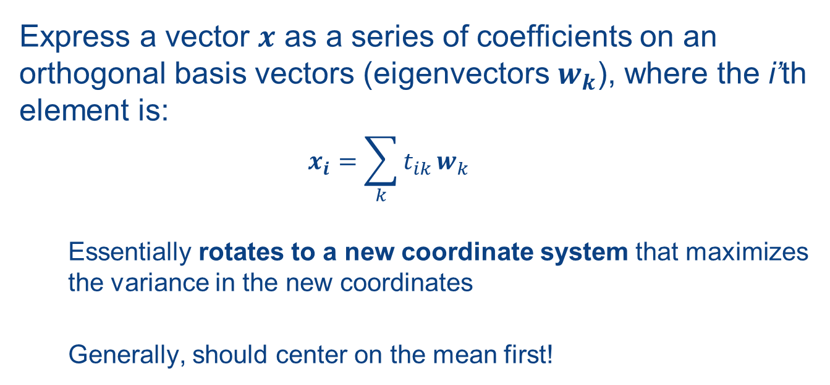
How Does It Work?
Express a vector $x$ as a series of coefficients on an orthogonal basis vectors (eigenvectors $w_{k}$), where the i’th element is:
$$x_{i}=\sum_{k}{t_{ik}}w_{k}$$
Essentially rotates to a new coordinate system that maximizes the variance in the new coordinates
Generally, should center on the mean first!

Slide 23
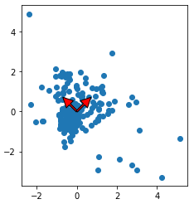
PCA, Visualized
Transform to new coordinate system:
Find directions of maximum variation (covariance)
Minimize reconstruction error
PC2
PC1
Notes:
The red lines represent the first and second principle component. You can intuitively see that PC1 points in a direction that captures the most variation.

Slide 24
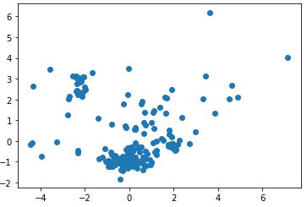
PCA Projection
PC2
PC1
Notes:
Here we’ve re-plotted using the new coordinate system (one axis is PC1, the other PC2).

Slide 25
Observations
PCA is not scale-invariant as it finds the direction of maximum variation!
We can look at explained variance for each component – the ratio of the principal component vs the total variance across all components
First k principal components explain the most variance any k variables can explain

Slide 26
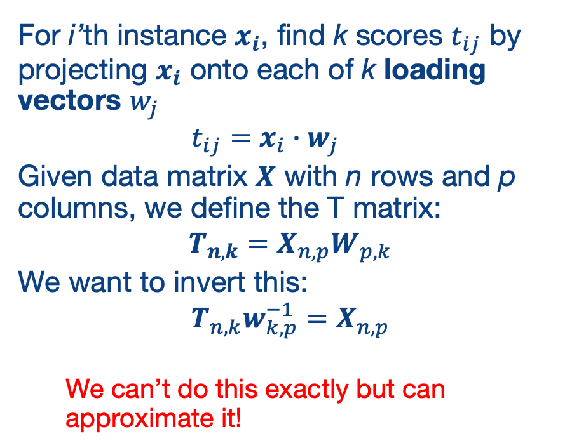
Formalizing PCA
For i’th instance $x_{i}$, find k scores $t_{ij}$ by projecting $x_{i}$ onto each of k loading vectors $w_{j}$
$$t_{ij}=x_{i}∙w_{j}$$
Given data matrix $X$ with n rows and p columns, we define the T matrix:
$$T_{n,k}=X_{n,p}W_{p,k}$$
We want to invert this:
$$T_{n,k}w_{k,p}^{−1}=X_{n,p}$$
We can’t do this exactly but can approximate it!

Slide 27
A PCA Example
Glass Identification Data Set from UC Irvine ML Repository
https://archive.ics.uci.edu/ml/datasets/glass+identification
The task:
Forensic scientists need to identify the type of glass based on its chemical composition!
Can we take a dataset of glass instances and their chemical compositions and:
Reduce dimensionality (by default 8 elements + refractive index are given)
Predict the type of glass: building, vehicle, container, tableware, headlight [this part uses supervised machine learning]

Slide 28
Glass Data in a DataFrame
 | ID | Refractive Index | Na | Mg | Al | Si | K | Ca | Ba | Fe | Type
0 | 1 | 1.52101 | 13.64 | 4.49 | 1.10 | 71.78 | 0.06 | 8.75 | 0.00 | 0.0 | 1
1 | 2 | 1.51761 | 13.89 | 3.60 | 1.36 | 72.73 | 0.48 | 7.83 | 0.00 | 0.0 | 1
2 | 3 | 1.51618 | 13.53 | 3.55 | 1.54 | 72.99 | 0.39 | 7.78 | 0.00 | 0.0 | 1
3 | 4 | 1.51766 | 13.21 | 3.69 | 1.29 | 72.61 | 0.57 | 8.22 | 0.00 | 0.0 | 1
4 | 5 | 1.51742 | 13.27 | 3.62 | 1.24 | 73.08 | 0.55 | 8.07 | 0.00 | 0.0 | 1
... | ... | ... | ... | ... | ... | ... | ... | ... | ... | ... | ...
# Remove the ID and the Type labels for # the training data set X
X = glass_df.drop(['ID','Type'], axis=1)
# Labels are in a separate y vector
y = glass_df['Type']

Slide 29
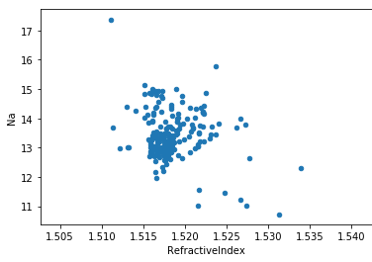
Glass Data in a DataFrame
 | ID | Refractive Index | Na | Mg | Al | Si | K | Ca | Ba | Fe | Type
0 | 1 | 1.52101 | 13.64 | 4.49 | 1.10 | 71.78 | 0.06 | 8.75 | 0.00 | 0.0 | 1
1 | 2 | 1.51761 | 13.89 | 3.60 | 1.36 | 72.73 | 0.48 | 7.83 | 0.00 | 0.0 | 1
2 | 3 | 1.51618 | 13.53 | 3.55 | 1.54 | 72.99 | 0.39 | 7.78 | 0.00 | 0.0 | 1
3 | 4 | 1.51766 | 13.21 | 3.69 | 1.29 | 72.61 | 0.57 | 8.22 | 0.00 | 0.0 | 1
4 | 5 | 1.51742 | 13.27 | 3.62 | 1.24 | 73.08 | 0.55 | 8.07 | 0.00 | 0.0 | 1
... | ... | ... | ... | ... | ... | ... | ... | ... | ... | ... | ...
# Remove the ID and the Type labels for # the training data set X
X = glass_df.drop(['ID','Type'], axis=1)
# Labels are in a separate y vector
y = glass_df['Type']

Slide 30
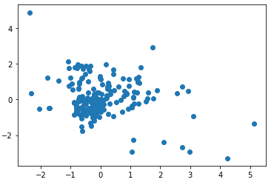
Best Practice: Scaling and Centering
# Standardize features by removing the mean and scaling to unit variance
from sklearn.preprocessing import StandardScaler
# Standardizing the features between 0 and 1
X = StandardScaler().fit_transform(X)
X
array([[ 0.87286765, 0.28495326, 1.25463857, ..., -0.14576634, -0.35287683, -0.5864509 ], [-0.24933347, 0.59181718, 0.63616803, ..., -0.79373376, -0.35287683, -0.5864509 ], [-0.72131806, 0.14993314, 0.60142249, ..., -0.82894938, -0.35287683, -0.5864509 ], ..., [ 0.75404635, 1.16872135, -1.86551055, ..., -0.36410319, 2.95320036, -0.5864509 ], [-0.61239854, 1.19327046, -1.86551055, ..., -0.33593069, 2.81208731, -0.5864509 ], [-0.41436305, 1.00915211, -1.86551055, ..., -0.23732695, 3.01367739, -0.5864509 ]])

Slide 31
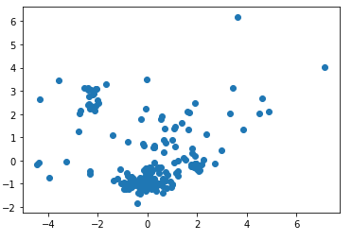
PCA in SciKit-Learn
from sklearn.decomposition import PCA
pca = PCA(n_components=9)
X2 = pca.fit_transform(X)
# Let's see the components
pca.components_
array([[ 0.54517662, -0.2581256 , 0.11088095, -0.42870863, -0.22883635, -0.21934405, 0.49230609, -0.25037512, 0.18584154], [ 0.28568318, 0.27035007, -0.59355826, 0.29521154, -0.15509891, -0.15397013, 0.3453798 , 0.48470218, -0.06203879], [ 0.08691083, -0.38491962, 0.00841796, 0.32923712, -0.45870884, 0.66257412, -0.00098473, 0.07405473, 0.28445055], [ 0.14738099, 0.49124204, 0.37878577, -0.13750592, -0.65253771, -0.03853544, -0.27644322, 0.13317545, -0.23049202], [-0.0735427 , 0.1536833 , 0.12350912, 0.01410888, 0.00850012, -0.30703984, -0.18818774, 0.25133426, 0.87326405], [ 0.11528772, -0.55811757, 0.30818598, -0.01885731, 0.08609797, -0.24363237, -0.14866937, 0.65721884, -0.24304431], [ 0.08186724, 0.14858006, -0.20604537, -0.69923557, 0.21606658, 0.50412141, -0.09913463, 0.35178255, 0.07372136], [-0.7522159 , -0.12769315, -0.07689061, -0.27444105, -0.37992298, -0.10981168, 0.39870468, 0.14493235, -0.01627141], [ 0.02573194, -0.31193718, -0.57727335, -0.19222686, -0.29807321, -0.26050863, -0.57932321, -0.1982282 , -0.01466944]])

Slide 32
Computing PCA via Singular Value Decomposition
A great tutorial: https://arxiv.org/pdf/1404.1100.pdf
Subtract off the mean from each column
Calculate the SVD of the matrix

Slide 33
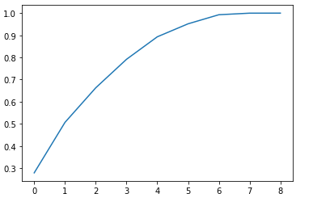
Principal Components vs Variance (Showing with 9 possible components)
np.set_printoptions(suppress=True)
pca.explained_variance_ratio_
array([0.27901819, 0.2277858 , 0.15609378, 0.12865138, 0.10155581, 0.05862613, 0.04099538, 0.00709477, 0.00017876])

Slide 34
Can We Do Supervised Learning with It?
from sklearn import linear_model
from sklearn.metrics import mean_squared_error, r2_score
from sklearn.model_selection import train_test_split
# Split 80% of data to train the supervised classifer
# and 20% to test on
X_train, X_test, y_train, y_test = train_test_split(\
X, y, test_size=0.20, random_state=42)
# Fit the PCA on the training data
pca = PCA(n_components=6)
X_train_2 = pca.fit_transform(X_train)
# Then train a simple linear regression classifier
# (details aren’t important yet -- tries
# to find the best weighted linear combination to
# match the output)
regr = linear_model.LinearRegression()
regr.fit(X_train_2, y_train)

Slide 35
Can We Do Supervised Learning with It?
from sklearn import linear_model
from sklearn.metrics import mean_squared_error, r2_score
from sklearn.model_selection import train_test_split
# Split 80% of data to train the supervised classifer
# and 20% to test on
X_train, X_test, y_train, y_test = train_test_split(\
X, y, test_size=0.20, random_state=42)
# Fit the PCA on the training data
pca = PCA(n_components=6)
X_train_2 = pca.fit_transform(X_train)
# Then train a simple linear regression classifier
# (details aren’t important yet -- tries
# to find the best weighted linear combination to
# match the output)
regr = linear_model.LinearRegression()
regr.fit(X_train_2, y_train)
X_test_2 = pca.transform(X_test)
regr.predict(X_test_2)
regr.score(X_test_2, y_test)
0.8739872270917841

Slide 36
Summary: Principal Component Analysis
Unsupervised method to reduce dimensionality, often before running supervised machine learning
Finds directions of maximum variance in high-dimensional data
Projects onto a smaller (or equal) subspace
Uses SVD (or eigenvectors) under the covers
Assumes linearity
Sensitive to data scaling

Slide 37
A Common Alternative for Visualization: t-SNE t-Distributed Stochastic Neighbor Embedding
For visualizing high-dimensional data
Makes similar data points close
Converts similarities between data points to joint probabilities
Minimizes Kullback-Leibler divergence between joint probabilities of low-dimensional embedding and high-dimensional data
Non-convex cost function
Different initializations yield different results
Can be slow, may want to do PCA first!

Slide 38
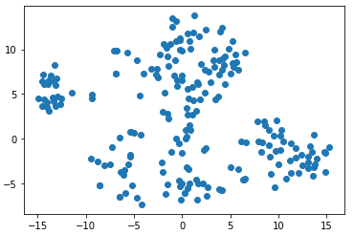
t-SNE in Python
from sklearn.manifold import TSNE
X_embedded = TSNE(n_components=2).fit_transform(X)
plt.scatter(X_embedded[:,0],X_embedded[:,1])

Slide 39
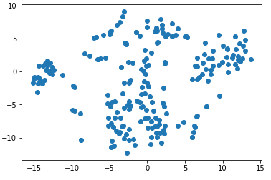
t-SNE in Python
from sklearn.manifold import TSNE
X_embedded = TSNE(n_components=2).fit_transform(X)
plt.scatter(X_embedded[:,0],X_embedded[:,1])
2nd run is different!

Slide 40
Dimensionality Reduction Wrap-up
Two main methods for reducing dimensionality
PCA – assumes linearity, sensitive to scaling, but broadly effective
t-SNE – helpful in visualizing highly dimensional data, doesn’t scale as well
Generally these are used as an intermediate step towards some broader task, whether visualizing + understanding data or doing supervised machine learning
Next, let’s consider another unsupervised method for understanding complex data – clustering

Slide 41
Clustering Data

Slide 42
The Goal of Clustering
Seeks to find “natural groupings” in data, based on some (perhaps multidimensional) notion of distance
the “clustering coefficient” – very important
Some things we may cluster:
Documents (e.g., web pages, new stories)
People (market segmentation, types of users)
RNA, DNA, diseases, …
Generally we start with a predefined number of clusters, often called k
We’ll see later how to best choose k

Slide 43
The Simplest Algorithm: k-Means
The basic idea:
For each of k clusters, pick a centroid for the cluster
Assign each point (data instance) to the cluster associated with the nearest centroid
How do we pick the centroids?
Randomly choose them, then iteratively update, until we reach convergence!

Slide 44
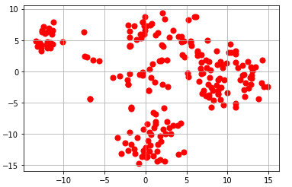
K-Means

Slide 45
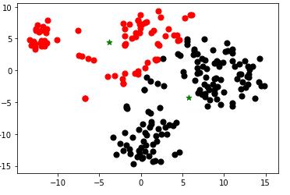
K-Means

Slide 46
The Basic K-Means Algorithm
# Initialize the centroids to random data points
centroids = np.zeros((k,2))
cluster_assignments = [0 for i in range(len(X))]
for i in range(0, k):
centroids[i] = X[randint(0, X.shape[0])]

Slide 47
The Basic K-Means Algorithm
while changed:
changed = False
# Assign points to clusters
for i,x in enumerate(X):
nearest = get_nearest(centroids, x)
# We changed a cluster mapping!
if nearest != cluster_assignments[i]:
changed = True
cluster_assignments[i] = nearest
# Recompute clusters
for i in range(len(centroids)):
points = [j for j,v in enumerate(cluster_assignments) \ if v == i]
X_subset = np.array([[X[i,0],X[i,1]] for i in points])
centroids[i][0] = np.sum(X_subset[:, 0]) / len(points)
centroids[i][1] = np.sum(X_subset[:, 1]) / len(points) return (centroids, np.array(cluster_assignments))
# Initialize the centroids to random data points
centroids = np.zeros((k,2))
cluster_assignments = [0 for i in range(len(X))]
for i in range(0, k):
centroids[i] = X[randint(0, X.shape[0])]

Slide 48
Stop Conditions
Convergence, as in our code – every cluster label remains the same
Fixed number of iterations (typically used with SciKit)
User-defined tolerance

Slide 49
Results
Initialized centroids to: [[-11.82199955 6.87400341] [ 1.68457079 1.6951865 ]] Iteration 1 Cluster 0 [-11.33586516 4.95605412] Cluster 1 [ 4.23969028 -2.00317546] Iteration 2 Cluster 0 [-9.78340957 4.5092549 ] Cluster 1 [ 4.55216471 -2.18941684] Iteration 3 Cluster 0 [-7.49966563 4.80706721] Cluster 1 [ 4.95082383 -2.74943724] Iteration 4 Cluster 0 [-6.18770585 5.02668734] Cluster 1
…

Slide 50
Results
Initialized centroids to: [[-11.82199955 6.87400341] [ 1.68457079 1.6951865 ]] Iteration 1 Cluster 0 [-11.33586516 4.95605412] Cluster 1 [ 4.23969028 -2.00317546] Iteration 2 Cluster 0 [-9.78340957 4.5092549 ] Cluster 1 [ 4.55216471 -2.18941684] Iteration 3 Cluster 0 [-7.49966563 4.80706721] Cluster 1 [ 4.95082383 -2.74943724] Iteration 4 Cluster 0 [-6.18770585 5.02668734] Cluster 1
…
Converged!
array([0, 1, 1, 1, 1, 1, 1, 1, 0, 1, 1, 1, 1, 1, 1, 1, 1, 0, 0, 1, 1, 0, 1, 1, 1, 1, 1, 1, 1, 1, 1, 1, 1, 1, 1, 1, 0, 1, 0, 0, 1, 1, 1, 0, 1, 0, 1, 0, 0, 0, 0, 1, 1, 1, 1, 1, 1, 1, 1, 1, 1, 0, 0, 0, 0, 0, 0, 0, 0, 0, 1, 1, 1, 1, 1, 1, 1, 1, 1, 1, 1, 1, 1, 1, 0, 1, 1, 1, 1, 1, 1, 1, 1, 1, 1, 1, 1, 1, 1, 1, 1, 1, 1, 0, 0, 1, 0, 0, 0, 0, 0, 0, 0, 1, 1, 1, 1, 1, 1, 1, 1, 1, 1, 1, 0, 1, 1, 1, 1, 1, 0, 0, 1, 1, 1, 1, 1, 1, 1, 1, 1, 1, 1, 1, 1, 1, 1, 1, 1, 1, 1, 0, 1, 1, 1, 1, 1, 0, 1, 1, 1, 1, 1, 0, 1, 1, 1, 1, 1, 1, 0, 0, 0, 0, 1, 1, 0, 1, 0, 0, 1, 0, 0, 0, 0, 0, 0, 0, 0, 0, 0, 0, 0, 0, 0, 0, 0, 0, 0, 0, 0, 1, 0, 0, 0, 0, 0, 0, 0, 0, 0, 0, 0, 0])16

Slide 51
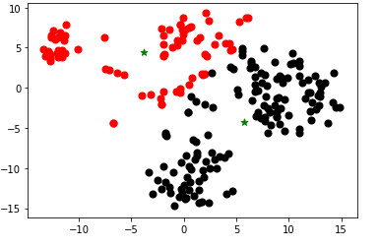
Results
Initialized centroids to: [[-11.82199955 6.87400341] [ 1.68457079 1.6951865 ]] Iteration 1 Cluster 0 [-11.33586516 4.95605412] Cluster 1 [ 4.23969028 -2.00317546] Iteration 2 Cluster 0 [-9.78340957 4.5092549 ] Cluster 1 [ 4.55216471 -2.18941684] Iteration 3 Cluster 0 [-7.49966563 4.80706721] Cluster 1 [ 4.95082383 -2.74943724] Iteration 4 Cluster 0 [-6.18770585 5.02668734] Cluster 1
…
Converged!
array([0, 1, 1, 1, 1, 1, 1, 1, 0, 1, 1, 1, 1, 1, 1, 1, 1, 0, 0, 1, 1, 0, 1, 1, 1, 1, 1, 1, 1, 1, 1, 1, 1, 1, 1, 1, 0, 1, 0, 0, 1, 1, 1, 0, 1, 0, 1, 0, 0, 0, 0, 1, 1, 1, 1, 1, 1, 1, 1, 1, 1, 0, 0, 0, 0, 0, 0, 0, 0, 0, 1, 1, 1, 1, 1, 1, 1, 1, 1, 1, 1, 1, 1, 1, 0, 1, 1, 1, 1, 1, 1, 1, 1, 1, 1, 1, 1, 1, 1, 1, 1, 1, 1, 0, 0, 1, 0, 0, 0, 0, 0, 0, 0, 1, 1, 1, 1, 1, 1, 1, 1, 1, 1, 1, 0, 1, 1, 1, 1, 1, 0, 0, 1, 1, 1, 1, 1, 1, 1, 1, 1, 1, 1, 1, 1, 1, 1, 1, 1, 1, 1, 0, 1, 1, 1, 1, 1, 0, 1, 1, 1, 1, 1, 0, 1, 1, 1, 1, 1, 1, 0, 0, 0, 0, 1, 1, 0, 1, 0, 0, 1, 0, 0, 0, 0, 0, 0, 0, 0, 0, 0, 0, 0, 0, 0, 0, 0, 0, 0, 0, 0, 1, 0, 0, 0, 0, 0, 0, 0, 0, 0, 0, 0, 0])16

Slide 52
Pre-Implemented K-Means in SciKit-Learn
from sklearn.cluster import KMeans
km = KMeans(n_clusters=2, 'random', n_init=1, \ max_iter=300, random_state=0)
km.fit(X_embedded)
km.cluster_centers_
array([[-3.8229299, 4.3934164], [ 5.771634 , -4.2901955]], dtype=float32)
km.labels_
array([0, 1, 1, 1, 1, 1, 1, 1, 0, 1, 1, 1, 1, 1, 1, 1, 1, 0, 0, 1, 1, 0, 1, 1, 1, 1, 1, 1, 1, …

Slide 53
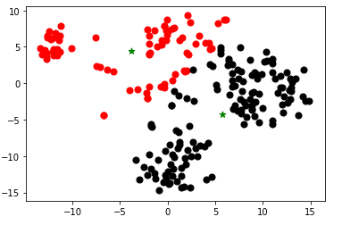
Pre-Implemented K-Means in SciKit-Learn
from sklearn.cluster import KMeans
km = KMeans(n_clusters=2, 'random', n_init=1, \ max_iter=300, random_state=0)
km.fit(X_embedded)
km.cluster_centers_
array([[-3.8229299, 4.3934164], [ 5.771634 , -4.2901955]], dtype=float32)
km.labels_
array([0, 1, 1, 1, 1, 1, 1, 1, 0, 1, 1, 1, 1, 1, 1, 1, 1, 0, 0, 1, 1, 0, 1, 1, 1, 1, 1, 1, 1, …

Slide 54
How Many Clusters Do We Need?
An issue to this point – we have to pre-select k!
How do we choose it?
Idea: pick a version of k that produces a good “fit” (clusters are “tight”, i.e., points are near centroids)

Slide 55
“The Elbow Method”
The “fit” of the clusters can be characterized by the “distortion”
Sum of squared distances (Euclidean distances) between each point and the cluster centroid
Let’s plot different values of k and find the sweet spot (elbow)!
distortions = []
max_k = 10
for i in range(1,max_k+1):
km = KMeans(n_clusters=i,
init='random',
n_init=1,
max_iter=300,
random_state=0)
km.fit(X)
# The distortion
distortions.append(km.inertia_)
plt.plot(range(1,max_k+1), distortions, marker='o')

Slide 56
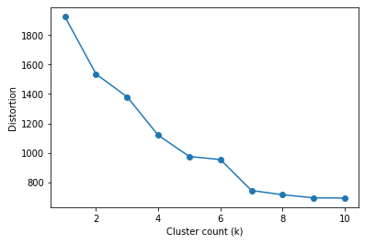
“The Elbow Method”
The “fit” of the clusters can be characterized by the “distortion”
Sum of squared distances (Euclidean distances) between each point and the cluster centroid
Let’s plot different values of k and find the sweet spot (elbow)!
distortions = []
max_k = 10
for i in range(1,max_k+1):
km = KMeans(n_clusters=i,
init='random',
n_init=1,
max_iter=300,
random_state=0)
km.fit(X)
# The distortion
distortions.append(km.inertia_)
plt.plot(range(1,max_k+1), distortions, marker='o')
Notes:
Here we can see that the cluster count has less and less benefit as we go from 6 to 8 to 10.

Slide 57
“The Elbow Method”
The “fit” of the clusters can be characterized by the “distortion”
Sum of squared distances (Euclidean distances) between each point and the cluster centroid
Let’s plot different values of k and find the sweet spot (elbow)!
distortions = []
max_k = 10
for i in range(1,max_k+1):
km = KMeans(n_clusters=i,
init='random',
n_init=1,
max_iter=300,
random_state=0)
km.fit(X)
# The distortion
distortions.append(km.inertia_)
plt.plot(range(1,max_k+1), distortions, marker='o')
Elbow

Slide 58
Summary: K-Means Clustering
One of the most scalable methods for clustering!
Each cluster is represented by a “prototype”
As we saw it in Euclidean space: a centroid
Alternatively: it could be a medoid (“k-mediods”), etc.
Some limitations:
Spherically shaped clusters
Sensitive to outliers
Many other clustering methods exist…

Slide 59
Wrap-up: Learning Unsupervised Models of Data
Two main aspects:
Dimensionality reduction – mapping to a lower-dimensional subspace
Principal Components Analysis
t-SNE
Finding natural clusters in the data
k-Means iterative algorithm

Slide 60
Wrap-up: Learning Unsupervised Models of Data
Two main ideas:
Dimensionality reduction – mapping to a lower-dimensional subspace
Principal Components Analysis
t-SNE
Finding natural clusters in the data
k-Means iterative algorithm

