Slide 1

Network Centrality and PageRank

Slide 2
Measuring “Importance” in a Field
We saw that degree of a node tells how well connected it is – directly
But what about indirectly?
e.g., how do we know Einstein was an influential physicist?
Notes:
How do we now by looking at the data that Einstein was an influential physicist?

Slide 3
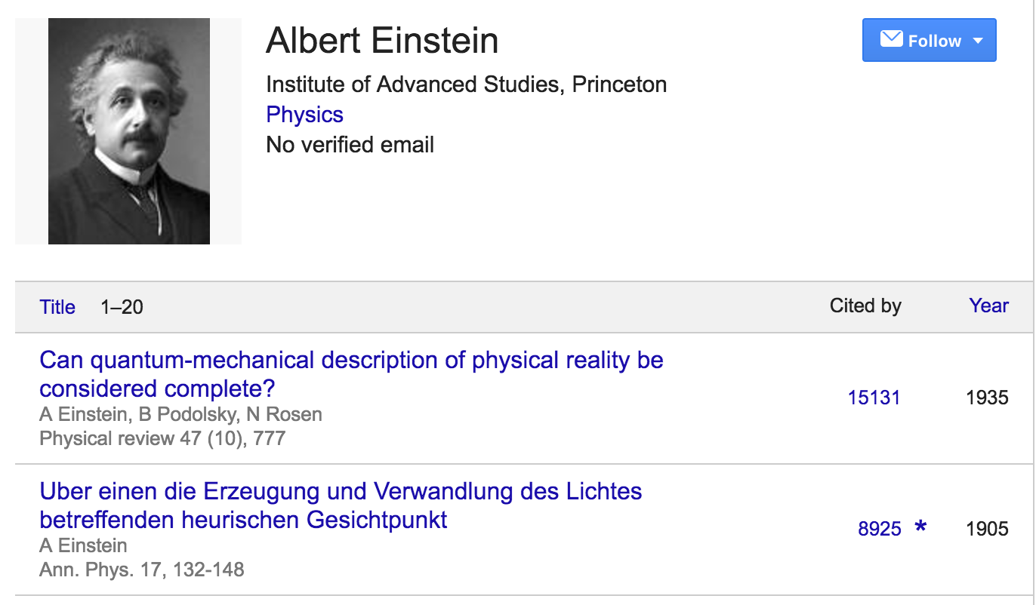
Measuring “Importance” in a Field
Notes:
Suppose we just count the number of citations for a person. Einstein has a paper that is highly cited: 15131.

Slide 4
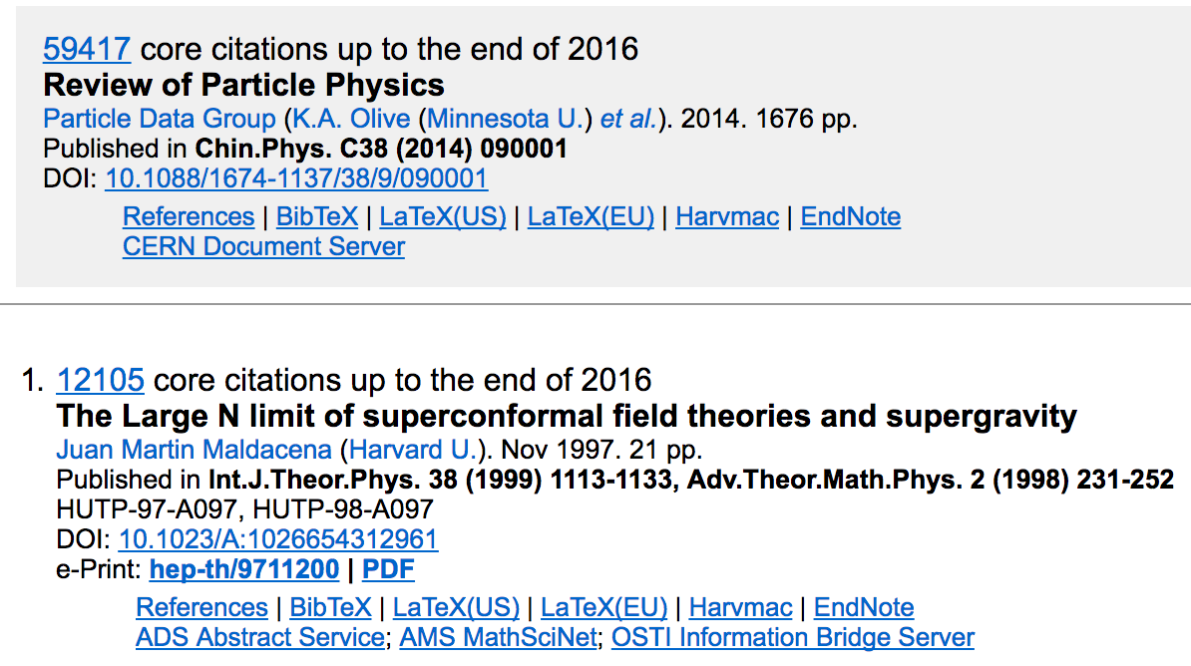
Measuring “Importance” in a Field
Notes:
Here’s another paper, with more citations. So is this person more influential than Einstein? Our degree centrality didn’t work here because we are weighting every citation equally.

Slide 5
Measuring “Importance” in a Graph
Revisiting our discussion of measures of centrality –
eigenvector centrality gives us a recursive measure of importance, i.e., do I connect to important nodes, do they connect to important nodes, etc.
In the Web graph, this is called link analysis

Slide 6
Link Analysis for the Web
Suppose a search engine processes a query for “physics"
Problem: Millions of pages contain these words!
Which ones should we return first?
Idea: Hyperlinks encode a considerable amount of human judgment, much as citations do
What does it mean when a web page links another page?
Intra-domain links: Often created primarily for navigation
Inter-domain links: Confer some measure of authority
It’s more than looking at the count of the links!

Slide 7
Other Applications of the Same Idea
This question occurs in several other areas:
How do we measure the "impact" of a researcher? (#papers? #citations?)
What are the most useful datasets? (# downloads?)
Who are the most "influential" individuals in a social network? (#friends?)
Which programmers are writing the "best" code? (#uses?)
...

Slide 8
PageRank: Intuition
G
E
H
F
I
Imagine a contest for The Web's Best Page
Initially, each page has one vote
Each page votes for all the pages it has a link to
To ensure fairness, pages voting for more than one page must split their vote equally between them
Notes:
Which page seems like it should be the most important ? H.
But how important are E and F?

Slide 9
PageRank: Intuition
A
G
B
E
H
C
F
D
I
Imagine a contest for The Web's Best Page
Initially, each page has one vote
Each page votes for all the pages it has a link to
To ensure fairness, pages voting for more than one page must split their vote equally between them
Notes:
Now, F seems to be more important than E.

Slide 10
A
G
B
E
H
C
F
I
D

Slide 11
PageRank: Intuition
A
G
B
E
H
C
F
D
I
Imagine a contest for The Web's Best Page
Initially, each page has one vote
Each page votes for all the pages it has a link to
To ensure fairness, pages voting for more than one page must split their vote equally between them
Notes:
H still seems to be more important than G or I because E and F both point to it, while the others have either E or F. So here the weight of E’s vote, as long as it’s nonzero, is less important than the fact that there are two votes for H.

Slide 12
PageRank: Intuition
A
How many levels should we consider?
G
B
E
H
C
F
D
I
Voting proceeds in rounds; in each round, each page has the number of votes it received in the previous round
In practice, it's a little more complicated - but not much!
Imagine a contest for The Web's Best Page
Initially, each page has one vote
Each page votes for all the pages it has a link to
To ensure fairness, pages voting for more than one page must split their vote equally between them

Slide 13
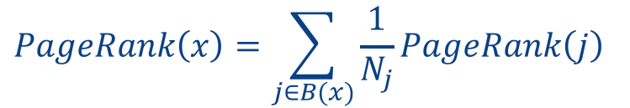
Simplified Version of PageRank
Each page x is given a rank PageRank(x)
Goal: Assign the PageRank(x) such that the rank of each page is governed by the ranks of the pages linking to it:
G
$$PageRank\left(x\right)=\sum_{j∈B(x)}{\frac{1}{N_{j}}PageRank\left(j\right)}$$
E
H
F
I
Rank of page j
Rank of page x
How do we compute the rank values?
Number of
links out
from page j
Every page
j that links to x
Notes:
PageRank formula.

Slide 14
Implementing Naïve PageRank

Slide 15
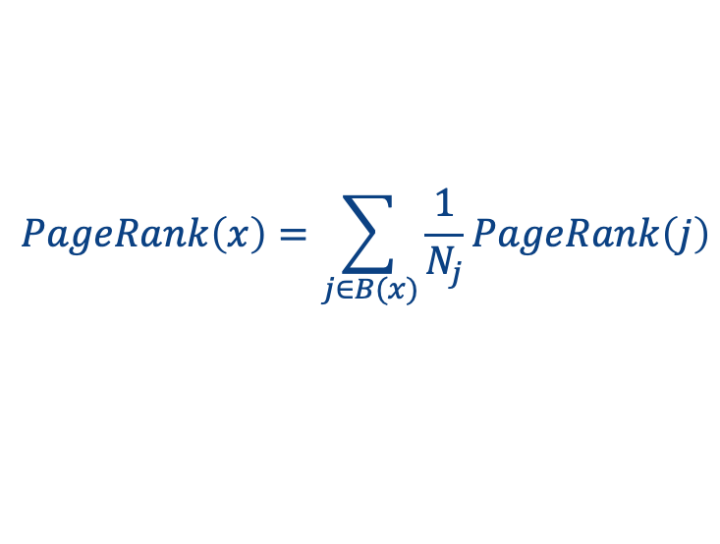
Restating the Simplified Model as a Browsing Experience
Let’s imagine we “randomly walk” through a graph of nodes and connections
At each point, we look at the out-edges and follow each with equal probability
$$PageRank\left(x\right)=\sum_{j∈B(x)}{\frac{1}{N_{j}}PageRank\left(j\right)}$$

Slide 16
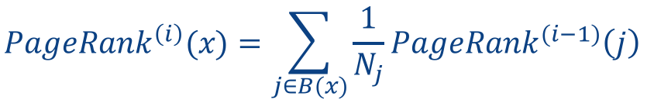

Iterative PageRank (simplified)
Initialize all ranks to be equal, e.g.:
$$PageRank^{\left(0\right)}(x)=\frac{1}{n}$$
Iterate until convergence
$$PageRank^{\left(i\right)}(x)=\sum_{j∈B(x)}{\frac{1}{N_{j}}PageRank^{(i−1)}\left(j\right)}$$

Slide 17
Iterative PageRank (simplified)
Initialize all ranks to be equal, e.g.:
$$PageRank^{\left(0\right)}(x)=\frac{1}{n}$$
Iterate until convergence
$$PageRank^{\left(i\right)}(x)=\sum_{j∈B(x)}{\frac{1}{N_{j}}PageRank^{(i−1)}\left(j\right)}$$
No need to decide how many levels to consider!

Slide 18

Example: Step 0
Initialize all ranks to be equal
$$PageRank^{(0)}(x)=\frac{1}{n}$$
0.33
0.33
0.33

Slide 19
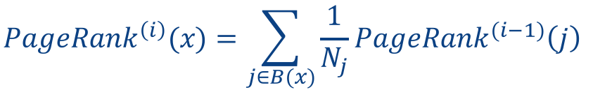
Example: Step 1
Propagate weights across out-edges
$$PageRank^{\left(i\right)}(x)=\sum_{j∈B(x)}{\frac{1}{N_{j}}PageRank^{(i−1)}\left(j\right)}$$
0.33
0.17
0.33
0.17

Slide 20
Example: Step 2
Compute weights
based on in-edges
$$PageRank^{\left(i\right)}(x)=\sum_{j∈B(x)}{\frac{1}{N_{j}}PageRank^{(i−1)}\left(j\right)}$$
0.50
0.33
0.17

Slide 21
Example: Convergence After ~15 Iterations
$$PageRank^{\left(i\right)}(x)=\sum_{j∈B(x)}{\frac{1}{N_{j}}PageRank^{(i−1)}\left(j\right)}$$
0.4
0.4
0.2

Slide 22
Great! We Can Compute PageRank Iteratively
We can use the intuitions from what we just saw to compute this much like our recursive path traversal in Spark – via iteration and join
In each round:
compute the “rank” to be sent from each source node to each destination node (1 / number of out-edges from the source node)
sum the incoming “ranks” for each destination node
But some pieces of this can be thought of in a more general way, to significant benefit…
Next up: let’s reformulate PageRank, thinking of the graph as a matrix!

