Slide 1
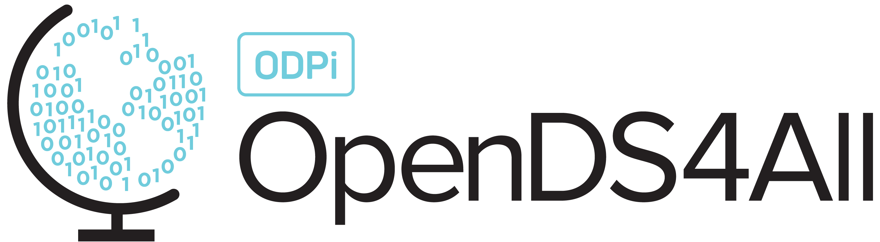
Training Robust Models

Slide 2
The Challenge: How Do We Train a Good Model?
We now know techniques for dimensionality reduction, clustering, classification and regression
PCA and k-means clustering
Decision trees and random forests
Linear + logistic regression
Neural networks
But: how do we train and validate robust models?
Encoding features the best way
Setting hyperparameters
etc.

Slide 3
Normalizing and Regularizing Data

Slide 4
Thinking about Feature Values: Not All Methods are Scale-Invariant
Many ML methods are affected by the value range of features!
i.e., multiplying all values of a feature by a nonzero number may result in different predictions
PCA
k-means clustering
Ridge and elastic net regression
Neural networks
Methods that are scale-invariant:
linear / logistic regression (without regularization)
decision trees + random forests

Slide 5
Notebook and Dataset for this Module
See associated lecture notebook.
Recall the glass dataset:
9 features – levels of silicon, magnesium, etc.
7 different classes for glass type (only 6 present in data)
This is a multiclass prediction problem
In a previous model, we used PCA on it to reduce dimensionality
… But PCA is NOT scale-invariant!

Slide 6
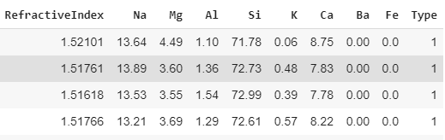
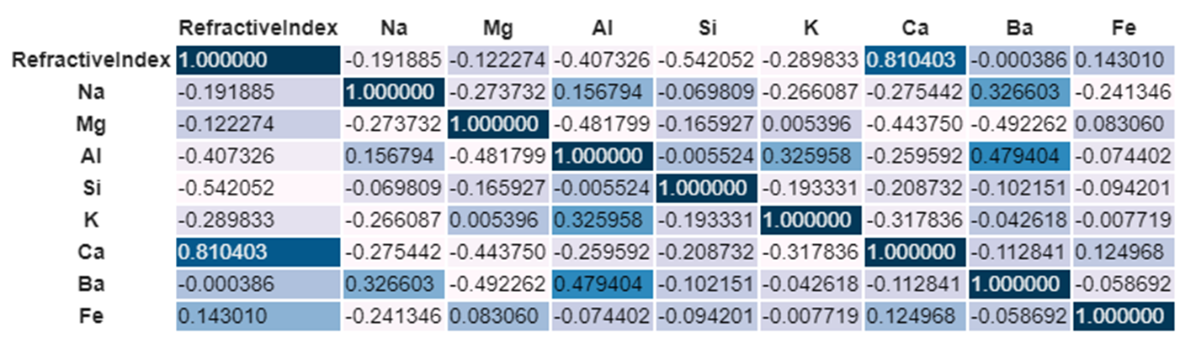
Looking Closely at Our Glass Dataset
7 different kinds of glass
corr_matrix = X_df.corr()
Notes:
We are plotting a correlation matrix; the data exhibits multicollinearity – fields such as Ca and RefractiveIndex are highly correlated. We should use PCA (or at least regularization) to address this. But before that, we should look at the scales!

Slide 7
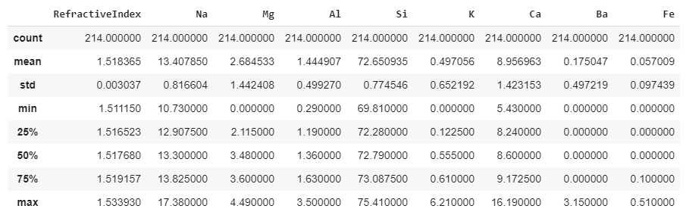
Looking More Closely at Our Glass Dataset
7 different kinds of glass

Slide 8
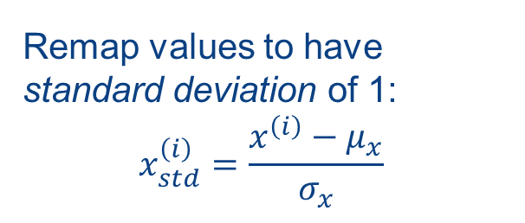
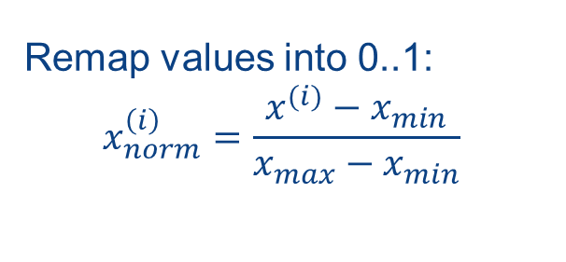
Two Techniques for Data Scaling
Normalization
Standardization
Remap values into 0..1:
$$x_{norm}^{\left(i\right)}=\frac{x^{(i)}−x_{min}}{x_{max}−x_{min}}$$
Remap values to have standard deviation of 1:
$$x_{std}^{\left(i\right)}=\frac{x^{\left(i\right)}−μ_{x}}{σ_{x}}$$
from sklearn.preprocessing \
import MinMaxScaler
# Normalizing features between 0 and 1
X2 = MinMaxScaler().fit_transform(X)
# If clf is a classifier… clf.fit_transform(X2)
from sklearn.preprocessing \
import StandardScaler
# Standardizing features w/stdev 1
X2 = StandardScaler().fit_transform(X)
pca = PCA(n_components=9)
X2 = pca.fit_transform(X2)
Useful for many classifiers, but not for PCA
Appropriate for PCA

Slide 9
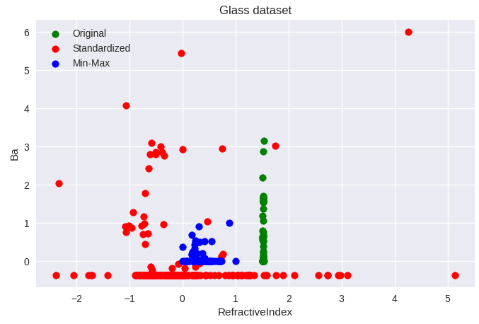
Notes:
Here we see what happens as we rescale. The original data is in green; using min-max scaling puts all values between 0 and 1 on each axis. Standardization scales based on stdev 1, so It has a much wider range.

Slide 10
Summary of Scaling: When to Use Which?
Nice write-up at: https://sebastianraschka.com/Articles/2014_about_feature_scaling.html
Generally you should use standard scaling, especially for:
PCA, other methods looking for directions that maximize variance
Regression and any methods using gradient descent
Perhaps the main case for min-max scaling:
Images (pixel intensities in a scale of 0-255)

Slide 11
Alternatively: What If We’re Missing Data?

Slide 12
Recall from Before
Pandas has special support for dropping rows with nulls – dropna
But that may lose too much training data!
What else can we do?

Slide 13
Some Ideas
Leave the nulls / NaNs – OK for some classifiers, but e.g., not the LinearRegression classifier in SciKit-Learn
Otherwise:
Value imputation by aggregation (mean, median, mode)
Nearest-neighbor
Separate features

Slide 14
Value Imputation
‘mean’, ‘median’,
‘most_frequent’
glass_df = pd.read_csv('glass.csv’,\ header=[0])
X_df = glass_df.drop(['ID','Type’],\ axis=1)
y = glass_df['Type'] X_train, X_test, y_train, y_test =\ train_test_split(X_df, y, \ test_size=0.3,random_state=42)
X_missing = X_train.copy()
for index,row in X_train.iterrows():
col = random.randint(0,8)
if col < 8:
X_missing.loc[index,\ X_df.columns[col]] = np.NaN
from sklearn.impute import SimpleImputer
imp = SimpleImputer(strategy='mean')
imp.fit(X_missing)
X_imputed = imp.transform(X_missing)
clf = LinearRegression()
clf.fit(X_imputed, y_train)
clf.score(X_test, y_test)
0.5686062225009938
without missing values, it’s:
0.595770232606166
Creating an example with missing data
Notes:
Can use mean, median, or mode (‘most_frequent’)

Slide 15
k-Nearest Neighbor
Instead of using the mean for each column – we:
Identify the k instances that are “closest” on their non-null dimensions according to Euclidean distance
Fill in with the mean value for each missing feature
imp = KNNImputer()
imp.fit(X_missing)
X_imputed = imp.transform(X_missing)
0.676923076923077

Slide 16
Imputation Brings Some Risks
It doesn’t account for correlations and can introduce bias!
An alternative: build off the ideas of one-hot encoding
One-hot encoding for categorical attributes: add a Boolean feature for each potential value
For “optional fields”: include one field for the data, and also a Boolean feature for “missing” data
0 if the field contains real data
1 if the field contains 0 or an imputed value…

Slide 17
The Idea: Missing Data and Features
X[0] | X[1]
1 | NaN
NaN | 22
NaN | 8
4 | NaN
X[0] | No_0 | X[1] | No_1
1 | 0 | 0 | 1
0 | 1 | 22 | 0
0 | 1 | 8 | 0
4 | 0 | 0 | 1
Replace features with 0 or mean,
add a new feature for missing value

Slide 18
Summary: Missing Data
Sometimes it’s not possible to dropna
Value imputation with mean, median, or mode can be used in some cases – but this is domain specific
SciKit has Imputers to do this automatically
Another option is to include a special field (analogous to one-hot encoding) for missing data

Slide 19
Controlling Model Complexity

Slide 20
Balancing between Under and Over-Training
Intuitively: The complexity of a model limits how many “exception cases” it can accommodate
As we train data over successively larger amounts of data:
Initially: model is too simple to capture general trends
Thus it does poorly over training or test data
Next model becomes rich enough to capture the general trends
This may approach the sweet spot
Then starts to reflect the idiosyncrasies of the training data
This is overfitting

Slide 21
Visually…
x
x
x
x
x
x
o
o
x
x
o
o
x
x
o
o
x
x
o
x
o
x
o
x
o
o
o
o
o
o
o
o
o
Underfit
“Just right”
Overfit
Underfit model has overly high bias – it has limited flexibility to represent the signal in the data
Overfit model has overly high variance – it is sensitive to specific data

Slide 22
Prediction Error
on new data
on training data
Model Complexity

Slide 23
How Do We Find the Right Model Complexity?
Many hyperparameters affect model complexity, e.g., decision tree depth or regularization weights
But: how do we evaluate configurations against one another, and assess model performance? We should NOT use the same test data!
This motivates holdout or validation data….

Slide 24
Creating Training, Validation and Test Datasets

Slide 25
Simplest: Split into Train and Test
from sklearn.model_selection import train_test_split
X_train, X_test, y_train, y_test = train_test_split(X, y, \
test_size=0.3,\
random_state=42)
training set
(70%)
Train + test on
independent samples of the population
test set
(30%)

Slide 26
Holdout Sets
What if we need to tune hyperparameters?
We now need independent sets for training, for tuning hyper-parameters (validation), and for testing
Often there is not enough labeled data for this…
training set
(60%)
validation set
(10%)
test set
(30%)

Slide 27
k-Fold Cross-Validation: More Representative Validation
Approach: maximally use training data
Never validate on same data > 1 time
Divide the data: k folds w/o replacement
(k-1) folds for training of model
1 fold for validation of the model
Repeat k times: get k classifiers + performance estimates
Then look at aggregate performance across all k
k is typically 10 (larger for small datasets)
Tuning: retrain next model as above, compare; ultimate test best model with independent test set
test set

Slide 28
Directly Supported In SciKit-Learn
from sklearn.model_selection import cross_val_score
scores = cross_val_score(estimator=LinearRegression(), X=X,y=y, cv=5)
print('Cross-validation accuracy scores: %s' %scores)
print('Cross-validation accuracy: %.3f +/- %.3f' % (np.mean(scores), np.std(scores)))
Cross-validation accuracy scores: [0.54866323 0.46820691 0.55078434 0.53698703 0.66051406] Cross-validation accuracy: 0.553 +/- 0.062
If not ideal, update hyperparameters, re-run…

Slide 29
Summary – Test and Training Sets
Simple case: training vs. test set
Usually: k-fold crossvalidation (CV)
And then a separate test set
… Or can do double k-fold CV

Slide 30
Reducing Overfitting via Regularization

Slide 31
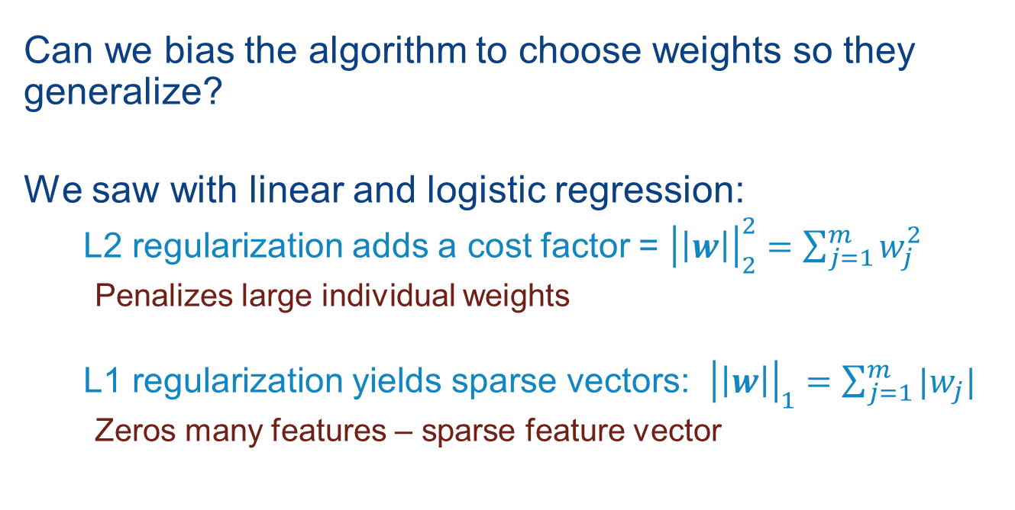
Regularization of the Weights in Linear / Logistic Regression
Can we bias the algorithm to choose weights so they generalize?
We saw with linear and logistic regression:
L2 regularization adds a cost factor = ${\left|\left|w\right|\right|}_{2}^{2}=\sum_{j=1}^{m}{w_{j}^{2}}$
Penalizes large individual weights
L1 regularization yields sparse vectors: ${\left|\left|w\right|\right|}_{1}=\sum_{j=1}^{m}{|w_{j}|}$
Zeros many features – sparse feature vector
In SciKit, you can specify a penalty type (l1, l2, elasticnet) and an inverse strength C

Slide 32
Another Regularization Scheme: Dimensionality Reduction
Or use PCA or other dimensionality reduction techniques first, then feed into regression, decision trees, etc.
Depending on the dataset, either approach may work better – need to do validation to assess!

Slide 33
How Well Are We Fitting vs Overfitting? Evaluating a Classifier

Slide 34
Factors and Hyperparameters Affecting Model Complexity
In decision trees and random forests, greater depth (and tree size) → more complexity
In regression, more features or a smaller regularization penalty → more complexity
We saw that we can evaluate via k-fold validation
How do we set these and other hyperparameters?

Slide 35
Learning Curve Shows Accuracy vs Training Samples
from sklearn.model_selection import learning_curve
clf = LogisticRegression(penalty='l2', random_state=42)
train_sizes, train_scores, test_scores = \
learning_curve(estimator=clf,
X=X_tr,
y=y_train,
train_sizes=[0.1, 0.3, 0.5, 0.6, 0.7, 0.8], cv=10,
n_jobs=1)
Notes:
Explain pipeline

Slide 36
Learning Curve Shows Accuracy vs Training Samples
from sklearn.model_selection import learning_curve
clf = LogisticRegression(penalty='l2', random_state=42)
train_sizes, train_scores, test_scores = \
learning_curve(estimator=clf,
X=X_tr,
y=y_train,
train_sizes=[0.1, 0.3, 0.5, 0.6, 0.7, 0.8], cv=10,
n_jobs=1)
plt.plot(train_sizes,np.mean(train_scores, axis=1),\ marker='o', label='Training accuracy')
plt.plot(train_sizes,np.mean(test_scores, axis=1),\ marker='+', label='Validation accuracy')
plt.xlabel('Training samples')
plt.legend()
Notes:
Explain pipeline

Slide 37
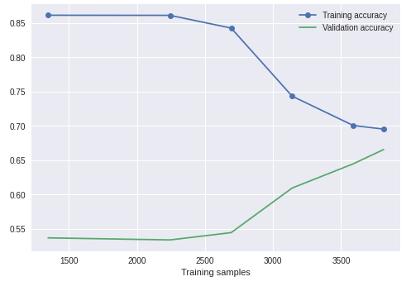
Plotting the Learning Curve
Notes:
How many training samples do you need before overfitting? You can see that the accuracy improves until about 60, then starts diminishing after 70

Slide 38
Bias vs Variance
High bias (underfit): accuracy of train + cross-validation test becomes similar, but is low
High variance (overfit): large gap between training, test accuracy in cross-validation
Middle: accuracies converge to similar value

Slide 39
Summary: Just Complex Enough
Learning curve allows us to evaluate behavior and determine whether we have high bias or variance
Can adjust training set size, regularization
Let’s now consider how to find the right level of regularization…

Slide 40
Tuning Regularization & Other Hyperparameters: Validation Curves
Recall that logistic regression has a regularization parameter C
Validation curves plot performance vs parameters, to help us find the ideal value
Notes:
Validation curves are about other types of hyperparameters (regularization). What do you set the parameter to?

Slide 41
Validation Curves
param_range = [0.001, 0.01, 0.01, 1.0, 10.0, 100.0]
train_scores, test_scores = \
validation_curve(clf,
X_train,
y_train,
“C",
param_range,
cv=10)
train_scores_mean = np.mean(train_scores, axis=1)
train_scores_std = np.std(train_scores, axis=1)
test_scores_mean = np.mean(test_scores, axis=1)
test_scores_std = np.std(test_scores, axis=1)
Cross-validation
varying hyper-parameter
C (inverse regularization) according to param_range
Notes:
Here the hyperparameter is varying from 10^-5 to 10^5

Slide 42
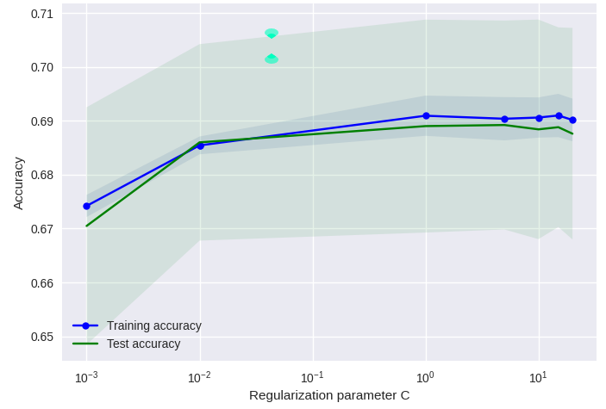
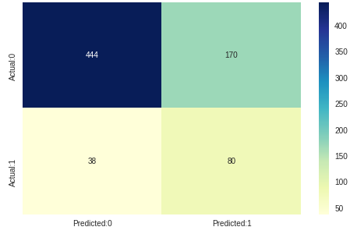
Validation Curves
Optimal
Notes:
The performance is indicated here, with accuracy scores over the training and cross-validation. It’s diminishing after about 10^1.

Slide 43
Summary
Validation curves allow us to plot performance vs hyperparameter values across a range
We find the “sweet spot” balancing bias and variance, as with the learning curve
These and the learning curve are useful in understanding when we are optimally fitting vs overfitting

Slide 44
Measuring Performance

Slide 45
Classifier (In)Accuracy
Some classifiers (e.g., decision trees) directly produce Boolean values or class labels
Others produce a score between [0,1], e.g., logistic regression
We can set a threshold (e.g., 0.5) as the basis of determining whether an item belongs in a class

Slide 46
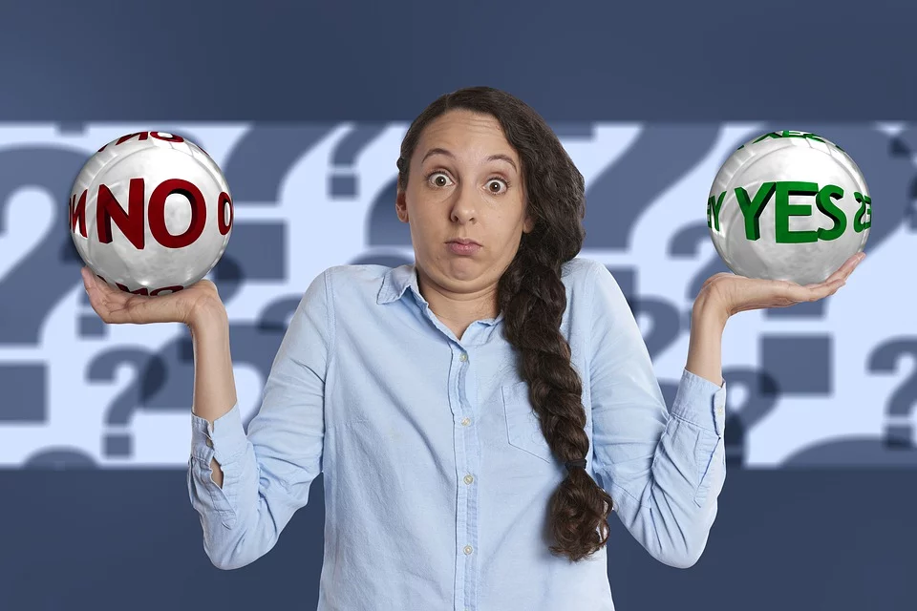
Basis of Measuring Accuracy: The Confusion Matrix
 | Predicted Class
Actual Class |  | Positive | Negative
 | Positive | True Positive (TP) | False Negative (FN)
 | Negative | False Positive (FP) | True Negative (TN)
This can also be generalized when I have multiple class predictions, e.g., to compare predictions of Class 1 vs 2, or Class 1 vs All Others
Notes:
Imagefrom Pixabay, https://pixabay.com/photos/yes-no-opportunity-decision-woman-3100993/

Slide 47
Computing Confusion Matrices in SciKit-Learn
from sklearn.metrics import confusion_matrix
clf = LogisticRegression(penalty='l2', random_state=42,\
max_iter=5000)
clf.fit(X_tr, y_train)
y_pred = clf.predict(X_test)
# We have a multiclass problem, let’s just look at 1 vs 2 confmat = confusion_matrix(y_true=y_test, y_pred=y_pred,\
labels=[1,2])
print(confmat)
[[14 4]
[ 6 16]]
Compare ability to predict Class 1 vs 2

Slide 48
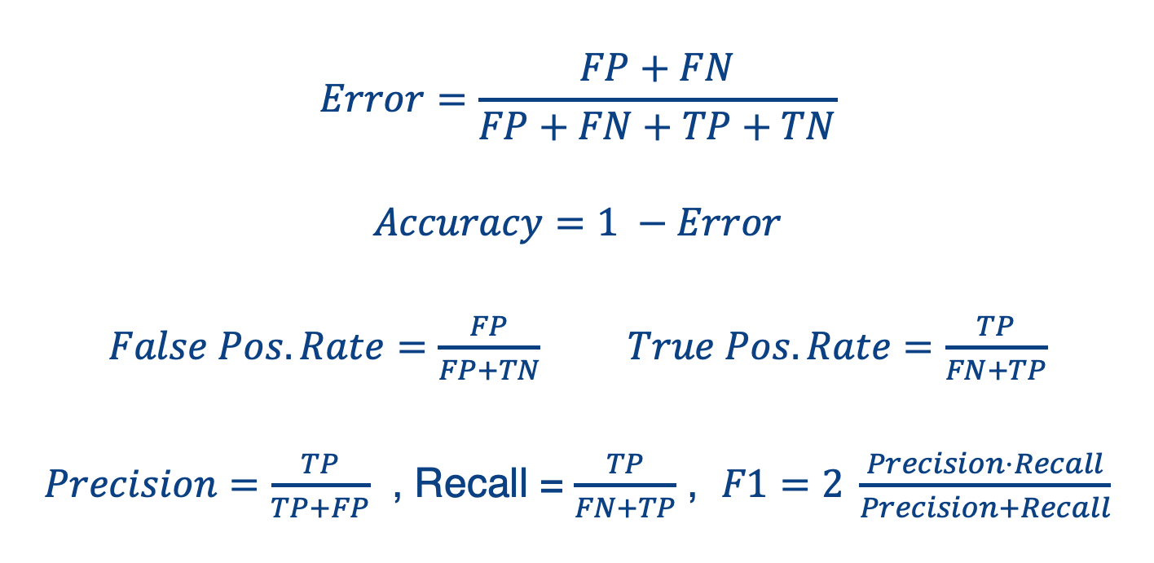
Performance Measures
Pred. pos
Pred. neg
$$Error=\frac{FP+FN}{FP+FN+TP+TN}$$
$$Accuracy=1 −Error$$
$False Pos. Rate=\frac{FP}{FP+TN}$ $True Pos. Rate=\frac{TP}{FN+TP}$
$Precision=\frac{TP}{TP+FP}$ , Recall = $\frac{TP}{FN+TP}$ , $F1=2 \frac{Precision⋅Recall}{Precision+Recall}$
TP | FN
FP | TN
Actual pos
Actual neg

Slide 49
Example
Pred. pos
Pred. neg
Precision
14 | 4
6 | 16
TP | FN
FP | TN
Actual pos
Actual neg
Recall
Error = (FP + FN) / (FP + FN + TP + TN) = (6 + 4) / (40) = 25%
Accuracy = 1 – Error = 75%
False positive rate = FP / (FP + TN) = 6 / 22 = 27%
False negative rate = FN / (FN + TP) = 4 / 18 = 22%
Precision = TP / (TP + FP) = 14 / (14 + 6) = 70%
Recall = TP / (FN + TP) = 14 / (4 + 14) = 78%
F1 = 2 * Prec * Recall / (Prec + Recall) = 73.8%

Slide 50
Precision, Recall, F1 In SciKit-Learn
from sklearn.metrics import precision_score, \ recall_score, f1_score
print('Precision: %.3f' %precision_score(y_true=y_test, \
y_pred=y_pred))
print('Recall: %.3f' %recall_score(y_true=y_test, \
y_pred=y_pred))
print('F1: %.3f' %f1_score(y_true=y_test, y_pred=y_pred))
Precision: 0.625 Recall: 0.714 F1: 0.667

Slide 51
ROC Graphs to Analyze Effectiveness
“Receiver operator characteristic”
Idea: take classifier score (not just prediction)
Vary the threshold from 0 → 1
Plot precision vs. recall
Aggregate measure: area under the curve (AUC): the integral under the curve
Optimal is 1.0
Flipping a coin is 0.5

Slide 52
Creating an ROC Curve in SciKit-Learn, for Each Class
y_test_2 = label_binarize(y_test, classes=[1,2,3,4,5,6,7])
for i in range(y_test_2.shape[1]):
fpr[i], tpr[i], _ = \ roc_curve(y_test_2[:, i], y_score[:, i])
roc_auc[i] = auc(fpr[i], tpr[i])
# Compute micro-average ROC curve and ROC area
fpr["micro"], tpr["micro"], _ = \ roc_curve(y_test_2.ravel(), y_score.ravel(), pos_label=1)
roc_auc["micro"] = auc(fpr["micro"], tpr["micro"])
derived from SciKit example code

Slide 53
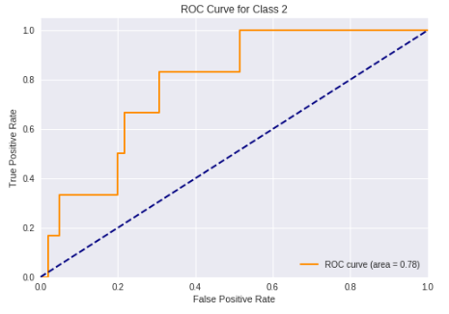
Creating an ROC Curve in SciKit-Learn, for Each Class
y_test_2 = label_binarize(y_test, classes=[1,2,3,4,5,6,7])
for i in range(y_test_2.shape[1]):
fpr[i], tpr[i], _ = \ roc_curve(y_test_2[:, i], y_score[:, i])
roc_auc[i] = auc(fpr[i], tpr[i])
# Compute micro-average ROC curve and ROC area
fpr["micro"], tpr["micro"], _ = \ roc_curve(y_test_2.ravel(), y_score.ravel(), pos_label=1)
roc_auc["micro"] = auc(fpr["micro"], tpr["micro"])
derived from SciKit example code

Slide 54
Summary: Evaluating Classifier Performance
Learning curve measures training + validation vs. sample size
Lets us tune training size vs overfitting
Validation curve measures validation vs. hyperparameters
We can tune, e.g., regularization coefficients
Confusion matrix, accuracy, error, precision, recall, and F1 scores
ROC graphs and Area Under Curve (AUC) assess quality
Also allow us to trade off false vs true positive rates

