Slide 1

Scaling to Big Data and the Cloud

Slide 2


Sometimes We Need Greater Scalability or Speed!
Image by John Cummings licensed under CC BY-SA 3.0
Not uncommon as data grows:
We don’t have enough CPU power to process all data as fast as we need
We don’t have enough I/O bandwidth to fetch and process all of the data
We don’t have enough RAM to use Pandas on our data

Slide 3

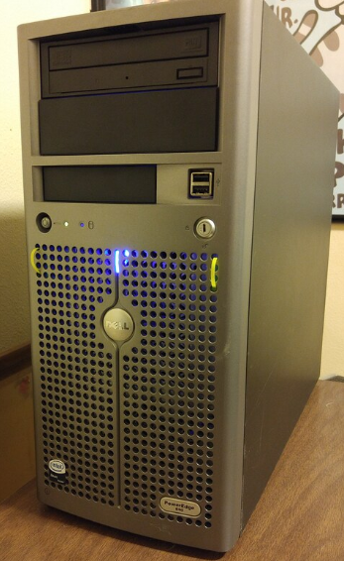
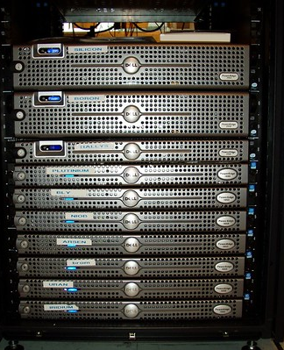

The First Approach: Bigger Machines and Dask / Swifter
2019 laptop:
16GB RAM
6 4GHz cores
2TB SSD
2019 Server:
1TB RAM
GPU, 28 4GHz cores
1PB SSD
Cluster:
30 servers, fast network among them
"SAMSUNG LAPTOP NOTEBOOK7" by TheBetterDay is licensed under CC BY-ND 2.0
"Silicon and Boron in the rack" by gruzuk is licensed under CC BY-NC-SA 2.0
"Dell PowerEdge 840" by trekkyandy is licensed under CC BY-SA 2.0

Slide 4
Non-uniform Costs in Clusters and Parallel Systems
Recall we needed to pay a lot of attention to algorithms when we had a disk
Internal CPU state (registers, cache)
Memory (latency 1000s of times slower)
SSD / disk (latency 1000+ times slower)
S₁
Memory
Disk
Notes:
When we talked about a single computer, we had a disk, memory and a CPU and there was a gap in performance between the levels of memory.

Slide 5
Non-uniform Costs in Clusters and Parallel Systems
Recall we needed to pay a lot of attention to algorithms when we had a disk
Internal CPU state (registers, cache)
Memory (latency 1000s of times slower)
SSD / disk (latency 1000+ times slower)
Same is true if we have multiple computers!
Each processor should work “independently” and “locally” as much as possible
S₁
S₂
Memory
Memory
Disk
Disk
Notes:
When we have a compute cluster there is also an (even longer) delay in communication between the processors, i.e. S1 getting data from S2’s disk.

Slide 6
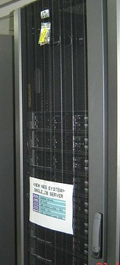


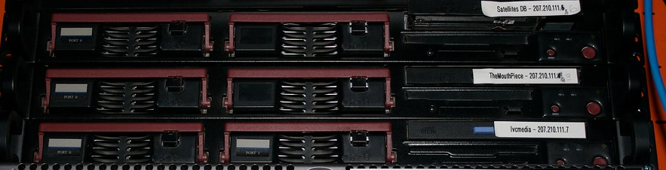

Building Clusters of Computers
Network switch
"Network" by UWW University Housing is licensed under CC BY-NC-SA 2.0
Rack
Nodes/blades (often identical)
"Hulk!" by kaeru.my is licensed under CC BY 2.0
Storage device(s)
"The main cast" by Tim Dorr is licensed under CC BY-SA 2.0
"Server Area" by Kusumsiri is licensed under CC BY-NC-SA 2.0
Many similar machines, close interconnection (same room?)
Usually owned and used by a single organization

Slide 7

Scaling Out
Laptop
Server
Cluster
Data center
What if your cluster is too big (hot, power hungry) to fit into your office building?
Build a separate building for the cluster
Building can have lots of cooling and power
Result: Data center
"SAMSUNG LAPTOP NOTEBOOK7" by TheBetterDay is licensed under CC BY-ND 2.0
"Dell PowerEdge 840" by trekkyandy is licensed under CC BY-SA 2.0
"Silicon and Boron in the rack" by gruzuk is licensed under CC BY-NC-SA 2.0
Notes:
Data center image: https://baxtel.com/data-center/google-the-dalles-oregon

Slide 8
“The Cloud”
Commercial cloud: data centers run by commercial providers
Amazon Web Services, Microsoft Azure, IBM Cloud, Google Cloud, Rackspace, Linode, …
Machines you can access “elastically”, maintained by the cloud provider’s staff
MANY services, ranging from “configurable Linux machines” to “Storage” or “Jupyter”
Often less expensive than maintaining local resources – due to economies of scale
Hybrid cloud: data centers run by commercial providers, combined with some local clusters administered the same way

Slide 9
Summary: Clusters and Data Centers Provide the Hardware for Big Data
Today we build parallel computation by linking together many compute nodes
Each has its own local CPU cache, memory, and disk
Communication costs vary dramatically at different levels
The challenge: we can’t program these just using Python and Pandas!
How do we get 30 multicore servers to work together?
At scale, machines crash all the time – how do we handle failures?

Slide 10
Processing Data in Clusters

Slide 11
So How Do We Use Compute Clusters to Handle Big Data?
Two main issues:
Making computation parallel
Minimizing communication and coordination
(Many of the same principles also hold for multiple CPUs, etc.)
S₁
S₂
Memory
Memory
Disk
Disk

Slide 12

Sharding: A Generalization of Maps and Indices
We saw an index as a map: key → the set of tuple(s) with the key
Suppose we take a set of computers in a cluster, and build a map from key range to machine
Then we send to that machine all tuples whose key matches this
Sometimes called “horizontal partitioning”
A-E
F-G
H-M
N-Z
Notes:
The key idea for all big data processing platforms is to take the tables and split them up so different parts are on different machines.
If different rows are on different machines, then it is possible for computation over those rows to be performed in parallel.
A simple example is shown to the right: Suppose we have tuples split according to their shard key ranges A-E, F-G, H-M and N-Z. These can then be assigned to machines, as shown by the red arrows.
In this example, the key field was a string, and we just took the first letter out of the string to do the assignment – but this is not a very good way to split up the data.

Slide 13
Doing this More Intelligently and Generally
What if we want to partition based on arbitrary datatypes and numbers of nodes?
Hashing: takes a value (“a hash key”) and returns a large integer
For a good hash function h, for any k₁, k₂, h(k₁) = h(k₂) if k₁ = k₂ h(k₁) ≠ h(k₂) with high probability if k₁ ≠ k₂!
Then, if we have n machines, we typically put the data for key k at node: h(k) (modulo n) or, in Python, h(k) % n
h(k) | h(k) % 3
0 | 0
1 | 1
2 | 2
3 | 0
4 | 1
Notes:
More generally, we might hash the key to assign to a machine to assure that data is evenly split.

Slide 14
Doing this More Intelligently and Generally
What if we want to partition based on arbitrary datatypes and numbers of nodes?
Hashing: takes a value (“a hash key”) and returns a large integer
For a good hash function h, for any k₁, k₂, h(k₁) = h(k₂) if k₁ = k₂ h(k₁) ≠ h(k₂) with high probability if k₁ ≠ k₂!
Then, if we have n machines, we typically put the data for key k at node: h(k) (modulo n) or, in Python, h(k) % n
We want to understand how this is done, but we don’t want to do it ourselves!
So let’s look at a platform that
does this automatically!
h(k) | h(k) % 3
0 | 0
1 | 1
2 | 2
3 | 0
4 | 1

Slide 15

Apache Spark: A Platform for Sharded Big Data
Runs on a cluster with a master node and multiple worker nodes
Data is replicated across workers, in memory and on disk; computing is done across the workers
“Shards” tables as we discussed: “Spark DataFrames” similar to Pandas DataFrames
The most popular of several “big data” engines
Similar programming model to Apache Hadoop, Flink, many other big data engines
Notes:
Shard based on a key – must be deterministic.
We need an environment in which the parallelism is managed for us. The master node manages the computation: makes sure the work is done, makes sure worker nodes are still alive, and if a worker node dies then it reallocates the subtask to another worker.
So failures are handled automatically.
Spark gives an interface to Python (PySpark) which looks very similar to a dataframe, but a dataframe is sharded across more than one machine.
It also provides an SQL interface.
There are many other big data engines (Hadoop, Flink, …).

Slide 16
Spark Practicalities
See accompanying Lecture Notebook
Jupyter and Spark will now run on different machines! (Laptop vs Master node)
On Colab and some cloud settings: Python itself is also running on the Master!
Spark is not written in Python, making for some quirks:
Spark dataframes have a typed schema – Spark can’t determine on-the-fly whether input fields are strings vs integers like Python does (See sample notebook for example code)
Notation in Spark:
df[‘x’] and df.x both reference field x in dataframe df
Projection via double-brackets: df[[‘field1’, ‘field2’]]
Selection via “filter” function: df.filter(df.field op value)
Notes:
Apache Spark is a big data engine that runs on compute clusters, including on the cloud. It does not run on Colab, so you must connect to a cluster running on some cloud provider and your notebook will need to make a connection to the cluster.
The accompanying notebook is set up assuming that:
(1) Spark is running on a cloud server that is public and (2) we need to run the actual Python commands on that server, requiring us to put `%%spark` "magic" commands at the start of each cell.

Slide 17
Writing Code for Spark
In Colab, every cell will need to execute remotely on a Python/Spark machine
Prefix the cell with %%spark
Spark supports Dataframes style operations, as in Pandas
Or SQL-style operations as with relational DBMSs:
linked_df.createOrReplaceTempView("linked_in")
sqlContext.sql("select * from linked_in")
Spark also does something non-intuitive: lazy evaluation
… Nothing gets computed until you try to save, show, or collect it!
Notes:
Why does Spark use lazy evaluation? If it has a sequence of joins (and/or other operations), it will look and see if it can switch the order to see if it can be executed faster. So it is trying to optimize your code in the same manner as a database.

Slide 18
Sharding and Tables
Given a cluster with n workers, running remotely, Spark creates a table with at least n partitions (here, 200, where 100 are stored on each machine)
Spark will partition “automatically” but it’s best to repartition on the key you want!
%%spark
# 10K records from linkedin
linked_in = requests.get('https://X')
my_list = [json.loads(line) for line in linked_in.iter_lines()]
linked_df = sqlContext.createDataFrame(my_list, schema).\ repartition(‘_id’)
Notes:
Suppose we are using a crawl from LlinkedIn of 3M records. Since it is so big, in then notebook we use a smaller dataset stored in ‘X’, which is a file of JSON rows.
My_list is a variable where each row is a dictionary representing a person entry.
From this, we create a Spark dataframe. If you run the code as is here, lots of errors will be thrown because Spark needs a schema – the code for this is elided here for simplicity (see notebook for details).
The data is actually hierarchical: each person has a list of skills, which in a relational database would have to be split out into a separate table. However, Spark allows this data to be nested, so linked_df is a hierarchical structure.
After creating the dataframe, we repartition based on _id. That is, each row in the dataframe will be sharded according to its _id. Spark handles this for us automatically. A by-product of this is that every tuple with the same shard key will be on the same compute node. Here, since _id is a key, no two rows will have the same shard key… but two rows may still be assigned to the same compute node based on the hash function.

Slide 19
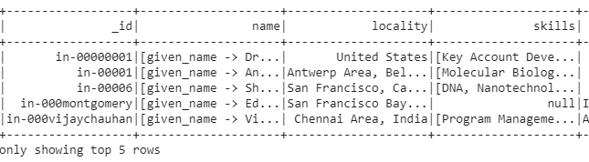
Sharding and Tables
Given a cluster with n workers, running remotely, Spark creates a table with at least n partitions (here, 200, where 100 are stored on each of 2 machines)
Spark will partition “automatically” but it’s best to repartition on the key you want!
%%spark
# 10K records from linkedin
linked_in = requests.get('https://X')
my_list = [json.loads(line) for line in linked_in.iter_lines()]
linked_df = sqlContext.createDataFrame(my_list, schema).\ repartition(‘_id’)
Notes:
This is what linked_df looks like. Note that name and skills are both hierarchical; name is a map, and skills is a list (array). The different colors represent the assignment to partitions. If there are more partitions than compute nodes (which is almost always the case), then a compute node may have more than one partition. This is useful for scaling as compute nodes are added, and handling failures.

Slide 20
Computation in a Sharded System: Selection, Projection
Selection + projection is “farmed out” to each worker, run simultaneously:
linked_df.filter(linked_df.locality == 'United States')[['_id', 'name', 'locality']].show(5)
Notes:
Here we are selecting rows in the dataframe where the locality is United States (“filter”), and projecting over three columns (“[[…]]”). Saying ”.show(5)” forces this to be executed; otherwise, it would execute in 3ms and do nothing until the data is asked for (lazy evaluation). This is farmed off to all workers to execute in parallel, and the first 5 results to be calculated are shown (more may be calculated than this, but only 5 are shown).

Slide 21
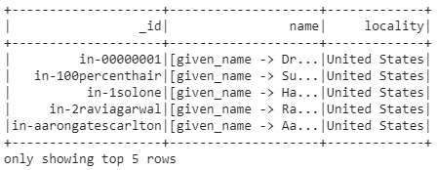
Computation in a Sharded System: Selection, Projection
Selection + projection is “farmed out” to each worker, run simultaneously:
linked_df.filter(linked_df.locality == 'United States')[['_id', 'name', 'locality']].show(5)
Notes:
Note that name is actually a map: given_name, etc.

Slide 22
Apply (with Python Functions) in Spark
https://docs.databricks.com/spark/latest/spark-sql/udf-python.html
%%spark
from pyspark.sql.functions import udf
from pyspark.sql.types import StringType
acro = udf(lambda x: ''.join([n[0] for n in x.split(), StringType())
linked_df.select("id", acro("locality").alias(“acronym")).show(5)
Note also that we used Spark’s select function – whose arguments looks much like a list for SQL select!
As with select / project, apply is run on each worker in parallel!
Notes:
Another common operation is apply. In Pandas, when we call apply we pass in a Python function. However, Spark is written in Scala rather than Python, and is running on a server elsewhere. So when we pass in a function to apply in Spark you have to do some extra stuff to tell Scala how to handle it, in particular what kind of result is being returned.
In “acro”, udf stands for “user defined function”. It specifies a Python function and the return type. What x.split does it to break a string into ”words” (i.e. sequences of characters separated by white space) and returns a string of the first letter of each word – e.g. “United States” becomes “US”.
The last line shows the SQL influence in Spark: acro("locality").alias(“acronym") applies the acro function to the locality column and renames it “acronym”).

Slide 23
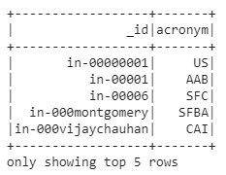
Apply (with Python Functions) in Spark
https://docs.databricks.com/spark/latest/spark-sql/udf-python.html
%%spark
from pyspark.sql.functions import udf
from pyspark.sql.types import StringType
acro = udf(lambda x: ''.join([n[0] for n in x.split(), StringType())
linked_df.select("id", acro("locality").alias(“acronym")).show(5)
Note also that we used Spark’s select function – whose arguments looks much like a list for SQL select!
As with select / project, apply is run on each worker in parallel!
Notes:
The udf is being called in parallel across multiple computers.

Slide 24
Grouping
Grouping needs all of the tuples in a group to be on the same machine, in order to do a computation over the group! In SparkSQL:
%%spark
# Which industries are most popular?
sqlContext.sql('select count(_id), industry '+\
'from linked_in group by industry '+\
'order by count(_id) desc').show(5)
_id | industry
0 | IT
1 | Software
2 | IT
3 | Software
sharded
by _id
Notes:
How many crawled LinkedIn members work in each industry? Show the top 5 such industries.
This shows the records sharded by id (color coded over 2 computers).

Slide 25
Grouping
Grouping needs all of the tuples in a group to be on the same machine, in order to do a computation over the group! In SparkSQL:
%%spark
# Which industries are most popular?
sqlContext.sql('select count(_id), industry '+\
'from linked_in group by industry '+\
'order by count(_id) desc').show(5)
_id | industry
0 | IT
1 | Software
2 | IT
3 | Software
internally repartition
by industry
_id | industry
0 | IT
1 | IT
2 | Software
3 | Software
sharded
by _id
Notes:
When “group by industry”, the computation can’t be done separately on each computer so internally Spark calls repartition over the group key.

Slide 26
Grouping
Grouping needs all of the tuples in a group to be on the same machine, in order to do a computation over the group! In SparkSQL:
%%spark
# Which industries are most popular?
sqlContext.sql('select count(_id), industry '+\
'from linked_in group by industry '+\
'order by count(_id) desc').show(5)
_id | industry
0 | IT
1 | Software
2 | IT
3 | Software
internally repartition
by industry
_id | industry
0 | IT
1 | IT
2 | Software
3 | Software
sharded
by _id
count(_id)
count(_id)
Notes:
And now the computation can be performed locally. The repartition by industry comes at a cost.

Slide 27
Summary
What we’ve discussed about Big Data engines so far:
We need to partition or shard data by keys, allowing machines to work in parallel across different shards
Apache Spark is the most popular system for doing this right now
Supports Spark dataframes or Spark SQL
Some variations from Pandas: strong typing, syntax variations, special udf function
You can control sharding via repartition
Select, project, apply all work in parallel across shards
Grouping typically requires the machines to exchange or repartition data
We’ll discuss join momentarily, when we look at graph computations!
Notes:
Do not expect Spark to be faster than Pandas, especially if the data is not large, i.e. fits in memory
There is a lot of overhead in spinning up the parallel environment before the computation always runs. Where you start to see the difference is when the data gets very large.

