Slide 1
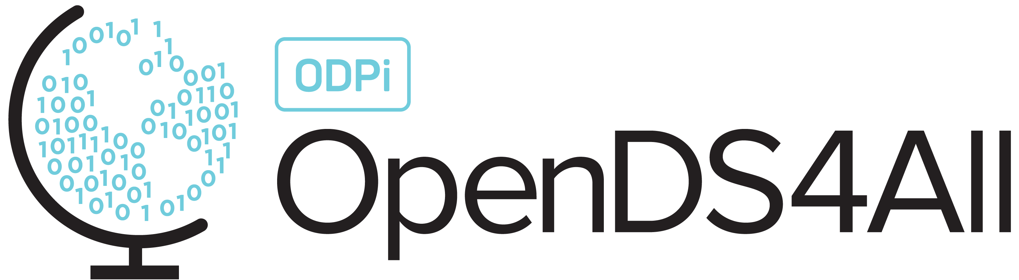
Supervised Machine Learning: Overview, Decision Trees, Random Forests

Slide 2
Two Flavors of Machine Learning
1. Find the structure in the data (unsupervised)
x
x
x
x
x
x
Input data: x₁, x₂, x₃, …, x_{n}
x
x
x
x
Notes:
Recall from a previous module, we can think about unsupervised vs supervised ML.

Slide 3
Two Flavors of Machine Learning
1. Find the structure in the data (unsupervised)
x
x
x
x
x
x
Input data: x₁, x₂, x₃, …, x_{n}
x
x
x
x

Slide 4
Two Flavors of Machine Learning
1. Find the structure in the data (unsupervised)
2. Find a function mapping from data features to classes (supervised)
x
x
x
x
x
x
Input data: x₁, x₂, x₃, …, x_{n}
x
x
x
x
x
x
x
x
x
Input data: x₁, x₂, x₃, …, x_{n}
x
x
x
x
x

Slide 5
Two Flavors of Machine Learning
1. Find the structure in the data (unsupervised)
2. Find a function mapping from data features to classes (supervised)
x
x
x
x
x
x
Input data: x₁, x₂, x₃, …, x_{n}
x
x
x
x
x
x
x
x
x
Input data: x₁, x₂, x₃, …, x_{n}
o
o
o
+ Labels: y₁, y₂, y₃, …, y_{n}
o
o

Slide 6
Two Flavors of Machine Learning
1. Find the structure in the data (unsupervised)
2. Find a function mapping from data features to classes (supervised)
x
x
x
x
x
x
Input data: x₁, x₂, x₃, …, x_{n}
x
x
x
x
x
x
x
x
x
Input data: x₁, x₂, x₃, …, x_{n}
o
o
o
+ Labels: y₁, y₂, y₃, …, y_{n}
o
o

Slide 7
A Workflow for ML: Unsupervised → Supervised Learning
Often, start with unsupervised learning, to identify useful features to extract
Then run supervised learning methods!
Notes:
In this module we’ll discuss the latter!

Slide 8

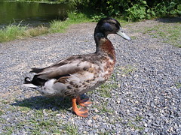
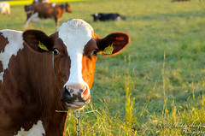

Supervised Learning Starts with Feature Extraction
Start with a matrix X of extracted features
Input data
X: features
✔ Beak
? Webbed feet
✔ Quacks
✔ Beak
✔ Webbed feet
✔ Quacks
x Beak
x Webbed feet
x Quacks
Notes:
You’ve probably heard the saying, “If it looks like a duck and quacks like a duck, it’s probably a duck.” How could we formalize this?
Rubber duck, https://www.dutchwatersector.com/news/giant-rubber-duck-continues-china-tour-in-macao
Duck – CC BY-SA 2.0 https://ccsearch.creativecommons.org/photos/21e6f7bd-0d1b-41bd-8d18-4d7816a0bb55
Cow – Markku Akerfelt, CC-Attribution-NonCommercial-NODerivs 2.0 https://www.flickr.com/photos/44758702@N07/4944275265

Slide 9
Supervised Learning Starts with Feature Extraction, Then Training
Train using a matrix X and a label or class, in vector y
Input
X: features
y: class
✔ Is a duck
✔ Beak
? Webbed feet
✔ Quacks
✔ Is a duck
✔ Beak
✔ Webbed feet
✔ Quacks
x Is NOT a duck
x Beak
x Webbed feet
x Quacks
Notes:
Rubber duck, https://www.dutchwatersector.com/news/giant-rubber-duck-continues-china-tour-in-macao
Duck – CC BY-SA 2.0 https://ccsearch.creativecommons.org/photos/21e6f7bd-0d1b-41bd-8d18-4d7816a0bb55
Cow – Markku Akerfelt, CC-Attribution-NonCommercial-NODerivs 2.0 https://www.flickr.com/photos/44758702@N07/4944275265

Slide 10
Under the Covers…
Supervised learning finds a function to map from values of X to values of y
Won’t always be perfect: goal is to minimize the error or loss function
✔ Beak
✔ Webbed feet
✔ Quacks
?
✔ Is a duck

Slide 11
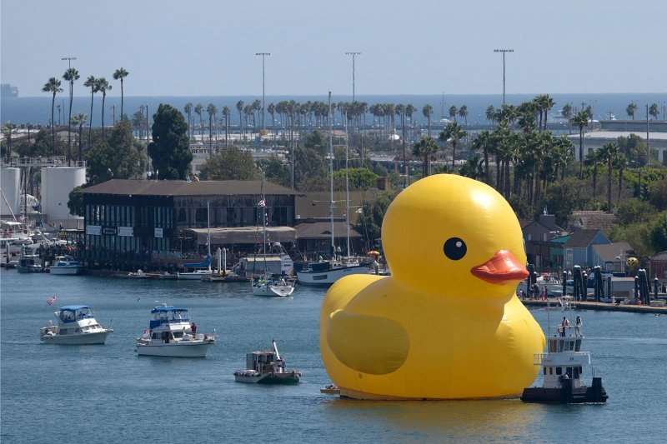

Then: Prediction
X_{new}: features
$\hat{y}$: predicted class
✔ Beak
? Webbed feet
✔ Quacks
✔ Is a duck
How well the classifier does on its training data may be different
from how it does on completely new data!
Notes:
Once we’ve learned the function, we can use it to predict whether other things are ducks!
https://time.com/3153925/giant-rubber-duck-los-angeles/

Slide 12
Types of Supervised Learning
Classification: y is categorical
each value is from a finite set, e.g., nationality, page will be clicked on, item is a duck
Regression: y is continuous
each value is numeric within a continuous range, e.g., age, dollars spent

Slide 13
Classification

Slide 14
The Process of Building and Evaluating a Classifier
Train
Validate
Test
(optional)
Find the function
from X to y;
fit parameters
Tune parameters,
choose from
multiple
models
Assess performance
Notes:
We’ll explain why we have these three stages in the next slide

Slide 15
Why the Three Stages? Challenges Faced in Building a Classifier
Goal: Learn from training data – but generalize!
Risk of overfitting on the training data
Need roughly as many observations as features
Validation data helps us to compare different classifier settings (each trained on the training data) to see which is better
Test data helps us to evaluate the final classifier by comparing its predictions vs the “gold standard”
Training may be computationally costly (esp. neural nets)
Notes:
Overfitting: the classifier too closely learns the dataset it was trained on, making it ineffective on new data that is slightly different.
Validation is an optional stage, which we’ll get to in Module 7 as we seek to tune classifiers.

Slide 16
Python Provides a Standard Interface to Many Classifiers – SciKit-Learn
SciKit-Learn provides a standard interface that looks like this:
x
x
x
x
x
o
o
o
o
o
# Create classifier clf = Classifier(my_params)
# X = training data features (N rows by d dimensions) # y = actual class (training data) for each of N rows clf.fit(X, y)
# Evaluate now over new “test” data predicted_y_test_data = clf.predict(X_test_data)
Notes:
The beauty of SciKit-Learn is that you can almost use the classifiers interchangeably *if* they are well-tuned.
The reality is that you’ll often need to customize their behavior, which means you need to understand how they work, and how to tune (which is a separate module)

Slide 17
Explainable Classifiers: Decision Trees
Please see the companion notebook

Slide 18

An Example
Suppose we want to predict if someone is going to buy a pet (y), given 4 features in our input matrix X.
X[0] | X[1] | X[2] | X[3]
1 | 0 | 0 | 0
0 | 1 | 1 | 1
0 | 1 | 0 | 0
0 | 0 | 0 | 1
1 | 1 | 0 | 0
y
1
1
0
0
1
Which single feature best predicts this?
Notes:
To answer this question, we need to look at how the values of each feature X[i] correlate to the values of y…

Slide 19
Intuition: Determine How Well Each Feature Predicts the Output
y
y
 | t | f
t | 2 | 0
f | 1 | 2
 | t | f
t | 2 | 1
f | 1 | 1
X[0]
X[1]
X[1] correct 3 times
X[0] correct 4 times
y
y
 | t | f
t | 1 | 0
f | 2 | 2
 | t | f
t | 1 | 1
f | 2 | 1
X[2]
X[3]
NOT X[3] correct 3 times
X[2] correct 3 times

Slide 20
An Example
Using X[0] to predict…
X[0] | X[1] | X[2] | X[3]
1 | 0 | 0 | 0
1 | 1 | 0 | 0
y
1
1
X[0] | X[1] | X[2] | X[3]
1 | 0 | 0 | 0
0 | 1 | 1 | 1
0 | 1 | 0 | 0
0 | 0 | 0 | 1
1 | 1 | 0 | 0
y
1
1
0
0
1
X[0] | X[1] | X[2] | X[3]
0 | 1 | 1 | 1
0 | 1 | 0 | 0
0 | 0 | 0 | 1
y
1
0
0
Which feature best predicts y if X[0] = 0?
X[2]

Slide 21
A Flowchart for Making Predictions…
X[0]?
T
F
Result = True
(2 instances)
X[2]?
F
T
Result = False
(2 instances)
Result = True
(1 instance)
Notes:
We can define a flowchart with some choices, aka a decision tree!

Slide 22
A Decision Tree for Making Predictions…
X[0]?
T
F
Result = True
(2 instances)
X[2]?
F
T
Result = False
(2 instances)
Result = True
(1 instance)

Slide 23
Building a Decision Tree in SciKit-Learn…
clf = tree.DecisionTreeClassifier(criterion="entropy")
clf = clf.fit(X, y)
X[0] <= 0.5
entropy = 0.971
samples = 5
value = [2, 3]
tree.plot_tree(clf.fit(X, y))
X[2] <= 0.5
entropy = 0.918
samples = 3
value = [2, 1]
entropy = 0.0
samples = 2
value = [0, 2]
entropy = 0.0
samples = 2
value = [2, 0]
entropy = 0.0
samples = 1
value = [0, 1]
Notes:
Here’s an example of a decision tree in SciKit, and its visualization!
We see the condition at the top, and the number of data values (samples) satisfying the condition as the 2nd line. Their values are the 3rd line.
We’ll talk about what entropy means shortly.

Slide 24
How a Decision Tree Is Built

Slide 25
We Saw this in Our Example
c(f)
F
T
At each point, find a feature (and condition) to split the decision tree
Do this at the root, and then divide the training set into subsets depending on the condition
Repeat recursively
Questions that should come to mind:
Does it matter which condition (and feature) we use?
Is there an optimal strategy? https://link.springer.com/article/10.1007/s10994-017-5633-9
Notes:
Answers to the questions:
1. Yes, both the accuracy and effectiveness of the decision tree are determined by the order in which we split.
2. Yes, if we seek to develop a decision tree which has the best success on the training data. But this is computationally intractable (NP-hard, Hyafil & Rivest 76). So instead we use greedy heuristics.

Slide 26
A Greedy Heuristic to Build Decision Trees
c(f)
F
T
Split(dataset)
If items in dataset are not all of the same class:
Determine a predicate over a feature that maximizes some notion of information gain (to be defined)
Partition the dataset according to the predicate
Split each sub-dataset
This may overfit to the training data
Heuristic: “generalize” the tree by pruning off some of the lower levels (e.g., anything below a max depth)

Slide 27
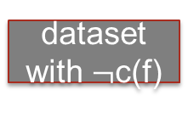
So… How to Define Information Gain?
dataset
c(f)
F
T
dataset
with $¬$c(f)
dataset with c(f)
Compare the dataset pre-split vs the combination of split datasets
First idea: use entropy (from information theory) as the basis of comparison…

Slide 28
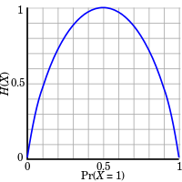
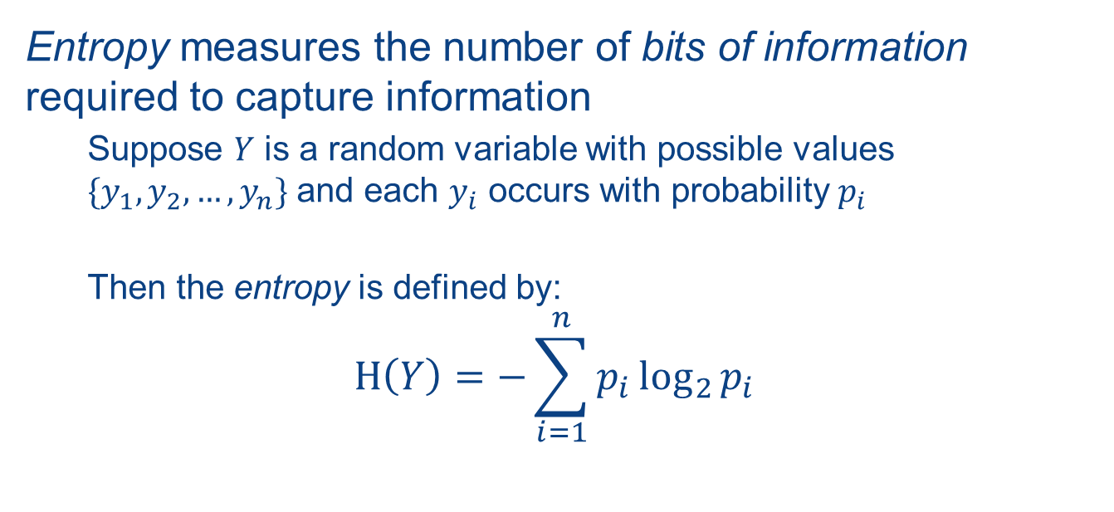
Entropy
Entropy measures the number of bits of information required to capture information
Suppose $Y$ is a random variable with possible values $\{y_{1},y_{2},…,y_{n}\}$ and each $y_{i}$ occurs with probability $p_{i}$
Then the entropy is defined by:
$$Η\left(Y\right)=−\sum_{i=1}^{n}{p_{i}\log_{2}{p_{i}}}$$
H(Y)
Pr(Y=1)
https://en.wikipedia.org/wiki/Entropy_(information_theory)#/media/File:Binary_entropy_plot.svg
Notes:
Entropy in information theory is represented using the Greek letter Eta, which looks like an H.
Entropy of something certain (probability = 0 or 1) is 0.

Slide 29
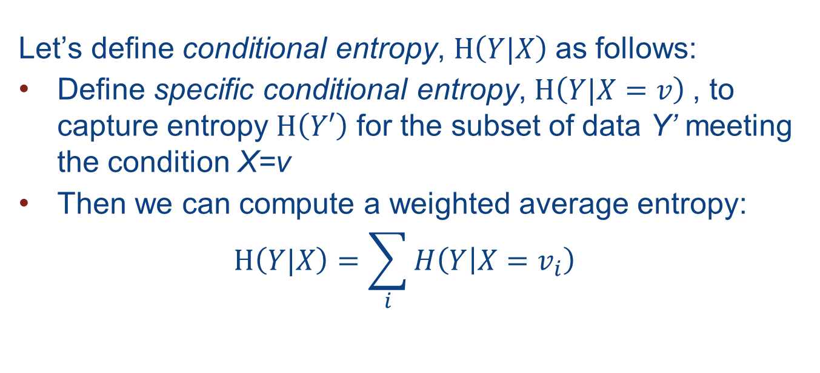
Conditional Entropy
Let’s define conditional entropy, $Η\left(Y|X\right)$as follows:
Define specific conditional entropy, $Η\left(Y|X=v\right)$, to capture entropy $Η\left(Y′\right)$ for the subset of data Y’ meeting the condition X=v
Then we can compute a weighted average entropy:
$$Η\left(Y|X\right)=\sum_{i}{H\left(Y | X=v_{i}\right)}$$

Slide 30
An Example: Entropy
input_data:
Entropy of input_data[major]:
 | major | likes_stats
0 | math | False
1 | math | False
2 | math | True
3 | math | True
4 | engl | False
5 | stat | True
6 | stat | True
7 | engl | False
def prob(term):
return len(input_data[input_data['major’]\ ==term])/len(input_data)
majors = set(input_data['major'])
probs = {}
for major in majors:
probs[major] = prob(major)
entropy_major = \ -sum([p * log2(p) for p in probs.values()])
{'math': 0.5, 'engl': 0.25, 'stat': 0.25} Entropy of major: 1.50

Slide 31
An Example: Conditional Entropy
Conditional entropy of
input_data[likes_stats]| input_data[major]:
input_data:
 | major | likes_stats
0 | math | False
1 | math | False
2 | math | True
3 | math | True
4 | engl | False
5 | stat | True
6 | stat | True
7 | engl | False
def get_subset_likes_stats(term):
subset = input_data[input_data['major']==term]\ ['likes_stats']
return [sum(subset==False)/len(subset), \
sum(subset==True)/len(subset)]
subsets = {}
for major in majors:
subsets[major] = get_subset_likes_stats(major)
sum([probs[major]*entropy(subsets[major],base=2)\
for major in probs.keys()])
0.5 * entropy( [0.5, 0.5] ) +
0.25 * entropy( [1.0, 0.0] ) +
0.25 * entropy( [0.0, 1.0] )
Total: 0.5

Slide 32
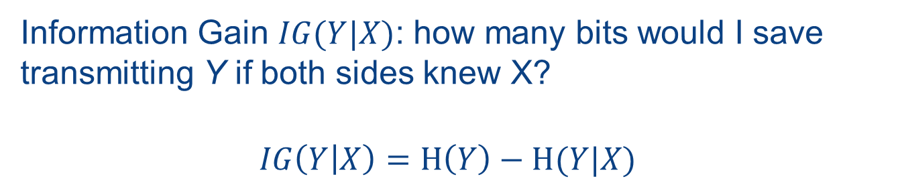
Information Gain
Information Gain $IG(Y|X)$: how many bits would I save transmitting Y if both sides knew X?
$$IG\left(Y | X\right)=Η\left(Y\right)−Η(Y|X)$$
In our example: $Η\left(Y\right)=1.0$ and $Η\left(Y|X\right)=0.5$, so $IG\left(Y | X\right)=0.5$
Notes:
We can use entropy to define a notion of information gain now…

Slide 33

Another Common Metric
“Gini Index” instead of entropy:
$$I_{G}\left(t\right)=1−\sum_{i=1}^{c}{p{\left(i | t\right)}^{2}}$$
where I = class and t =node
Notes:
Entropy-based information gain is commonly used to choose decision tree “splits” or “pivot points”
But another popular metric is the so-called Gini index, which we show here. Note it’s 1 minus the square of the probabilities…

Slide 34
An Example
Let’s consider a dataset of wines of 3 classes
from sklearn.datasets import load_wine
dataset = load_wine()
alcohol | malic acid | ash | alkalinity of ash | magnesium | total phenols | …
0 | 14.23 | 1.71 | 2.43 | 15.6 | 127.0 | …
1 | 13.20 | 1.78 | 2.14 | 11.2 | 100.0 | …
2 | 13.16 | 2.36 | 2.67 | 18.6 | 101.0 | …
3 | 14.37 | 1.95 | 2.50 | 16.8 | 113.0 | …
4 | 13.24 | 2.59 | 2.87 | 21.0 | 118.0 | …
... | ... | ... | ... | ... | ... | …

Slide 35
Creating Training + Test Sets
Recall we need to do training, optional validation, and testing
Scikit helps us create test and training sets with our X matrix and y vector…
from sklearn.model_selection import train_test_split
X_train, X_test, y_train, y_test = train_test_split(\
dataset.data, dataset.target, test_size=0.30)
Notes:
As we’ll do for all of our supervised ML algorithms, we actually need to divide our data into test and training sets.
(We may also want a validation set in some cases, but for here we’ll stay with the two.)
There’s a built in train_test_split function in SciKit to help…

Slide 36
Training and Testing the Decision Tree
# Training step, on X_train with y_train
clf = tree.DecisionTreeClassifier()
clf = clf.fit(X_train,y_train)
# Prediction step, with X_test (and we will
# validate accuracy against y_test)
prediction = clf.predict(X_test)
# Test accuracy, ie Jaccard distance of matched items
accuracy = sklearn.metrics.accuracy_score(prediction,y_test)
print("Accuracy: %.1f%%"% (accuracy*100))

Slide 37
Training and Testing the Decision Tree
X[9] <= 3.46
gini = 0.654
samples = 124
value = [39, 52, 33]
# Training step, on X_train with y_train
clf = tree.DecisionTreeClassifier()
clf = clf.fit(X_train,y_train)
# Prediction step, with X_test (and we will
# validate accuracy against y_test)
prediction = clf.predict(X_test)
# Test accuracy, ie Jaccard distance of matched items
accuracy = sklearn.metrics.accuracy_score(prediction,y_test)
print("Accuracy: %.1f%%"% (accuracy*100))
gini = 0.0
samples = 42
value = [0,42, 0]
X[6] <= 1.58
gini = 0.597
samples = 82
value = [39, 10, 33]
X[9] <= 3.8
gini = 0.057
samples = 34
value = [0,1, 33]
X12] <= 697.0
gini = 0.305
samples = 48
value = [39, 9, 0]
gini = 0.0
samples = 1
value = [0,1, 0]
gini = 0.0
samples = 33
value = [0,33, 0]
gini = 0.0
samples = 9
value = [0,9, 0]
gini = 0.0
samples = 39
value = [39, 0, 0]
Accuracy: 96.3%

Slide 38
Summary: Decision Tree Basics
Decision trees are generally built with a greedy algorithm that recursively splits data according to a notion of information gain (sometimes called impurity)
This can be computed via entropy or Gini index
Should split our training dataset into
labeled training data
labeled test data
(the latter to determine how accurate our predictions are)

Slide 39
Decision Trees and Overfitting

Slide 40
Major Danger of Decision Trees
Decision trees are highly susceptible to overfitting
We can end up with a tree that tests exactly if the data matches the training set!
This won’t generalize to even similar data that hasn’t been seen!
Some responses:
Apply PCA in advance to remove correlated features
Balance positive and negative examples
Limit the depth of the tree
Don’t split if below a minimum number of samples
Prune lower levels of the tree
tunable
hyper-parameters
of the decision tree

Slide 41
Another Approach to Make Classifiers More Accurate: Ensembles
Train classifiers over different subsets of the input
X
(X_train, y_train): training data
subsets of
(X_train, y_train)
X1
X2
X3
X4
ensemble of separately trained classifiers
c1
c2
c3
c4
c_ens
classifier combines votes of ensemble members
Notes:
An ensemble is a set of classifiers that can vote together

Slide 42
Ensembles of Decision Trees – Random Forests
Draw a random bootstrap data sample of size n, with replacement (called “bagging”)
Build (“grow”) a tiny decision tree (or “stump”)
At each node, randomly select d candidate features w/o replacement
Split the node using the feature with best split according to objective function (e.g. info gain)
Repeat to produce k decision trees (a forest!)
For prediction, use majority vote to predict a class for new data

Slide 43
Random Forest Hyperparameters
How many trees (estimators)?
Tree depth
Size of the candidate feature set to consider in each tree
Default: n_estimators n log(n)

Slide 44
Random Forests in SciKit-Learn
from sklearn.ensemble import RandomForestClassifier
clf = RandomForestClassifier(n_estimators = 20, \
max_depth=2)
clf.fit(X_train,y_train)
prediction = clf.predict(X_test)
accuracy=sklearn.metrics.accuracy_score(prediction,y_test)
print("Accuracy: %.1f%%"% (accuracy*100))
Accuracy: 98.1%

Slide 45
Summary of Decision Trees and Random Forests
Decision trees are:
Fast
Scale-invariant
Can handle categorical and continuous data (CART)
Understandable (“explainable AI”)
Prone to overfitting
Random forests:
Use a form of ensembles called “bagging”
Highly accurate, parallelizable, and used in practice
Don’t require hyperparameter search
Random forests are one of the most popular and accurate method classifiers for big data!

