Slide 1

Network Centrality and PageRank

Slide 2
Measuring “Importance” in a Field
We saw that degree of a node tells how well connected it is – directly
But what about indirectly?
e.g., how do we know Einstein was an influential physicist?
Notes:
How do we now by looking at the data that Einstein was an influential physicist?

Slide 3

Measuring “Importance” in a Field
Notes:
Suppose we just count the number of citations for a person. Einstein has a paper that is highly cited: 15131.

Slide 4

Measuring “Importance” in a Field
Notes:
Here’s another paper, with more citations. So is this person more influential than Einstein? Our degree centrality didn’t work here because we are weighting every citation equally.

Slide 5
Measuring “Importance” in a Graph
Revisiting our discussion of measures of centrality –
eigenvector centrality gives us a recursive measure of importance, i.e., do I connect to important nodes, do they connect to important nodes, etc.
In the Web graph, this is called link analysis

Slide 6
Link Analysis for the Web
Suppose a search engine processes a query for “physics"
Problem: Millions of pages contain these words!
Which ones should we return first?
Idea: Hyperlinks encode a considerable amount of human judgment, much as citations do
What does it mean when a web page links another page?
Intra-domain links: Often created primarily for navigation
Inter-domain links: Confer some measure of authority
It’s more than looking at the count of the links!

Slide 7
Other Applications of the Same Idea
This question occurs in several other areas:
How do we measure the "impact" of a researcher? (#papers? #citations?)
What are the most useful datasets? (# downloads?)
Who are the most "influential" individuals in a social network? (#friends?)
Which programmers are writing the "best" code? (#uses?)
...

Slide 8
PageRank: Intuition
G
E
H
F
I
Imagine a contest for The Web's Best Page
Initially, each page has one vote
Each page votes for all the pages it has a link to
To ensure fairness, pages voting for more than one page must split their vote equally between them
Notes:
Which page seems like it should be the most important ? H, since it has incoming edges (links) from both E and F (total of 1 vote). G and I both have one incoming edge, from either E or F (total of 0.5 vote each).
But how important are E and F?

Slide 9
PageRank: Intuition
A
G
B
E
H
C
F
D
I
Imagine a contest for The Web's Best Page
Initially, each page has one vote
Each page votes for all the pages it has a link to
To ensure fairness, pages voting for more than one page must split their vote equally between them
Notes:
Suppose A-D are also included, with edges as shown. Now, F seems to be more important than E since it has three incoming edges, each with vote 1, whereas E only has one incoming edge with vote 1.
However, H still seems to be more important than G or I because E and F both point to it, while the others have either E or F. So here the weight of E’s vote, as long as it’s nonzero, is less important than the fact that there are two votes for H.

Slide 10
PageRank: Intuition
A
How many levels should we consider?
G
B
E
H
C
F
D
I
Imagine a contest for The Web's Best Page
Initially, each page has one vote
Each page votes for all the pages it has a link to
To ensure fairness, pages voting for more than one page must split their vote equally between them
Notes:
Consider another level out, the nodes pointing to A-D modeled here in green. This would again modify the number of votes that A-D have to distribute to E and F, and thus to G-I.

Slide 11
PageRank: Intuition
A
How many levels should we consider?
G
B
E
H
C
F
D
I
Voting proceeds in rounds; in each round, each page has the number of votes it received in the previous round
In practice, it's a little more complicated - but not much!
Imagine a contest for The Web's Best Page
Initially, each page has one vote
Each page votes for all the pages it has a link to
To ensure fairness, pages voting for more than one page must split their vote equally between them
Notes:
So in general, voting proceeds in rounds. During each round, each page takes the number of votes received in the previous round to distribute equally to pages that it points to,

Slide 12
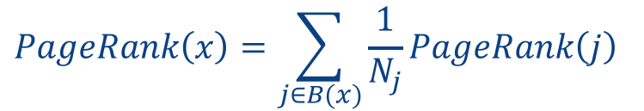
Simplified Version of PageRank
Each page x is given a rank PageRank(x)
Goal: Assign the PageRank(x) such that the rank of each page is governed by the ranks of the pages linking to it:
G
$$PageRank\left(x\right)=\sum_{j∈B(x)}{\frac{1}{N_{j}}PageRank\left(j\right)}$$
E
H
F
I
Rank of page j
Rank of page x
How do we compute the rank values?
Number of
links out
from page j
Every page
j that links to x
Notes:
In a given round of PageRank, we want to assign a rank to each page x, called PageRank(x) based on the ranks of all pages linking to it. Each page gives an equal portion of its current rank (“vote”) to each page that it points to. So if page j has Nj links out of it, then it gives PageRank(j)/Nj votes to each page that it links to. So PageRank(x) is calculated by summing up, over all pages that link to x, the “vote” of that page for x.

Slide 13
Implementing Naïve PageRank

Slide 14
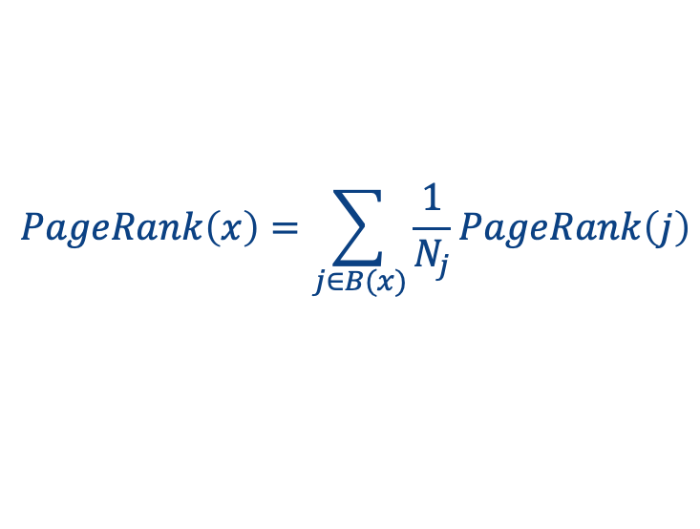
Restating the Simplified Model as a Browsing Experience
Let’s imagine we “randomly walk” through a graph of nodes and connections
At each point, we look at the out-edges and follow each with equal probability
$$PageRank\left(x\right)=\sum_{j∈B(x)}{\frac{1}{N_{j}}PageRank\left(j\right)}$$

Slide 15
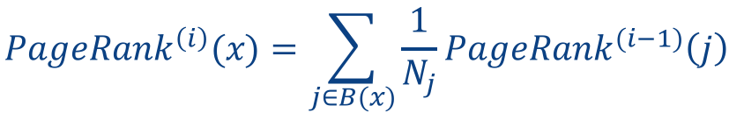

Iterative PageRank (simplified)
Initialize all ranks to be equal, e.g.:
$$PageRank^{\left(0\right)}(x)=\frac{1}{n}$$
Iterate until convergence
$$PageRank^{\left(i\right)}(x)=\sum_{j∈B(x)}{\frac{1}{N_{j}}PageRank^{(i−1)}\left(j\right)}$$

Slide 16
Iterative PageRank (simplified)
Initialize all ranks to be equal, e.g.:
$$PageRank^{\left(0\right)}(x)=\frac{1}{n}$$
Iterate until convergence
$$PageRank^{\left(i\right)}(x)=\sum_{j∈B(x)}{\frac{1}{N_{j}}PageRank^{(i−1)}\left(j\right)}$$
No need to decide how many levels to consider!

Slide 17

Example: Step 0
Initialize all ranks to be equal
$$PageRank^{(0)}(x)=\frac{1}{n}$$
0.33
0.33
0.33

Slide 18
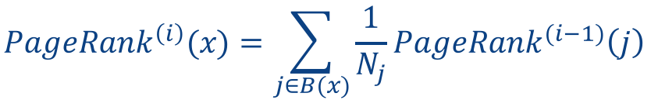
Example: Step 1
Propagate weights across out-edges
$$PageRank^{\left(i\right)}(x)=\sum_{j∈B(x)}{\frac{1}{N_{j}}PageRank^{(i−1)}\left(j\right)}$$
0.33
0.17
0.33
0.17

Slide 19
Example: Step 2
Compute weights
based on in-edges
$$PageRank^{\left(i\right)}(x)=\sum_{j∈B(x)}{\frac{1}{N_{j}}PageRank^{(i−1)}\left(j\right)}$$
0.50
0.33
0.17

Slide 20
Example: Convergence After ~15 Iterations
$$PageRank^{\left(i\right)}(x)=\sum_{j∈B(x)}{\frac{1}{N_{j}}PageRank^{(i−1)}\left(j\right)}$$
0.4
0.4
0.2

Slide 21
Great! We Can Compute PageRank Iteratively
We can use the intuitions from what we just saw to compute this much like our recursive path traversal in Spark – via iteration and join
In each round:
compute the “rank” to be sent from each source node to each destination node (1 / number of out-edges from the source node)
sum the incoming “ranks” for each destination node
But some pieces of this can be thought of in a more general way, to significant benefit…
Next up: let’s reformulate PageRank, thinking of the graph as a matrix!

