Slide 1

Supervised Machine Learning: Artificial Neural Networks

Slide 2
Machine Learning So Far…
Supervised machine learning
Classification or regression, generally with linear functions:
Linear regression or logistic regression
Next: Flexible nonlinear supervised learning – via artificial neural networks

Slide 3


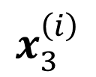
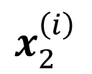
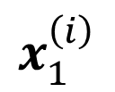
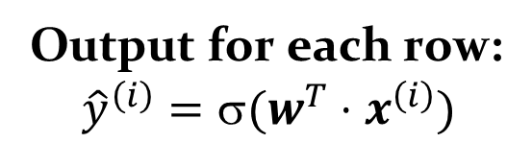
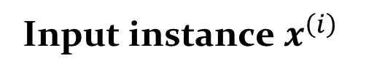
Recall Logistic Regression
Predict probability each item belongs to a class
Output for each row: $${\hat{y}}^{\left(i\right)}=\text{s}(w^{T}⋅x^{\left(i\right)})$$
$$$$
Apply a sigmoid or logistic function
$\text{s}\left(z\right)=$ $\frac{1}{1+e^{−z}}$
w₁
w₂
w₃
Training (setting w) is based on gradient descent minimizing the loss function
$$x_{1}^{\left(i\right)}$$
$$x_{2}^{\left(i\right)}$$
$$x_{3}^{\left(i\right)}$$
Input instance $x^{\left(i\right)}$
Notes:
For logistic regression, we tend to use a log cost function.
In fact for our examples we’ll use a different cost function more suitable for neural nets!

Slide 4
Finding the Weights in Logistic Regression via Gradient Descent

Slide 5
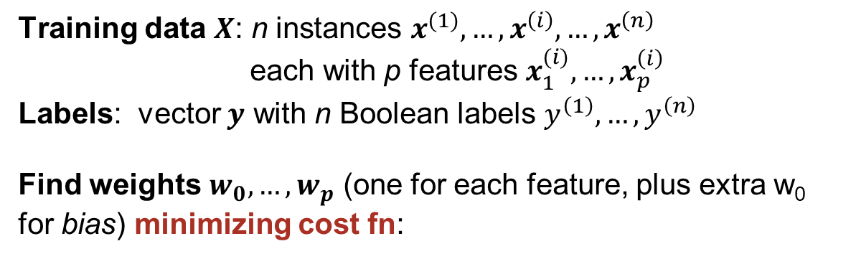

Logistic Regression as an Optimization Problem
Given:
Goal:
We’ll typically use log loss error for cost:
$−\frac{1}{n}\sum_{i=1}^{n}{\left[y^{\left(i\right)}\log\left({\hat{p}}^{\left(i\right)}\right)+\left(1−y^{\left(i\right)}\right)\log\left(1−{\hat{p}}^{\left(i\right)}\right)\right]}$, where
${\hat{p}}^{\left(i\right)}=σ(w^{T}⋅x^{\left(i\right)}$)
Training data $X$: n instances $x^{(1)},…,x^{\left(i\right)},…,x^{\left(n\right)}$ each with p features $x_{1}^{(i)},…,x_{p}^{\left(i\right)}$
Labels: vector $y$ with n Boolean labels $y^{\left(1\right)}, …,y^{\left(n\right)}$
Find weights $w_{0},…,w_{p}$ (one for each feature, plus extra w₀ for bias) minimizing cost fn:
probabilistic value, not the thresholded prediction!

Slide 6
Building Intuitions via Linear Regression

Slide 7
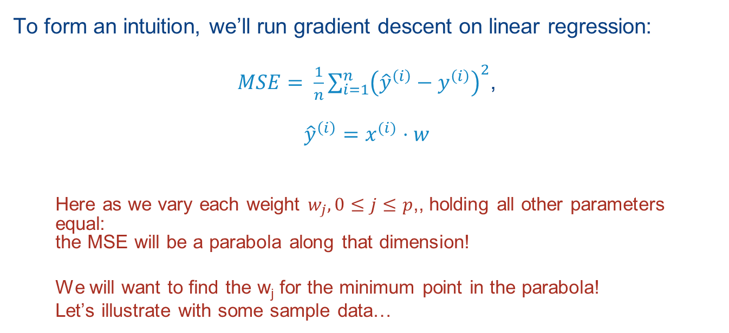
Gradient Descent with Linear Regression
To form an intuition, we’ll run gradient descent on linear regression:
$MSE= \frac{1}{n}\sum_{i=1}^{n}{{\left({\hat{y}}^{\left(i\right)}−y^{\left(i\right)}\right)}^{2}}$,
$${\hat{y}}^{\left(i\right)}=x^{(i)}⋅w$$
Here as we vary each weight $w_{j},0≤j≤p$,, holding all other parameters equal: the MSE will be a parabola along that dimension!
We will want to find the w_{j} for the minimum point in the parabola!
Let’s illustrate with some sample data…

Slide 8
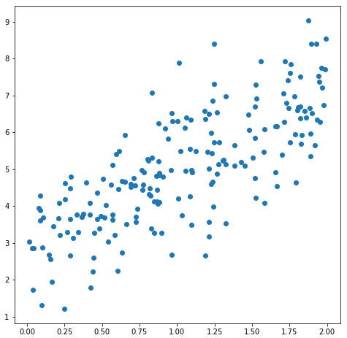
A Simple Dataset
# Let's plot a series of points
X = 2 * np.random.rand(200, 1)
# We are plotting y = 2x + 3 plus a random
# value
y = 2 * X + 3 + np.random.randn(200, 1)

Slide 9
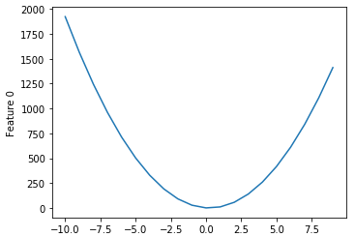
Example: Cost as a Function of the Weight, for Feature 6
Feature 0
We want to find w₆ to minimize MSE – we’ll call this μ_{p}

Slide 10

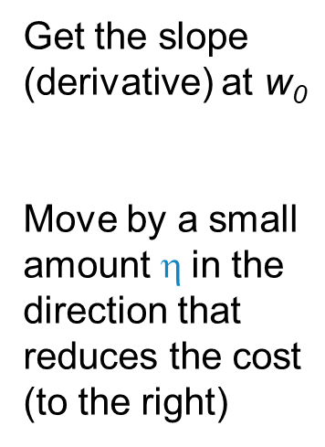
Finding the Minimum
Get the slope (derivative) at w₀
Move by a small amount $\text{h}$in the direction that reduces the cost (to the right)
Our initial weight w₀
Feature 0
$$\text{h}$$
Notes:
There is an iterative process to find the correct weight to minimize the cost for Feature 0

Slide 11
Finding the Minimum
Get the slope (derivative) at w₀
Move by a small amount $\text{h}$in the direction that reduces the cost (to the right)
Our initial weight w₀
Feature 0
The derivative at w₀
$$\text{h}$$

Slide 12

Finding the Minimum
Get the slope (derivative) at w₀
Move by a small amount $\text{h}$in the direction that reduces the cost (to the right)
Our initial weight w₀
Feature 0
The derivative at w₀
$$\text{h}$$

Slide 13
Finding the Minimum
Get the slope (derivative) at w₀
Move by a small amount $\text{h}$in the direction that reduces the cost (to the right)
Our initial weight w₀
Feature 0
The derivative at w₀

Slide 14
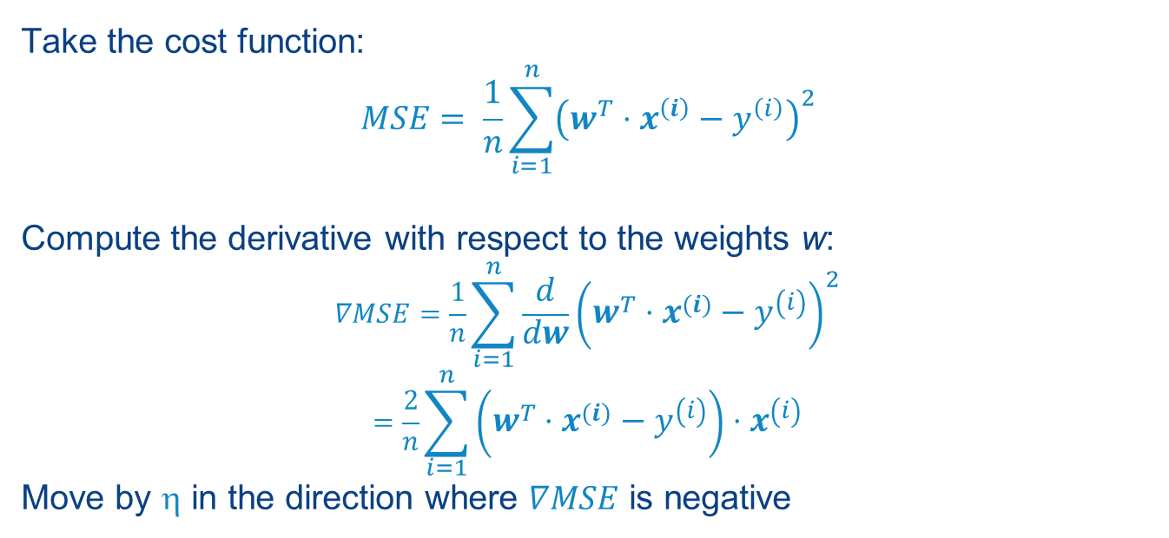
The Mechanics: Finding the Slope
Take the cost function:
$$MSE= \frac{1}{n}\sum_{i=1}^{n}{{\left(w^{T}⋅x^{\left(i\right)}−y^{\left(i\right)}\right)}^{2}}$$
Compute the derivative with respect to the weights w:
$$∇MSE=\frac{1}{n}\sum_{i=1}^{n}{\frac{d}{dw}{\left(w^{T}⋅x^{\left(i\right)}−y^{\left(i\right)}\right)}^{2}}$$
$$=\frac{2}{n}\sum_{i=1}^{n}{\left(w^{T}⋅x^{\left(i\right)}−y^{\left(i\right)}\right)}⋅x^{\left(i\right)}$$
Move by $\text{h}$ in the direction where $∇MSE$ is negative
Notes:
Here’s how we do this…

Slide 15
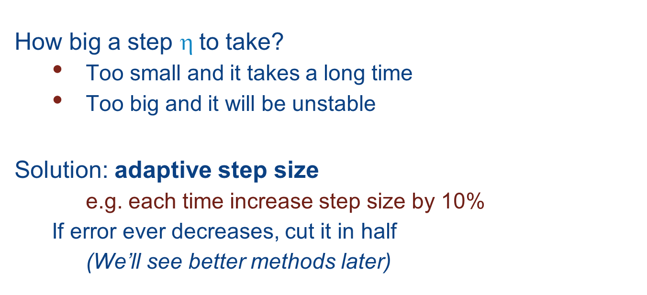
Key questions
How big a step $\text{h}$to take?
Too small and it takes a long time
Too big and it will be unstable
Solution: adaptive step size
e.g. each time increase step size by 10%
If error ever decreases, cut it in half
(We’ll see better methods later)
Notes:
The algorithm actually needs us to consider things.

Slide 16
Great… That’s the Theory! How Does It Work?
Let’s now compute weights for logistic regression
We’ll later generalize to artificial neural nets
We’ll “train” over many rounds/epochs
Inputs: data points X, set of labels y
To set weights w via gradient descent
Then use as a classifier by thresholding

Slide 17
Lecture Notebook: Consider a Simple Dataset
from sklearn.datasets import make_blobs
(X, y) = make_blobs(n_samples=1000, n_features=2, \
centers=2, cluster_std=1.10, \
random_state=42)
Notes:
To see this in action, let’s look at some real data… Or at least synthetic real data!

Slide 18
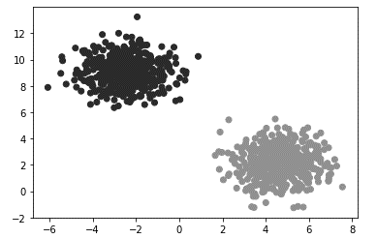
A Simple Dataset
from sklearn.datasets import make_blobs
(X, y) = make_blobs(n_samples=1000, n_features=2, \
centers=2, cluster_std=1.10, \
random_state=42)

Slide 19
Logistic Regression: “Sigmoid” Is Applied Over (x * w) to Make a Prediction
# Here is our sigmoid function for making
# predictions with logistic regression
# or with perceptron-style neural nets
def prediction(x):
return 1.0 / (1 + np.exp(-x))

Slide 20
Logistic Regression: “Sigmoid” Is Applied Over (x * w) to Make a Prediction
# Here is our sigmoid function for making
# predictions with logistic regression
# or with perceptron-style neural nets
def prediction(x):
return 1.0 / (1 + np.exp(-x))

Slide 21
Logistic Regression: “Sigmoid” Is Applied Over (x * w) to Make a Prediction
# Here is our sigmoid function for making
# predictions with logistic regression
# or with perceptron-style neural nets
def prediction(x):
return 1.0 / (1 + np.exp(-x))
To get a classifier, we’ll then threshold at 0.5

Slide 22
The Classifier, Applied to the Test Data
for item in range(len(X_test)):
predicted_label = 0 if prediction\ (X_test[item].dot(weights)) < 0.5 else 1
The more interesting part: how to train the classifier,
via gradient descent
Notes:
Very simple: we call the prediction function (the sigmoid) based on the dot product of the instance and the weights.

Slide 23
The Gradient Descent
def gradient_descent(epochs, eta, X, w, y):
for i in range(epochs):
predictions = prediction(X.dot(w))
# The overall error, as a vector
error = (predictions - y) # Record the MSE so we can plot it
mean_sq_error = np.sum(error ** 2) / X.shape[0]
# The gradient is based on the partial derivative
# of the MSE with respect to w. This is the gradient for # log-loss with sigmoid:
gradient = 2 / X.shape[0] * X.T.dot(error) w = w - eta * gradient
return w

Slide 24
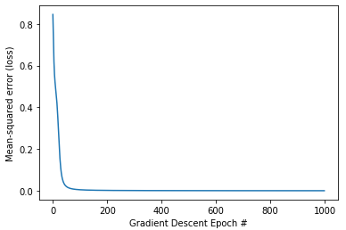
Descending the Gradient: Plotting Mean-Squared Error in Each Epoch
Notes:
We see an “elbow” where the MSE quickly drops, telling us how many epochs are needed. It’s around 60.

Slide 25
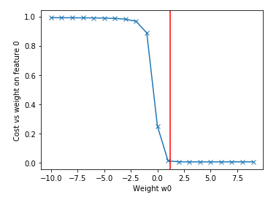
Finally: The Optimal Weight for Feature 0
Notes:
Here we can see another elbow, where the cost is minimized with weight around 1.2.

Slide 26
The Classifier
for item in range(len(X_test)):
predicted_label = 0 if prediction\ (X_test[item].dot(weights)) < 0.5 else 1
print('Prediction {} vs {}'.format(predicted_label,\ y_test[item]))

Slide 27
The Classifier
for item in range(len(X_test)):
predicted_label = 0 if prediction\ (X_test[item].dot(weights)) < 0.5 else 1
print('Prediction {} vs {}'.format(predicted_label,\ y_test[item]))
Prediction 1 vs 1
Prediction 0 vs 0
Prediction 0 vs 0
Prediction 1 vs 1
Prediction 0 vs 0
Prediction 1 vs 1
Prediction 1 vs 1
Prediction 0 vs 0
Prediction 0 vs 0
Prediction 0 vs 0
Prediction 1 vs 1

Slide 28
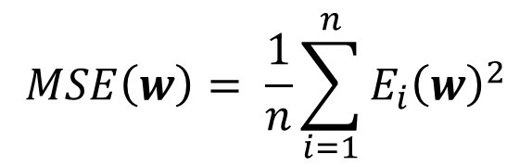

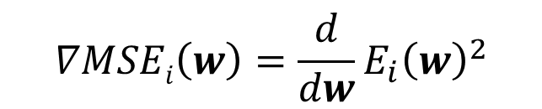
Stochastic Gradient Descent
If we have a very large data set, update the model after observing each single observation
“online” or “streaming” learning
$$MSE\left(w\right)= \frac{1}{n}\sum_{i=1}^{n}{E_{i}{\left(w\right)}^{2}}$$
$$∇MSEi\left(w\right)=\frac{d}{dw}E_{i}{\left(w\right)}^{2}$$
E_{i} = error between sigmoid output and training label
$$w≔w+\text{h} ∇MSEi\left(w\right)$$
Notes:
Normal gradient descent works over the whole dataset, one iteration at a time.
On the opposite extreme, we do the gradient descent one instance at a time.
It turns out this (perhaps surprisingly) has similar outcomes to regular gradient descent.

Slide 29
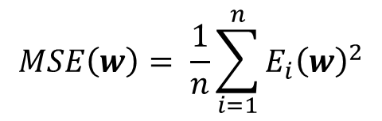

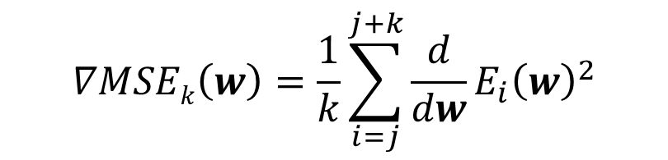
Mini-batch
Update the model every k observations
Batch size k (e.g. 50)
More efficient than pure stochastic gradient or full gradient descent
$$∇MSEk\left(w\right)=\frac{1}{k}\sum_{i=j}^{j+k}{\frac{d}{dw}E_{i}{\left(w\right)}^{2}}$$
$$MSE\left(w\right)= \frac{1}{n}\sum_{i=1}^{n}{E_{i}{\left(w\right)}^{2}}$$
E_{i} = error between sigmoid output and training label
$$w≔w+\text{h} ∇kMSE\left(w\right)$$
Notes:
In between full and stochastic gradient descent, we can do our computations every k rows…

Slide 30
Recap: Gradient Descent
Progressively “follow the slope” towards a minimum
Analytical or numerical derivative
Need to pick step size
larger = faster convergence but instability
Lots of variations
“Stochastic gradient descent or minibatch
Can get caught in local minima
Alternative, simulated annealing, uses random restarts with less and less likelihood of restarting
Critical for training neural nets, as we’ll see next
Notes:
Simulated annealing: in each iteration, flip a coin. With high probability do a gradient descent step on w and save the current optimum. With low probability, jump to a new location of w. Repeat for many iterations. As time progresses, make the random-jump probability less and less.

Slide 31



Logistic Regression Is Actually a Basic “Artificial Neuron”!
The output “activation function”:
Activation fn
Σ
$$a\left(x\right)=\text{s}(w^{T}⋅x)$$
Sigmoid:
$$\text{s}\left(z\right)=1/(1+e^{−z})$$
w₁
w₂
w₃
x₁
x₂
x₃
Inputs $x$
Notes:
Let’s come back to the big picture of regression “units” – which in fact are going to be the building blocks for artificial neural nets.
In this visualization we see a set of inputs, each with weights. The Sigma indicates we sum the products of the weights (w’s) and inputs (x’s).
Then there is a threshold / activation function applied to the outputs of Sigma (which is a dot product between x and w vectors).
The simplest version of the activation function is the sigmoid, which we already saw for logistic regression.

Slide 32

This Is Actually a Basic “Artificial Neuron”!
One tweak: we’ll introduce another input called a bias that is “always on” (with a new weight w₀)
$$a\left(x\right)=\text{s}(w^{T}⋅x)$$
Activation fn
Σ
w₀
w₁
w₂
w₃
1
x₁
x₂
x₃
Inputs $x$

Slide 33
Artificial Neurons (by Default) Are Essentially Logistic Regression Steps
An artificial neuron seeks to approximate (learn) a function (possibly regression or classification)
Can be just a logistic regression “module”
“Activation function” is a sigmoid
We train via gradient descent (minimizing, say, SSE)
We typically add a bias set to 1
Since we don’t really need probability of classification:
Can replace sigmoid “activation function” with others

Slide 34
From a Neuron to a Network

Slide 35
A Perceptron – Running Multiple Regressions at Once
“One hot” encoding on outputs; each regression learns “one vs all”
class1?
class2?
class3?
Σ
Σ
Σ
1
x₁
x₂
bias
inputs
Notes:
Notice here we are connecting each input (and the bias) to every regression unit. Each “activation unit” is making a different prediction, e.g., it’s learning to predict a different class here.

Slide 36
For Later: More Complex (“Deeper”) Networks
We don’t need to decide a priori which
variables are being
predicted here
Σ
Σ
Σ
1
x₁
x₂
bias
inputs

Slide 37
For Later: More Complex (“Deeper”) Networks
class?
Training will help direct what the hidden variables should be
Σ
We don’t need to decide a priori which
variables are being
predicted here
Σ
Σ
Σ
1
x₁
x₂
bias
inputs
Notes:
Suppose we are trying to predict one class, but from three different composite characteristics. This requires composition.

Slide 38
A Simple Single-Layer Network

Slide 39
Let’s Simultaneously Train…
Consider a very simple example
We have input instances with two features, x₁, x₂
We want to build a classifier for x₁ AND x₂, x₁ OR x₂
Let’s set up a very simple single-layer network with two artificial neurons

Slide 40
An Example Using Single Neurons (Perceptrons)
Let’s use w_{j,i} to be the weight
from input i to neuron j
x1 AND x2
x1 OR x2
Σ
Σ
For simplicity we’ll use the heaviside activation
function,
$$f\left(x\right)=\left\{\begin{aligned}0 if x<0 \\ 1 if x≥0\end{aligned}\right.$$
w_{1,0}
w_{1,2}
w_{1,1}
w_{2,2}
1
x₁
x₂
bias
inputs

Slide 41
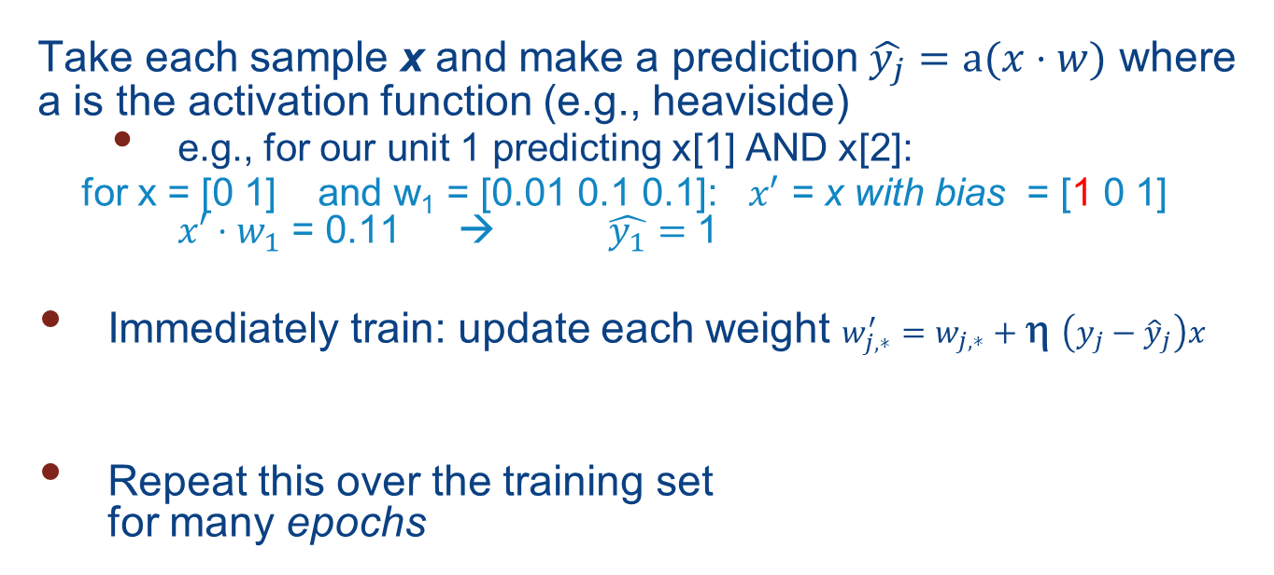
Training Is Incremental
Take each sample x and make a prediction $\hat{y_{j}}=a(x⋅w)$ where a is the activation function (e.g., heaviside)
e.g., for our unit 1 predicting x[1] AND x[2]:
for x = [0 1] and w₁ = [0.01 0.1 0.1]: $x′$ = x with bias = [1 0 1] $x′⋅w_{1}$ = 0.11 → $\hat{y_{1}}=$ 1
Immediately train: update each weight $w_{j,∗}^{′}=w_{j,∗}+\text{h} \left({y_{j}−\hat{y}}_{j}\right)x$
Repeat this over the training set for many epochs
Looks like gradient descent update rule with logistic regression!
η = learning rate

Slide 42
Example: Learning OR
X y
[0 0] -> 0
[0 1] -> 1
[1 0] -> 1
[1 1] -> 1
x1 or x2
Σ
(heaviside, $\text{h}$=0.01)
1
x₁
x₂
bias
Start with random weights w_{2,*} = [0 -0.3 0.7] (recall w_{0,2} is for bias)
Notes:
The heaviside function is simpler than sigmoid: it returns 0 if n < 0 and 1 if n >= 0.
Here we’ll train a set of weights to learn the OR function. To do this, we do a dot product of the x_{i}’s and w, then we set y-hat based on whether we are at (or above) or below zero. We are using sgd so we adjust w after every instance.

Slide 43
Example: Learning OR
X y
[0 0] -> 0
[0 1] -> 1
[1 0] -> 1
[1 1] -> 1
x1 or x2
Σ
(heaviside, $\text{h}$=0.01)
1
x₁
x₂
bias
Start with random weights w_{2,*} = [0 -0.3 0.7] (recall w_{0,2} is for bias)
Train on x = [0 0]:
Extend vector with bias: x’ = [1 0 0]
Multiply $x⋅w_{\text{2}}=$[1 0 0] [0 -0.3 0.7] = 0
Predict $\hat{y}=$heaviside(0) = 1 $y=(0∨0)=0$
Compute update $Δw_{\text{∗,2}}=η\left(y−\hat{y}\right)x=0.01 \left(0 −1\right)\left[1 0 0\right]$ = [-0.01 0 0]
Notes:
The heaviside function is simpler than sigmoid: it returns 0 if n < 0 and 1 if n >= 0.
Here we’ll train a set of weights to learn the OR function. To do this, we do a dot product of the x_{i}’s and w, then we set y-hat based on whether we are at (or above) or below zero. We are using sgd so we adjust w after every instance.

Slide 44
Example: Learning OR
X y
[0 0] -> 0
[0 1] -> 1
[1 0] -> 1
[1 1] -> 1
x1 or x2
Σ
(heaviside, $\text{h}$=0.01)
1
x₁
x₂
bias
Start with random weights w_{2,*} = [-0.01 -0.3 0.7]
Train on x = [0 1]:
Extend vector with bias: x’ = [1 0 1]
Multiply $x⋅w_{\text{2}}=$[1 0 1] [-0.01 -0.3 0.7] = 0.69
Predict $\hat{y}=$heaviside(0.69) = 1 $y=(0∨1)=1$
Compute update $Δw_{\text{∗,2}}=η\left(y−\hat{y}\right)x=0.01 \left(1 −1\right)\left[1 0 1\right]$ = [0 0 0]
Notes:
The heaviside function is simpler than sigmoid: it returns 0 if n < 0 and 1 if n >= 0.
Here we’ll train a set of weights to learn the OR function. To do this, we do a dot product of the x_{i}’s and w, then we set y-hat based on whether we are at (or above) or below zero. We are using sgd so we adjust w after every instance.

Slide 45
Example: Learning OR
X y
[0 0] -> 0
[0 1] -> 1
[1 0] -> 1
[1 1] -> 1
x1 or x2
Σ
(heaviside, $\text{h}$=0.01)
1
x₁
x₂
bias
Start with random weights w_{2,*} = [-0.01 -0.3 0.7]
Train on x = [1 0]:
Extend vector with bias: x’ = [1 1 0]
Multiply $x⋅w_{\text{2}}=$[1 1 0] [-0.01 -0.3 0.7] = -0.31
Predict $\hat{y}=$heaviside(-0.31) = 0 $y=(1∨0)=1$
Compute update $Δw_{\text{∗,2}}=η\left(y−\hat{y}\right)x=0.01 \left(1 −0\right)\left[1 1 0\right]$ = [0.01 0.01 0]
Notes:
The heaviside function is simpler than sigmoid: it returns 0 if n < 0 and 1 if n >= 0.
Here we’ll train a set of weights to learn the OR function. To do this, we do a dot product of the x_{i}’s and w, then we set y-hat based on whether we are at (or above) or below zero. We are using sgd so we adjust w after every instance.

Slide 46
Example: Learning OR
X y
[0 0] -> 0
[0 1] -> 1
[1 0] -> 1
[1 1] -> 1
x1 or x2
Σ
(heaviside, $\text{h}$=0.01)
1
x₁
x₂
bias
Start with random weights w_{2,*} = [0 -0.29 0.7]
Train on x = [1 1]:
Extend vector with bias: x’ = [1 1 1]
Multiply $x⋅w_{\text{2}}=$[1 1 1] [0 -0.29 0.7] = 0.41
Predict $\hat{y}=$heaviside(0.41) = 1 $y=(1∨1)=1$
Compute update $Δw_{\text{∗,2}}=η\left(y−\hat{y}\right)x=0.01 \left(1 −1\right)\left[1 1 0\right]$ = [0 0 0]
And we repeat the entire process for many epochs!
Notes:
The heaviside function is simpler than sigmoid: it returns 0 if n < 0 and 1 if n >= 0.
Here we’ll train a set of weights to learn the OR function. To do this, we do a dot product of the x_{i}’s and w, then we set y-hat based on whether we are at (or above) or below zero. We are using sgd so we adjust w after every instance.

Slide 47
Ultimately, We Learn a Separating Hyperplane…
Output True
Output False
Input x₂
w₀
Input x₁
Notes:
Much like with linear regression, we draw a line between the

Slide 48
Training the Perceptron: Guarantees
Learns linear decision boundaries, much as with logistic regression… but predicts class, not probability!
Guaranteed to converge if the classes are linearly separable

Slide 49
Training and Using a Perceptron in SciKit-Learn
from sklearn.linear_model import Perceptron
clf = Perceptron(random_state=42)
clf.fit(X_train, y_train)
clf.predict(X_test)

Slide 50
Summary of Perceptrons
A vector of artificial neurons in a single “layer”
Often produce “one-hot” encoding of output
Can train them all simultaneously based on a gradient descent-style update, with a learning rate
Guaranteed to converge for linearly separable data
But not all data is linearly separable, which requires us to compose perceptrons in layers!

Slide 51
Multi-Layer (Feed-forward) Networks

Slide 52
Assembling a Perceptron (“Activation Unit”) into Multiple Layers
class1?
class2?
class3?
Σ
Σ
Σ
output layer
w⁽²⁾_{1,0}
More than 2 layers: a “deep network”
1
Σ
Σ
Σ
hidden layer(s)
input layer
1
x₁
x₂

Slide 53
Assembling a Perceptron (“Activation Unit”) into Multiple Layers
class1?
class2?
class3?
a^{(i)} vector: a(z^{(i)})
Σ
Σ
Σ
z^{(i)} vector: a^{(i-1)} * w^{(i-1)}
w^{(i-1)} vector: weights for input level i
w⁽²⁾_{3,3}
w⁽²⁾_{1,0}
a⁽²⁾ vector: a(z⁽²⁾)
1
Σ
Σ
Σ
z⁽²⁾ vector: x * w⁽¹⁾
w⁽¹⁾_{1,2}
w⁽¹⁾ vector: weights for level 1
1
x₁
x₂
x vector: inputs (and bias)

Slide 54
Prediction: “Feed-Forward”
class1?
class2?
class3?
a⁽³⁾ = f(z⁽³⁾)
Σ
Σ
Σ
z⁽³⁾ = a⁽²⁾ * w⁽²⁾
We’ll discuss how to train, in a generalization of our gradient descent technique, in the next module!
a⁽²⁾ = f(z⁽²⁾)
1
Σ
Σ
Σ
z⁽²⁾ = x * w⁽¹⁾
1
x₁
x₂
Read x

Slide 55
Commonly Used Activation Functions for Multilayer Networks
Sigmoid $σ\left(z\right)=\frac{1}{1+e^{−z}}$
Rectified linear (ReLU)
$$ReLU\left(z\right)=\max\left(z,0\right)$$
Piecewise linear!
Hyperbologic tangent
$$tanh\left(z\right)$$

Slide 56
Using Feedforward Networks from SciKit

Slide 57
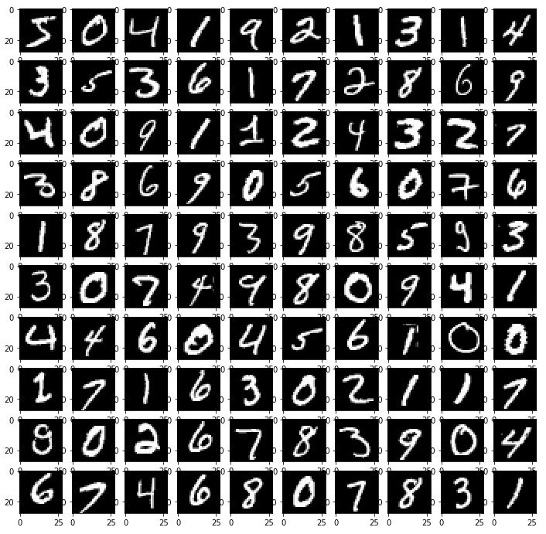
Use Case: MNIST letters
Each letter is 28x28
grayscale pixels
We create 784 features to represent each letter
We have class labels
0 - 9
Notes:
Let’s see an example using our companion lecture notebook. We’ll train a feed-forward network over images of handwritten letters.
The ‘MNIST’ data set was used to learn handwritten zipcodes.
Each image gets mapped into a single feature vector: we take the 28x28 pixels and reshape into 784x1 pixels. This is our feature vector.
Let’s see how to use a feedforward network with this.

Slide 58
The Multi-Layer Perceptron in Scikit-Learn
Adopts the familiar Sklearn fit / predict API. Note that we can specify multiple hidden layers as a tuple.
from sklearn.neural_network import MLPClassifier
mlp = MLPClassifier(hidden_layer_sizes=(10,10))
mlp.fit(X_train, y_train)
mlp.predict(X_test)
array([8, 0, 6, ..., 3, 3, 3])
Notes:
Pretty straightforward to use!
How does it actually work? We’ll consider this next.

Slide 59
Internals of Multi-Layer Perceptrons: Feed-Forward and Backpropagation

Slide 60
Training Multi-Layer Networks
Backpropagation algorithm: For each training instance:
Compute output of every neuron in each layer [forward pass]
Compute network output error (desired – output error)
Compute how much each neuron in previous hidden layer contributed – propagate the error gradient backwards, scaled by each neuron’s contribution to the error
Do gradient descent on connection weights

Slide 61

(1) “Feed-Forward”
$$\hat{y}=a^{(3)}$$
Σ
Σ
Σ
w⁽²⁾_{j,i}: 3 outputs * (3 hidden units + bias) = 12 edges with weights
1
Σ
Σ
Σ
w⁽¹⁾_{j,i:} (2 inputs + bias) * 3 hidden units = 9 edges with weights
1
x₁
x₂

Slide 62


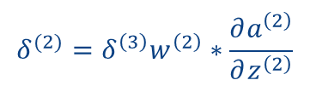


2. Computing Error + Backpropagation
$$δ^{(3)}=y−\hat{y}$$
$$δ_{1}^{(3)}=y_{1}−\hat{y_{1}}$$
$$δ_{2}^{(3)}=y_{2}−\hat{y_{2}}$$
$$δ_{3}^{(3)}=y_{3}−\hat{3}$$
Σ
Σ
Σ
$$δ^{(2)}=δ^{\left(3\right)}w^{\left(2\right)}∗\frac{∂a^{\left(2\right)}}{∂z^{\left(2\right)}}$$
1
Σ
Σ
Σ
1
x₀
x₁

Slide 63

2. Computing Error + Backpropagation
$$δ^{(3)}=y−\hat{y}$$
For sigmoid,
$$\frac{∂a^{(2)}}{∂z^{\left(2\right)}}=a^{\left(2\right)}∗(1−a^{\left(2\right)})$$
$$δ_{1}^{(3)}=y_{1}−\hat{y_{1}}$$
$$δ_{2}^{(3)}=y_{2}−\hat{y_{2}}$$
$$δ_{3}^{(3)}=y_{3}−\hat{3}$$
Σ
Σ
Σ
$$δ^{(2)}=δ^{\left(3\right)}w^{\left(2\right)}∗\frac{∂a^{\left(2\right)}}{∂z^{\left(2\right)}}$$
1
Σ
Σ
Σ
1
x₀
x₁

Slide 64


Backpropagation
$$δ^{(3)}=y−\hat{y}$$
Σ
Σ
Σ
$$δ^{(2)}=δ^{(3)}w^{(2)}∗a^{\left(2\right)}∗(1−a^{\left(2\right)})$$
1
Σ
Σ
Σ
Add $δ^{(2)}$ to $w^{\left(2\right)}$
1
x₀
x₁

Slide 65


Backpropagation
$$δ^{(3)}=y−\hat{y}$$
Σ
Σ
Σ
$$δ^{(2)}=δ^{(3)}w^{(2)}∗a^{\left(2\right)}∗(1−a^{\left(2\right)})$$
1
Σ
Σ
Σ
Add $δ^{(2)}$ to $w^{\left(2\right)}$
$$δ^{(1)}=δ^{(2)}w^{(1)}∗a^{\left(1\right)}∗(1−a^{\left(1\right)})$$
1
x₀
x₁
Add $δ^{(1)}$ to $w^{\left(1\right)}$

Slide 66
Now…
Feedforward and backpropagate for the rest of the instances
And repeat for many epochs!

Slide 67
Recap: Feedforward / Backpropagation
Once we have fed-forward the inputs, we need to backpropagate according to the contributions from the prior level, and do a gradient descent based on the activation function
We can do this using the same kinds of gradient descent algorithms we talked about previously – full gradient descent, minibatch, and stochastic gradient descent
This allows opportunities for parallelism – we’ll discuss this in mxnet next!

Slide 68
Beyond Multilayer Perceptrons: Advanced Topics
Convolutional neural networks:
given images or regular patterns, works on overlapping “windows” of the image and learns commonly occurring higher-level shapes as features
composes these features into higher-level features
makes predictions based on compositions of those features
Recurrent neural networks:
looks for patterns over “streams” of data (x follows y follows z), as is frequently useful in language models
https://towardsdatascience.com/a-comprehensive-guide-to-convolutional-neural-networks-the-eli5-way-3bd2b1164a53

