Slide 1
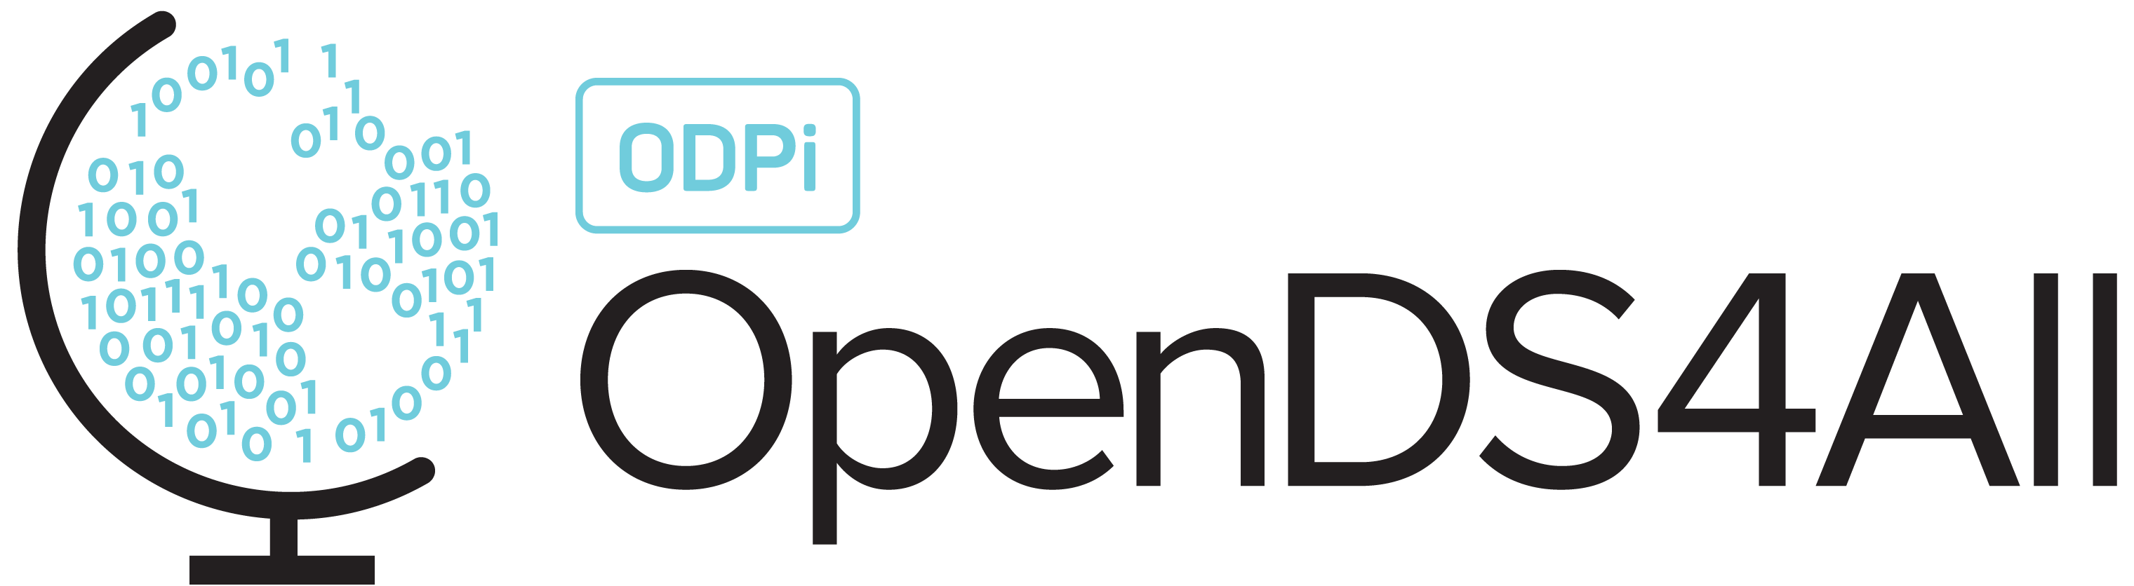
Supervised Machine Learning: Overview, Decision Trees, Random Forests

Slide 2
Two Flavors of Machine Learning
1. Find the structure in the data (unsupervised)
x
x
x
x
x
x
Input data: x₁, x₂, x₃, …, x_{n}
x
x
x
x
Notes:
Recall from a previous module, we can think about unsupervised vs supervised ML.

Slide 3
Two Flavors of Machine Learning
1. Find the structure in the data (unsupervised)
x
x
x
x
x
x
Input data: x₁, x₂, x₃, …, x_{n}
x
x
x
x

Slide 4
Two Flavors of Machine Learning
1. Find the structure in the data (unsupervised)
2. Find a function mapping from data features to classes (supervised)
x
x
x
x
x
x
Input data: x₁, x₂, x₃, …, x_{n}
x
x
x
x
x
x
x
x
x
Input data: x₁, x₂, x₃, …, x_{n}
x
x
x
x
x

Slide 5
Two Flavors of Machine Learning
1. Find the structure in the data (unsupervised)
2. Find a function mapping from data features to classes (supervised)
x
x
x
x
x
x
Input data: x₁, x₂, x₃, …, x_{n}
x
x
x
x
x
x
x
x
x
Input data: x₁, x₂, x₃, …, x_{n}
o
o
o
+ Labels: y₁, y₂, y₃, …, y_{n}
o
o

Slide 6
Two Flavors of Machine Learning
1. Find the structure in the data (unsupervised)
2. Find a function mapping from data features to classes (supervised)
x
x
x
x
x
x
Input data: x₁, x₂, x₃, …, x_{n}
x
x
x
x
x
x
x
x
x
Input data: x₁, x₂, x₃, …, x_{n}
o
o
o
+ Labels: y₁, y₂, y₃, …, y_{n}
o
o

Slide 7
A Workflow for ML: Unsupervised → Supervised Learning
Often, start with unsupervised learning, to identify useful features to extract
Then run supervised learning methods!
Notes:
In this module we’ll discuss the latter!

Slide 8

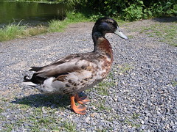
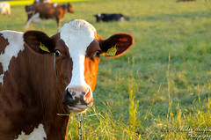

Supervised Learning Starts with Feature Extraction
Start with a matrix X of extracted features
Input data
X: features
✔ Beak
? Webbed feet
✔ Quacks
✔ Beak
✔ Webbed feet
✔ Quacks
x Beak
x Webbed feet
x Quacks
Notes:
You’ve probably heard the saying, “If it looks like a duck and quacks like a duck, it’s probably a duck.” How could we formalize this?
Rubber duck, https://www.dutchwatersector.com/news/giant-rubber-duck-continues-china-tour-in-macao
Duck – CC BY-SA 2.0 https://ccsearch.creativecommons.org/photos/21e6f7bd-0d1b-41bd-8d18-4d7816a0bb55
Cow – Markku Akerfelt, CC-Attribution-NonCommercial-NODerivs 2.0 https://www.flickr.com/photos/44758702@N07/4944275265

Slide 9
Supervised Learning Starts with Feature Extraction, Then Training
Train using a matrix X and a label or class, in vector y
Input
X: features
y: class
✔ Is a duck
✔ Beak
? Webbed feet
✔ Quacks
✔ Is a duck
✔ Beak
✔ Webbed feet
✔ Quacks
x Is NOT a duck
x Beak
x Webbed feet
x Quacks
Notes:
Rubber duck, https://www.dutchwatersector.com/news/giant-rubber-duck-continues-china-tour-in-macao
Duck – CC BY-SA 2.0 https://ccsearch.creativecommons.org/photos/21e6f7bd-0d1b-41bd-8d18-4d7816a0bb55
Cow – Markku Akerfelt, CC-Attribution-NonCommercial-NODerivs 2.0 https://www.flickr.com/photos/44758702@N07/4944275265

Slide 10
Under the Covers…
Supervised learning finds a function to map from values of X to values of y
Won’t always be perfect: goal is to minimize the error or loss function
✔ Beak
✔ Webbed feet
✔ Quacks
?
✔ Is a duck

Slide 11
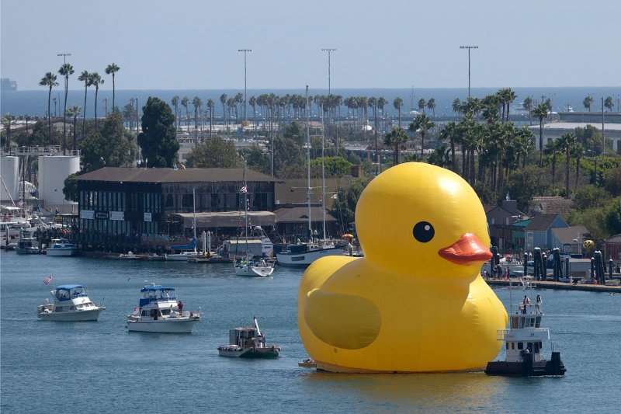

Then: Prediction
X_{new}: features
$\hat{y}$: predicted class
✔ Beak
? Webbed feet
✔ Quacks
✔ Is a duck
How well the classifier does on its training data may be different
from how it does on completely new data!
Notes:
Once we’ve learned the function, we can use it to predict whether other things are ducks!
https://time.com/3153925/giant-rubber-duck-los-angeles/

Slide 12
Types of Supervised Learning
Classification: y is categorical
each value is from a finite set, e.g., nationality, page will be clicked on, item is a duck
Regression: y is continuous
each value is numeric within a continuous range, e.g., age, dollars spent

Slide 13
Classification

Slide 14
The Process of Building and Evaluating a Classifier
Train
Validate
Test
(optional)
Find the function
from X to y;
fit parameters
Tune parameters,
choose from
multiple
models
Assess performance
Notes:
We’ll explain why we have these three stages in the next slide

Slide 15
Why the Three Stages? Challenges Faced in Building a Classifier
Goal: Learn from training data – but generalize!
Risk of overfitting on the training data
Need roughly as many observations as features
Validation data helps us to compare different classifier settings (each trained on the training data) to see which is better
Test data helps us to evaluate the final classifier by comparing its predictions vs the “gold standard”
Training may be computationally costly (esp. neural nets)
Notes:
Overfitting: the classifier too closely learns the dataset it was trained on, making it ineffective on new data that is slightly different.
Validation is an optional stage, which we’ll get to in Module 7 as we seek to tune classifiers.

Slide 16
Python Provides a Standard Interface to Many Classifiers – SciKit-Learn
SciKit-Learn provides a standard interface that looks like this:
x
x
x
x
x
o
o
o
o
o
# Create classifier clf = Classifier(my_params)
# X = training data features (N rows by d dimensions) # y = actual class (training data) for each of N rows clf.fit(X, y)
# Evaluate now over new “test” data predicted_y_test_data = clf.predict(X_test_data)
Notes:
The beauty of SciKit-Learn is that you can almost use the classifiers interchangeably *if* they are well-tuned.
The reality is that you’ll often need to customize their behavior, which means you need to understand how they work, and how to tune (which is a separate module)

Slide 17
Explainable Classifiers: Decision Trees
Please see the companion notebook

Slide 18
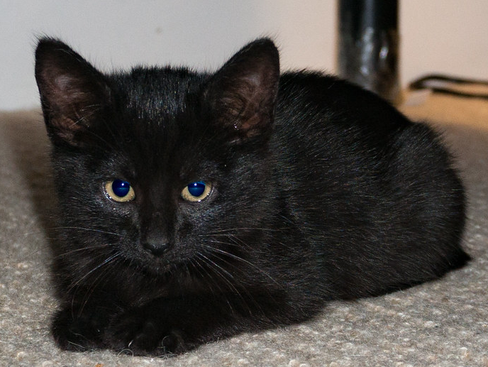
An Example
Suppose we want to predict if someone is going to buy a pet (y), given 4 features in our input matrix X.
black | furry | small | active
1 | 0 | 0 | 0
0 | 1 | 1 | 1
0 | 1 | 0 | 0
0 | 0 | 0 | 1
1 | 1 | 0 | 0
y
1
1
0
0
1
Which single feature best predicts this?

Slide 19
Intuition: Determine How Well Each Feature Predicts the Output
y
y
 | t | f
t | 2 | 0
f | 1 | 2
 | t | f
t | 2 | 1
f | 1 | 1
black
furry
==furry correct 3 times
==black correct 4 times
y
y
 | t | f
t | 1 | 0
f | 2 | 2
active
 | t | f
t | 1 | 1
f | 2 | 1
small
!=active correct 3 times
==small correct 3 times

Slide 20
An Example
Using ==black to predict…
black | furry | small | active
1 | 0 | 0 | 0
1 | 1 | 0 | 0
y
1
1
black | furry | small | active
1 | 0 | 0 | 0
0 | 1 | 1 | 1
0 | 1 | 0 | 0
0 | 0 | 0 | 1
1 | 1 | 0 | 0
y
1
1
0
0
1
black | furry | small | active
0 | 1 | 1 | 1
0 | 1 | 0 | 0
0 | 0 | 0 | 1
y
1
0
0
Which feature best predicts y if animal is not black?
==small

Slide 21
A Flowchart for Making Predictions…
==black?
T
F
Result = True
(2 instances)
==small?
F
T
Result = False
(2 instances)
Result = True
(1 instance)

Slide 22
A Decision Tree for Making Predictions…
==black?
T
F
Result = True
(2 instances)
==small?
F
T
Result = False
(2 instances)
Result = True
(1 instance)

Slide 23
Building a Decision Tree in SciKit-Learn…
clf = tree.DecisionTreeClassifier(criterion="entropy")
clf = clf.fit(X, y)
black <= 0.5
entropy = 0.971
samples = 5
value = [2, 3]
tree.plot_tree(clf.fit(X, y))
small <= 0.5
entropy = 0.918
samples = 3
value = [2, 1]
entropy = 0.0
samples = 2
value = [0, 2]
entropy = 0.0
samples = 2
value = [2, 0]
entropy = 0.0
samples = 1
value = [0, 1]

Slide 24
Summary: Decision Tree Basics
A decision tree is a simple flowchart for deciding on whether an item belongs to a class
Each intermediate (“split”) point evaluates one or more predicates
We split the data based on whether it satisfies the predicate
Leaf-level nodes will be associated with classes, based on the majority-label
(Depending on how deep we go, there may be multiple labels on the data)
Easy to use in SciKit-Learn, although we will want to know more about how they work!

Slide 25
How a Decision Tree Is Built

Slide 26
From the Basics to an Algorithm
We now understand how a decision tree works – and represents an explanation of the decision points in making a classification
We saw an informal means of deciding how to choose the intermediate node
Let’s see how we can formalize this into an algorithm

Slide 27
The Basic Approach
c(f)
F
T
At each point, find a feature (and condition) to split the decision tree
Do this at the root, and then divide the training set into subsets depending on the condition
Repeat recursively on each of the data subsets
Questions that should come to mind:
Does it matter which condition (and feature) we use? Yes!
Is there an optimal strategy? Yes, but it’s NP Hard; recent work does Mixed Integer Optimization https://link.springer.com/article/10.1007/s10994-017-5633-9
Notes:
Answers to the questions:
1. Yes, both the accuracy and effectiveness of the decision tree are determined by the order in which we split.
2. Yes, if we seek to develop a decision tree which has the best success on the training data. But this is computationally intractable (NP-hard, Hyafil & Rivest 76). So instead we use greedy heuristics.

Slide 28
A Greedy Heuristic to Build Decision Trees
c(f)
F
T
Split(dataset)
If items in dataset are not all of the same class:
Determine a predicate over a feature that maximizes some notion of information gain (to be defined)
Partition the dataset according to the predicate
Split each sub-dataset
This may overfit to the training data
Another heuristic: “generalize” the tree by pruning off some of the lower levels (e.g., anything below a max depth)

Slide 29
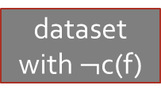
So… How to Define Information Gain?
dataset
c(f)
F
T
dataset
with $¬$c(f)
dataset with c(f)
Compare the dataset pre-split vs the combination of split datasets
Measure “purity” – whether all data is in the same class
First idea: use entropy (from information theory) as the basis of comparison

Slide 30
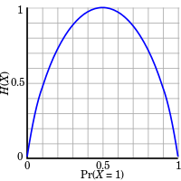
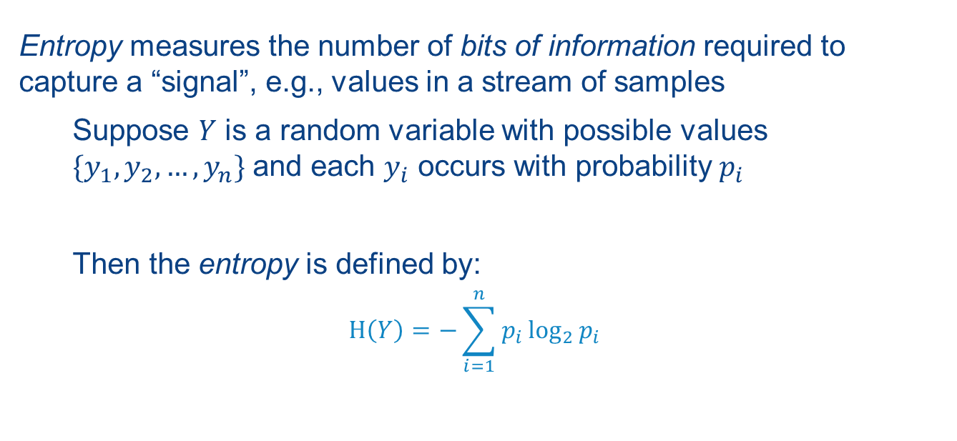
Entropy
Entropy measures the number of bits of information required to capture a “signal”, e.g., values in a stream of samples
Suppose $Y$ is a random variable with possible values $\{y_{1},y_{2},…,y_{n}\}$ and each $y_{i}$ occurs with probability $p_{i}$
Then the entropy is defined by:
$$Η\left(Y\right)=−\sum_{i=1}^{n}{p_{i}\log_{2}{p_{i}}}$$
Entropy for 1 bit
H(y_{i})
Pr(y_{i}=1)
https://en.wikipedia.org/wiki/Entropy_(information_theory)#/media/File:Binary_entropy_plot.svg
Notes:
Entropy in information theory is represented using the Greek letter Eta, which looks like an H.
Entropy of something certain (probability = 0 or 1) is 0.

Slide 31
An Example: Entropy
input_data:
Entropy of input_data[major]:
 | major | likes_stats
0 | math | False
1 | math | False
2 | math | True
3 | math | True
4 | engl | False
5 | stat | True
6 | stat | True
7 | engl | False
def prob(term):
return len(input_data[input_data['major’]\ ==term])/len(input_data)
majors = set(input_data['major'])
probs = {}
for major in majors:
probs[major] = prob(major)
entropy_major = -sum([p * log2(p) \ for p in probs.values()])
{'math': 0.5, 'engl': 0.25, 'stat': 0.25} Entropy of likes_stats: 1.00

Slide 32
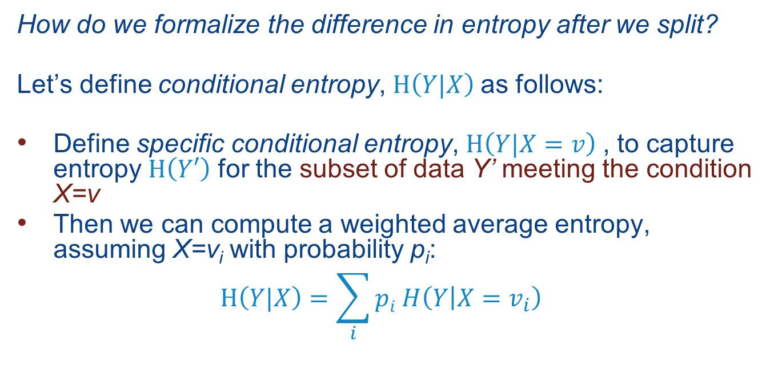
Conditional Entropy
How do we formalize the difference in entropy after we split?
Let’s define conditional entropy, $Η\left(Y|X\right)$as follows:
Define specific conditional entropy, $Η\left(Y|X=v\right)$, to capture entropy $Η\left(Y′\right)$ for the subset of data Y’ meeting the condition X=v
Then we can compute a weighted average entropy, assuming X=v_{i} with probability p_{i}:
$$Η\left(Y|X\right)=\sum_{i}{pi H\left(Y | X=v_{i}\right)}$$

Slide 33
An Example: Conditional Entropy
Conditional entropy of
input_data[likes_stats]| input_data[major]:
input_data:
 | major | likes_stats
0 | math | False
1 | math | False
2 | math | True
3 | math | True
4 | engl | False
5 | stat | True
6 | stat | True
7 | engl | False
def get_subset_likes_stats(term):
subset = input_data[input_data['major']==term]\ ['likes_stats']
return [sum(subset==False)/len(subset), \
sum(subset==True)/len(subset)]
subsets = {}
for major in majors:
subsets[major] = get_subset_likes_stats(major)
sum([probs[major]*entropy(subsets[major],base=2)\
for major in probs.keys()])
0.5 * entropy( [0.5, 0.5] ) +
0.25 * entropy( [1.0, 0.0] ) +
0.25 * entropy( [0.0, 1.0] )
Total: 0.5

Slide 34
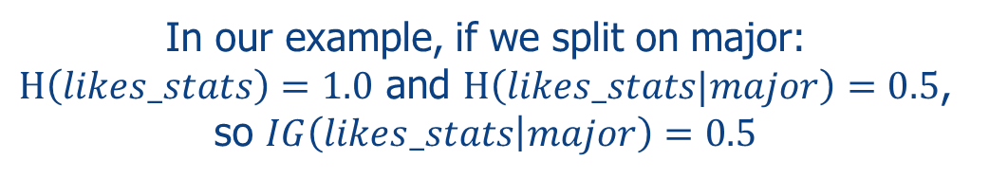
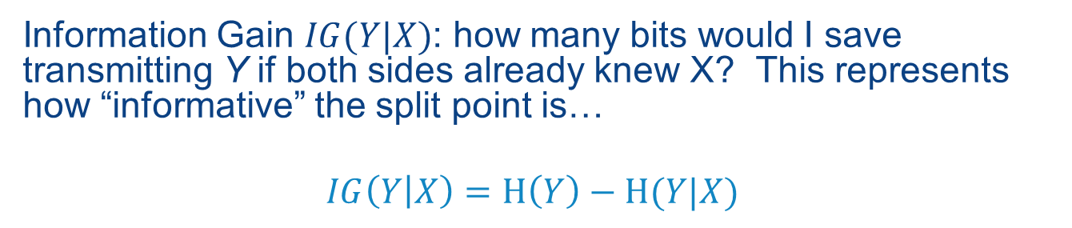
From Conditional Entropy: Information Gain!
Information Gain $IG(Y|X)$: how many bits would I save transmitting Y if both sides already knew X? This represents how “informative” the split point is…
$$IG\left(Y | X\right)=Η\left(Y\right)−Η(Y|X)$$
In our example, if we split on major:
$Η\left(likes_stats\right)=1.0$ and $Η\left(likes_stats|major\right)=0.5$, so $IG\left(likes_stats | major\right)=0.5$
We split using the predicate that maximizes information gain!

Slide 35
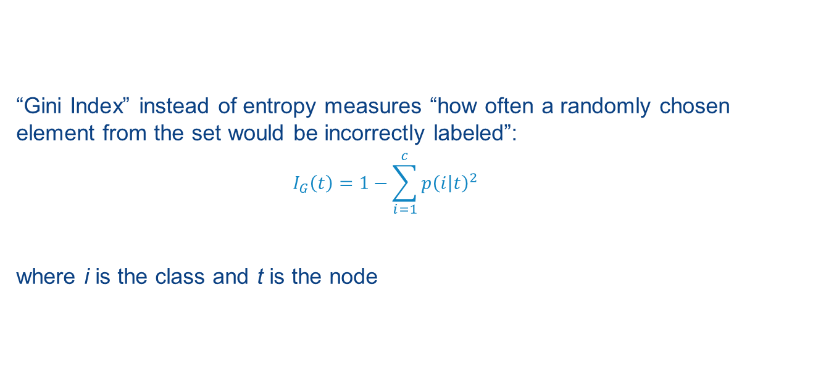
Entropy Isn’t the Only Possible Metric for Information Gain
“Gini Index” instead of entropy measures “how often a randomly chosen element from the set would be incorrectly labeled”:
$$I_{G}\left(t\right)=1−\sum_{i=1}^{c}{p{\left(i | t\right)}^{2}}$$
where i is the class and t is the node
We won’t go into this one in detail, but again, we look at the
information gain in terms of Gini index to choose a split point!

Slide 36
Summary: Decision Trees and Split Points
Choosing a split point (predicate for intermediate node) is heuristics-based – it is NP hard to find an optimal split
We usually look for a split that maximizes information gain, IG, by looking at the difference in conditional entropy
Another measure is called the Gini index
Finally: Note that unlike many supervised machine learning algorithms, decision trees are scale-invariant so normalizing / scaling the data doesn’t matter

Slide 37
Decision Trees and Overfitting

Slide 38
Major Danger of Decision Trees
Decision trees are highly susceptible to overfitting
We can end up with a tree that tests exactly if the data matches the training set!
This won’t generalize to even similar data that hasn’t been seen!
Some responses:
Apply PCA in advance to remove correlated features
Balance positive and negative examples
Limit the depth of the tree
Don’t split if below a minimum number of samples
Prune lower levels of the tree
tunable
hyper-parameters
of the decision tree

Slide 39
Another Approach to Make Classifiers More Accurate: Ensembles
Train classifiers over different subsets of the input
X
(X_train, y_train): training data
subsets of
(X_train, y_train)
X1
X2
X3
X4
ensemble of separately trained classifiers
c1
c2
c3
c4
c_ens
classifier combines votes of ensemble members
Notes:
An ensemble is a set of classifiers that can vote together

Slide 40
Ensembles of Decision Trees – Random Forests
Draw a random bootstrap data sample of size n, with replacement (called “bagging”)
Build (“grow”) a tiny decision tree (or “stump”)
At each node, randomly select d candidate features w/o replacement
Split the node using the feature with best split according to objective function (e.g. info gain)
Repeat to produce k decision trees (a forest!)
For prediction, use majority vote to predict a class for new data

Slide 41
Random Forest Hyperparameters
How many trees (estimators)?
Tree depth
Size of the candidate feature set to consider in each tree
Default: n_estimators n log(n)

Slide 42
Random Forests in SciKit-Learn
from sklearn.ensemble import RandomForestClassifier
clf = RandomForestClassifier(n_estimators = 20, \
max_depth=2)
clf.fit(X_train,y_train)
prediction = clf.predict(X_test)
accuracy=sklearn.metrics.accuracy_score(prediction,y_test)
print("Accuracy: %.1f%%"% (accuracy*100))
Accuracy: 98.1%

Slide 43
Summary of Decision Trees and Random Forests
Decision trees are:
Fast
Scale-invariant
Can handle categorical and continuous data (CART)
Understandable (“explainable AI”)
Prone to overfitting
Random forests:
Use a form of ensembles called “bagging”
Highly accurate, parallelizable, and used in practice
Don’t require hyperparameter search
Random forests are one of the most popular and accurate method classifiers for big data!

