Slide 1

Supervised Machine Learning: Linear and Logistic Regression

Slide 2
A Different Approach to Supervised Learning
Recall: Decision trees:
We don’t restrict the “shape” of the decision tree a priori
Generally useful for classification but can also be used for regression via CART learning
Today: assume we know the function and are looking to find its parameters
Parametric learning, as opposed to decision trees that are non-parametric
Notes:
For regression, we are learning a set of weights (coefficients) that are combined with feature values via dot product, then we may apply a function to that.

Slide 3
Regression, as a Task and as a Building Block
Two general cases we’ll consider today:
To solve the regression problem for continuous output:
Linear regression – fit a linear function to “optimally” match data between classes
To solve the classification problem:
Logistic regression – generalize the techniques to classification (requires us to move to a non-linear function)

Slide 4
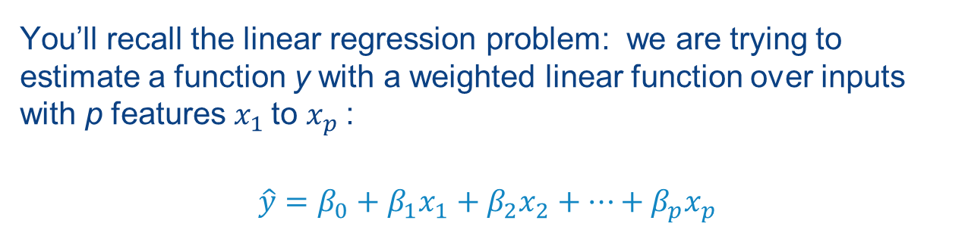

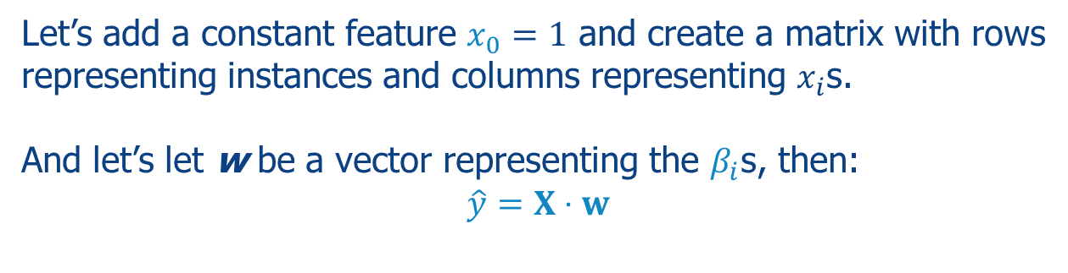
The Basics: Linear Regression (which should look familiar)
You’ll recall the linear regression problem: we are trying to estimate a function y with a weighted linear function over inputs with p features $x_{1}$to $x_{p}$:
$$\hat{y}=β_{0}+β_{1}x_{1}+β_{2}x_{2}+⋯+β_{p}x_{p}$$
Our task is to find values for w that minimize the difference:
$$\hat{y}−y$$
Let’s add a constant feature $x_{0}=1$ and create a matrix with rows representing instances and columns representing $x_{i}$s.
And let’s let w be a vector representing the $β_{i}$s, then:
$$\hat{y}=X⋅w$$
Notes:
Note we add an extra term w₀ here, called a bias, which is basically the intercept if you think of the slope-intercept equation of a line.

Slide 5
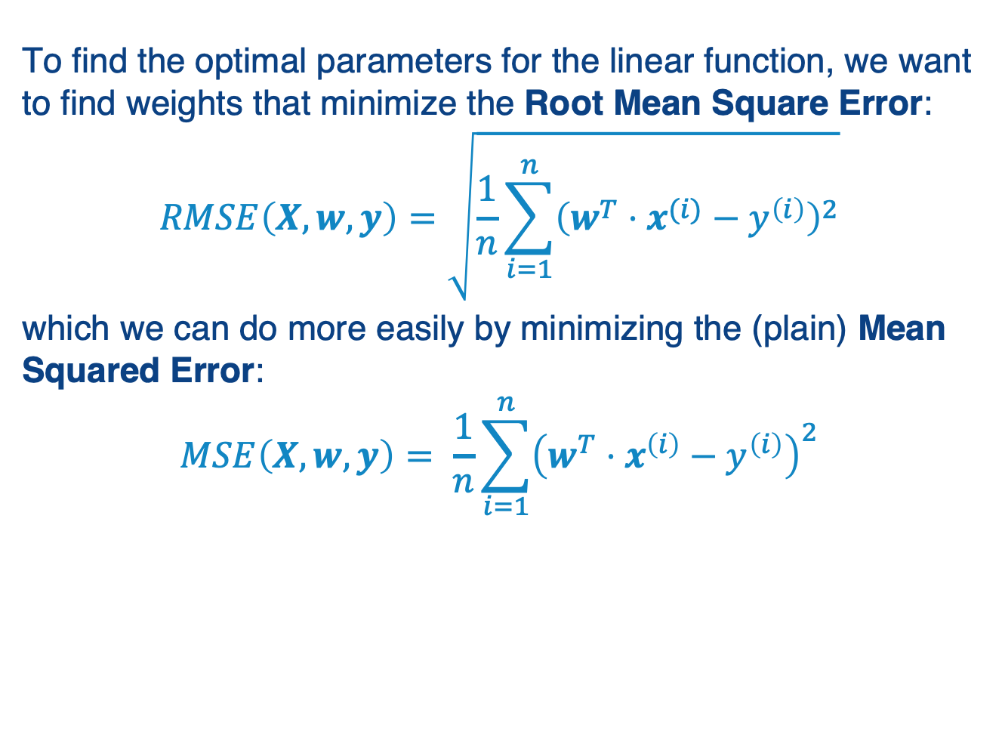
Linear Regression Minimizes Squared Error
To find the optimal parameters for the linear function, we want to find weights that minimize the Root Mean Square Error:
$$RMSE\left(X,w,y\right)=\sqrt{\frac{1}{n}\sum_{i=1}^{n}{{\left(w^{T}⋅x^{(i)}−y^{\left(i\right)}\right)}^{2}}}$$
which we can do more easily by minimizing the (plain) Mean Squared Error:
$$MSE\left(X, w,y\right)= \frac{1}{n}\sum_{i=1}^{n}{{\left(w^{T}⋅x^{\left(i\right)}−y^{\left(i\right)}\right)}^{2}}$$
Notes:
Here’s how we typically optimize the coefficients (weights) in the line…

Slide 6
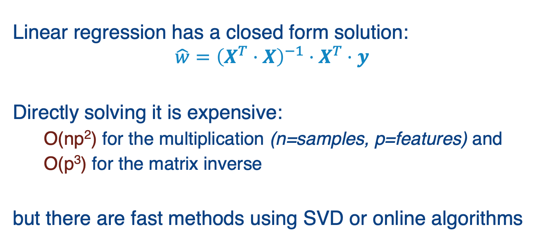
Linear Regression Algorithms
Linear regression has a closed form solution:
$$\hat{w}={\left(X^{T}⋅X\right)}^{−1}⋅X^{T}⋅y$$
Directly solving it is expensive:
O(np²) for the multiplication (n=samples, p=features) and
O(p³) for the matrix inverse
but there are fast methods using SVD or online algorithms
Notes:
We won’t go into detail, but please see https://www.thekerneltrip.com/machine/learning/computational-complexity-learning-algorithms/

Slide 7
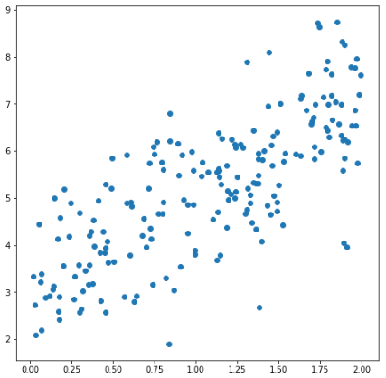
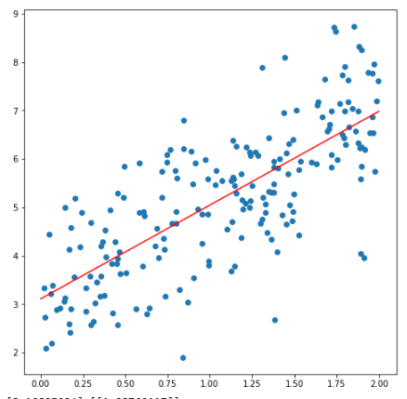
An Example of Linear Regression: Fitting a Scatter Plot for y = 2x + 3 + random factor
rgr = LinearRegression()
rgr.fit(X, y)
# Scatter plot for the data
fig, ax = plt.subplots(figsize=(8,8))
ax.scatter(X, y)
# Plot regression line from 0 - 2
X2 = range(0,3)
y2 = rgr.coef_*X2 + rgr.intercept_
ax.plot(X2, y2.T, color='red')
plt.show()
print (rgr.coef_, rgr.intercept_)
[[1.93760117]][3.10825094]
Notes:
Here we are plotting the regression line against the scatter plot of 2D values…

Slide 8
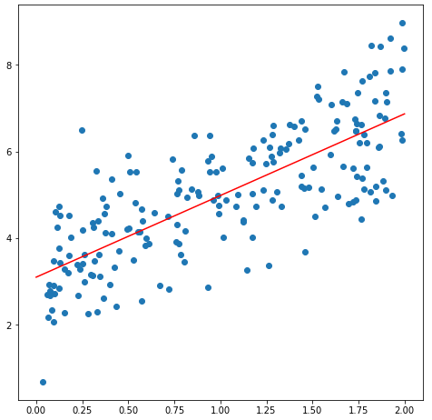
And Done Using Linear Algebra
# Insert the x_0 column
X_with_bias = np.ones((X.shape[0],2))
X_with_bias[:,1] = X.T
b = inv(X_with_bias.T.dot(X_with_bias)).dot\ (X_with_bias.T).dot(y)
yhat = X_with_bias.dot(b)
ax.scatter(X, y)
plt.plot(X, yhat, color='red')
plt.show()
Intercept: [3.10237355] Coefficient: [[1.88463454]]

Slide 9
Things to Beware Of
“Multicollinearity”: multiple features are correlated with each other
Plot correlation matrix, remove highly correlated features
Use PCA beforehand (sometimes this is called Principal Components Regression or PCR)
Use Partial Least Squares Regression
Overfitting: often we will get a model that uses more adjustable parameters than optimal… Leads us to variations on the algorithm we’ll talk about next

Slide 10
Summary of Linear Regression
Finds a set of weights defining a linear function from input features (and the bias) to the output value
A type of parametric learning: we know the class of function, just need its parameters
Fairly easy to express as closed-form solution, though expensive
Often solved other faster techniques
“Ordinary least squares” or standard linear regression – minimizes Mean Squared Error, but may overfit

Slide 11
Feature Selection
A major issue: with many features, “ordinary least squares” regression tends to overfit!
What can we do? “Regularize” to reduce model complexity
Focus the classifier on the most important contributing features, shrink the rest to 0
Notes:
Now the question is: how many features do we assign weights to?
By default linear regression will pick a nonzero weight to each feature if this makes any difference on the training data set.
But often this makes it more brittle, i.e., it doesn’t generalize to data outside the training set.
This motivates ways of changing the function we are optimizing – aka regularization.

Slide 12

Encouraging “Sparse” Models: Lasso (L1) Regression
Add a penalty based on L1 norm: sum of the weights
Pushes weights towards zero, if they don’t have a significant effect on the error
$$\frac{1}{n}\sum_{i=1}^{n}{{\left(w^{T}⋅x^{\left(i\right)}−y^{\left(i\right)}\right)}^{2}+\text{l}\text{1} \sum_{j=1}^{p}{\text{|}w^{(j)}|}}$$

Slide 13
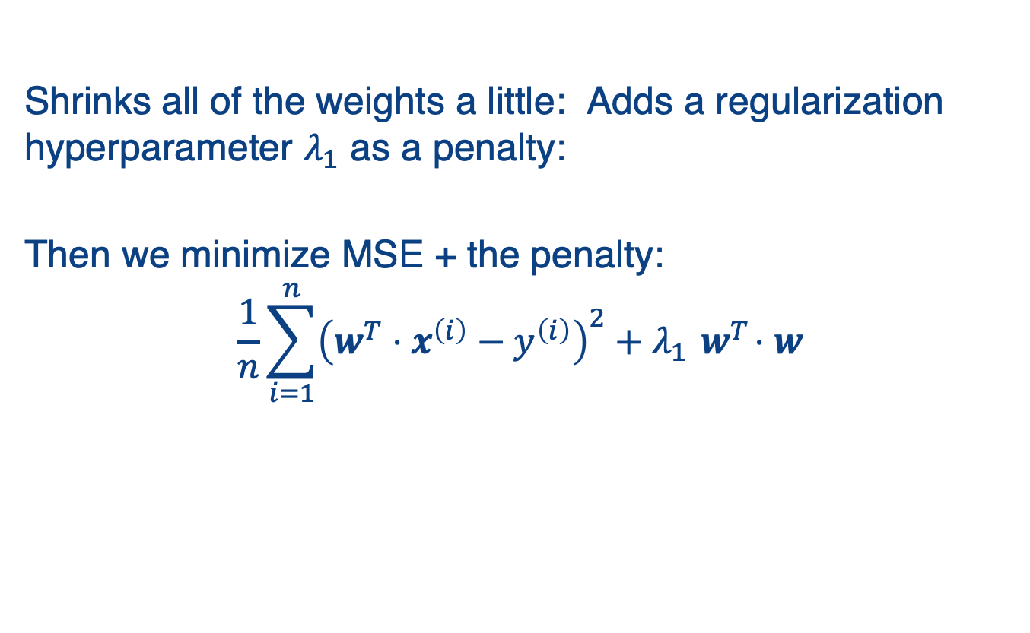
Ridge (L2) Regression
Shrinks all of the weights a little: Adds a regularization hyperparameter $λ_{1}$ as a penalty:
Then we minimize MSE + the penalty:
$$\frac{1}{n}\sum_{i=1}^{n}{{\left(w^{T}⋅x^{\left(i\right)}−y^{\left(i\right)}\right)}^{2}+λ_{1}{ w}^{T}⋅w}$$
Notes:
Here, we see the normal MSE cost on the left, and then the “ridge regularization” parameter on the right.

Slide 14
Lasso vs Ridge
Lasso tends to work well if there are a few significant parameters and the others aren’t significant
Ridge works well when there are many large parameters of around the same value
Can we put the two together?

Slide 15

Elastic Net Regression: L1 + L2
Combines lasso and ridge – very commonly used
We minimize MSE + the penalty:
$$\frac{1}{n}\sum_{i=1}^{n}{{\left(w^{T}⋅x^{\left(i\right)}−y^{\left(i\right)}\right)}^{2}\text{+} \text{l}\text{1} \sum_{j=1}^{p}{\text{|}w^{(j)}|}+λ_{2}{ w}^{T}⋅w}$$

Slide 16
Three Techniques to Reduce Overfitting
Lasso (L1 penalty): reduces overfitting when a small number of features are important
Ridge (squared L2 penalty): preferable when there are many heavily weighted parameters
Elastic Net combines the two
We’ll see later how to optimize the size of the penalty terms

Slide 17
Summary: Linear Regression
Finds weights that best fit a linear model to a training set
Typically minimizing the mean-squared error
Closed-form solution works for 10Ks of features
For more, need to use gradient descent or similar methods (we’ll see this later)
Various regularization strategies can be used to make the model more robust

Slide 18
Logistic Regression

Slide 19
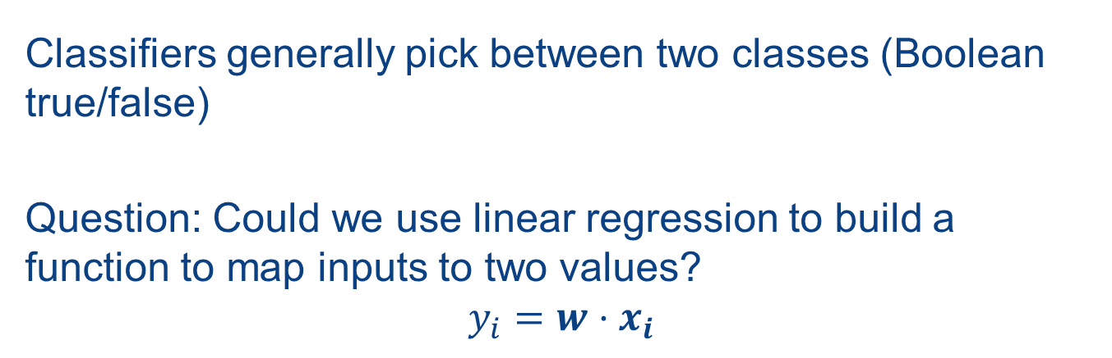
Regression for Classification
Classifiers generally pick between two classes (Boolean true/false)
Question: Could we use linear regression to build a function to map inputs to two values?
$$y_{i}=w⋅x_{i}$$
Notes:
Of course, the range of values for a linear function is infinite, so we want to map it in a way that approximates a step function…

Slide 20
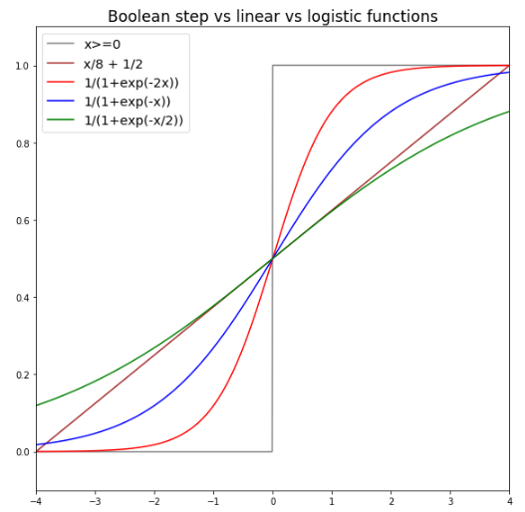

Logistic (aka Sigmoid, $σ$) Functions
Notes:
Note the 0-1 step function, and how sigmoid with different coefficients can approximate this more and more tightly.

Slide 21
How Does It Work?
Training – requires gradient descent to minimize a cost function
Prediction – evaluate the logistic function and use it to determine if an item is in the class
Notes:
Training finds the weights that minimize the cost function.
Prediction uses these weights, plus the features on some new instance, to make a prediction about the instance.

Slide 22
How Does It Work?
Training – requires gradient descent to minimize a cost function
Prediction – evaluate the logistic function and use it to determine if an item is in the class
We’ll start with prediction because it will also be used as part of training!

Slide 23
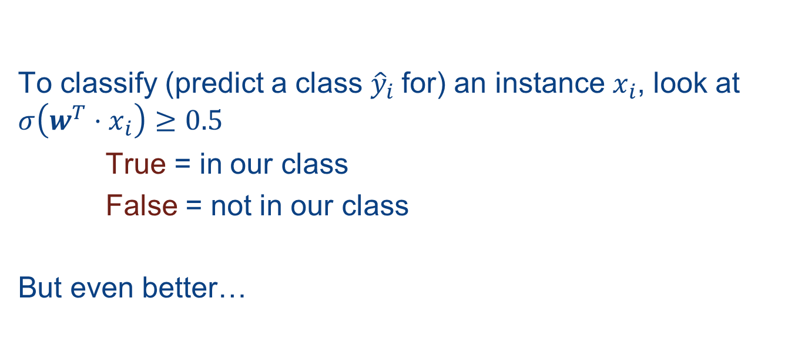
Logistic Regression: Prediction
To classify (predict a class ${\hat{y}}_{i}$for) an instance $x_{i}$, look at $σ\left({w^{T}⋅x}_{i}\right)≥0.5$
True = in our class
False = not in our class
But even better…

Slide 24
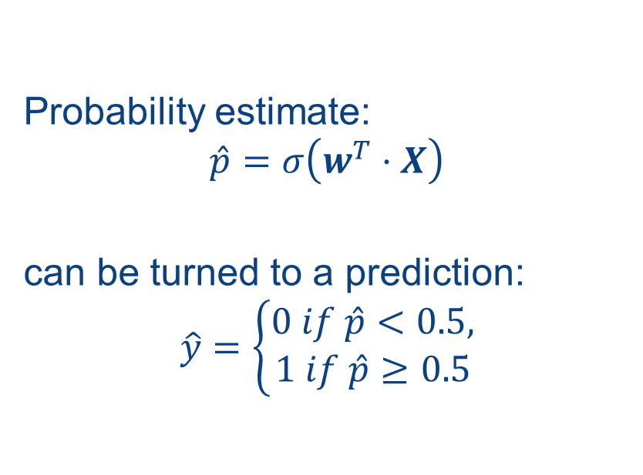
Logistic Regression Gives a Probabilistic Prediction!
Probability estimate:
$$\hat{p}=σ\left(w^{T}⋅X\right)$$
can be turned to a prediction:
$$\hat{y}=\left\{\begin{aligned}0 if \hat{p}<0.5, \\ 1 if \hat{p}≥0.5\end{aligned}\right.$$

Slide 25
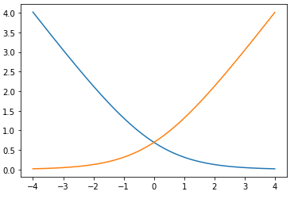
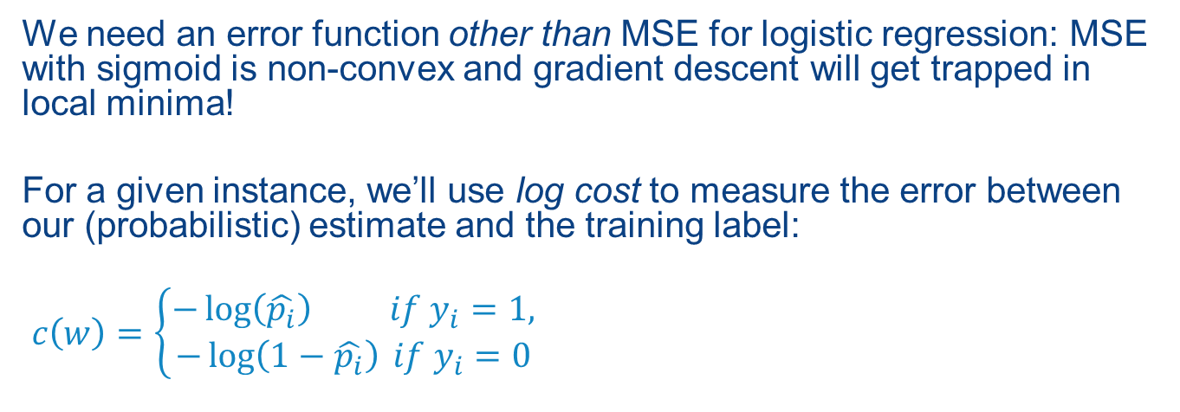


How Do We Train Logistic Regression?
We need an error function other than MSE for logistic regression: MSE with sigmoid is non-convex and gradient descent will get trapped in local minima!
For a given instance, we’ll use log cost to measure the error between our (probabilistic) estimate and the training label:
$c\left(w\right)=\left\{\begin{aligned}−\log\left(\hat{p_{i}}\right) if y_{i}=1, \\ −\log\left(1−\hat{p_{i}}\right) if y_{i}=0\end{aligned}\right.$
$$−\log\left(\hat{p_{i}}\right)$$
$$−\log\left(1−\hat{p_{i}}\right)$$

Slide 26

How Do We Train Logistic Regression?
Given log cost:
$$c\left(w\right)=\left\{\begin{aligned}−\log\left(\hat{p_{i}}\right) if y_{i}=1, \\ −\log\left(1−\hat{p_{i}}\right) if y_{i}=0\end{aligned}\right.$$
Across n training instances, this averages to:
$$−\frac{1}{n}\sum_{i=1}^{n}{\left[y^{\left(i\right)}\log\left({\hat{p}}^{\left(i\right)}\right)+\left(1−y^{\left(i\right)}\right)\log\left(1−{\hat{p}}^{\left(i\right)}\right)\right]}$$
y^{(i)} = 1 or 0
Notes:
Estimates the mean response given the data is binomial trials, i.e., gives the probability of success.

Slide 27
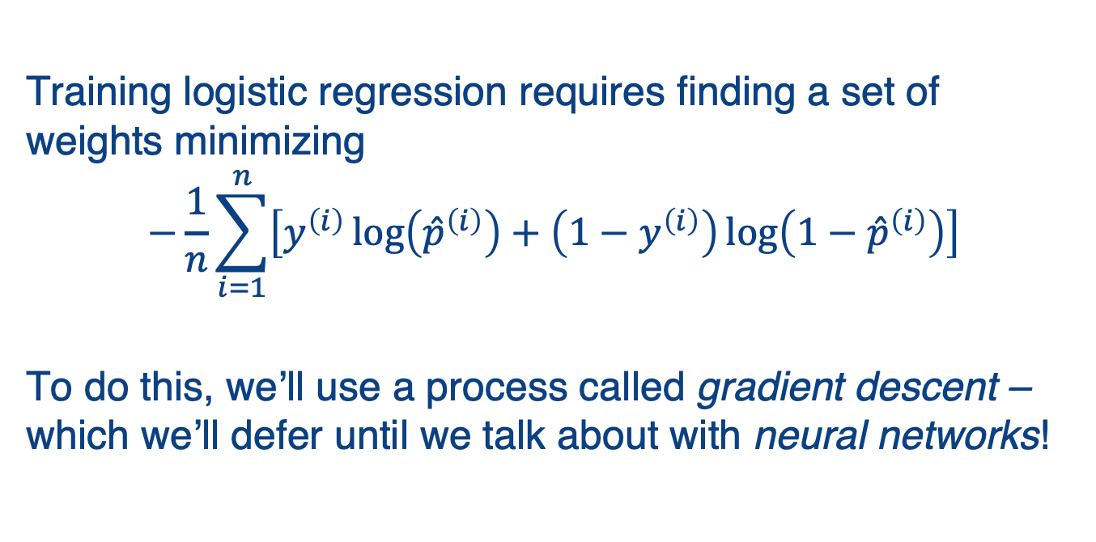
Training, Continued
Training logistic regression requires finding a set of weights minimizing
$$−\frac{1}{n}\sum_{i=1}^{n}{\left[y^{\left(i\right)}\log\left({\hat{p}}^{\left(i\right)}\right)+\left(1−y^{\left(i\right)}\right)\log\left(1−{\hat{p}}^{\left(i\right)}\right)\right]}$$
To do this, we’ll use a process called gradient descent – which we’ll defer until we talk about with neural networks!
Notes:
We would next minimize the cost function. We’ll discuss this in the next (optional) submodule!
Meanwhile let’s see how to use logistic regression…

Slide 28
Using Logistic Regression in SciKit-Learn
Let’s consider a dataset of wines.
from sklearn.datasets import load_wine
dataset = load_wine()
 | alcohol | malic acid | ash | alkalinity of ash | magnesium | …
0 | 14.23 | 1.71 | 2.43 | 15.6 | 127.0 | …
1 | 13.20 | 1.78 | 2.14 | 11.2 | 100.0 | …
2 | 13.16 | 2.36 | 2.67 | 18.6 | 101.0 | …
3 | 14.37 | 1.95 | 2.50 | 16.8 | 113.0 | …
4 | 13.24 | 2.59 | 2.87 | 21.0 | 118.0 | …
... | ... | ... | ... | ... | ... | …
y
0
2
0
1
…
Notes:
To use SciKit, the first thing we have to do is import some data with labels. Here is one that is built into SciKit about wines, that has things like the level of magnesium.
The data (features) is in the table to the left; the labels, e.g. 0, 1, 2 are in the y-vector to the right.

Slide 29
Training a Logistic Regression Classifier
from sklearn.linear_model \ import LogisticRegression
clf = LogisticRegression(max_iter=10000)
clf.fit(X_train,y_train)
prediction = clf.predict(X_test)
accuracy = sklearn.metrics.accuracy_score\ (prediction,y_test)
print("Accuracy: %.1f%%"% (accuracy*100))
Accuracy: 96.3%
Notes:
As with other classifiers in SciKit, the first thing we do is create the classifier (Logistic Regression), then we call fit with the training data and class labels. At this point the classifier is trained, and we can use it to predict from the test data. On the slide, we compare the predictions against the correct labels for testing; note that the accuracy is high (96.3%).

Slide 30
Summary: Logistic Regression
A variation of regression used for classification – estimates probability that instance belongs to a class
Based on the sigmoid function
Requires regularization of parameters

Slide 31
Supervised Learning Summary
Linear regression
Has a closed form solution
Usually requires regularization to prevent overfitting
Logistic regression
Linear model that predicts class membership

