Slide 1

How Your Computer Works
Difficulty level: basic

Slide 2
Understanding a Bit of Computer Architecture Is Key to Performance
A few ideas you need from Computer Architecture:
Different program instructions take different amounts of work and time
Lines of code (in Python / C / etc.) turn into multiple machine instructions
Machine instructions don’t all have equal performance!
The computer’s memory hierarchy means accessing data is also not uniform
Modern hardware includes special optimizations to:
Do the same operation on multiple data items simultaneously
Run multiple independent pieces of code at the same time

Slide 3
Key Aspects of a Computer: Simplified View of a Microprocessor
CPU
RAM
Internal
Memory
(Registers)
Core
Disk / SSD
Network
(Another
machine)
Instructions
Notes:
This is the classic picture of a computer from the 1980s. The light blue is the brains of the computer (microprocessor). The CPU needs to pull the data out of RAM into the microprocessor. To do that, it puts it into registers, performs computation, and writes it back out.
But the microprocessor has gotten much faster since then (top of the line is ~5 Gigahertz, can execute 5B instructions/sec). The problem is that it must have the data to use, and the RAM is slow (75 nanosecond response time). So the processing is hampered by the RAM (75x delay).
The idea is to make memory faster, but the bigger the memory is the slower it becomes. Can we use smaller, much faster memory, to improve performance?

Slide 4
Key Aspects of a Computer: Simplified View of a Microprocessor
CPU
RAM
Internal
Memory
(Registers)
Core
Disk / SSD
L1 Data Cache
Network
(Another
machine)
L2+ Data Caches
Instructions
Another Core/CPU
Notes:
This is called a cache, and there are various levels (2-4, number by how close they are to the processor and how slow they are). L1 might be a 2 nanosecond delay, but it is really small; L2 has a slightly larger delay but is larger.
On the side, we also have disk which is even bigger than the RAM (typically 1 Terabyte or Petabye). Sometimes you need to pull data from disk to RAM to cache, etc.
So there are multiple levels of memory, each of a different size and with different speeds.

Slide 5
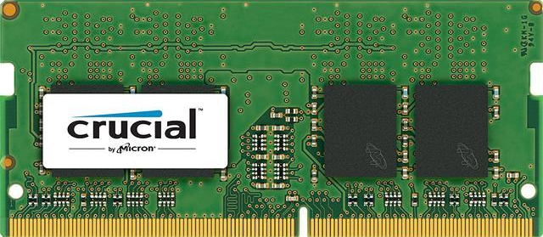
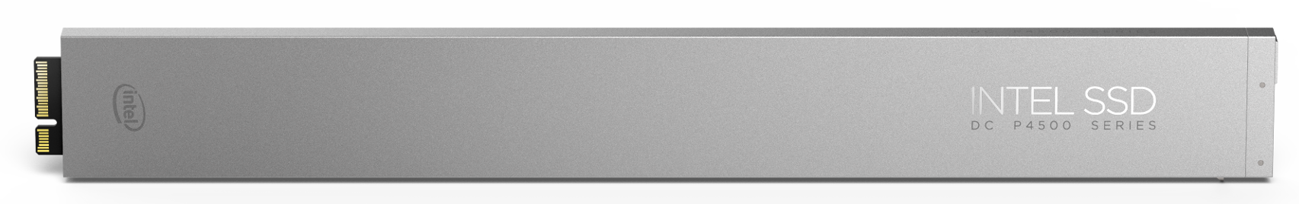
The Memory Hierarchy from One X86’s Perspective
Ryzen 2000 vs Core 8000:
https://www.anandtech.com/show/12625/amd-second-generation-ryzen-7-2700x-2700-ryzen-5-2600x-2600/3
Registers
16 int, 16-32 double, 0.2 ns
L1 cache
32KB, 1ns
L2 cache
256-512KB 2-3ns
L3 cache
2MB/core, 8-9ns
RAM
TB+, 75ns
https://www.newegg.com/crucial-16gb-260-pin-ddr4-so-dimm/p/N82E16820156081
SSD
PB+, 10us
https://www.intel.com/content/www/us/en/products/memory-storage/solid-state-drives/data-center-ssds/dc-p4500-series/dc-p4500-8tb-ruler-3d1.html
Notes:
When we have big data, you want things to be as small as possible so they can fit higher up in the hierarchy.

Slide 6
How Are Caches Used? (We Are Simplifying to 1 Level)
Core
# Create an array 1,000,000 by 1
my_list = np.empty(1000000)
for i in range(0, len(my_list)):
my_list[i] = my_list[i] + \
random.random()
my_list[0:999]
my_list[0:1000000]
~4MB
Notes:
This code creates a big list, 1M integers, 4MB memory, does something with each and writes back to memory.

Slide 7
How Are Caches Used? (We Are Simplifying to 1 Level)
Core
# Create an array 1,000,000 by 1
my_list = np.empty(1000000)
for i in range(0, len(my_list)):
my_list[i] = my_list[i] + \
random.random()
my_list[0:999]
~4KB
my_list[0:999]
75ns
75ns
my_list[0:1000000]
~4MB
Notes:
Suppose there is a cache in between RAM and memory (one level for simplicity). Suppose the cache can only take 1000 elements at a time (4KB). So what happens is that they computer pulls out as much as it can (4KB) when the first request is made (my_list[0]). So the computer sits for 75 ns while the data is loading,

Slide 8
How Are Caches Used? (We Are Simplifying to 1 Level)
Core
# Create an array 1,000,000 by 1
my_list = np.empty(1000000)
for i in range(0, len(my_list)):
my_list[i] = my_list[i] + \
random.random()
my_list[i] = …
1ns
1ns
my_list[0:999]
~4KB
my_list[0:999]
75ns
my_list[0:1000000]
~4MB
Notes:
To operate on mylist_[0], it is then loaded into memory (1ns), the new value is written, and the updated entry is saved in cache. The same happens for the remaining 999 elements of my_list that are in cache. 75x faster than going out to disk.

Slide 9
How Are Caches Used? (We Are Simplifying to 1 Level)
Core
# Create an array 1,000,000 by 1
my_list = np.empty(1000000)
for i in range(0, len(my_list)):
my_list[i] = my_list[i] + \
random.random()
my_list[i] = …
1ns
1ns
my_list[0:999]
~4KB
my_list[1000:1999]
75ns
75ns
my_list[0:1000000]
~4MB
Notes:
For mylist[1000], the data is not in cache. So the cache is written out and the next 1000 elements are loaded. The process is repeated until all 1M elements have been processed.

Slide 10


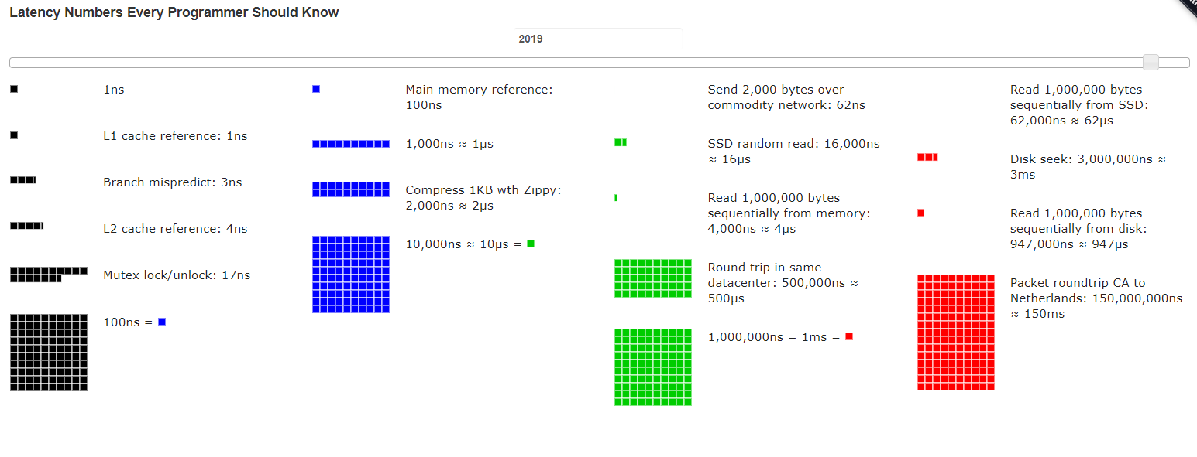
Interactive Visualizer (Colin Scott): https://people.eecs.berkeley.edu/~rcs/research/interactive_latency.html
Original list from Jeff Dean and Peter Norvig (Google)

Slide 11
What Does the Memory Hierarchy Mean When Thinking about Scale?
Fewer computations are better: algorithmic efficiency!
Accessing data in predictable ways is better
CPU predicts and “pre-fetches” the data into caches
Repeated requests to related data keep memory in the caches
Smaller “memory footprints” are better (at tension with the previous)
Doing independent tasks on different processors is better
Packing multiple data values into the same memory, and applying a repeated computation is better
Challenge: many tasks are partly independent / parallel, and partly sequential
Notes:
This conclusion naturally leads to a discussion of scalable data processing, and we recommend the next slide set to be EFFICIENT-DATA-PROCESSING-algorithms-intermediate from the opends4all-scalable-data-processing module.

