Slide 1

Supervised Machine Learning: Linear and Logistic Regression

Slide 2
A Different Approach to Supervised Learning
Recall: Decision trees:
We don’t restrict the “shape” of the decision tree a priori
Generally useful for classification but can also be used for regression via CART learning
Today: assume we know the function and are looking to find its parameters
Parametric learning, as opposed to decision trees that are non-parametric
Notes:
For regression, we are learning a set of weights (coefficients) that are combined with feature values via dot product, then we may apply a function to that.

Slide 3
Regression, as a Task and as a Building Block
Two general cases we’ll consider today:
To solve the regression problem for continuous output:
Linear regression – fit a linear function to “optimally” match data between classes
To solve the classification problem:
Logistic regression – generalize the techniques to classification (requires us to move to a non-linear function)

Slide 4
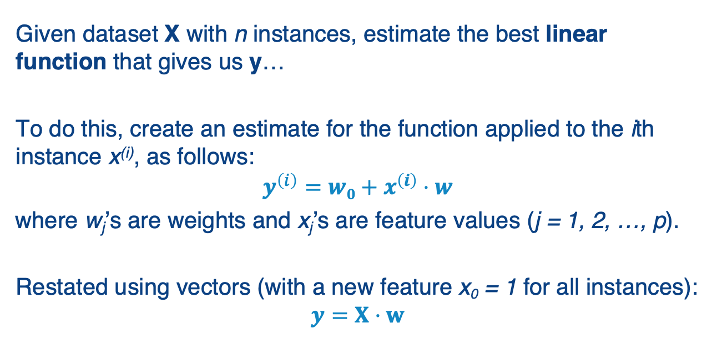
The Basics: Linear Regression (which should look familiar)
Given dataset X with n instances, estimate the best linear function that gives us y…
To do this, create an estimate for the function applied to the ith instance x^{(i)}, as follows:
$$y^{\left(i\right)}={w0+x}^{\left(i\right)}⋅w$$
where w_{j}’s are weights and x_{j}’s are feature values (j = 1, 2, …, p).
Restated using vectors (with a new feature x₀ = 1 for all instances):
$$y=X⋅w$$
Notes:
You’ve undoubtedly seen linear regression in your statistics class. Conceptually we’re finding the best line to “summarize” or “fit” a data distribution. In more than two dimensions this is a hyperplane.
Note we add an extra term w₀ here, called a bias, which is basically the intercept if you think of the slope-intercept equation of a line.

Slide 5
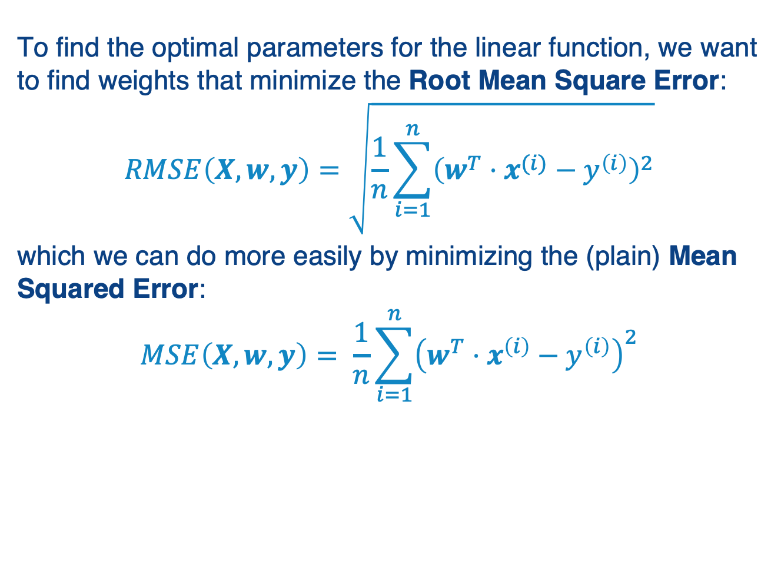
Linear Regression Minimizes Squared Error
To find the optimal parameters for the linear function, we want to find weights that minimize the Root Mean Square Error:
$$RMSE\left(X,w,y\right)=\sqrt{\frac{1}{n}\sum_{i=1}^{n}{{\left(w^{T}⋅x^{(i)}−y^{\left(i\right)}\right)}^{2}}}$$
which we can do more easily by minimizing the (plain) Mean Squared Error:
$$MSE\left(X, w,y\right)= \frac{1}{n}\sum_{i=1}^{n}{{\left(w^{T}⋅x^{\left(i\right)}−y^{\left(i\right)}\right)}^{2}}$$
Notes:
Here’s how we typically optimize the coefficients (weights) in the line…

Slide 6
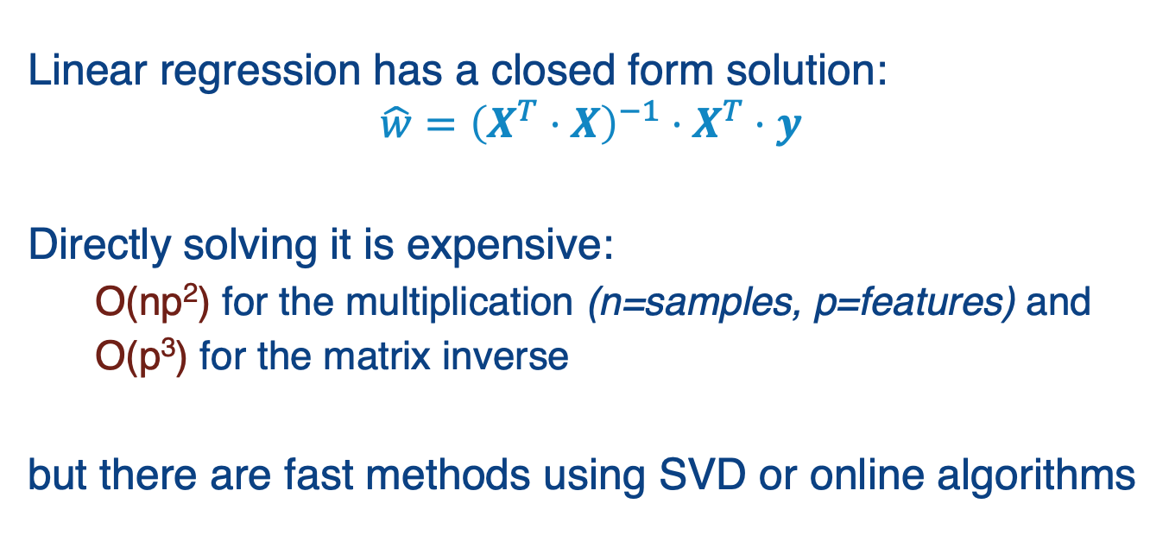
Linear Regression Algorithms
Linear regression has a closed form solution:
$$\hat{w}={\left(X^{T}⋅X\right)}^{−1}⋅X^{T}⋅y$$
Directly solving it is expensive:
O(np²) for the multiplication (n=samples, p=features) and
O(p³) for the matrix inverse
but there are fast methods using SVD or online algorithms
Notes:
We won’t go into detail, but please see https://www.thekerneltrip.com/machine/learning/computational-complexity-learning-algorithms/

Slide 7
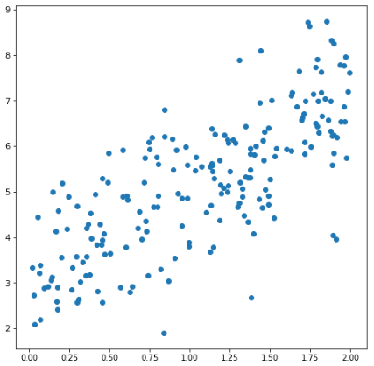
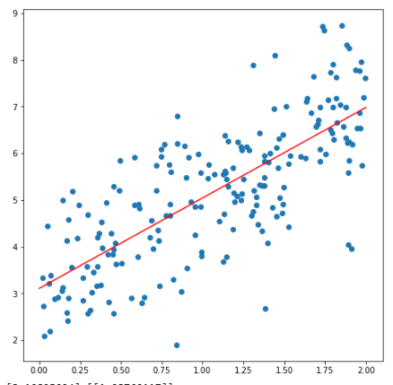
An Example of Linear Regression: Fitting a Scatter Plot for y = 2x + 3 + random factor
rgr = LinearRegression()
rgr.fit(X, y)
# Scatter plot for the data
fig, ax = plt.subplots(figsize=(8,8))
ax.scatter(X, y)
# Plot regression line from 0 - 2
X2 = range(0,3)
y2 = rgr.coef_*X2 + rgr.intercept_
ax.plot(X2, y2.T, color='red')
plt.show()
print (rgr.coef_, rgr.intercept_)
[[1.93760117]][3.10825094]
Notes:
Here we are plotting the regression line against the scatter plot of 2D values…

Slide 8
Feature Selection
A major issue: with many features, “ordinary least squares” regression tends to overfit!
What can we do? “Regularize” to reduce model complexity
Focus the classifier on the most important contributing features, shrink the rest to 0
Notes:
Now the question is: how many features do we assign weights to?
By default linear regression will pick a nonzero weight to each feature if this makes any difference on the training data set.
But often this makes it more brittle, i.e., it doesn’t generalize to data outside the training set.
This motivates ways of changing the function we are optimizing – aka regularization.

Slide 9
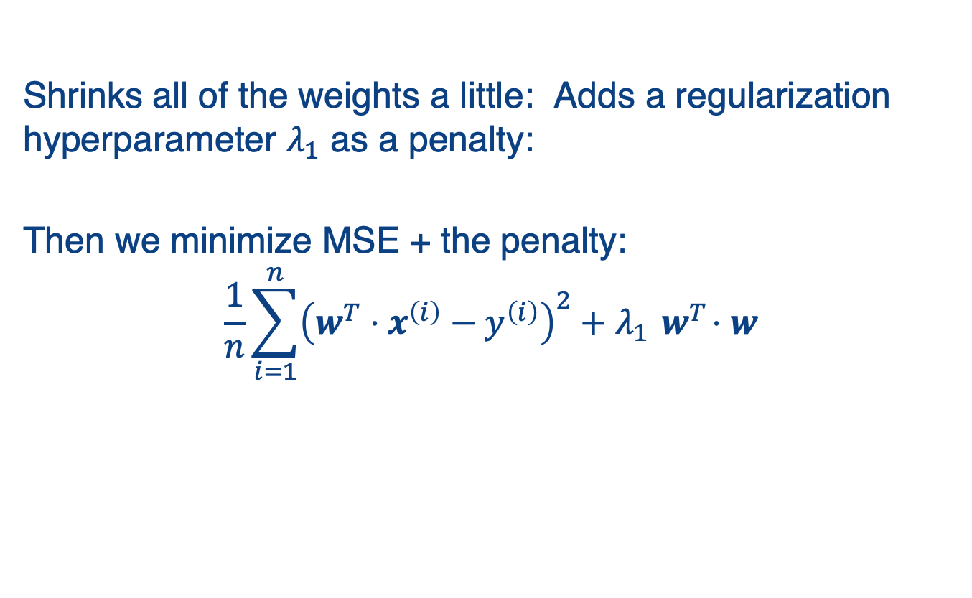
Ridge (L2) Regression
Shrinks all of the weights a little: Adds a regularization hyperparameter $λ_{1}$ as a penalty:
Then we minimize MSE + the penalty:
$$\frac{1}{n}\sum_{i=1}^{n}{{\left(w^{T}⋅x^{\left(i\right)}−y^{\left(i\right)}\right)}^{2}+λ_{1}{ w}^{T}⋅w}$$
Notes:
Here, we see the normal MSE cost on the left, and then the “ridge regularization” parameter on the right.

Slide 10
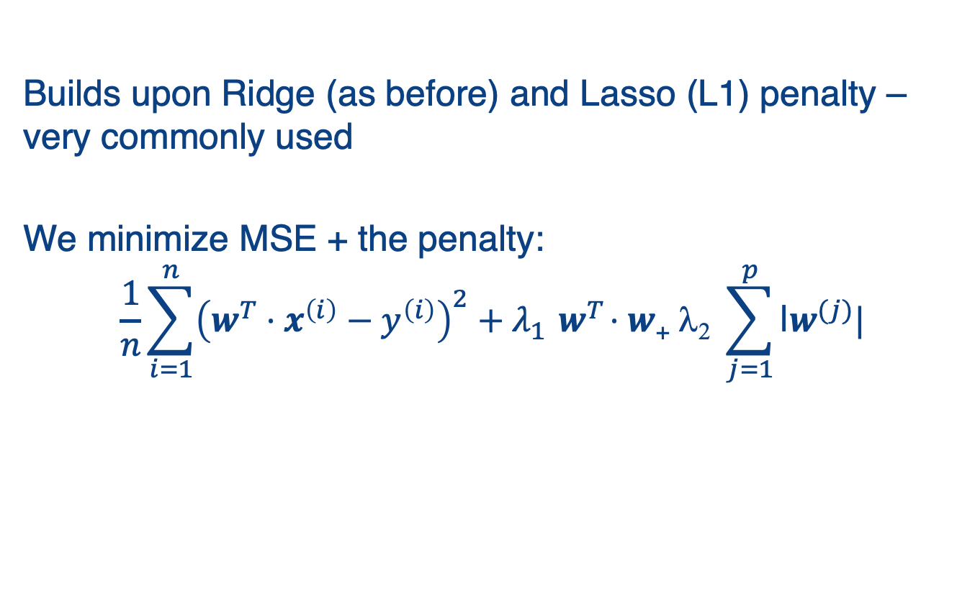
Elastic Net Regression: L1 + L2
Builds upon Ridge (as before) and Lasso (L1) penalty – very commonly used
We minimize MSE + the penalty:
$$\frac{1}{n}\sum_{i=1}^{n}{{\left(w^{T}⋅x^{\left(i\right)}−y^{\left(i\right)}\right)}^{2}+λ_{1}{ w}^{T}⋅w\text{+} \text{l}\text{2} \sum_{j=1}^{p}{\text{|}w^{(j)}|}}$$
Notes:
We can also consider a penalty based on the L1 norm of the data, which is often called Lasso regularization.
Ridge (from the previous side) plus Lasso results in this version.

Slide 11
Summary: Linear Regression
Finds weights that best fit a linear model to a training set
Typically minimizing the mean-squared error
Closed-form solution works for 10Ks of features
For more, need to use gradient descent or similar methods (we’ll see this later)
Various regularization strategies can be used to make the model more robust

Slide 12
Logistic Regression

Slide 13
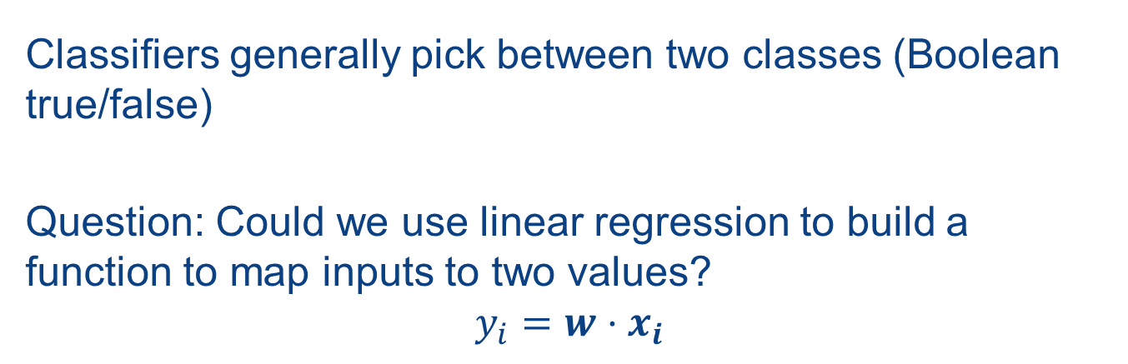
Regression for Classification
Classifiers generally pick between two classes (Boolean true/false)
Question: Could we use linear regression to build a function to map inputs to two values?
$$y_{i}=w⋅x_{i}$$
Notes:
Of course, the range of values for a linear function is infinite, so we want to map it in a way that approximates a step function…

Slide 14
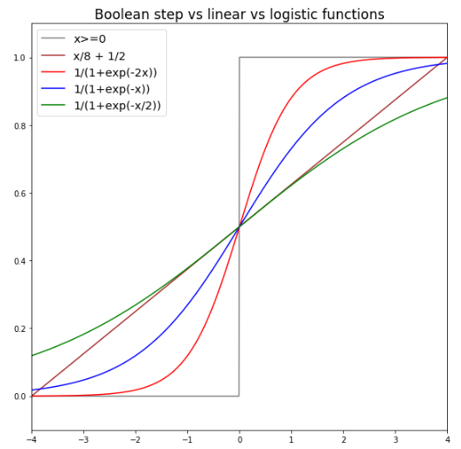

Logistic (aka Sigmoid, $σ$) Functions
Notes:
Note the 0-1 step function, and how sigmoid with different coefficients can approximate this more and more tightly.

Slide 15
How Does It Work?
Training – requires gradient descent to minimize a cost function
Prediction – evaluate the logistic function and use it to determine if an item is in the class
Notes:
Training finds the weights that minimize the cost function.
Prediction uses these weights, plus the features on some new instance, to make a prediction about the instance.

Slide 16
How Does It Work?
Training – requires gradient descent to minimize a cost function
Prediction – evaluate the logistic function and use it to determine if an item is in the class
We’ll start with prediction because it will also be used as part of training!

Slide 17
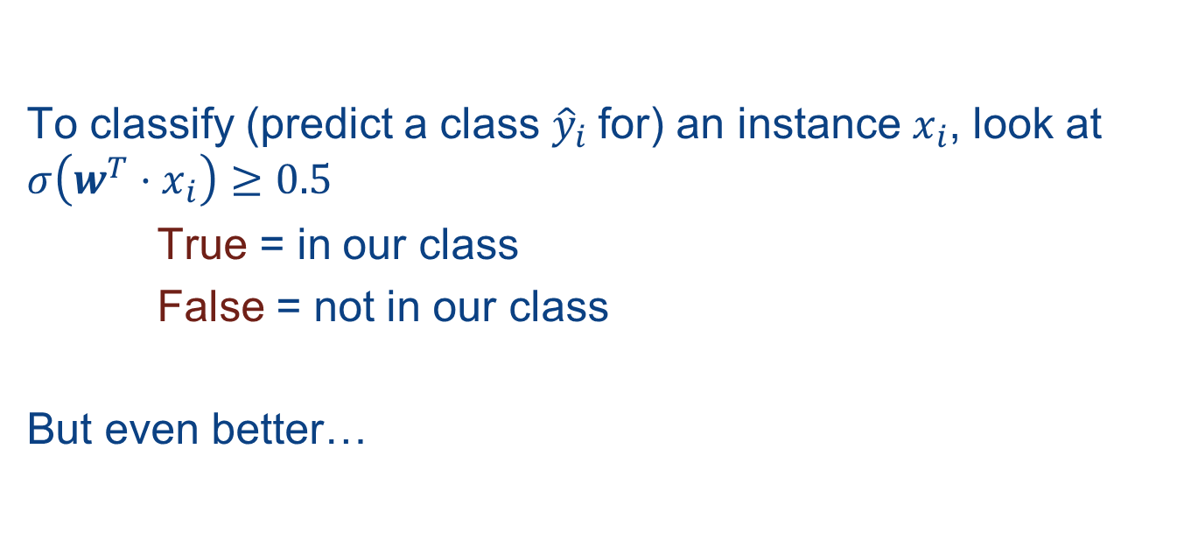
Logistic Regression: Prediction
To classify (predict a class ${\hat{y}}_{i}$for) an instance $x_{i}$, look at $σ\left({w^{T}⋅x}_{i}\right)≥0.5$
True = in our class
False = not in our class
But even better…

Slide 18
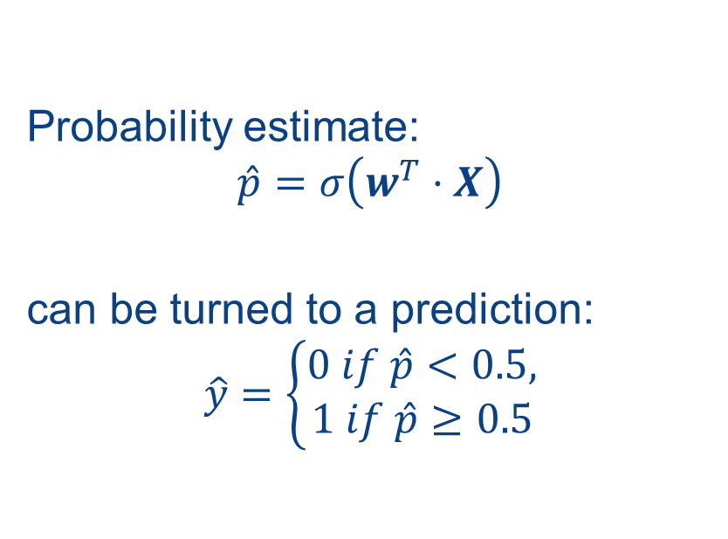
Logistic Regression Gives a Probabilistic Prediction!
Probability estimate:
$$\hat{p}=σ\left(w^{T}⋅X\right)$$
can be turned to a prediction:
$$\hat{y}=\left\{\begin{aligned}0 if \hat{p}<0.5, \\ 1 if \hat{p}≥0.5\end{aligned}\right.$$

Slide 19
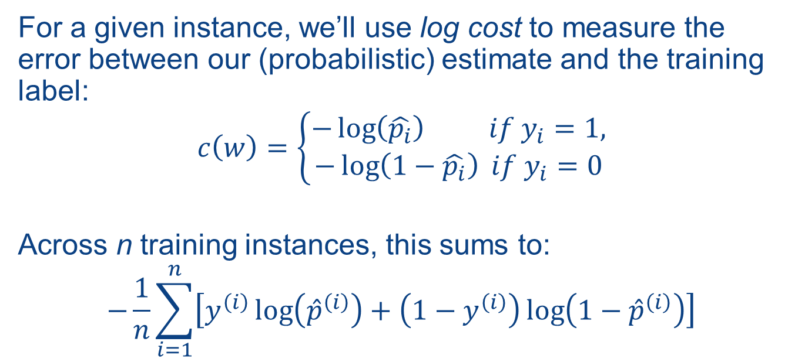
How Do We Train Logistic Regression?
For a given instance, we’ll use log cost to measure the error between our (probabilistic) estimate and the training label:
$$c\left(w\right)=\left\{\begin{aligned}−\log\left(\hat{p_{i}}\right) if y_{i}=1, \\ −\log\left(1−\hat{p_{i}}\right) if y_{i}=0\end{aligned}\right.$$
Across n training instances, this sums to:
$$−\frac{1}{n}\sum_{i=1}^{n}{\left[y^{\left(i\right)}\log\left({\hat{p}}^{\left(i\right)}\right)+\left(1−y^{\left(i\right)}\right)\log\left(1−{\hat{p}}^{\left(i\right)}\right)\right]}$$
y^{(i)} = 1 or 0
Notes:
We’ve seen prediction.
To train, we essentially to to predict, then we see how far off our value is. This is measured with the (log) cost function.

Slide 20
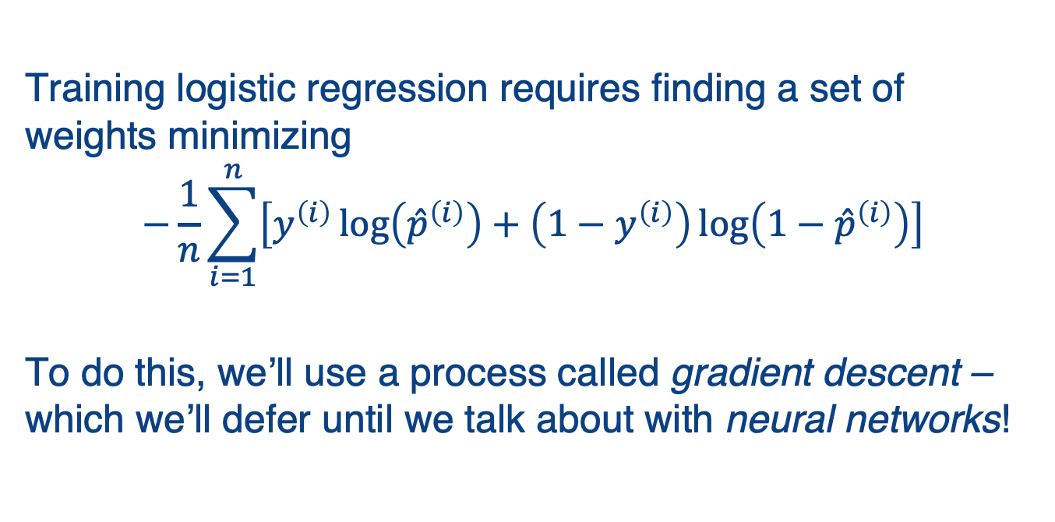
Training, Continued
Training logistic regression requires finding a set of weights minimizing
$$−\frac{1}{n}\sum_{i=1}^{n}{\left[y^{\left(i\right)}\log\left({\hat{p}}^{\left(i\right)}\right)+\left(1−y^{\left(i\right)}\right)\log\left(1−{\hat{p}}^{\left(i\right)}\right)\right]}$$
To do this, we’ll use a process called gradient descent – which we’ll defer until we talk about with neural networks!
Notes:
We would next minimize the cost function. We’ll discuss this in the next (optional) submodule!
Meanwhile let’s see how to use logistic regression…

Slide 21
Using Logistic Regression in SciKit-Learn
Let’s consider a dataset of wines.
from sklearn.datasets import load_wine
dataset = load_wine()
 | alcohol | malic acid | ash | alkalinity of ash | magnesium | …
0 | 14.23 | 1.71 | 2.43 | 15.6 | 127.0 | …
1 | 13.20 | 1.78 | 2.14 | 11.2 | 100.0 | …
2 | 13.16 | 2.36 | 2.67 | 18.6 | 101.0 | …
3 | 14.37 | 1.95 | 2.50 | 16.8 | 113.0 | …
4 | 13.24 | 2.59 | 2.87 | 21.0 | 118.0 | …
... | ... | ... | ... | ... | ... | …
y
0
2
0
1
…
Notes:
To use SciKit, the first thing we have to do is import some data with labels. Here is one that is built into SciKit about wines, that has things like the level of magnesium.
The data (features) is in the table to the left; the labels, e.g. 0, 1, 2 are in the y-vector to the right.

Slide 22
Training a Logistic Regression Classifier
from sklearn.linear_model \ import LogisticRegression
clf = LogisticRegression(max_iter=10000)
clf.fit(X_train,y_train)
prediction = clf.predict(X_test)
accuracy = sklearn.metrics.accuracy_score\ (prediction,y_test)
print("Accuracy: %.1f%%"% (accuracy*100))
Accuracy: 96.3%
Notes:
As with other classifiers in SciKit, the first thing we do is create the classifier (Logistic Regression), then we call fit with the training data and class labels. At this point the classifier is trained, and we can use it to predict from the test data. On the slide, we compare the predictions against the correct labels for testing; note that the accuracy is high (96.3%).

Slide 23
Summary: Logistic Regression
A variation of regression used for classification – estimates probability that instance belongs to a class
Based on the sigmoid function
Requires regularization of parameters

Slide 24
Supervised Learning Summary
Linear regression
Has a closed form solution
Usually requires regularization to prevent overfitting
Logistic regression
Linear model that predicts class membership

