Slide 1

PageRank and Graph Analysis Using Linear Algebra

Slide 2
Reminder: Graphs and Adjacency Matrices
Recall that we can use an adjacency matrix to describe connectivity
 | a | b | c | d
a | 0 | 0 | 1 | 0
b | 0 | 0 | 1 | 1
c | 1 | 1 | 0 | 1
d | 0 | 1 | 1 | 0
Graph G
c
d
a
b
Let’s generalize from this idea for PageRank, adding
direction and weight to the edges…
Notes:
\

Slide 3

PageRank Linear Algebra Formulation
Create an m x m “weight transfer matrix” M to capture links:
M(i, j) = 1 / n_{j} if page i is pointed to by page j and page j has n_{j} outgoing links = 0 otherwise
Iterative computation:
$$PageRank^{(i)}=M⋅PageRank^{(i−1)}$$

Slide 4
PageRank Linear Algebra Formulation
Create an m x m “weight transfer matrix” M to capture links:
M(i, j) = 1 / n_{j} if page i is pointed to by page j and page j has n_{j} outgoing links = 0 otherwise
Initialize all PageRanks to 1, multiply by M repeatedly until all values converge:
Iterative computation:
$$PageRank^{(i)}=M⋅PageRank^{(i−1)}$$

Slide 5
PageRank Linear Algebra Formulation
Create an m x m “weight transfer matrix” M to capture links:
M(i, j) = 1 / n_{j} if page i is pointed to by page j and page j has n_{j} outgoing links = 0 otherwise
Initialize all PageRanks to 1, multiply by M repeatedly until all values converge:
Computes principal eigenvector via power iteration
Iterative computation:
$$PageRank^{(i)}=M⋅PageRank^{(i−1)}$$

Slide 6
A Brief Example
M
G
g'
m’
a’
g
m
a
=
*
A
M
G
Notes:
We have three websites, call them Company G, A, and M.
Lowercase g, m and a are the initial weights for each

Slide 7
A Brief Example
M
G
g'
m’
a’
0 | 0.5 | 0.5
0 | 0 | 0.5
1 | 0.5 | 0
g
m
a
=
*
A
M
G
Notes:
Write out the transfer of weight as follows, e.g. M transfers half its weight on each of the two edges.

Slide 8
A Brief Example
m
G
g'
m’
a’
0 | 0.5 | 0.5
0 | 0 | 0.5
1 | 0.5 | 0
g
m
a
=
*
A
M
g
Running for multiple iterations:
g
m
a
1
1
1
1
0.5
1.5
1
0.75
1.25
1
0.67
1.33
=
,
,
, …
Total rank sums to number of pages
Notes:
Write out the transfer of weight as follows. Assume initial g=m=a=1, finally converges on A having 1.33, M 0.67 and G 1.

Slide 9
Oops #1 – PageRank sinks
G
g'
m’
a’
0 | 0 | 0.5
0.5 | 0 | 0.5
0.5 | 0 | 0
g
m
a
=
*
A
M
Notes:
Have to fix a few things to make this practical. It is possible that M decides to remove their link to A so that they are not linked to anything. (Column of 0’s).

Slide 10
Oops #1 – PageRank sinks
G
g'
m’
a’
0 | 0 | 0.5
0.5 | 0 | 0.5
0.5 | 0 | 0
g
m
a
=
*
A
M
Running for multiple iterations:
g
m
a
1
1
1
0.5
1
0.5
0.25
0.5
0.25
0
0
0
=
,
,
, … ,
Notes:
When we run this, after a few iterations everything goes to 0.

Slide 11
Oops #1 – PageRank sinks
G
g'
m’
a’
0 | 0 | 0.5
0.5 | 0 | 0.5
0.5 | 0 | 0
g
m
a
=
*
A
M
'dead end' - PageRank is lost after each round
Running for multiple iterations:
g
m
a
1
1
1
0.5
1
0.5
0.25
0.5
0.25
0
0
0
=
,
,
, … ,
Notes:
We shouldn’t lose the total PageRank that we started with (3). It is getting absorbed in the ”dead end” of M.

Slide 12
Oops #2 - PageRank hogs
G
g'
m’
a’
0 | 0 | 0.5
0.5 | 1 | 0.5
0.5 | 0 | 0
g
m
a
=
*
A
M
Running for multiple iterations:
g
m
a
=
Notes:
Another problem is when there are self loops.

Slide 13
Oops #2 - PageRank hogs
G
g'
m’
a’
0 | 0 | 0.5
0.5 | 1 | 0.5
0.5 | 0 | 0
g
m
a
=
*
A
M
Running for multiple iterations:
g
m
a
1
1
1
0.5
2
0.5
0.25
2.5
0.25
0
3
0
=
,
,
, … ,
Notes:
After running for multiple iterations, the page with the self-loop (M) “absorbs” all the PageRank credit.

Slide 14
Oops #2 - PageRank hogs
G
g'
m’
a’
0 | 0 | 0.5
0.5 | 1 | 0.5
0.5 | 0 | 0
g
m
a
=
*
A
M
PageRank cannot flow out and accumulates
Running for multiple iterations:
g
m
a
1
1
1
0.5
2
0.5
0.25
2.5
0.25
0
3
0
=
,
,
, … ,
Notes:
This is because PageRank can never “flow out” of M, and so it accumulates.

Slide 15
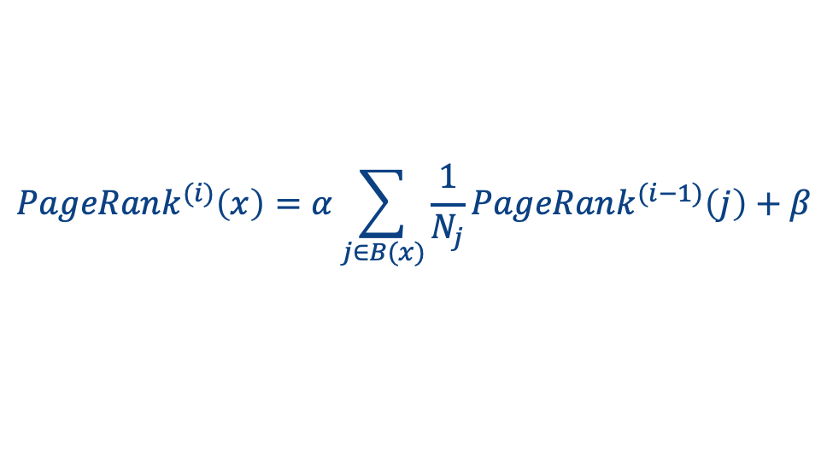
Reducing Rank Hogs and Dead-Ends
Remove out-degree 0 nodes (or consider them to refer back to referrer)
Add damping or decay factor 𝛼 to deal with sinks
Typical values: 𝛼 =0.85 β = m element vector with values 1 - 𝛼 = 0.15
$$PageRank^{(i)}=α⋅M⋅PageRank^{(i−1)}+β$$
Non-matrix form is
$$PageRank^{(i)}\left(x\right)=α\sum_{j∈B(x)}{\frac{1}{N_{j}}PageRank^{(i−1)}\left(j\right)+β}$$
Notes:
To avoid the problem of dead-ends (pages with no outgoing links), we can either remove them or add back-edges for these nodes, i.e. edges going the reverse direction of incoming edges.
Alternatively we can add a damping or decay factor to deal with sinks, which also helps deal with rank hogs.

Slide 16


Example: Reducing the Hog
$$β$$
G
g'
m’
m’
$$α$$
0 | 0 | 0.5
0.5 | 1 | 0.5
0.5 | 0 | 0
g
m
a
0.15
0.15
0.15
= 0.85
*
+
A
M
Running for multiple iterations:
g
m
a
=
Notes:
Returning to the example using alpha and beta, we again run for multiple iterations.

Slide 17
Example: Reducing the Hog
$$β$$
G
g'
m’
m’
$$α$$
0 | 0 | 0.5
0.5 | 1 | 0.5
0.5 | 0 | 0
g
m
a
0.15
0.15
0.15
= 0.85
*
+
A
M
Running for multiple iterations:
g
m
a
0.57
1.85
0.57
0.39
2.21
0.39
0.32
2.36
0.32
0.26
2.48
0.26
,
,
… ,
=
,
Notes:
Now converging to something where M no longer absorbs all the Pagerank

Slide 18
Intuition Behind PageRank: Random Surfer Model
PageRank has an intuitive basis in random walks on graphs
Imagine a random surfer, who starts on a random page with equal probability and, in each step,
with probability 𝛼, clicks on a random link on the page
with probability β = 1 - 𝛼, jumps to a random page (bored?)
The PageRank of a page can be interpreted as the fraction of steps the surfer spends on the corresponding page
Transition matrix can be interpreted as a Markov Chain

Slide 19
Variations on PageRank
Many have been studied!
What if we don’t randomly jump with equal probability?
What if we want to “personalize” PageRank or measure it relative to certain start points?

Slide 20
Recap and Take-aways
We’ve seen some basic algorithms for graphs – which are incredibly common in representing real-world phenomena
We’ve seen this both as dataframes – representing adjacency lists
… and as matrices!
Later we’ll see how we can build graphs representing similarities / overlap among data

