Slide 1
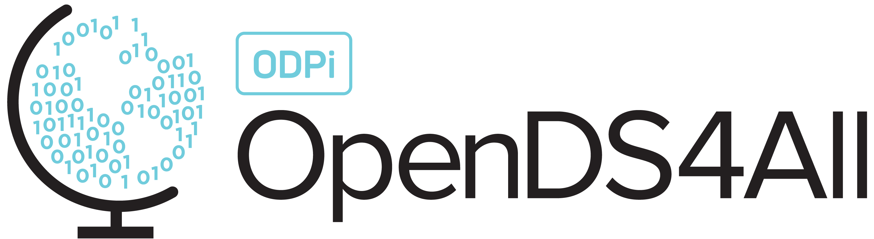
Cluster-Based Processing of Graph Data

Slide 2
Outline: Graph Computations in Apache Spark
(As necessary: review Graph Theory Basics module)
Simple graph centrality measures in Apache Spark: degree centrality
Traversing a graph in Apache Spark via Breadth-First Search
A few applications of Distributed BFS

Slide 3
Degree Centrality in Apache Spark
For each node, compute its degree, i.e., the number of edges it connects to
In a directed graph suppose we want outdegree centrality, i.e., the number of edges coming out from each node n
How to write in Spark, given a relation edges(from, to)?

Slide 4
LinkedIn Example
See accompanying Lecture Notebook
Given a list edges that looks like:
[[0,5], [5,10], …]
from pyspark.sql.types import IntegerType
schema = StructType([
StructField("from", IntegerType(), True),
StructField("to", IntegerType(), True)
])
# Load the remote data as a list of dictionaries
edges_df = sqlContext.createDataFrame(edges, schema)
edges_df.createOrReplaceTempView('edges')
sqlContext.sql('select from as id, count(to) as degree '+
\'from edges group by from')
Notes:
Encoding graphs as Spark dataframe: The first step is to define a schema for the dataframe (from: integer, to: integer). Then sqlContext is the connection to Spark, and asking Spark to create a dataframe.
Edges_df is a variable in Pandas.
Alternatively we can create a table in SQL, and call SQL functions over that table.

Slide 5
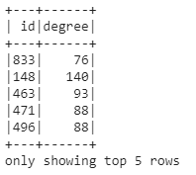
LinkedIn Example
See accompanying Lecture Notebook
Given a list edges that looks like:
[[0,5], [5,10], …]
from pyspark.sql.types import IntegerType
schema = StructType([
StructField("from", IntegerType(), True),
StructField("to", IntegerType(), True)
])
# Load the remote data as a list of dictionaries
edges_df = sqlContext.createDataFrame(edges, schema)
edges_df.createOrReplaceTempView('edges')
sqlContext.sql('select from as id, count(to) as degree '+
\'from edges group by from')
Notes:
This is the result of query the SQL table.
Note that in Pandas you didn’t have to give a schema during the construction of the dataframe, but this is important in Spark.

Slide 6
Beyond Degree Centrality
Degree centrality is moderately useful
citation counts in academia
number of followers in Twitter
number of commits in GitHub
But we may want to look at relationships to more distant nodes!
To get there, let’s look at how to reason about what’s nearby in a graph

Slide 7
Exploring a Graph
We will want to start at some node (set) and look at connected nodes in the graph
How far away is X from Y?
How many nodes are within distance k?
What are the odds I can start at X and end up at Y?
(Some of these are the basis of ranking + recommendations)
So how can we do this? Breadth-first search

Slide 8
Distributed Breadth-First Search

Slide 9
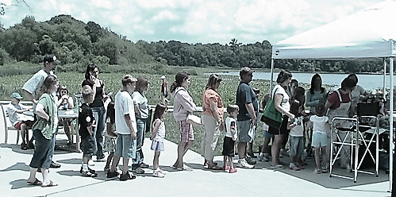

Recall Breadth-First Search (BFS) for Undirected or Directed Graphs
"The line for face painting" by be OH be is licensed under CC BY-NC 2.0
Unexplored
vertices
Queue of Frontier Vertices
Visited
vertices
Frontier
vertices
Notes:
Start at some node, and look at outgoing edges. The nodes at the end of these edges are called the “frontier” (shown in red, the visited nodes are in blue). Once the red nodes become blue, the white nodes become red. Make sure we don’t backtrack by making sure that the frontier nodes have not already been visited.

Slide 10
Breadth-First Search in Apache Spark
The centralized BFS algorithm relied on sequence to avoid redundant work – every node was visited at the earliest point possible, and never again
(As necessary: review Graph Theory Basics module)
We want to (partly) parallelize, which may introduce redundant, but not sequenced, work!
Notes:
How can we run this on the cloud? We can’t use the queue because it forces a sequence in terms of how nodes are visited. It also ensures that each node is visited exactly once, which we are going to give up on a bit in the parallel Spark version.

Slide 11
Distributed Traversal of the Graph Requires a Join in Each Step
from pyspark.sql.functions import col
# Start with a subset of nodes
start_nodes_df = edges_df[['from']].filter(edges_df['from'] < 1000).\
select(col('from').alias('id’)).drop_duplicates()
Notes:
We choose the origin nodes as the from nodes, from edges_df with value < 1000. We call these ID.

Slide 12

Distributed Traversal of the Graph Requires a Join in Each Step
from pyspark.sql.functions import col
# Start with a subset of nodes
start_nodes_df = edges_df[['from']].filter(edges_df['from'] < 1000).\
select(col('from').alias('id’)).drop_duplicates()
Notes:
The output would something like the table on the right. This is the origin.

Slide 13
Distributed Traversal of the Graph Requires a Join in Each Step
from pyspark.sql.functions import col
# Start with a subset of nodes
start_nodes_df = edges_df[['from']].filter(edges_df['from'] < 1000).\
select(col('from').alias('id’)).drop_duplicates()
neighbor_nodes_df = start_nodes_df.\
join(edges_df, start_nodes_df.id == edges_df['from']).\
select(col('to').alias('id'))
Notes:
We find the neighbors of these start nodes by joining with the edges_df and picking the to nodes. These are also IDs.

Slide 14

Distributed Traversal of the Graph Requires a Join in Each Step
from pyspark.sql.functions import col
# Start with a subset of nodes
start_nodes_df = edges_df[['from']].filter(edges_df['from'] < 1000).\
select(col('from').alias('id’)).drop_duplicates()
neighbor_nodes_df = start_nodes_df.\
join(edges_df, start_nodes_df.id == edges_df['from']).\
select(col('to').alias('id'))
Notes:
This is the output.
Note that in Spark this is called “join” rather than “merge”.
In Python, from is a reserved word so had to use edges_df[‘from’] rather than the Spark-style edges_df.from.

Slide 15

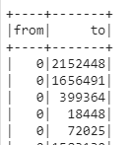


What Happens Under the Covers? Sharded Computation, 2 Nodes
Suppose that edges_df is sharded by from and that we put even numbers on worker 0 and odd numbers on worker 1
edges_df
start_nodes_df
neighbor_nodes_df
Node 0
Node 1
Notes:
When we compute with edges_df on a 2-node cluster, we can shard by the one field, in this case the from node.
What that does is put all of the even-numbered from edges on node 0, indicated with white background, and all of the odd-numbered from edges on node 1, with cyan background.
If we compute start_nodes_df as on the previous slide, we get the from edges renamed as ids. The data stays where it originated, with even values on node 0 and odd values on node 1.
Now when we join to get neighbor_nodes_df, the data gets joined. This is nice because the data to be joined happens to be on the right compute node and can be done in parallel without resharding.
But now we pick the to column, and it ISN’T the case that to columns are split in any systematic way. We get some odd values on node 0 and some even values on node 1.

Slide 16


Neighbor’s Neighbor?
neighbor_neighbor_nodes_df = neighbor_nodes_df.\
join(edges_df, neighbor_nodes_df.id == edges_df['from']).\
select(col('to').alias('id'))
neighbor_nodes_df
repartitioned by id
edges_df
neighbor_nodes_df
Notes:
Now, if we use neighbor_nodes_df from the previous slide -- Spark has to repartition the data to use it as part of a join with the from nodes in edges_df. This is automatic but it slows things down!!!
It is also good to drop duplicates, to reduce the processing time.

Slide 17
Generalizing: Neighbor’s Neighbor’s … Can I Do an Iterative Join?
Can we generalize from start -> neighbor -> neighbor’s neighbor in a loop?
Base case: start with the origin, join with the directly connected edges
Iterative case: start with the endpoint of existing paths, add an edge
id
(from, to)
id
(from, to)
(from, to)
(from, to)
Notes:
We saw how to go from the start nodes, to their neighbors, to their neighbors’ neighbors, essentially doing copy-and-paste.
That’s not a very elegant way of doing this – we’ll instead do this in a loop!

Slide 18
Iterative Join
def iterate(df, depth):
df.createOrReplaceTempView('iter')
# Base case: direct connection
result = sqlContext.sql('select from, to, 1 as depth from iter')
for i in range(1, depth):
result.createOrReplaceTempView('result’)
result = sqlContext.sql('select r1.from as from, r2.to as to, r1.depth+1 as depth '\
'from result r1 join iter r2 ‘\
'on r1.to=r2.from')
return result
iterate(edges_df.filter(edges_df['from'] < 1000), 1).orderBy('from','to').show()
iterate(edges_df.filter(edges_df['from'] < 1000), 2).orderBy('from','to').show()
Notes:
Here we are also calculating the distance from an origin as “depth”

Slide 19
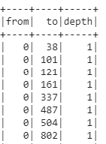
Iterative Join
def iterate(df, depth):
df.createOrReplaceTempView('iter')
# Base case: direct connection
result = sqlContext.sql('select from, to, 1 as depth from iter')
for i in range(1, depth):
result.createOrReplaceTempView('result’)
result = sqlContext.sql('select r1.from as from, r2.to as to, r1.depth+1 as depth '\
'from result r1 join iter r2 ‘\
'on r1.to=r2.from')
return result
iterate(edges_df.filter(edges_df['from'] < 1000), 1).orderBy('from','to').show()
iterate(edges_df.filter(edges_df['from'] < 1000), 2).orderBy('from','to').show()

Slide 20
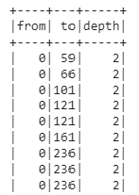
Iterative Join
def iterate(df, depth):
df.createOrReplaceTempView('iter')
# Base case: direct connection
result = sqlContext.sql('select from, to, 1 as depth from iter')
for i in range(1, depth):
result.createOrReplaceTempView('result’)
result = sqlContext.sql('select r1.from as from, r2.to as to, r1.depth+1 as depth '\
'from result r1 join iter r2 ‘\
'on r1.to=r2.from')
return result
iterate(edges_df.filter(edges_df['from'] < 1000), 1).orderBy('from','to').show()
iterate(edges_df.filter(edges_df['from'] < 1000), 2).orderBy('from','to').show()

Slide 21
Summary of Path Traversal
Traditional algorithm for shortest-paths relies on sequencing our traversal
“Radiate outwards” and add to the queue
We never revisit a node we have already visited
BFS doesn’t quite solve shortest path as we’ve given it – but:
It “radiates outwards” and visits all items in parallel
As a result, it may revisit a node multiple times – we will need to address this (left as an exercise)

Slide 22
A Few Applications of Distributed BFS

Slide 23
A Common Question in Networks
How far away is V from A?
“Shortest path”
Let’s assume that
the graph is directed and may have cycles
all edges have equal (“unit”) cost
Can BFS help?
O
N
H
G
P
F
M
B
Q
A
E
W
D
L
I
V
C
K
J
U
R
S
T

Slide 24
Adding Connections in Social Networks
One’s friends tend to become each other’s friends.
This is called Triadic Closure.
A node A violates the Triadic Closure Property if it has two friends B and C who are not each other’s friends.
We often look to complete triangles to recommend
friends – prioritize by the number of incomplete triangles
B
A₂
A₁
C
Notes:
Friend recommendations.

Slide 25
Adding Connections in Social Networks
One’s friends tend to become each other’s friends.
This is called Triadic Closure.
A node A violates the Triadic Closure Property if it has two friends B and C who are not each other’s friends.
We often look to complete triangles to recommend
friends – prioritize by the number of incomplete triangles
B
A₂
A₁
C
Discuss: How can we use BFS/Shortest Path here?
Hint: consider a set of start nodes and the (min) depths
Notes:
Friend recommendations.

Slide 26
A Sketch of a Solution
Run BFS from “us” to find friends (nodes at depth 1) and friends of our friends (nodes with min depth 2)
Run BFS from FoF to depth 1
For each FoF n, count how many of our friends are in common
Rank each FoF n by how many friends we have in common
Notes:
For many years, this was the basic algorithm used by Facebook.

Slide 27
Other Common Path-based algorithms
Sometimes our goal is to compute information about the paths (sets of paths) between nodes
Edges may be annotated with cost, distance, or similarity
Examples of such problems (see algorithms courses):
Shortest path from one node to another (we saw)
Minimum spanning tree (minimal-cost tree connecting all vertices in a graph)
Steiner tree (minimal-cost tree connecting certain nodes)
Topological sort (node in a graph without cycles comes before all nodes it points to)
Other times we want to visit all nodes, all edges, …

Slide 28
Summary
Joins are a way of starting with a set of nodes and performing path traversals
Multi-step joins achieve multi-step paths
We can easily implement distributed BFS and use this to solve other problems

