Slide 1

Unsupervised Machine Learning
Notes:
Framing: unsupervised, supervised, reinforcement learning.

Slide 2
Machine Learning Basics
Data is typically comprised of features – values that might be useful in predicting the output
Red, green, blue values of pixels in an image
Keywords in a document
Purchases of a customer
These are used in machine learning, which either finds commonality among features, or finds a function between features and a prediction
“Not all features are created equal”
Some are easier to learn from
Some are correlated with others!
Notes:
Before we talk about supervised and unsupervised machine learning, it’s important to start with understanding the machine learning problem formulation and setup.

Slide 3
Two Flavors of Machine Learning
1. Find the structure in the data (unsupervised)
2. Find a function mapping from data features to classes (supervised)
x
x
x
x
x
x
Input data: x₁, x₂, x₃, …, x_{n}
x
x
x
x
x
x
x
x
x
Input data: x₁, x₂, x₃, …, x_{n}
x
o
x
x
o
+ Labels: y₁, y₂, y₃, …, y_{n}
o
x
x
o
o

Slide 4
A Workflow for ML: Unsupervised → Supervised Learning
Often, start with unsupervised learning, which can:
Reduce number of dimensions
Provide insights into natural clusters
Generate more natural features
Then run supervised learning methods!
Notes:
The two kinds of ML are often used together in a “pipeline”…

Slide 5
Outline
Background: representing data for machine learning
Unsupervised machine learning (the main part of this lecture)
Supervised machine learning (next lecture)

Slide 6
Representing Data for Machine Learning
(Also see companion lecture notebook)

Slide 7
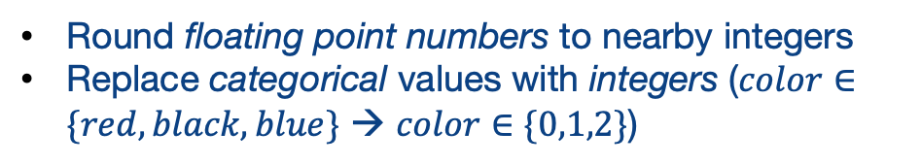
Matrices for Machine Learning
We have used Dataframes (relations) for our data
Machine learning typically works best using matrices
Map from a row in the dataframe → a row in a numeric matrix
customer | phone_color | purchase_amt
1 | blue | $30.90
2 | black | $55.22
Matrices have one type of data; change representations, e.g.:
1 | 2 | 31
2 | 1 | 56
Round floating point numbers to nearby integers
Replace categorical values with integers ($color∈\{red,black,blue\}$ → $color∈\{0,1,2\}$)
But perhaps more than that. Let’s explore with a more realistic example!
Notes:
When we go from a dataframe, which allows for heterogeneous fields, to a matrix, we often need to change our representation of the data.

Slide 8
Matrices in Python
Most commonly: numpy arrays
Recall that arrays have all elements of the same type, so must be floating-point- or integer-valued
# Basics of arrays: Numpy
import numpy as np
# We start with a simple array, initialized with random values
arr = np.ndarray((4,2))
# Show dimensions
arr.shape
Notes:
ndarray takes a tuple specifying the number of items in each dimension.
By default, it does not initialize the values in the array, so they are whatever is left in memory
You can use np.zeros or np.ones to preconfigure the data to 0’s or 1’s.

Slide 9
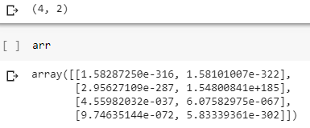
Matrices in Python
Most commonly: numpy arrays
Recall that arrays have all elements of the same type, so must be floating-point- or integer-valued
# Basics of arrays: Numpy
import numpy as np
# We start with a simple array, initialized with random values
arr = np.ndarray((4,2))
# Show dimensions
arr.shape
Notes:
ndarray takes a tuple specifying the number of items in each dimension.
By default, it does not initialize the values in the array, so they are whatever is left in memory
You can use np.zeros or np.ones to preconfigure the data to 0’s or 1’s.

Slide 10
Matrices in Python
Most commonly: numpy arrays
Recall that arrays have all elements of the same type, so must be floating-point- or integer-valued
# Basics of arrays: Numpy
import numpy as np
# We start with a simple array, initialized with random values
arr = np.ndarray((4,2))
# Show dimensions
arr.shape
arr = np.zeros((4,2))
arr = np.ones((4,2))
Notes:
ndarray takes a tuple specifying the number of items in each dimension.
By default, it does not initialize the values in the array, so they are whatever is left in memory
You can use np.zeros or np.ones to preconfigure the data to 0’s or 1’s.

Slide 11
Matrices as Inputs to Machine Learning
Each row represents an instance or observation
Each column represents a feature
Again, all data is integer or float!
Requires us to think about feature extraction!
x1 | x2 | x3 | x4 | x5 | x6
instance (row, sample, observation)
extracted feature
Notes:
We need to make sure each row represents one observation or instance, and we need to populate the feature values as columns, all in the same type…

Slide 12
From DataFrames to Features: Some Simple Ideas
Replace string or categorical data with integer codes
e.g., for US states: {0: ‘Alabama’, 1: ‘Alaska’, 2: ‘Arizona’, …, 49: ‘Wyoming’}
Also: is there linear relationship between values?
categorical data items are generally not related
some data, e.g., geocodes, may be better off mapped into zones and treated as categorical
One-hot encoding: turn a set of potential values into a set of disjoint features – in a bit vector
Alabama | Alaska | … | Wyoming
0 | 0 | … | 1
1 | 0 | … | 0

Slide 13
One-Hot Encoding in Pandas
 | city | state
0 | New York | NY
1 | Los Angeles | CA
2 | Chicago | IL
3 | Houston | TX
4 | Phoenix | AZ
5 | Philadelphia | PA
6 | San Antonio | TX
addresses_df = \ pd.DataFrame([{'city': 'New York', 'state': 'NY'},\
{'city': 'Los Angeles', 'state': 'CA'},\
{'city': 'Chicago', 'state': 'IL'},\
{'city': 'Houston', 'state': 'TX'},\
{'city': 'Phoenix', 'state': 'AZ'}, \
{'city': 'Philadelphia', 'state': 'PA'}, \
{'city': 'San Antonio', 'state': 'TX'}])
 | AZ | CA | IL | NY | PA | TX
0 | 0 | 0 | 0 | 1 | 0 | 0
1 | 0 | 1 | 0 | 0 | 0 | 0
2 | 0 | 0 | 1 | 0 | 0 | 0
3 | 0 | 0 | 0 | 0 | 0 | 1
4 | 1 | 0 | 0 | 0 | 0 | 0
5 | 0 | 0 | 0 | 0 | 1 | 0
6 | 0 | 0 | 0 | 0 | 0 | 1
pd.get_dummies(addresses_df['state'])
pd.get_dummies(addresses_df['state’]).\ to_numpy()
Notes:
The Pandas get_dummies function takes a field and automatically expands it into a one-hot encoding with a Boolean value for each categorical attribute. Calling to_numpy() will turn it into an array.

Slide 14
Sometimes We Want Only a Subset of Features -- Slicing a Matrix
NumPy lets you specify, for each dimension, a range of values to “slice” out…
Negative numbers mean “dimension size minus the number”
# In each dimension you can give a left:right
# range. Ranges are left-inclusive and right exclusive
arr[1:3,1]
X = input[:,0:-1]
Notes:
We can “slice” each dimension from a:b (non-inclusive). If b is negative that is the number of columns from the upper bound.

Slide 15
Where this Is Frequently Useful in Machine Learning
We may have data in which the last column is the label for whether the data belongs to a class
We may split this into the matrix X (features) and vector y (class labels)
array([[0, 0, 0, 1, 0, 0, False], [0, 1, 0, 0, 0, 0, True], [0, 0, 1, 0, 0, 0, False], [0, 0, 0, 0, 0, 1, False], [1, 0, 0, 0, 0, 0, True], [0, 0, 0, 0, 1, 0, True], [0, 0, 0, 0, 0, 1, False]], dtype=object)
# All rows, last column
y = data[:,-1]
# All rows, all but last column
X = data[:,0:-1]
Notes:
We will cluster on X, or use X for testing a supervised machine learning algorithm (classifier), or use X and y together as inputs to train a classifier.

Slide 16
Where this Is Frequently Useful in Machine Learning
y (labels): [False True False False True True False] X (training data): [[0 0 0 1 0 0] [0 1 0 0 0 0] [0 0 1 0 0 0] [0 0 0 0 0 1] [1 0 0 0 0 0] [0 0 0 0 1 0] [0 0 0 0 0 1]]
We may have data in which the last column is the label for whether the data belongs to a class
We may split this into the matrix X (features) and vector y (class labels)
array([[0, 0, 0, 1, 0, 0, False], [0, 1, 0, 0, 0, 0, True], [0, 0, 1, 0, 0, 0, False], [0, 0, 0, 0, 0, 1, False], [1, 0, 0, 0, 0, 0, True], [0, 0, 0, 0, 1, 0, True], [0, 0, 0, 0, 0, 1, False]], dtype=object)
# All rows, last column
y = data[:,-1]
# All rows, all but last column
X = data[:,0:-1]
Notes:
We will cluster on X, or use X for testing a supervised machine learning algorithm (classifier), or use X and y together as inputs to train a classifier.

Slide 17
Summary: The Basics of Data Representation
Machine learning algorithms typically take an input 2D matrix
Rows = instances or samples
Columns = features
We may need to extract or encode values from a DataFrame
Encodings for non-numeric data
One-hot encodings
We can use slicing to restrict the set of instances or features we consider
Notation: Often, the matrix for machine learning is simply referred to as the X matrix!

Slide 18
Unsupervised Machine Learning

Slide 19
Unsupervised Machine Learning
Technique 1: Dimensionality Reduction
Principal Component Analysis (PCA)
Reduce high number of correlated features to a lower number of uncorrelated features
New features are weighted combinations of originals
t-Distributed Stochastic Neighbor Embedding (t-SNE)
Technique 2: Clustering
Find groupings in the data

Slide 20
Reducing Dimensionality: Principal Component Analysis (PCA)

Slide 21
What Is Principal Component Analysis?
An unsupervised method that takes X from p dimensions down to k dimensions
Why is this helpful?
Reduces noise in the data for supervised learning
Reduces data
Simpler to visualize data (though dimensions may be unintuitive!)

Slide 22
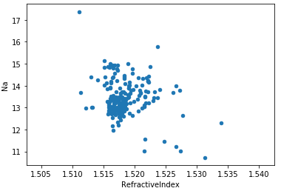
The Intuition
Take a data set as a matrix X of features
Some have little variance, some have a lot
Some are correlated, some are not
Scale each dimension so they are comparable
Consider the glass dataset, with 2D to the right
Sodium and refractive index are plotted and might in fact be correlated
Find the vector that maximizes variance – the principal eigenvector
Repeat for the next orthogonal vector, etc.

Slide 23
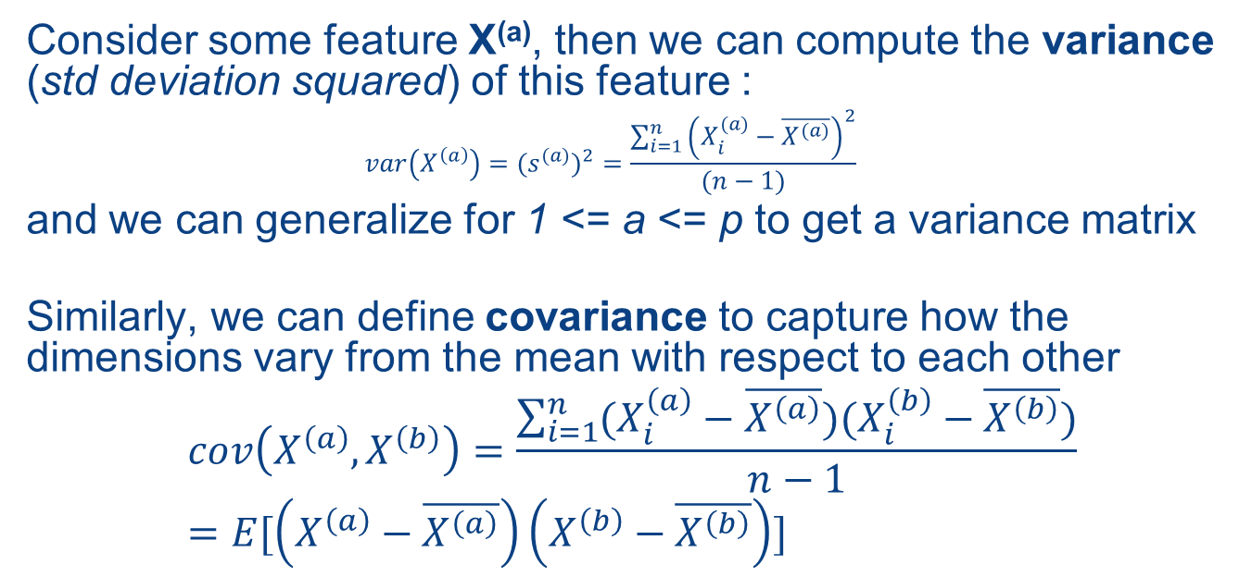
How Do We Formalize This?
Consider some feature X^{(a)}, then we can compute the variance (std deviation squared) of this feature :
$${var\left(X^{\left(a\right)}\right)=(s^{(a)})}^{2}=\frac{\sum_{i=1}^{n}{{\left(X_{i}^{(a)}−\overline{X^{(a)}}\right)}^{2}}}{(n−1)}$$
and we can generalize for 1 <= a <= p to get a variance matrix
Similarly, we can define covariance to capture how the dimensions vary from the mean with respect to each other
$$cov\left(X^{\left(a\right)},X^{\left(b\right)}\right)=\frac{\sum_{i=1}^{n}{(X_{i}^{\left(a\right)}−\overline{X^{\left(a\right)}})(X_{i}^{\left(b\right)}−\overline{X^{\left(b\right)}})}}{n−1}=E[\left(X^{\left(a\right)}−\overline{X^{\left(a\right)}}\right)\left(X^{\left(b\right)}−\overline{X^{\left(b\right)}}\right)]$$

Slide 24
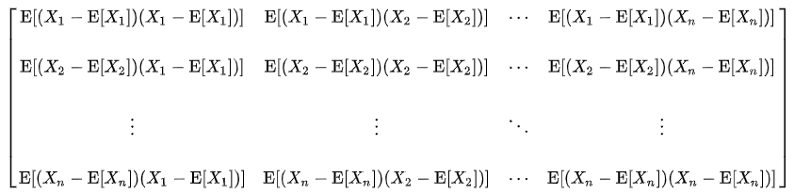
The Covariance Matrix
For 1 <= a <= p
For 1 <= b <= p
Let $Σ\left[b,a\right]=cov(X^{\left(a\right)},X^{\left(b\right)})$
$$Σ=E\left[\left(X−\overline{X}\right){\left(X−\overline{X}\right)}^{T}\right]$$
And if X is zero-centered (and n is large):
$$Σ=\frac{XX^{T}}{n−1}≈\frac{XX^{T}}{n}$$
https://en.wikipedia.org/wiki/Covariance_matrix
Notes:
The diagonal is in fact the variances for each attribute

Slide 25
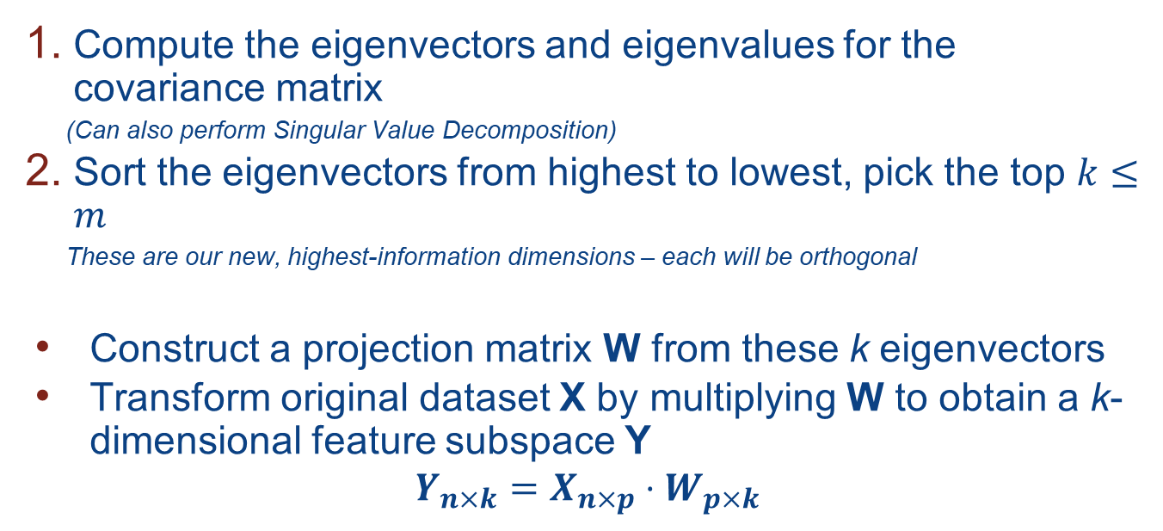
From Covariance Matrix, Computing the Principal Components
Compute the eigenvectors and eigenvalues for the covariance matrix
(Can also perform Singular Value Decomposition)
Sort the eigenvectors from highest to lowest, pick the top $k≤m$
These are our new, highest-information dimensions – each will be orthogonal
Construct a projection matrix W from these k eigenvectors
Transform original dataset X by multiplying W to obtain a k-dimensional feature subspace Y
$$Y_{n×k}=X_{n×p}⋅W_{p×k}$$

Slide 26
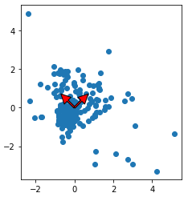
PCA, Visualized
Transform to new coordinate system:
Find directions of maximum variation (covariance)
Minimize reconstruction error
PC2
PC1

Slide 27
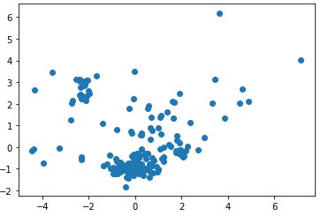
PCA Projection
PC2
PC1
Notes:
Plot using the new coordinate system.

Slide 28
Observations
PCA is not scale-invariant as it finds the direction of maximum variation!
We can look at explained variance for each component – the ratio of the principal component vs the total variance across all components
First k principal components explain the most variance any k variables can explain

Slide 29
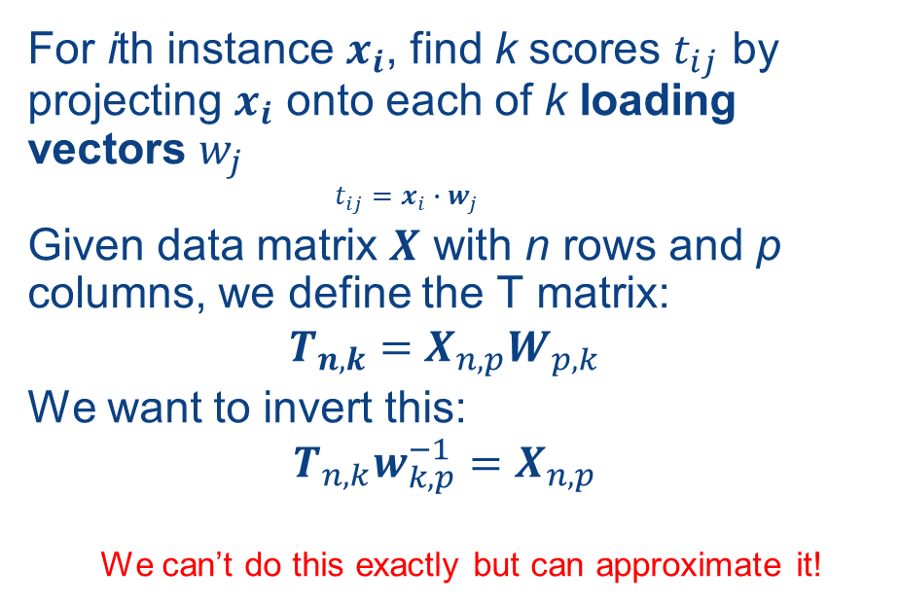
Formalizing PCA
For ith instance $x_{i}$, find k scores $t_{ij}$ by projecting $x_{i}$ onto each of k loading vectors $w_{j}$
$$t_{ij}=x_{i}∙w_{j}$$
Given data matrix $X$ with n rows and p columns, we define the T matrix:
$$T_{n,k}=X_{n,p}W_{p,k}$$
We want to invert this:
$$T_{n,k}w_{k,p}^{−1}=X_{n,p}$$
We can’t do this exactly but can approximate it!

Slide 30
A PCA Example
Glass Identification Data Set from UC Irvine ML Repository
https://archive.ics.uci.edu/ml/datasets/glass+identification
The task:
Forensic scientists need to identify the type of glass based on its chemical composition!
Can we take a dataset of glass instances and their chemical compositions and:
Reduce dimensionality (by default 8 elements + refractive index are given)
Predict the type of glass: building, vehicle, container, tableware, headlight [this part uses supervised machine learning]

Slide 31
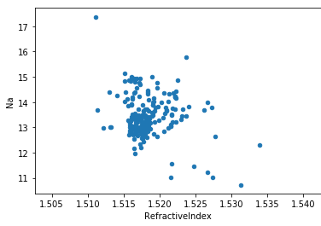
Glass Data in a DataFrame
 | ID | Refractive Index | Na | Mg | Al | Si | K | Ca | Ba | Fe | Type
0 | 1 | 1.52101 | 13.64 | 4.49 | 1.10 | 71.78 | 0.06 | 8.75 | 0.00 | 0.0 | 1
1 | 2 | 1.51761 | 13.89 | 3.60 | 1.36 | 72.73 | 0.48 | 7.83 | 0.00 | 0.0 | 1
2 | 3 | 1.51618 | 13.53 | 3.55 | 1.54 | 72.99 | 0.39 | 7.78 | 0.00 | 0.0 | 1
3 | 4 | 1.51766 | 13.21 | 3.69 | 1.29 | 72.61 | 0.57 | 8.22 | 0.00 | 0.0 | 1
4 | 5 | 1.51742 | 13.27 | 3.62 | 1.24 | 73.08 | 0.55 | 8.07 | 0.00 | 0.0 | 1
... | ... | ... | ... | ... | ... | ... | ... | ... | ... | ... | ...
# Remove the ID and the Type labels for # the training data set X
X = glass_df.drop(['ID','Type'], axis=1)
# Labels are in a separate y vector
y = glass_df['Type']

Slide 32
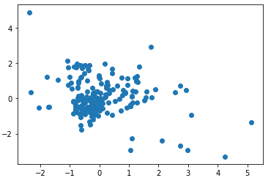
Best Practice: Scaling and Centering
# Standardize features by removing the mean and scaling to unit variance
from sklearn.preprocessing import StandardScaler
# Standardizing the features between 0 and 1
X = StandardScaler().fit_transform(X)
X
array([[ 0.87286765, 0.28495326, 1.25463857, ..., -0.14576634, -0.35287683, -0.5864509 ], [-0.24933347, 0.59181718, 0.63616803, ..., -0.79373376, -0.35287683, -0.5864509 ], [-0.72131806, 0.14993314, 0.60142249, ..., -0.82894938, -0.35287683, -0.5864509 ], ..., [ 0.75404635, 1.16872135, -1.86551055, ..., -0.36410319, 2.95320036, -0.5864509 ], [-0.61239854, 1.19327046, -1.86551055, ..., -0.33593069, 2.81208731, -0.5864509 ], [-0.41436305, 1.00915211, -1.86551055, ..., -0.23732695, 3.01367739, -0.5864509 ]])

Slide 33
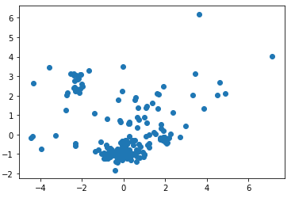
PCA in SciKit-Learn
from sklearn.decomposition import PCA
pca = PCA(n_components=9)
X2 = pca.fit_transform(X)
# Let's see the components
pca.components_
array([[ 0.54517662, -0.2581256 , 0.11088095, -0.42870863, -0.22883635, -0.21934405, 0.49230609, -0.25037512, 0.18584154], [ 0.28568318, 0.27035007, -0.59355826, 0.29521154, -0.15509891, -0.15397013, 0.3453798 , 0.48470218, -0.06203879], [ 0.08691083, -0.38491962, 0.00841796, 0.32923712, -0.45870884, 0.66257412, -0.00098473, 0.07405473, 0.28445055], [ 0.14738099, 0.49124204, 0.37878577, -0.13750592, -0.65253771, -0.03853544, -0.27644322, 0.13317545, -0.23049202], [-0.0735427 , 0.1536833 , 0.12350912, 0.01410888, 0.00850012, -0.30703984, -0.18818774, 0.25133426, 0.87326405], [ 0.11528772, -0.55811757, 0.30818598, -0.01885731, 0.08609797, -0.24363237, -0.14866937, 0.65721884, -0.24304431], [ 0.08186724, 0.14858006, -0.20604537, -0.69923557, 0.21606658, 0.50412141, -0.09913463, 0.35178255, 0.07372136], [-0.7522159 , -0.12769315, -0.07689061, -0.27444105, -0.37992298, -0.10981168, 0.39870468, 0.14493235, -0.01627141], [ 0.02573194, -0.31193718, -0.57727335, -0.19222686, -0.29807321, -0.26050863, -0.57932321, -0.1982282 , -0.01466944]])

Slide 34
Computing PCA via Singular Value Decomposition
A great tutorial: https://arxiv.org/pdf/1404.1100.pdf
Subtract off the mean from each column
Calculate the SVD of the matrix
Take the k principal eigenvectors for the matrix W

Slide 35
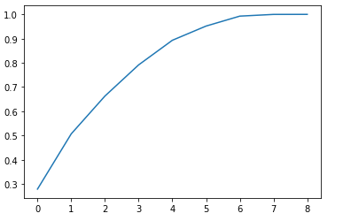
Principal Components vs Variance (Showing with 9 possible components)
np.set_printoptions(suppress=True)
pca.explained_variance_ratio_
array([0.27901819, 0.2277858 , 0.15609378, 0.12865138, 0.10155581, 0.05862613, 0.04099538, 0.00709477, 0.00017876])
We should ideally set k
to the smallest value where we see things flatten out

Slide 36
PCA Often Feeds into Supervised Machine Learning
from sklearn import linear_model
from sklearn.metrics import mean_squared_error, r2_score
from sklearn.model_selection import train_test_split
# Split 80% of data to train the supervised classifer
# and 20% to test on
X_train, X_test, y_train, y_test = train_test_split(\
X, y, test_size=0.20, random_state=42)
# Fit the PCA on the training data
pca = PCA(n_components=6)
X_train_2 = pca.fit_transform(X_train)
# Then train a simple linear regression classifier
# (details aren’t important yet -- tries
# to find the best weighted linear combination to
# match the output)
regr = linear_model.LinearRegression()
regr.fit(X_train_2, y_train)
X_test_2 = pca.transform(X_test)
regr.predict(X_test_2)
regr.score(X_test_2, y_test)
0.8739872270917841

Slide 37
Summary: Principal Component Analysis
Unsupervised method to reduce dimensionality, often before running supervised machine learning
Finds directions of maximum variance in high-dimensional data
Projects onto a smaller (or equal) subspace
Uses SVD (or eigenvectors) under the covers
Assumes linearity
Sensitive to data scaling

Slide 38
A Common Alternative for Visualization: t-SNE t-Distributed Stochastic Neighbor Embedding
For visualizing high-dimensional data
Makes similar data points close
Converts similarities between data points to joint probabilities
Minimizes Kullback-Leibler divergence between joint probabilities of low-dimensional embedding and high-dimensional data
Non-convex cost function
Different initializations yield different results
Can be slow, may want to do PCA first!

Slide 39
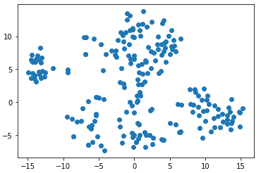
t-SNE in Python
from sklearn.manifold import TSNE
X_embedded = TSNE(n_components=2).fit_transform(X)
plt.scatter(X_embedded[:,0],X_embedded[:,1])

Slide 40
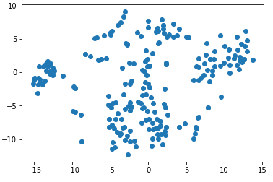
t-SNE in Python
from sklearn.manifold import TSNE
X_embedded = TSNE(n_components=2).fit_transform(X)
plt.scatter(X_embedded[:,0],X_embedded[:,1])
2nd run is different!

Slide 41
Dimensionality Reduction Wrap-up
Two main methods for reducing dimensionality
PCA – assumes linearity, sensitive to scaling, but broadly effective
t-SNE – helpful in visualizing highly dimensional data, doesn’t scale as well
Generally these are used as an intermediate step towards some broader task, whether visualizing + understanding data or doing supervised machine learning
Next, let’s consider another unsupervised method for understanding complex data – clustering

Slide 42
Clustering Data

Slide 43
The Goal of Clustering
Seeks to find “natural groupings” in data, based on some (perhaps multidimensional) notion of distance
the “clustering coefficient” – very important
Some things we may cluster:
Documents (e.g., web pages, new stories)
People (market segmentation, types of users)
RNA, DNA, diseases, …
Generally we start with a predefined number of clusters, often called k
We’ll see later how to best choose k

Slide 44
The Simplest Algorithm: k-Means
The basic idea:
For each of k clusters, pick a centroid for the cluster
Assign each point (data instance) to the cluster associated with the nearest centroid
How do we pick the centroids?
Randomly choose them, then iteratively update, until we reach convergence!

Slide 45
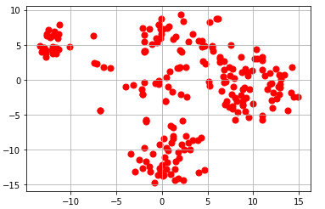
K-Means

Slide 46
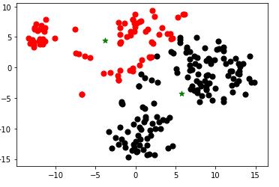
K-Means

Slide 47
The Basic K-Means Algorithm
# Initialize the centroids to random data points
centroids = np.zeros((k,2))
cluster_assignments = [0 for i in range(len(X))]
for i in range(0, k):
centroids[i] = X[randint(0, X.shape[0])]

Slide 48
The Basic K-Means Algorithm
while changed:
changed = False
# Assign points to clusters
for i,x in enumerate(X):
nearest = get_nearest(centroids, x)
# We changed a cluster mapping!
if nearest != cluster_assignments[i]:
changed = True
cluster_assignments[i] = nearest
# Recompute clusters
for i in range(len(centroids)):
points = [j for j,v in enumerate(cluster_assignments) \ if v == i]
X_subset = np.array([[X[i,0],X[i,1]] for i in points])
centroids[i][0] = np.sum(X_subset[:, 0]) / len(points)
centroids[i][1] = np.sum(X_subset[:, 1]) / len(points) return (centroids, np.array(cluster_assignments))
# Initialize the centroids to random data points
centroids = np.zeros((k,2))
cluster_assignments = [0 for i in range(len(X))]
for i in range(0, k):
centroids[i] = X[randint(0, X.shape[0])]

Slide 49
Stop Conditions
Convergence, as in our code – every cluster label remains the same
Fixed number of iterations (typically used with SciKit)
User-defined tolerance

Slide 50
Results
Initialized centroids to: [[-11.82199955 6.87400341] [ 1.68457079 1.6951865 ]] Iteration 1 Cluster 0 [-11.33586516 4.95605412] Cluster 1 [ 4.23969028 -2.00317546] Iteration 2 Cluster 0 [-9.78340957 4.5092549 ] Cluster 1 [ 4.55216471 -2.18941684] Iteration 3 Cluster 0 [-7.49966563 4.80706721] Cluster 1 [ 4.95082383 -2.74943724] Iteration 4 Cluster 0 [-6.18770585 5.02668734] Cluster 1
…

Slide 51
Results
Initialized centroids to: [[-11.82199955 6.87400341] [ 1.68457079 1.6951865 ]] Iteration 1 Cluster 0 [-11.33586516 4.95605412] Cluster 1 [ 4.23969028 -2.00317546] Iteration 2 Cluster 0 [-9.78340957 4.5092549 ] Cluster 1 [ 4.55216471 -2.18941684] Iteration 3 Cluster 0 [-7.49966563 4.80706721] Cluster 1 [ 4.95082383 -2.74943724] Iteration 4 Cluster 0 [-6.18770585 5.02668734] Cluster 1
…
Converged!
array([0, 1, 1, 1, 1, 1, 1, 1, 0, 1, 1, 1, 1, 1, 1, 1, 1, 0, 0, 1, 1, 0, 1, 1, 1, 1, 1, 1, 1, 1, 1, 1, 1, 1, 1, 1, 0, 1, 0, 0, 1, 1, 1, 0, 1, 0, 1, 0, 0, 0, 0, 1, 1, 1, 1, 1, 1, 1, 1, 1, 1, 0, 0, 0, 0, 0, 0, 0, 0, 0, 1, 1, 1, 1, 1, 1, 1, 1, 1, 1, 1, 1, 1, 1, 0, 1, 1, 1, 1, 1, 1, 1, 1, 1, 1, 1, 1, 1, 1, 1, 1, 1, 1, 0, 0, 1, 0, 0, 0, 0, 0, 0, 0, 1, 1, 1, 1, 1, 1, 1, 1, 1, 1, 1, 0, 1, 1, 1, 1, 1, 0, 0, 1, 1, 1, 1, 1, 1, 1, 1, 1, 1, 1, 1, 1, 1, 1, 1, 1, 1, 1, 0, 1, 1, 1, 1, 1, 0, 1, 1, 1, 1, 1, 0, 1, 1, 1, 1, 1, 1, 0, 0, 0, 0, 1, 1, 0, 1, 0, 0, 1, 0, 0, 0, 0, 0, 0, 0, 0, 0, 0, 0, 0, 0, 0, 0, 0, 0, 0, 0, 0, 1, 0, 0, 0, 0, 0, 0, 0, 0, 0, 0, 0, 0])16

Slide 52
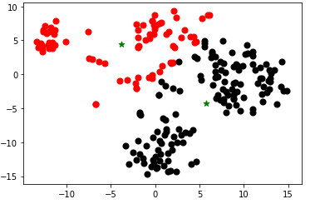
Results
Initialized centroids to: [[-11.82199955 6.87400341] [ 1.68457079 1.6951865 ]] Iteration 1 Cluster 0 [-11.33586516 4.95605412] Cluster 1 [ 4.23969028 -2.00317546] Iteration 2 Cluster 0 [-9.78340957 4.5092549 ] Cluster 1 [ 4.55216471 -2.18941684] Iteration 3 Cluster 0 [-7.49966563 4.80706721] Cluster 1 [ 4.95082383 -2.74943724] Iteration 4 Cluster 0 [-6.18770585 5.02668734] Cluster 1
…
Converged!
array([0, 1, 1, 1, 1, 1, 1, 1, 0, 1, 1, 1, 1, 1, 1, 1, 1, 0, 0, 1, 1, 0, 1, 1, 1, 1, 1, 1, 1, 1, 1, 1, 1, 1, 1, 1, 0, 1, 0, 0, 1, 1, 1, 0, 1, 0, 1, 0, 0, 0, 0, 1, 1, 1, 1, 1, 1, 1, 1, 1, 1, 0, 0, 0, 0, 0, 0, 0, 0, 0, 1, 1, 1, 1, 1, 1, 1, 1, 1, 1, 1, 1, 1, 1, 0, 1, 1, 1, 1, 1, 1, 1, 1, 1, 1, 1, 1, 1, 1, 1, 1, 1, 1, 0, 0, 1, 0, 0, 0, 0, 0, 0, 0, 1, 1, 1, 1, 1, 1, 1, 1, 1, 1, 1, 0, 1, 1, 1, 1, 1, 0, 0, 1, 1, 1, 1, 1, 1, 1, 1, 1, 1, 1, 1, 1, 1, 1, 1, 1, 1, 1, 0, 1, 1, 1, 1, 1, 0, 1, 1, 1, 1, 1, 0, 1, 1, 1, 1, 1, 1, 0, 0, 0, 0, 1, 1, 0, 1, 0, 0, 1, 0, 0, 0, 0, 0, 0, 0, 0, 0, 0, 0, 0, 0, 0, 0, 0, 0, 0, 0, 0, 1, 0, 0, 0, 0, 0, 0, 0, 0, 0, 0, 0, 0])16

Slide 53
Pre-Implemented K-Means in SciKit-Learn
from sklearn.cluster import KMeans
km = KMeans(n_clusters=2, 'random', n_init=1, \ max_iter=300, random_state=0)
km.fit(X_embedded)
km.cluster_centers_
array([[-3.8229299, 4.3934164], [ 5.771634 , -4.2901955]], dtype=float32)
km.labels_
array([0, 1, 1, 1, 1, 1, 1, 1, 0, 1, 1, 1, 1, 1, 1, 1, 1, 0, 0, 1, 1, 0, 1, 1, 1, 1, 1, 1, 1, …

Slide 54
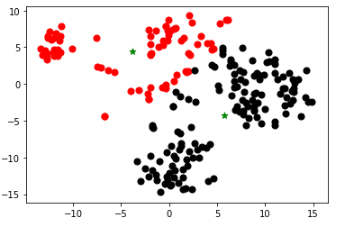
Pre-Implemented K-Means in SciKit-Learn
from sklearn.cluster import KMeans
km = KMeans(n_clusters=2, 'random', n_init=1, \ max_iter=300, random_state=0)
km.fit(X_embedded)
km.cluster_centers_
array([[-3.8229299, 4.3934164], [ 5.771634 , -4.2901955]], dtype=float32)
km.labels_
array([0, 1, 1, 1, 1, 1, 1, 1, 0, 1, 1, 1, 1, 1, 1, 1, 1, 0, 0, 1, 1, 0, 1, 1, 1, 1, 1, 1, 1, …

Slide 55
How Many Clusters Do We Need?
An issue to this point – we have to pre-select k!
How do we choose it?
Idea: pick a version of k that produces a good “fit” (clusters are “tight”, i.e., points are near centroids)

Slide 56
“The Elbow Method”
The “fit” of the clusters can be characterized by the “distortion”
Sum of squared distances (Euclidean distances) between each point and the cluster centroid
Let’s plot different values of k and find the sweet spot (elbow)!
distortions = []
max_k = 10
for i in range(1,max_k+1):
km = KMeans(n_clusters=i,
init='random',
n_init=1,
max_iter=300,
random_state=0)
km.fit(X)
# The distortion
distortions.append(km.inertia_)
plt.plot(range(1,max_k+1), distortions, marker='o')

Slide 57
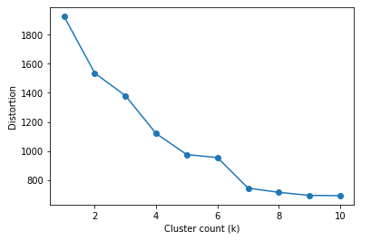
“The Elbow Method”
The “fit” of the clusters can be characterized by the “distortion”
Sum of squared distances (Euclidean distances) between each point and the cluster centroid
Let’s plot different values of k and find the sweet spot (elbow)!
distortions = []
max_k = 10
for i in range(1,max_k+1):
km = KMeans(n_clusters=i,
init='random',
n_init=1,
max_iter=300,
random_state=0)
km.fit(X)
# The distortion
distortions.append(km.inertia_)
plt.plot(range(1,max_k+1), distortions, marker='o')
Notes:
Here we can see that the cluster count has less and less benefit as we go from 6 to 8 to 10.

Slide 58
“The Elbow Method”
The “fit” of the clusters can be characterized by the “distortion”
Sum of squared distances (Euclidean distances) between each point and the cluster centroid
Let’s plot different values of k and find the sweet spot (elbow)!
distortions = []
max_k = 10
for i in range(1,max_k+1):
km = KMeans(n_clusters=i,
init='random',
n_init=1,
max_iter=300,
random_state=0)
km.fit(X)
# The distortion
distortions.append(km.inertia_)
plt.plot(range(1,max_k+1), distortions, marker='o')
Elbow

Slide 59
Summary: K-Means Clustering
One of the most scalable methods for clustering!
Each cluster is represented by a “prototype”
As we saw it in Euclidean space: a centroid
Alternatively: it could be a medoid (“k-mediods”), etc.
Some limitations:
Spherically shaped clusters
Sensitive to outliers
Many other clustering methods exist…

Slide 60
Wrap-up: Learning Unsupervised Models of Data
Two main aspects:
Dimensionality reduction – mapping to a lower-dimensional subspace
Principal Components Analysis
t-SNE
Finding natural clusters in the data
k-Means iterative algorithm

Slide 61
Wrap-up: Learning Unsupervised Models of Data
Two main ideas:
Dimensionality reduction – mapping to a lower-dimensional subspace
Principal Components Analysis
t-SNE
Finding natural clusters in the data
k-Means iterative algorithm

