Slide 1

Who Demands Comparability? Active vs. Passive Institutional Investors
Reginald Edwards
February 2018
Presented at The University of San Francisco School of Management

Slide 2
Research Question and Findings
What is the differential impact of financial statement comparability on active and passive investors?
“Active” investors prefer less comparability/passive prefer more
Cross-sectional evidence: OLS estimation in levels and changes
Accounting rule changes as quasi-natural experiments: difference-in-differences analyses
More managerial discretion leads to less comparability, which leads to relatively more active investment

Slide 3
Comparability as a Dimension of Accounting Quality
“The subject of comparability in financial reporting has received much attention in recent years. Yet there is not even a commonly understood meaning of the term.’”
-- Simmons (TAR, 1967)
``Relevance and reliability are the two primary qualities that make accounting information useful for decision making. Comparability is a secondary quality that interacts with relevance and reliability to contribute to the usefulness of information.’’
-- FASB Statement of Financial Accounting Concepts No. 2 (1980)
Notes:
Discuss definition of comparability
TODO: Add more. Clear and concise answer to “what do you mean by ‘comparability’?”
* Mapping of economic reality to accounting results

Slide 4

In-line with GAAP, they choose to estimate future demand for 787s and allocate costs accordingly
Unique among peers
Some investors may “see through” this
Some investors may avoid this

Slide 5
Measuring Accounting Comparability
For each firm-year, I extract the “Summary of Significant Accounting Policies” section from annual report
Compare text of industry peers using cosine similarity measure
More similar text yields higher comparability score, COMP
Compute COMP by comparing text of same firm in adjacent years for context

Slide 6
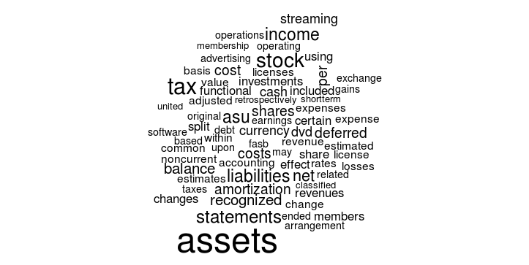
Summary of Significant Accounting Policies Section
Notes:
Discussion detaails of constructing cossim

Slide 7
Measuring Accounting Comparability
Cosine similarity
Documents as vectors of word counts
Text reuse/plagiarism detection
Document clustering
See Hoberg, Phillips, and Prabhala (2012) for a finance application
Apple Inc. and its wholly-owned subsidiaries (collectively “Apple” or the “Company”) design, manufacture, and market personal computers, mobile communication devices, and portable digital music and video players and sell a variety of related software, third-party digital content and applications, services, peripherals, and networking solutions.
(Apple 10-K, 2009)
Apple Inc. and its wholly-owned subsidiaries (collectively “Apple” or the “Company”) designs, manufactures, and markets mobile communication and media devices, personal computers, and portable digital music players, and sells a variety of related software, services, peripherals, networking solutions, and third-party digital content and applications.
(Apple 10-K, 2011)
Notes:
Give a short example with text snippets: highlight similar, dissimilar text.
Does the presence of boilerplate alter measurement?

Slide 8
Measuring Accounting Comparability
2009 and 2011 words
[apple, applications, collectively, communication, computers, content, design, devices, digital, manufacture, market, media, …]
2009 word vector:
(2, 1, 1, 1, 1, 1, 1, 1, 2, 1, 1, 0, …)
2011 word vector:
(2, 1, 1, 1, 1, 1, 1, 1, 2, 1, 1, 1, …)
Notes:
Show vector representation

Slide 9

Measuring Accounting Comparability
$${θ(D}_{1},D_{2})=arcos\left(\frac{D_{1}⋅D_{2}}{\left|\left|D_{1}\right|\right|×\left|\left|D_{2}\right|\right|}\right)$$
D₂₀₀₉ = (2, 1, 1, 1, 1, 1, 1, 1, 2, 1, 1, 0, …)
D₂₀₁₁ = (2, 1, 1, 1, 1, 1, 1, 1, 2, 1, 1, 1, …)
Notes:
Show vector representation

Slide 10
Measuring Accounting Comparability
Airbus
10
Boeing
2
Lockheed
10
COMP_{BOEING} = 10
COMP_{AIRBUS} = 6
COMP_{LOCKHEED} = 6
Notes:
To do.

Slide 11
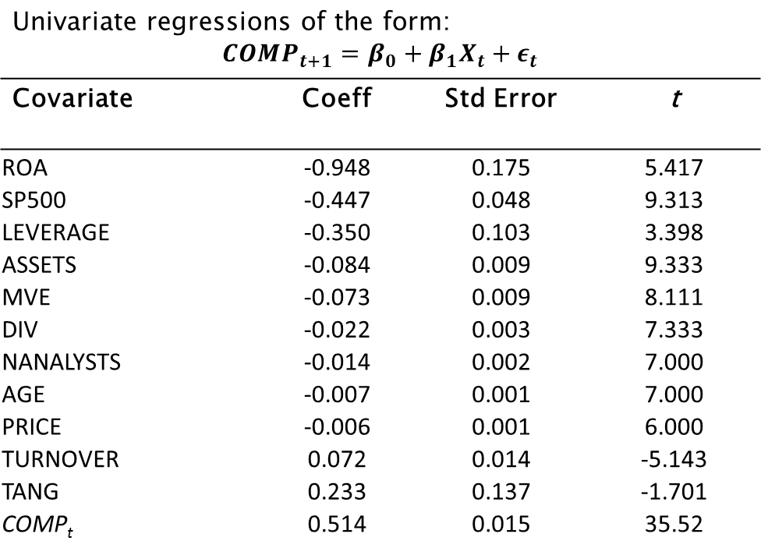
Measuring Accounting Comparability
Univariate regressions of the form: $$COMP_{t+1}=β_{0}+β_{1}X_{t}+ε_{t}$$
Covariate | Coeff | Std Error | t
ROA | -0.948 | 0.175 | 5.417
SP500 | -0.447 | 0.048 | 9.313
LEVERAGE | -0.350 | 0.103 | 3.398
ASSETS | -0.084 | 0.009 | 9.333
MVE | -0.073 | 0.009 | 8.111
DIV | -0.022 | 0.003 | 7.333
NANALYSTS | -0.014 | 0.002 | 7.000
AGE | -0.007 | 0.001 | 7.000
PRICE | -0.006 | 0.001 | 6.000
TURNOVER | 0.072 | 0.014 | -5.143
TANG | 0.233 | 0.137 | -1.701
COMP_{t} | 0.514 | 0.015 | 35.52

Slide 12
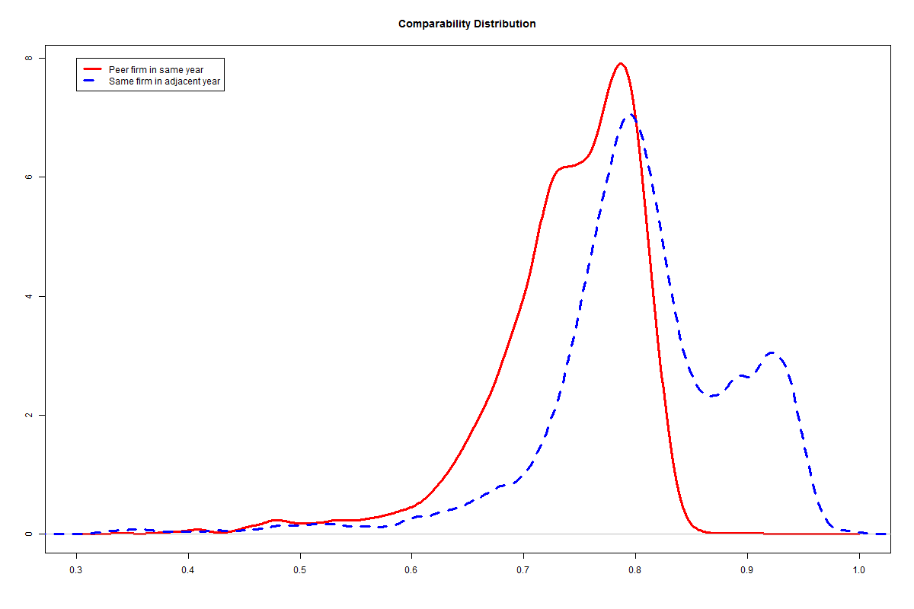
Measuring Accounting Comparability
 |  |  | Percentile
 | Mean | Std Dev | 1st | 5th | 25th | 50th | 75th | 95th | 99th
Peer firm comparability | 0.74 | 0.07 | 0.48 | 0.62 | 0.71 | 0.75 | 0.79 | 0.82 | 0.83
Own-firm comparability | 0.80 | 0.09 | 0.47 | 0.65 | 0.76 | 0.80 | 0.86 | 0.94 | 0.95

Slide 13
Information and Investor Preferences
Empirical Evidence is Mixed:
Brian Miller (TAR, 2010): Small investors trade less when 10-Ks are more complex (longer)
Mark Maffett (JAE, 2012): Weaker governance and disclosure laws lead to informed trading by institutions
Elliot, Rennekamp, and White (Rev. Acc. Stud., 2015): Investors prefer easier to understand (more concrete language) disclosures
Analytical Models:
A trader’s preference for information likely depends on precision of her private information (Merton, 1987; Kim and Verrecchia, 1994)
Notes:
Motivation: Brief review of lit around differential informational advantages.
Tension.

Slide 14
Active vs Passive Institutional Investor Ownership
Active institutional investors: investment companies and advisors, pensions, and endowments
Passive institutional investors: banks and insurance companies
Potential misclassification: small, but growing fraction of investment companies include passive funds [see Appel, Gormley, and Keim (JFE, 2016)]
Outcome variables:
PCT-ACTIVE: Proportion of active investor dollars over passive and active investor dollars
NUM-ACTIVE: Proportion of number of active investors over passive and active investors
Notes:
Define active and passive
Establish some empirical regularities
Are index funds in the sample?

Slide 15
Active-to-Passive Institutional Ownership Ratio and Comparability (Low minus High Deciles)

Slide 16
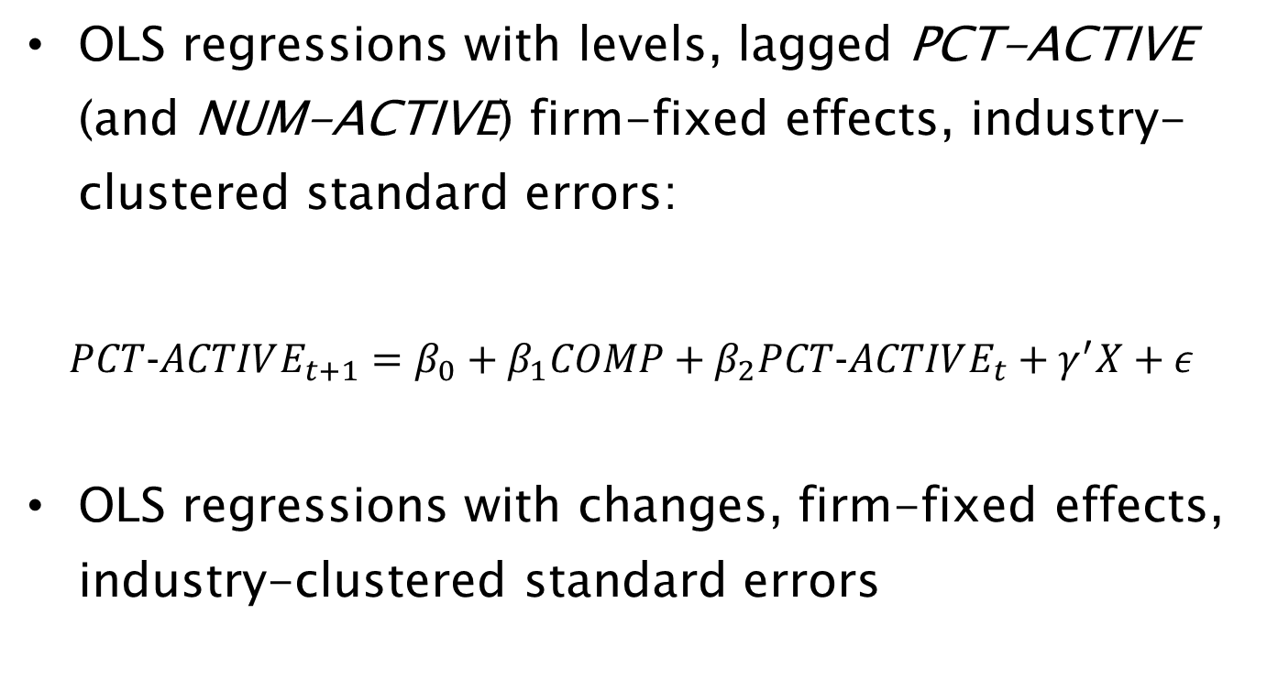
Empirical Design
OLS regressions with levels, lagged PCT-ACTIVE (and NUM-ACTIVE) firm-fixed effects, industry-clustered standard errors:
$$PCT−ACTIVE_{t+1}=β_{0}+β_{1}COMP+β_{2}PCT−ACTIVE_{t}+γ^{′}X+ε$$
OLS regressions with changes, firm-fixed effects, industry-clustered standard errors

Slide 17
Empirical Design
Data from Thomson Reuters Holdings, CRSP, Compustat, IBES
10-K’s retrieved from SEC EDGAR
Institutional investor classification scheme from Brian Bushee’s website
Control Variables:
ROA
Assets
Market cap
Age
Tobin’s Q
Leverage
Dividends
Analyst following
Average annual bid-ask spread
Average annual price
Buy-and-hold return
Forward PE
S&P 500 indicator
Asset tangibility
Average annual share turnover

Slide 18
OLS Results of Active-to-Passive Investment Ratio
 | PCT-ACTIVE_{t+1} |  | NUM-ACTIVE_{t+1}
 | (1) | (2) | (3) | (4)
PCT-ACTIVE | 0.7563 | 0.7806
NUM-ACTIVE |  |  | 0.9366 | 0.9015
COMP | -0.005 | -0.0073 | -0.012 | -0.007
Controls? | No | Yes | No | Yes
Fixed Effects? | Yes | Yes | Yes | Yes
R² | 54.59% | 56.07% | 61.85% | 64.60%
*p<0.1; **p<0.05; ***p<0.01

Slide 19
OLS Results of Change in Active-to-Passive Investment Ratio
 | ΔPCT-ACTIVE_{t+1} |  | ΔNUM-ACTIVE_{t+1}
 | (1) | (2) | (3) | (4)
ΔCOMP | -0.0018 | -0.0050 | -0.0030 | -0.0013
Controls? | No | Yes | No | Yes
Fixed Effects? | Yes | Yes | Yes | Yes
R² | 0.27% | 3.61% | 0.98% | 11.54%
*p<0.1; **p<0.05; ***p<0.01

Slide 20
Identification Strategy
Financial Statement Comparability
Active-to-passive institutional investment
Plausibly exog. shocks: SOP 97-2 and ASU 2009-13
COMPARABILITY
PCT-ACTIVE

Slide 21
Identification Strategy
Threats to causal identification
Reverse causality
Shocks plausibly exogenous to institutional ownership
Correlated omitted variable
DD falsification tests on competing explanations
Extensive control variables

Slide 22
Managerial Discretion, Comparability, and Ownership
Decreased managerial discretion
More comparable financial statements
Fewer active investors w.r.t. passive investors
Increased managerial discretion
Less comparable financial statements
More active investors w.r.t. passive investors
Notes:
Stress that the specific directions of causality are not important, just the channel itself. Investment = f(comparbility), where comparability = g(discretion). An incremental contribution of my paper is to provide evidence on the relation between managerial discretion and comparability.

Slide 23
Consequences of More Managerial Discretion
How does managerial discretion impact financial statements?
Bad: “Managers are opportunistic—they will game the system.”
Holthausen (JAE, 1990)
Watts and Zimmerman (TAR, 1990)
Good: “Managers know most--untie their hands”
Holthausen and Leftwich (JAE, 1983)
Healy and Palepu (Acc. Horizons, 1993)
Predictions for relevance, reliability, and comparability need not be aligned
Notes:
This is clearly an empirical question. And the answer will depend on the outcome under study and the setting.

Slide 24
Two Quasi-Natural Experiments
AICPA SOP 97-2
Intended to stop “aggressive” revenue recognition by software firms
Addressed firms bundling hardware, software, upgrades, and support
More verifiable and objective determination of selling price allocation
Prohibits managerial estimates of individual elements in multi-element arrangements
FASB ASU 2009-13

Slide 25
Two Quasi-Natural Experiments
AICPA SOP 97-2
FASB ASU 2009-13
Firms no longer need objective evidence of pricing for each element in multi-element arrangement
Managers can estimate what selling price would be in standalone transaction
Pushed for by some tech giants (but incidental to my outcome measures)

Slide 26
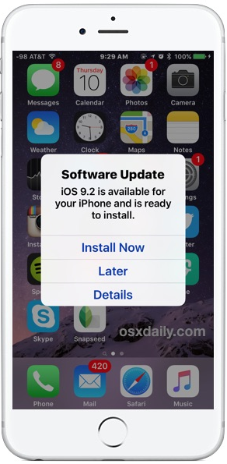


Multi-Element Arrangements
Hardware
Software and updates
Customer Service

Slide 27
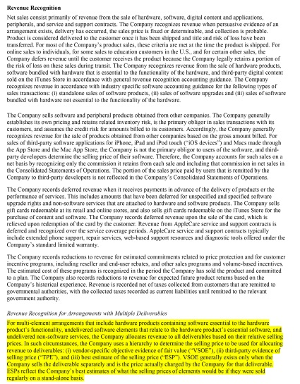
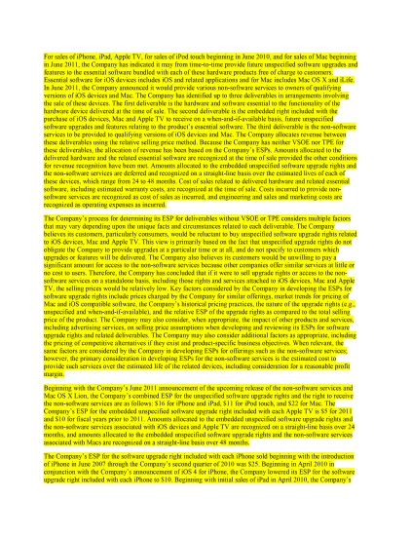
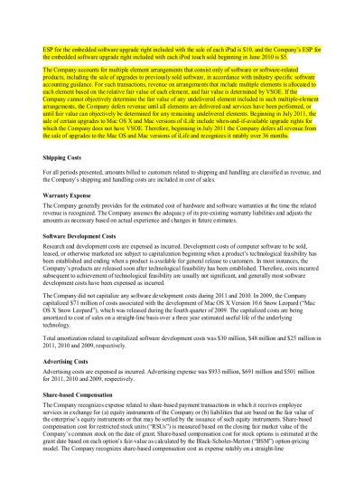
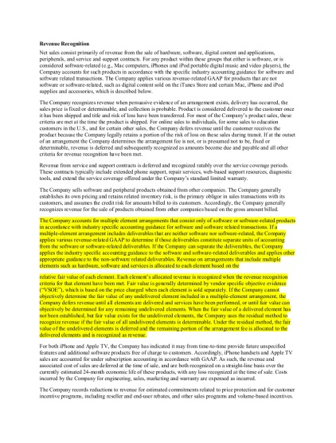
Apple, Inc. Revenue Recognition Disclosure: 2009 vs 2011
Apple, Inc. “Significant Accounting Policies – Revenue Recognition” section of 2011 10-K
Apple, Inc. “Significant Accounting Policies – Revenue Recognition” section of 2009 10-K
Text relevant to new revenue recognition under ASU 2009-13

Slide 28
Empirical Design
Difference-in-differences (DD) estimation
Treatment SOP 97-2 event
Pre-period is 1995-7, Post is 1998-2001
Treated industries (3-Digit SIC codes)
Household audio, video equipment, and audio receiving (365)
Communications equipment (366)
Electronic components and semiconductors (367)
Computer hardware (368)
Telephone communications (481)
Computer programming, software, and data processing (737)
Treatment firms for ASU 2009-13 event
Pre-period is 2008-9, Post is 2011-13

Slide 29
Difference-in-Differences Analyses
 | Mean treatment difference (post-pre) |  |  | Mean control difference (post-pre) | Mean DDs (treat-control)
SOP 97-2 Treatment Event
PCT-ACTIVE |  | 0.1158 | 0.0468 |  | -0.069
(standard error) |  | (0.00955) | (0.0048) |  | (0.0143)
NUM-ACTIVE |  | -0.1272 | -0.0775 |  | -0.0497
(standard error) |  | (0.0087) | (0.0044) |  | (0.013)
ASU 2009-13 Treatment Event
PCT-ACTIVE |  | -0.0759 | -0.0359 |  | 0.04
(standard error) |  | (0.0126) | (0.0063) |  | (0.0189)
NUM-ACTIVE |  | -0.0558 | -0.0058 |  | 0.05
(standard error) |  | (0.00555) | (0.0046) |  | (0.0065)

Slide 30
Alternative Explanation: Earnings Management
If earnings reliability of firms changes, investors ownership likely to change
Unclear if this would differentially affect active vs passive investors
Use incidence of just meeting or beating analyst earnings forecasts as proxy for earnings management
See Beatty et al (TAR, 2002); Ayers et al (TAR, 2006)
No strong evidence that earnings management increases around SOP 97-2/ASU 2009-13 (Consistent with Srivastava, 2014)

Slide 31
Alternative Explanation: Earnings Management
 | Mean treatment difference (post-pre) |  |  | Mean control difference (post-pre) | Mean DDs (treat-control)
SOP 97-2 Treatment Event
Pr(meet) |  | -0.0162 | 0.0019 |  | -0.0181
(standard error) |  | (0.0539) | (0.0047) |  | (0.103)
ASU 2009-13 Treatment Event
Pr(meet) |  | -0.0481 | -0.0131 |  | -0.035
(standard error) |  | (0.0095) | (0.0059) |  | (0.131)

Slide 32
Alternative Explanation: Voluntary Disclosure
In anticipation of changes to mandatory disclosure requirements, managers may change voluntary disclosure behavior
If managers increase voluntary disclosure before comparability is reduced, less likely to find results
Use incidence of earnings guidance as proxy
No strong evidence that this is the case

Slide 33
Alternative Explanation: Voluntary Disclosure
 | Mean treatment difference (post-pre) |  |  | Mean control difference (post-pre) | Mean DDs (treat-control)
SOP 97-2 Treatment Event
No. Forecasts |  | -1.6763 | -1.9278 |  | 0.2515
(standard error) |  | (0.1049) | (0.0671) |  | (0.1426)
ASU 2009-13 Treatment Event
No. Forecasts |  | -1.3133 | -1.2334 |  | -0.0799
(standard error) |  | (0.1873) | (0.1200) |  | (0.2545)

Slide 34
Conclusion
Compared to passive institutional investors, active investors prefer firms with less comparable financial statements
Evidence that more discretion leads to less comparable accounting
Accounting comparability or accounting complexity (e.g. length of “Significant Accounting Policies”)?
Separate but possibly related causes and consequences.
What about future performance?
Do actively managed funds generate alpha from investing in firms with lower comparability?

