Slide 1

Accounting Policy Similarity and
Active vs. Passive Institutional Investors
Reginald Edwards
March 2018
Dissertation Defense at the University of Michigan

Slide 2
Research Question and Findings
What is the differential impact of the textual similarity of accounting policy disclosures on active and passive investors?
“Active” investors prefer less similar/passive prefer more
Cross-sectional evidence: OLS estimation in levels and changes
Accounting rule changes as quasi-natural experiments: difference-in-differences analyses
  More managerial discretion leads to less similar accounting treatments, which leads to relatively more active investment

Slide 3
Theories of Information and Investor Preferences
Early models showed how and why information asymmetry among investors matters (i.e., influences asset prices, quantities, volatilities).
Silent on source of asymmetry.
  Grossman and Stiglitz (1980), “On the Impossibility of Informationally Efficient Markets”
  Hellwig (1980), “On the Aggregation of Information in Competitive Markets”
  Wang (1993), “A Model of Intertemporal Asset Prices Under Asymmetric Information.”
Notes:
Motivation: Brief review of lit around differential informational advantages.
Tension.

Slide 4
Theories of Information and Investor Preferences
Subsequent models link private information to actions/preferences
Admati (1985), “A Noisy Rational-Expectations Equilibrium for Multi-Asset Securities Markets.”
  Investors’ reaction to information depends on prior private information
Merton (1987), “A Simple Model of Capital-Market Equilibrium with Incomplete Information.” and Kim and Verrecchia (1994), “Market Liquidity and Volume Around Earnings Announcements.”
  A trader’s ex ante preferences for information likely depends on precision of her private information
Notes:
Motivation: Brief review of lit around differential informational advantages.
Tension.

Slide 5
Theories of Information and Investor Preferences
Easley and O’Hara (2004), “Information and the cost of capital”
  Explicates the source of information asymmetry
  Provides a role for accounting to create or alleviate information asymmetry
Notes:
Motivation: Brief review of lit around differential informational advantages.
Tension.

Slide 6
Information and Investor Preferences, Empirical Evidence
Brian Miller (TAR, 2010): Small investors trade less when 10-Ks are more complex (longer)
Mark Maffett (JAE, 2012): Weaker governance and disclosure laws lead to informed trading by institutions
Elliot, Rennekamp, and White (Rev. Acc. Stud., 2015): Investors prefer easier to more concrete language in disclosures
R. Edwards (Diss., 2018): relative to “passive” investors, “active” investors prefer firms with accounting treatments that are less similar to their peers
Notes:
Motivation: Brief review of lit around differential informational advantages.
Tension.

Slide 7
Information and Investor Preferences, Empirical Evidence
Brian Miller (TAR, 2010): Small investors trade less when 10-Ks are more complex (longer)
Mark Maffett (JAE, 2012): Weaker governance and disclosure laws lead to informed trading by institutions
Elliot, Rennekamp, and White (Rev. Acc. Stud., 2015): Investors prefer easier to more concrete language in disclosures
R. Edwards (Diss., 2018): relative to “passive” investors, “active” investors prefer firms with accounting treatments that are less similar to their peers
Notes:
Motivation: Brief review of lit around differential informational advantages.
Tension.

Slide 8
Sources of Accounting Information
Quarterly Financial Reports (10-Q’s)
Ad-hoc disclosures (e.g. 8-K’s)
Annual Reports (10-K’s)
  MD&A
  Footnotes to the Financial Statements
    “Summary of Significant Accounting Policies”
Notes:
Motivation: Brief review of lit around differential informational advantages.
Tension.

Slide 9
Active vs Passive Institutional Investor Ownership
Active institutional investors: investment companies and advisors, pensions, and endowments
Passive institutional investors: banks and insurance companies
Potential misclassification: small, but growing fraction of investment companies include passive funds [see Appel, Gormley, and Keim (JFE, 2016)]
Outcome variables:
  PCT-ACTIVE: Proportion of active investor dollars over passive and active investor dollars
  NUM-ACTIVE: Proportion of number of active investors over passive and active investors
Notes:
Define active and passive
Establish some empirical regularities
Are index funds in the sample?

Slide 10
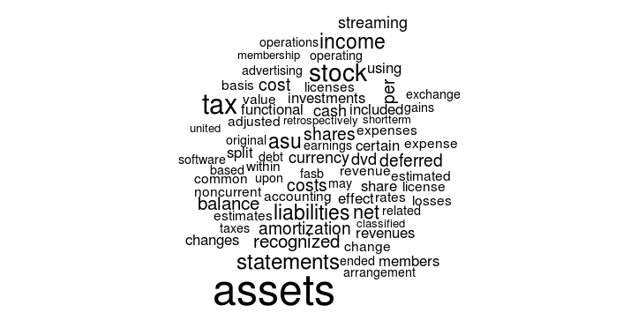
Summary of Significant Accounting Policies Section
Notes:
Discussion details of constructing sim. Replace with N-gram analysis

Slide 11
The Textual Similarity of Accounting Policy Disclosures
For each firm-year, I extract the “Summary of Significant Accounting Policies” section from annual report
Compare text of industry peers using cosine similarity measure
More similar text yields higher textual similarity score, SIM
Compute SIM by comparing text of same firm in adjacent years for context

Slide 12
Measuring Textual Similarity of Accounting Policy Disclosures
Cosine similarity
Documents as vectors of word counts
Text reuse/plagiarism detection
Document clustering
See Hoberg, Phillips, and Prabhala (2012) for a finance application
Apple Inc. and its wholly-owned subsidiaries (collectively “Apple” or the “Company”) design, manufacture, and market personal computers, mobile communication devices, and portable digital music and video players and sell a variety of related software, third-party digital content and applications, services, peripherals, and networking solutions.
(Apple 10-K, 2009)
Apple Inc. and its wholly-owned subsidiaries (collectively “Apple” or the “Company”) designs, manufactures, and markets mobile communication and media devices, personal computers, and portable digital music players, and sells a variety of related software, services, peripherals, networking solutions, and third-party digital content and applications.
(Apple 10-K, 2011)
Notes:
Give a short example with text snippets: highlight similar, dissimilar text.
Does the presence of boilerplate alter measurement?

Slide 13
Measuring Textual Similarity of Accounting Policy Disclosures
2009 and 2011 words
[apple, applications, collectively, communication, computers, content, design, devices, digital, manufacture, market, media, …]
2009 word vector:
(2, 1, 1, 1, 1, 1, 1, 1, 2, 1, 1, 0, …)
2011 word vector:
(2, 1, 1, 1, 1, 1, 1, 1, 2, 1, 1, 1, …)
Notes:
Show vector representation

Slide 14

Measuring Textual Similarity of Accounting Policy Disclosures
$${θ(D}_{1},D_{2})=arcos\left(\frac{D_{1}⋅D_{2}}{\left|\left|D_{1}\right|\right|×\left|\left|D_{2}\right|\right|}\right)$$
D₂₀₀₉ = (2, 1, 1, 1, 1, 1, 1, 1, 2, 1, 1, 0, …)
D₂₀₁₁ = (2, 1, 1, 1, 1, 1, 1, 1, 2, 1, 1, 1, …)
Notes:
Show vector representation

Slide 15
Measuring Textual Similarity
Airbus
10
Boeing
2
Lockheed
10
SIM_{BOEING} = 10
SIM_{AIRBUS} = 6
SIM_{LOCKHEED} = 6
Notes:
To do. Replace with an actual industry graph.

Slide 16
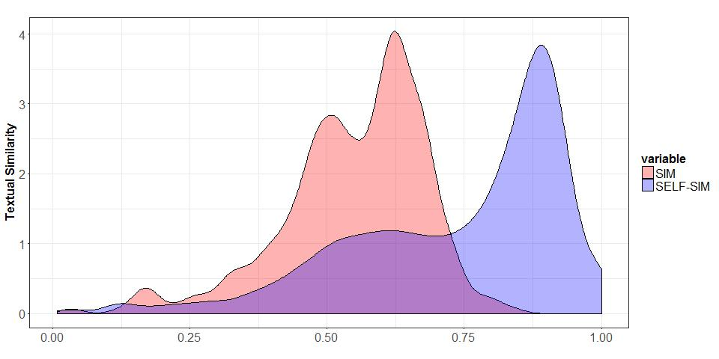
Properties of Textual Similarity of Accounting Policy Disclosures
 |  |  | Percentile
 | Mean | Std Dev | 1st | 5th | 25th | 50th | 75th | 95th | 99th
Peer firm similarity | 0.74 | 0.07 | 0.48 | 0.62 | 0.71 | 0.72 | 0.79 | 0.82 | 0.83
Own-firm similarity | 0.80 | 0.09 | 0.47 | 0.65 | 0.76 | 0.80 | 0.86 | 0.94 | 0.95
Notes:
Update

Slide 17
What is the information content of SIM?
Validation

Slide 18
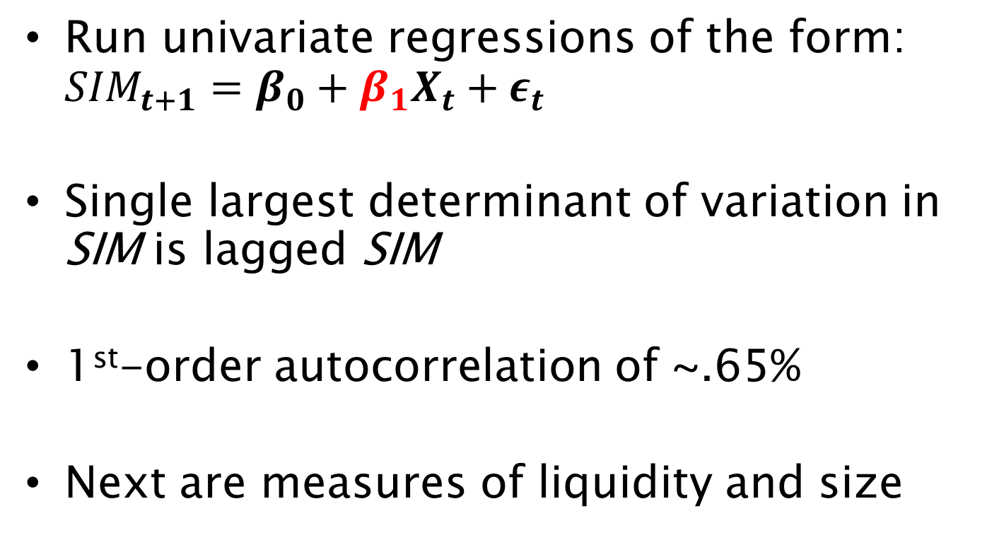
Textual Similarity of Accounting Policy Disclosures: Covariates
Run univariate regressions of the form: ${SIM}_{t+1}=β_{0}+β_{1}X_{t}+ε_{t}$
Single largest determinant of variation in SIM is lagged SIM
1st-order autocorrelation of ~.65%
Next are measures of liquidity and size

Slide 19
Textual Similarity of Accounting Policy Disclosures: Covariates
Multivariate regressions with controls
Increasing in…
  Size
  Liquidity
  buy-and-hold returns (past performance)
  firm age (firm life cycle)
Decreasing in…
  stock price and stock price to expected earnings (valuation)
  Tobin’s q (growth opportunities)
  ROA (growth)
  S&P 500 membership
  analyst following (information environment)

Slide 20
Textual Similarity of Accounting Policy Disclosures: Covariates
Multivariate regressions with controls
Increasing in…
  Size
  Liquidity
  buy-and-hold returns (past performance)
  firm age (firm life cycle)
Decreasing in…
  stock price and stock price to expected earnings (valuation)
  Tobin’s q (growth opportunities)
  ROA (growth)
  S&P 500 membership
  analyst following (information environment)

Slide 21
Textual Similarity of Accounting Policy Disclosures and Earnings
What is the predictive power of SIM for earnings measures?
ROA (contemporaneous net income scaled by assets)
Future ROA
Future negative earnings indicator
Future earnings decline indicator

Slide 22
Textual Similarity of Accounting Policy Disclosures and Earnings
What is the predictive power of SIM for earnings measures?
ROA (contemporaneous net income scaled by assets) ➔ YES (pos.)
Future ROA ➔ NOT REALLY
Future negative earnings indicator ➔ YES (neg.)
Future earnings decline indicator ➔ YES (neg.)

Slide 23
Textual Similarity of Accounting Policy Disclosures and Earnings
What is the predictive power of SIM for earnings measures?
ROA (contemporaneous net income scaled by assets) ➔ YES (pos.)
Future ROA ➔ NOT REALLY
Future negative earnings indicator ➔ YES (neg.)
Future earnings decline indicator ➔ YES (neg.)
 | ROA_{t} | ROA_{t+1} | NEARN | DEARN
SIM | 0.0047 | -0.0218 | -0.0400 | -0.0930
 | (0.0024) | (0.0146) | (0.0066) | (0.0076)

Slide 24
Is there an association between SIM and PCT-Active?
Empirical Design

Slide 25
Active-to-Passive Institutional Ownership Ratio and SIM (Low minus High Deciles)

Slide 26
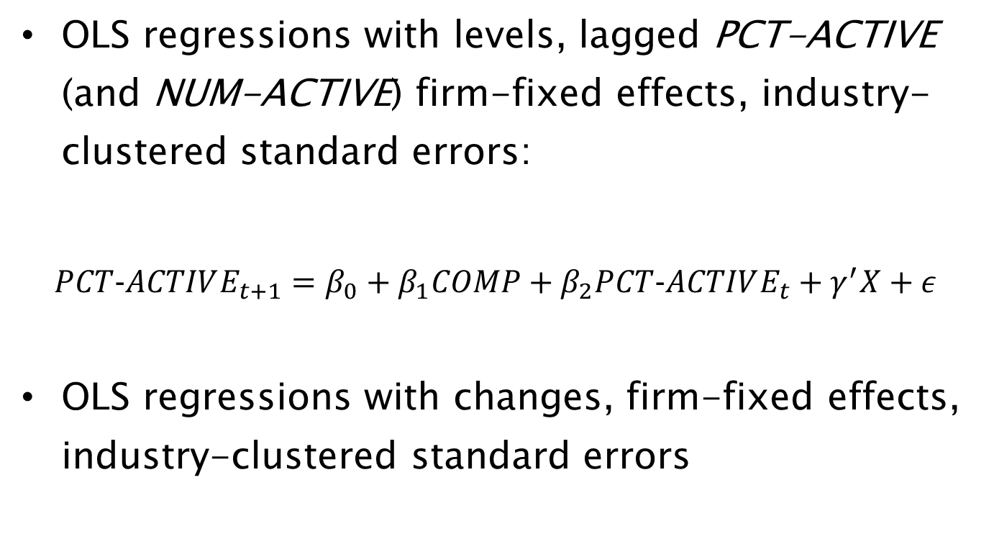
Model Specifications
OLS regressions with levels, lagged PCT-ACTIVE (and NUM-ACTIVE) firm-fixed effects, industry-clustered standard errors:
$$PCT−ACTIVE_{t+1}=β_{0}+β_{1}COMP+β_{2}PCT−ACTIVE_{t}+γ^{′}X+ε$$
OLS regressions with changes, firm-fixed effects, industry-clustered standard errors

Slide 27
Data Sources
Data from Thomson Reuters Holdings, CRSP, Compustat, IBES
10-K’s retrieved from SEC EDGAR
Institutional investor classification scheme from Brian Bushee’s website
Control Variables:
  ROA
  Assets
  Market cap
  Age
  Tobin’s Q
  Leverage
  Dividends
  Analyst following
  Average annual bid-ask spread
  Average annual price
  Buy-and-hold return
  Forward PE
  S&P 500 indicator
  Asset tangibility
  Average annual share turnover

Slide 28
OLS Results of Active-to-Passive Investment Ratio
 | PCT-ACTIVE_{t+1} |  | NUM-ACTIVE_{t+1}
 | (1) | (2) | (3) | (4)
PCT-ACTIVE | 0.7563 | 0.7806
NUM-ACTIVE |  |  | 0.9366 | 0.9015
SIM | -0.005*** | -0.0073*** | -0.012*** | -0.007***
Controls? | No | Yes | No | Yes
Fixed Effects? | Yes | Yes | Yes | Yes
R² | 54.59% | 56.07% | 61.85% | 64.60%
*p<0.1; **p<0.05; ***p<0.01

Slide 29
OLS Results of Change in Active-to-Passive Investment Ratio
 | ΔPCT-ACTIVE_{t+1} |  | ΔNUM-ACTIVE_{t+1}
 | (1) | (2) | (3) | (4)
ΔSIM | -0.0018*** | -0.0050*** | -0.0030*** | -0.0013**
Controls? | No | Yes | No | Yes
Fixed Effects? | Yes | Yes | Yes | Yes
R² | 0.27% | 3.61% | 0.98% | 11.54%
*p<0.1; **p<0.05; ***p<0.01

Slide 30
Is the association between SIM and PCT-Active causal?
Identification

Slide 31
Threats to Causal Interpretation
Reverse causality
  Shocks plausibly exogenous to institutional ownership
Correlated omitted variable
  DD falsification tests on competing explanations
  Extensive control variables

Slide 32
Identification Strategy
Accounting Treatment Similarity
Active-to-passive institutional investment
Plausibly exog. shocks: SOP 97-2 and ASU 2009-13
SIM
PCT-ACTIVE

Slide 33
Link Managerial Discretion, Accounting, and Ownership
Decreased managerial discretion
More similar accounting treatments
Fewer active investors w.r.t. passive investors
Increased managerial discretion
Less similar accounting treatments
More active investors w.r.t. passive investors

Slide 34
Consequences of More Managerial Discretion
How does managerial discretion impact financial statements?
Bad: “Managers are opportunistic—they will game the system.”
  Holthausen (JAE, 1990) “Accounting method choice: Opportunistic behavior, efficient contracting, and information perspectives”
  Watts and Zimmerman (TAR, 1990) “Positive Accounting Theory – A 10 Year Perspective”
Notes:
This is clearly an empirical question. And the answer will depend on the outcome under study and the setting.

Slide 35
Consequences of More Managerial Discretion
How does managerial discretion impact financial statements?
Good: “Managers know most--untie their hands”
  Holthausen and Leftwich (JAE, 1983), “The economic consequences of accounting choice implications of costly contracting and monitoring”
  Healy and Palepu (Acc. Horizons, 1993), “The Effect of Firms' Financial Disclosure Strategies on Stock Prices”
Notes:
This is clearly an empirical question. And the answer will depend on the outcome under study and the setting.

Slide 36
Two Quasi-Natural Experiments
Rule No. 1: American Institute of Certified Public Accountants Statement of Position 97-2
(SOP 97-2)
Rule No. 2: Financial Accounting Standards Board Accounting Standards Update 2009-13
(ASU 2009-13)

Slide 37
Two Quasi-Natural Experiments
Rule No. 1: AICPA SOP 97-2
  Intended to stop “aggressive” revenue recognition by software firms
  Addressed firms bundling hardware, software, upgrades, and support
  More verifiable and objective determination of selling price allocation
  Prohibits managerial estimates of individual elements in multi-element arrangements
Rule No. 2: FASB ASU 2009-13

Slide 38
Two Quasi-Natural Experiments
Rule No. 1: AICPA SOP 97-2
Rule No. 2: FASB ASU 2009-13
  Firms no longer need objective evidence of pricing for each element in multi-element arrangement
  Managers can estimate what selling price would be in standalone transaction
  Pushed for by some tech giants (but incidental to my outcome measures)

Slide 39
Difference-in-differences Estimation
Treatment SOP 97-2 event
  Pre-period is 1995-7, Post is 1998-2001
  Treated industries (3-Digit SIC codes)
    Household audio, video equipment, and audio receiving (365)
    Communications equipment (366)
    Electronic components and semiconductors (367)
    Computer hardware (368)
    Telephone communications (481)
    Computer programming, software, and data processing (737)

Slide 40
Difference-in-differences Estimation
Treatment firms for ASU 2009-13 event
  Pre-period is 2008-9
  Post-period is 2011-13

Slide 41
Do Treatment Events Affect Textual Similarity?
  Treatment SOP 97-2 event: increase in SIM by around 6.9% after SOP 97-2
  Treatment ASU 2009-13 event: a relative decrease in SIM by around 4.97%
Context: average value of textual similarity in sample is 36.4% and the effect of SOP 97-2 (ASU 2009-13) would be to move the median

Slide 42
Difference-in-Differences Analyses
 | Mean treatment difference (post-pre) |  |  | Mean control difference (post-pre) | Mean DDs (treat-control)
SOP 97-2 Treatment Event
SIM |  | 0.1158 | 0.0468 |  | 0.069
(standard error) |  | (0.00955) | (0.0048) |  | (0.0143)
ASU 2009-13 Treatment Event
SIM |  | -0.1272 | -0.0775 |  | -0.0497
(standard error) |  | (0.0126) | (0.0044) |  | (0.0130)

Slide 43
Does SIM Affect Institutional Investment?
  Treatment SOP 97-2 event:
    exogenous 6.9% increase in accounting similarity causes the share of active institutional investment to decrease by about -4%
  Treatment firms for ASU 2009-13 event:
    exogenous -4.97% decrease in accounting similarity causes the share of active institutional investment to increase by 1.88%

Slide 44
Difference-in-Differences Analyses
 | Mean treatment difference (post-pre) |  |  | Mean control difference (post-pre) | Mean DDs (treat-control)
SOP 97-2 Treatment Event
PCT-ACTIVE |  | -0.0759 | -0.0359 |  | -0.04
(standard error) |  | (0.00955) | (0.0063) |  | (0.0189)
NUM-ACTIVE |  | -0.0558 | -0.0058 |  | -0.05
(standard error) |  | (0.0087) | (0.0046) |  | (0.0065)
ASU 2009-13 Treatment Event
PCT-ACTIVE |  | 0.0277 | 0.0089 |  | 0.0188
(standard error) |  | (0.0042) | (0.0046) |  | (0.0043)
NUM-ACTIVE |  | 0.093 | 0.0035 |  | 0.0058
(standard error) |  | (0.0036) | (0.0032) |  | (0.0040)

Slide 45
Contributions
Compared to passive institutional investors, active investors prefer firms with less similar accounting treatments financial statements
Evidence that more discretion leads to less similar accounting treatments among otherwise similar firms
A textual analysis-based measure of similarity of accounting treatment that is predictive of investor behavior and firm performance

