Slide 1
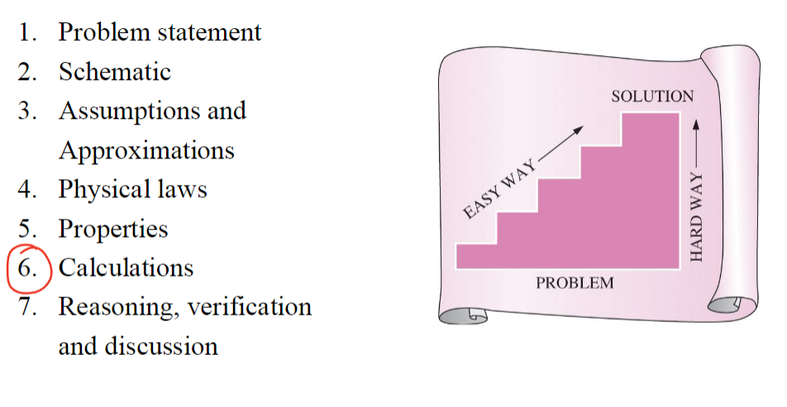
Course Info
Time: TR 8:00-9:15 AM
Location: CHEN 106
Teaching Assistants:
Reagan Kutter
Email: regankk@tamu.edu
Time: Friday 1:45-2:45 PM
Location: CHEN 540
Ashish Shyam Tangade
Email: ashish.tangade@tamu.edu
Time: Wednesday 4:00-5:00 PM
Location: CHEN 540
Instructor: Jeetain Mittal
Office: CHEN 500
Phone: (979) 862-1920
Email: Jeetain@tamu.edu
Office Hours:
Monday 2:00-3:00 PM
By appointment
Grading Info
Category | Date | Percentage
Participation/Quizzes | N/A | 5%
Homework | N/A | 10%
Midterm 1 | Sep 24th | 25%
Midterm 2 | Nov 7th | 25%
Final | Dec 6th 1:00-3:00 | 35%

Slide 2
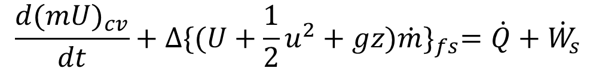






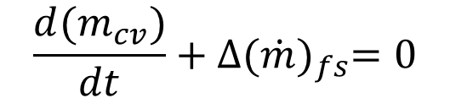
1st Law of Thermodynamics: Energy is conserved
Energy Balance on closed system
$$∆U^{t}=Q+W$$
$$dU^{t}=dQ+dW$$
$$W=−PdV$$
Enthalpy
$$H≡U+PV$$
$$dH=dU+PdV+VdP$$
$$dH=dQ+VdP$$
Energy Balance on open system
$$\frac{{d(m}_{cv})}{dt}+∆{(\dot{m})}_{fs}=0$$
$$\frac{{d(mU)}_{cv}}{dt}+∆{\{(U+\frac{1}{2}u^{2}+gz)\dot{m}\}}_{fs}=\dot{Q}+{\dot{W}}_{s}$$

Slide 3
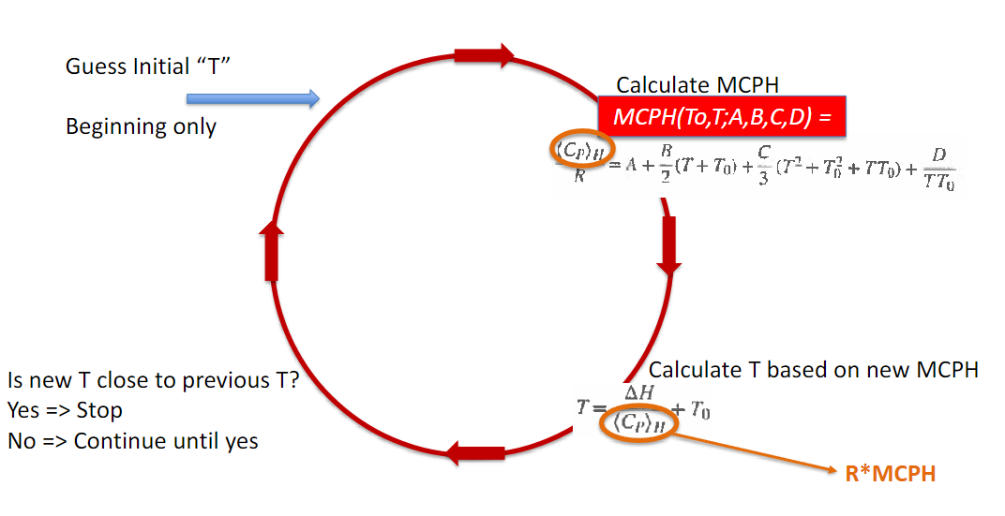
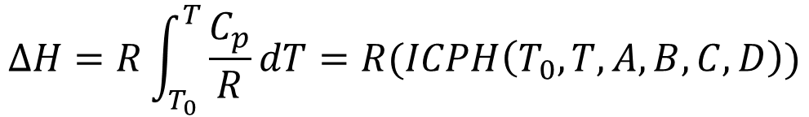

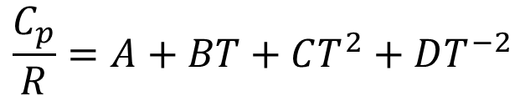
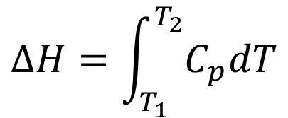
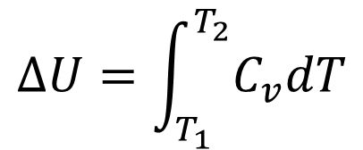
Constant Volume and constant Pressure heat capacity
$$∆U=\int_{T_{1}}^{T_{2}}{C_{v}dT}$$
$$∆H=\int_{T_{1}}^{T_{2}}{C_{p}dT}$$
Temperature Dependence on heat capacity
$$\frac{C_{p}}{R}=A+BT+CT^{2}+DT^{−2}$$
$$∆H=R\int_{T_{0}}^{T}{\frac{C_{p}}{R}dT}=R(ICPH\left(T_{0},T,A,B,C,D\right))$$
Finding Temperature through changes in enthalpy
$$ICPH\left(T_{0},T,A,B,C,D\right)=MCPH\left(T_{0},T,A,B,C,D\right)\left(T_{0}−T\right)=\frac{<C_{p}>}{R}(T_{0}−T)$$
$$∆H=<C_{p}>(T_{0}−T)$$

Slide 4
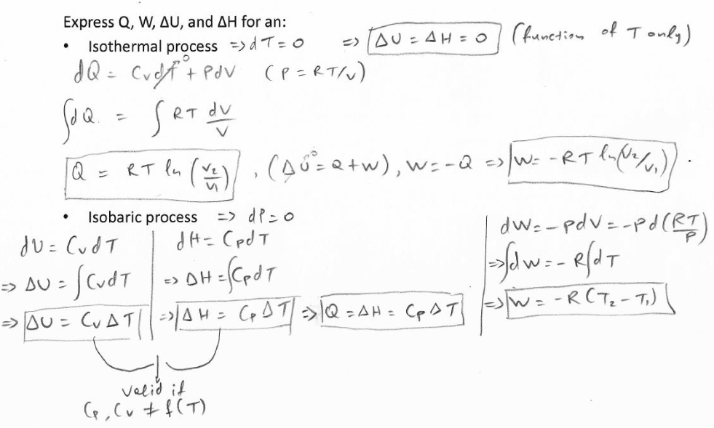
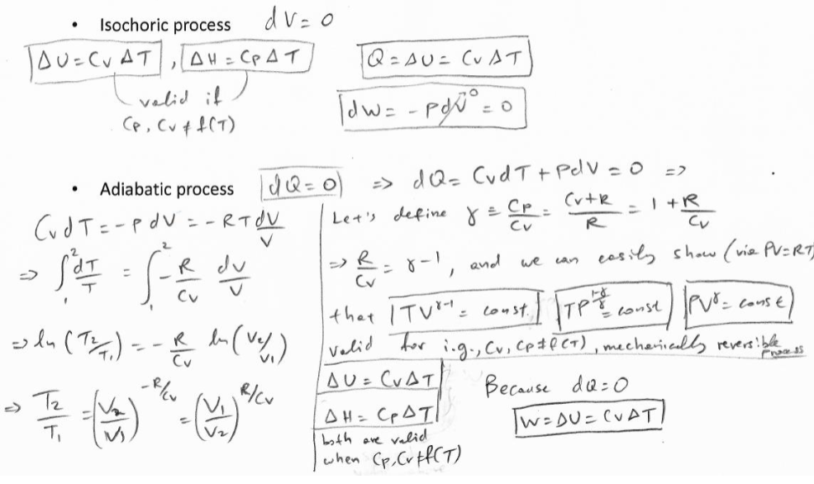


Equations of State
Gibbs’ Phase Rule
$$DoF=2−π+N$$
π = Number of phases, N = number of species
Ideal Gas Law
$$PV=RT$$
Finding Q, W, U, and H for reversible, closed systems

Slide 5
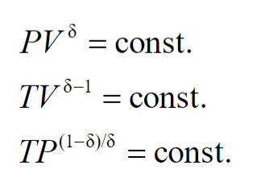

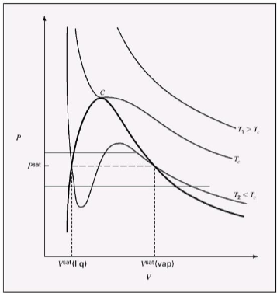
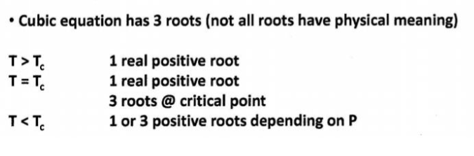
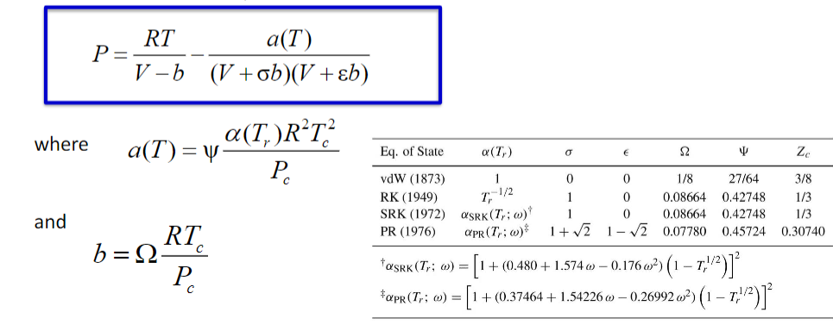
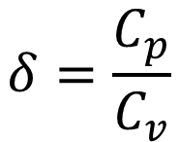
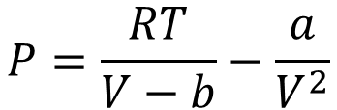
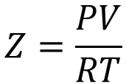
$$δ=\frac{C_{p}}{C_{v}}$$
Real Gasses
$$Z=\frac{PV}{RT}$$
Virial equation
Cubic Equations of state
Van der Waals Equation of state
$$P=\frac{RT}{V−b}−\frac{a}{V^{2}}$$

Slide 6
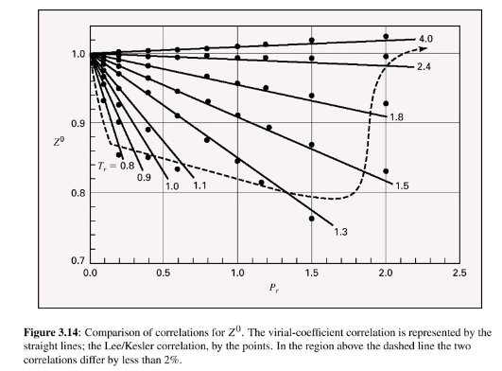
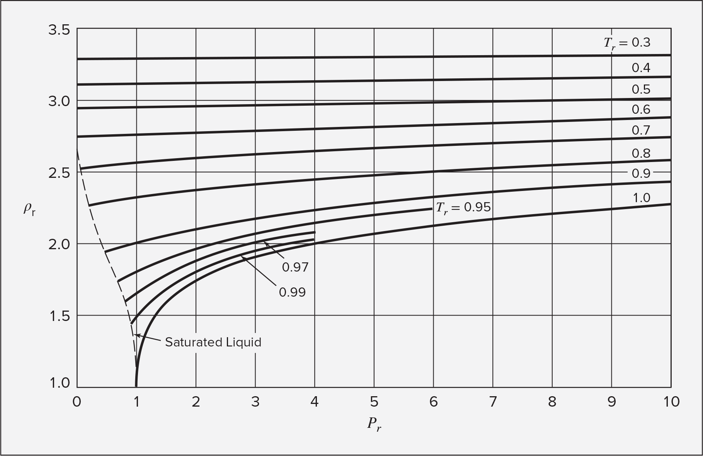

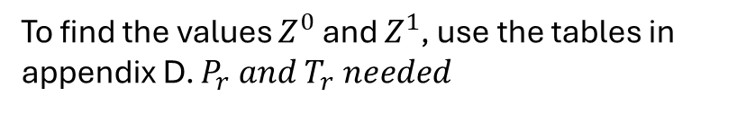




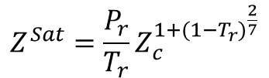



Pitzer Correlations
Compressibility Factor
Second virial coefficient
$$Z=Z^{0}+ωZ^{1}$$
To find the values $Z^{0}$ and $Z^{1}$, use the tables in appendix D. $P_{r} and T_{r} needed$
Note: Ideal gas law is acceptable to use if $Z^{0}$ is between 0.98 and 1.02 (2% error)
$$Z=1+ B^{0}\frac{P_{r}}{T_{r}}+ωB^{1}\frac{P_{r}}{T_{r}}$$
The Pitzer correlation for the second virial coefficient can only be used if inside the dotted line in on the figure below
$$B^{0}=0.083−\frac{0.422}{T_{r}^{1.6}}$$
$$B^{1}=0.139−\frac{0.172}{T_{r}^{4.2}}$$
Changes in states for liquids based on isothermal compressibility and volume expansivity:
$$\frac{dV}{V}=βdT−κdP$$
Generalized correlations for liquids
Rackett equation
Two parameter corresponding states
Use density with the chart to get other info
$$V^{Sat}=V_{c}Z_{c}^{{(1−T_{r})}^{\frac{2}{7}}}$$
Good For saturated liquids
$$Z^{Sat}=\frac{P_{r}}{T_{r}}Z_{c}^{1+{(1−T_{r})}^{\frac{2}{7}}}$$
$$ρ=\frac{1}{V}$$
$$ρ_{r}=\frac{ρ}{ρ_{c}}=\frac{V_{C}}{V}$$

Slide 7
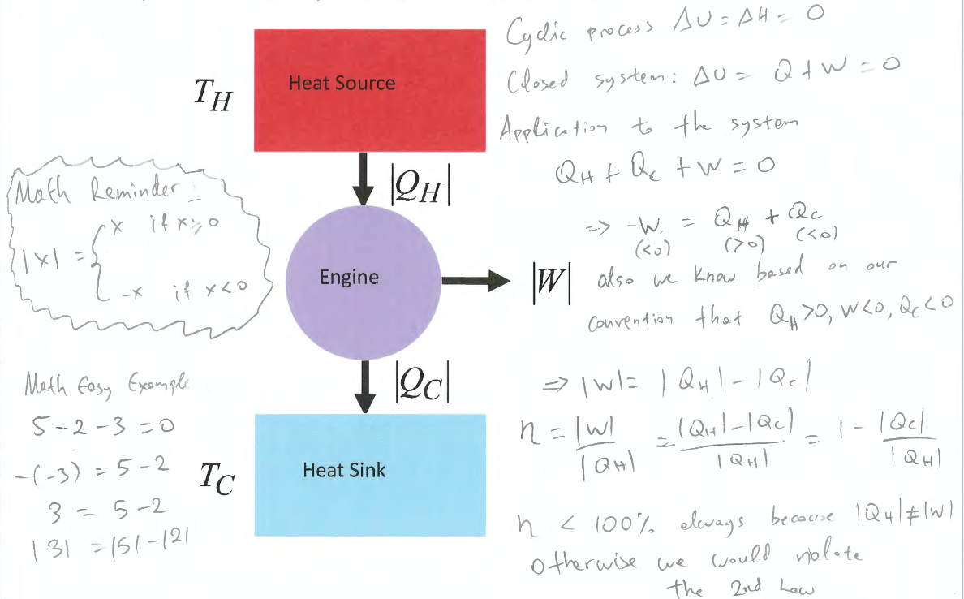

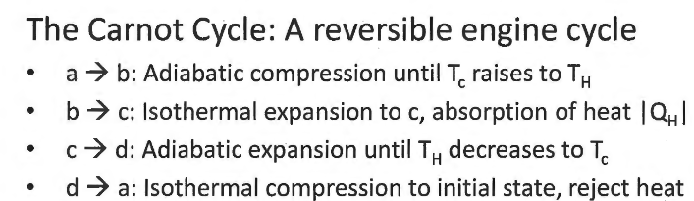
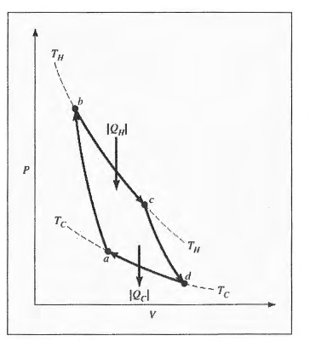

Entropy
2nd law: energy has different amounts of quality
EX: Work is more useful than heat

Slide 8



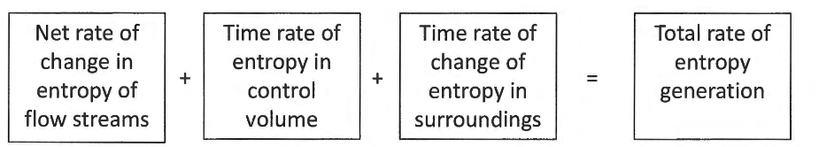




Changes in entropy of an ideal gas
Changes in entropy of an ideal gas in an open system
Chapter 6
Internal Energy
$$dU=TdS−PdV$$
Enthalpy
$$dH=TdS+VdP$$
Gibbs Free Energy
$$dG=VdP−SdT$$
Helmholtz Free Energy
$$dA=−PdV−SdT$$

Slide 9
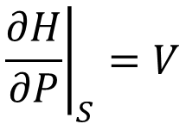
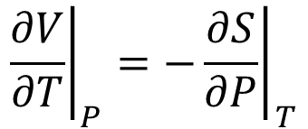
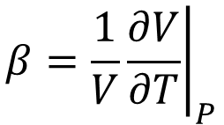
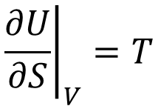
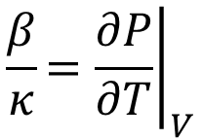
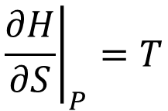
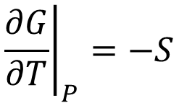
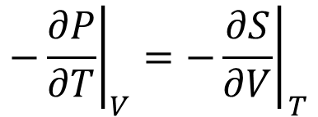
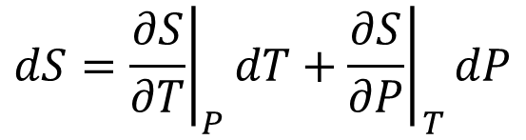

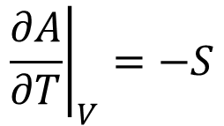
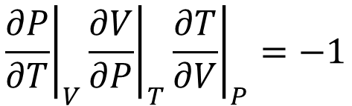

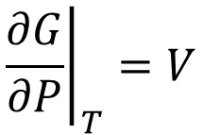
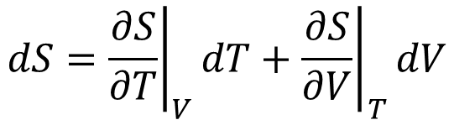
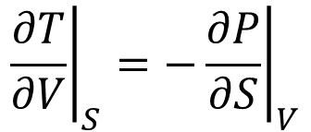
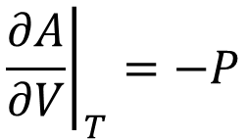
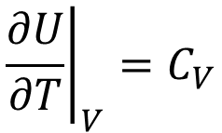

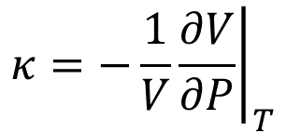
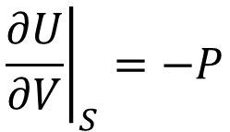
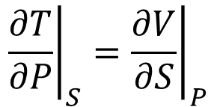

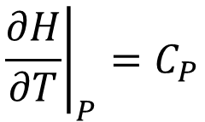
Maxwell’s Relations
Internal Energy
Enthalpy
$$dU=TdS−PdV$$
$$dH=TdS+VdP$$
$${\left.\frac{∂U}{∂S}\right|}_{V}=T$$
$${\left.\frac{∂U}{∂V}\right|}_{S}=−P$$
$${\left.\frac{∂H}{∂S}\right|}_{P}=T$$
$${\left.\frac{∂H}{∂P}\right|}_{S}=V$$
$${\left.\frac{∂T}{∂V}\right|}_{S}={\left.−\frac{∂P}{∂S}\right|}_{V}$$
$${\left.\frac{∂T}{∂P}\right|}_{S}={\left.\frac{∂V}{∂S}\right|}_{P}$$
Gibbs Free Energy
Helmholtz Free Energy
$$dG=VdP−SdT$$
$$dA=−PdV−SdT$$
$${\left.\frac{∂G}{∂P}\right|}_{T}=V$$
$${\left.\frac{∂G}{∂T}\right|}_{P}=−S$$
$${\left.\frac{∂A}{∂V}\right|}_{T}=−P$$
$${\left.\frac{∂A}{∂T}\right|}_{V}=−S$$
$${\left.\frac{∂V}{∂T}\right|}_{P}=−{\left.\frac{∂S}{∂P}\right|}_{T}$$
$${\left.−\frac{∂P}{∂T}\right|}_{V}=−{\left.\frac{∂S}{∂V}\right|}_{T}$$
Other Relations to keep in mind
$${\left.β=\frac{1}{V}\frac{∂V}{∂T}\right|}_{P}$$
$${\left.κ=−\frac{1}{V}\frac{∂V}{∂P}\right|}_{T}$$
$${\left.\frac{∂P}{∂T}\right|}_{V}{\left.\frac{∂V}{∂P}\right|}_{T}{\left.\frac{∂T}{∂V}\right|}_{P}=−1$$
$$\frac{β}{κ}{\left.=\frac{∂P}{∂T}\right|}_{V}$$
$${\left.\frac{∂H}{∂T}\right|}_{P}=C_{P}$$
$${\left.\frac{∂U}{∂T}\right|}_{V}=C_{V}$$
$$dS={\left.\frac{∂S}{∂T}\right|}_{V}dT+{\left.\frac{∂S}{∂V}\right|}_{T}dV$$
$$dS={\left.\frac{∂S}{∂T}\right|}_{P}dT+{\left.\frac{∂S}{∂P}\right|}_{T}dP$$

Slide 10
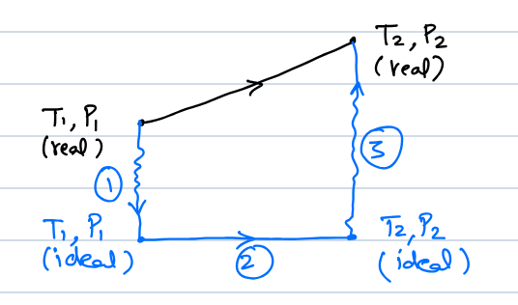
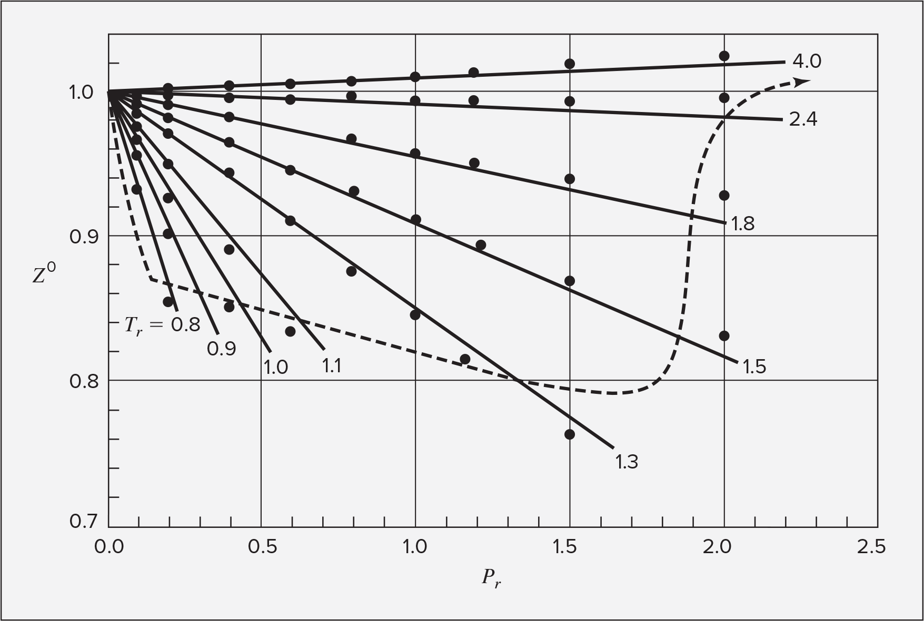
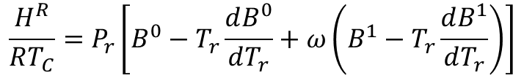
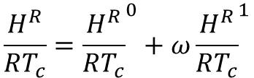



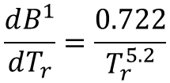



Residual Properties
$$M^{R}≡M−M^{i}$$
Residual = Actual - Ideal
Using Lee Kesler Tables
$$\frac{H^{R}}{RT_{c}}={\frac{H^{R}}{RT_{c}}}^{0}+ω{\frac{H^{R}}{RT_{c}}}^{1}$$
$$\frac{S^{R}}{R}={\frac{S^{R}}{R}}^{0}+ω{\frac{S^{R}}{R}}^{1}$$
Values can be found in appendix D
Using second virial generalized correlation
Note: this method can only be used if you are inside the line on the figure below
$$\frac{H^{R}}{RT_{C}}=P_{r}\left[B^{0}−T_{r}\frac{dB^{0}}{dT_{r}}+ω\left(B^{1}−T_{r}\frac{dB^{1}}{dT_{r}}\right)\right]$$
$$\frac{S^{R}}{RT_{C}}=P_{r}\left[\frac{dB^{0}}{dT_{r}}+ω\frac{dB^{1}}{dT_{r}}\right]$$
$$B^{0}=0.083−\frac{0.422}{T_{r}^{1.6}}$$
$$B^{1}=0.139−\frac{0.172}{T_{r}^{4.2}}$$
$$\frac{dB^{0}}{dT_{r}}=\frac{0.675}{T_{r}^{2.6}}$$
$$\frac{dB^{1}}{dT_{r}}=\frac{0.722}{T_{r}^{5.2}}$$

Slide 11








Introduction
Equilibrium
State of balance, no unbalanced driving forces
Thermal EQ: Uniform temperature
Mechanical EQ: Uniform pressure to no tendency for pressure to change locally
Phase EQ: Mass of each phase stays in the same quantity
Chemical EQ: No tendency for changes in chemical composition
Thermodynamic EQ: Equilibrium with respect to all possible changes in state
To be at equilibrium, the system must be
isolated (No exchange of energy, mass or
volume). Entropy must also be at a maximum.
Internal energy will be at a minimum
Process: any change that a system undergoes
from one state to another
Path: The series of states a system
goes through during the process
To fully describe a process, one must know the
initial and final states, as well as the path taken
New way to define internal energy:
$$dS^{t}=\frac{δQ_{rev}}{T}$$
$$dU^{t}=δQ+δW$$
$δ$ <- inexact differential
(used for path functions)
$$dU^{t}=TdS^{t}−PdV^{t}$$
From Themo I
New Term associated with chemical potential
$$dU^{t}=TdS^{t}−PdV^{t}+μdn$$
$$d(nU)=Td(nS)−Pd(nV)+μdn$$
If n=1
$$dU=TdS−PdV+μdn$$
The fundamental equation

Slide 12

















$${\left.\frac{∂U}{∂S}\right|}_{V, n}=T$$
$${\left.\frac{∂U}{∂V}\right|}_{S,n}=−P$$
$${\left.\frac{∂U}{∂n}\right|}_{S,V}=μ$$
$$dU={\left.\frac{∂U}{∂S}\right|}_{V, n}dS+{\left.\frac{∂U}{∂V}\right|}_{S,n}dV+{\left.\frac{∂U}{∂n}\right|}_{S,V}dn$$
U(S, V, n)
Expressing thermodynamic properties in terms of different variables
Internal Energy
Enthalpy
$$U\left(S, V, n\right)$$
$$H\left(S, P, n\right)=U+PV$$
$$dU=TdS−PdV+μdn$$
$$dH=TdS+VdP+μdn$$
Entropy
$$S(U,V,n)$$
$$dS=\frac{1}{T}dU+\frac{P}{T}dV−\frac{μ}{T}dn$$
Helmholtz Free Energy
Gibbs Free Energy
$$A\left(T, V, n\right)=U−TS$$
$$G\left(T, P, n\right)=U−TS+PV=H−TS$$
$$dA=−SdT−PdV+μdn$$
$$dG=−SdT+VdP+μdn$$
Helmholtz and Gibbs are the most useful, because they are expressed in easily found values
All the energies are at a minimum at equilibrium, and entropy is at a maximum
$$d(nG)=−(nS)dT+(nV)dP+\sum_{i}{μ_{i}dn_{i}}$$
Why didn’t we need the chemical equilibrium term before now?
Before this we were dealing with single phase closed PVT systems, so $\sum_{i}{μ_{i}dn_{i}}=0$
For a system in which there are two phases and N number of species, $\sum_{i}{μ_{i}dn_{i}}=0$ can be applied separately to each phase
Combining them,

Slide 13



This means that
Since the changes in one phase are equal but opposite to the other phase
The differentials are independent and arbitrary, so the only way this equation is satisfied is if:
= 0
So, at equilibrium, the chemical potential for each phase of a species is equal

Slide 14









Chapter 10 & 11: Solution Thermodynamics
10 is composed of a bunch of math, while 11 is applying it. Here we are combining them to hopefully make it easier
Mass/mole fractions
Molar concentration
How do we use pure component properties to predict mixture properties?
You can’t simply get properties of mixtures by adding the pure property components together
Intensive form for the difference between the actual volume and predicted volume
$$∆V_{mix}=V_{mix}−(x_{1}V_{1}+x_{2}V_{2})$$
$∆V_{mix}=0$: ideal solution, $∆V_{mix}<0$: contraction, $∆V_{mix}>0$: expansion
In general,
$$∆M_{mix}=M−\sum_{i}{x_{i}M_{i}}$$
Where M is V, S, U, H, A, or G
If we define $∆M_{mix}$ as $M^{E}$ and $\sum_{i}{x_{i}M_{i}}$ as $M^{id}$, we get
$$M^{E}=M−M^{id}$$
$M^{E}$is the excess property
For entropy we need to add another term
This is because adding 2 of the same species together will increase the entropy
This applies to functions with entropy as well,
$$S^{E}=S−\sum_{i}{x_{i}S_{i}}+R\sum_{i}{x_{i}\ln{x_{i}}}$$
$$G^{E}=G−\sum_{i}{x_{i}G_{i}}−RT\sum_{i}{x_{i}\ln{x_{i}}}$$

Slide 15









Mathematical framework for solving for solutions
Partial Properties: Represent the actual change from the expected property when in a mixture
Quantities of other substances
How the actual property changes with respect to the amount of it in the mixture with everything else held constant
These can be hard to represent, because The relationship can change in different ways depending on other factors.
Representing a change in a property based on the changes of its dependent variables (using a two-substance mixture for simplicity)
$$d\left(nM\right)={\left.\frac{∂(nM)}{∂T}\right|}_{P, n_{1},n_{2}}dT+{\left.\frac{∂(nM)}{∂P}\right|}_{T, n_{1},n_{2}}dP+{\left.\frac{∂(nM)}{∂n_{1}}\right|}_{T,P,n_{2}}dn_{1}+{\left.\frac{∂(nM)}{dn_{2}}\right|}_{T,P, n_{1}}dn_{2}$$
Can be represented as partials
$$d\left(nM\right)=ndM+Mdn$$
$$dn_{2}=d\left(nx_{2}\right)=ndx_{2}+x_{2}dn$$
$$dn_{1}=d\left(nx_{1}\right)=ndx_{1}+x_{1}dn$$
Combining all these equations ans inserting partials…
$$ndM+Mdn={\left.\frac{∂(nM)}{∂T}\right|}_{P, n_{1},n_{2}}dT+{\left.\frac{∂(nM)}{∂P}\right|}_{T, n_{1},n_{2}}dP+n\overline{M_{1}}dx_{1}+x_{1}\overline{M_{1}}dn+n\overline{M_{2}}dx_{2}+x_{2}\overline{M_{2}}dn$$
Consolidating terms into $n$ and $dn$ camps
$$\left[dM−{\left.\frac{∂M}{∂T}\right|}_{P, n_{1},n_{2}}dT−{\left.\frac{∂M}{∂P}\right|}_{T, n_{1},n_{2}}dP−\overline{M_{1}}dx_{1}−\overline{M_{2}}dx_{2}\right]n+\left[M−x_{1}\overline{M_{1}}−x_{2}\overline{M_{2}}\right]dn=0$$
Since $n$ and $dn$ don’t rely on each other…
$$M=x_{1}\overline{M_{1}}+x_{2}\overline{M_{2}}$$
$$M=\sum_{i}{x_{i}{\overline{M}}_{i}}$$
Summability

Slide 16















Also, from the consolidated function:
$$dM={\left.\frac{∂M}{∂T}\right|}_{P, n_{1},n_{2}}dT+{\left.\frac{∂M}{∂P}\right|}_{T, n_{1},n_{2}}dP+\overline{M_{1}}dx_{1}+\overline{M_{2}}dx_{2}$$
By taking the derivative of
$$M=x_{1}\overline{M_{1}}+x_{2}\overline{M_{2}}$$
$$dM={\overline{M}}_{1}dx_{1}+x_{1}d{\overline{M}}_{1}+{\overline{M}}_{2}dx_{2}+x_{2}d{\overline{M}}_{2}$$
By setting them equal
$$x_{1}d{\overline{M}}_{1}+x_{2}d{\overline{M}}_{2}={\left.\frac{∂M}{∂T}\right|}_{P, n_{1},n_{2}}dT+{\left.\frac{∂M}{∂P}\right|}_{T, n_{1},n_{2}}dP$$
Gibbs-Duhem Equation for a mixture
If T and P are constant…
You can use this as a consistency check for set of partial molar equations
$x_{1}d{\overline{M}}_{1}+x_{2}d{\overline{M}}_{2}=$0
$$\sum_{i}{x_{i}d{\overline{M}}_{i}}=0$$
This shows that partial molar properties don’t vary independently. Analogous to the constraint on mole fractions, where changes in one cause changes in another, because they can’t all sum to one. Similarly, the mole-fraction weighted sum of the partial properties must yield the overall solution property, and this constrains variation in partial molar properties with composition.
Partial properties are inherently arbitrary, because they assign part of a mixture to one species, even though in the mixture the species are intermingled. Though, since how partial properties are defined make them have all the characteristics as the individual species, this is ok
Getting ${\overline{M}}_{i}$
$$M=x_{1}\overline{M_{1}}+x_{2}\overline{M_{2}}$$
$x_{1}d{\overline{M}}_{1}+x_{2}d{\overline{M}}_{2}=$0
$$dM={\overline{M}}_{1}dx_{1}+{\overline{M}}_{2}dx_{2}$$
$$x_{1}+x_{2}=1$$
$$dx_{1}=−dx_{x}$$
Additionally, these equations, which are derivatives of the Gibbs-Duhem equation can be found
$$dM=\left({\overline{M}}_{1}−{\overline{M}}_{2}\right)dx_{1}$$
$$\frac{dM}{dx_{1}}={\overline{M}}_{1}−{\overline{M}}_{2}$$

Slide 17




Some representations of how to find ${\overline{M}}_{i}$ given a graph.
Where the slope intercepts the boundaries on each side are the values for the partials
The pure species property Mi and the Partial Mi in infinitesimally small fractions can be found by graphing M and finding where the slope intercepts 0 and 1 on the x1 axis at that specific value of x1

Slide 18




Example 10.3

Slide 19









Relations among partial Properties
We can use Maxwell’s relations to create some connections
Just like we did in chapter 6 by selecting T and P, we can select T or P and n
This gives us relations of partial Gibbs free energy and other partial properties
And for Gibbs free energy with changes of T and P…
Ideal Gas Mixture model
Equals 1, because you are holding other mole quantities constant, so changes in the total moles equal changes in the wanted moles
Partial Pressure
For Simplicity, when dealing with fractions, x is used with liquids and y is used with gases

Slide 20










Gibbs Theorem
So, for internal energy and enthalpy, which don’t change with pressure:
This means for enthalpy and internal energy, the partial property equals the pure state property
For entropy and Gibbs free energy, they do change with pressure
Changes in entropy in the ideal gas state
They can be simplified to this because we are considering changes in pressure
Integrating from the partial pressure to P gives us this:
By using Gibbs theorem with Gibbs free energy, we get this
(T and P removed for readability)
And by substituting the pure ideal gas properties in…
And all these equations can be applied to the summability

Slide 21







And to make these equations useful, we want to find the change in these properties
Value of the property in the mixture of gas
Sum of the values in their pure state
For properties that don’t depend on temperature, that change through mixing is zero
Remember to do final minus initial! The cases above are for when you are combining two gases.
Hint: When combining gases, the entropy goes up and vise versa
An example problem would ask for the change in entropy by mixing or separating. They could also ask you for the ideal work
Surrounding Temperature
Gibbs Free Energy for an Ideal Gas mixture
First, lets start with the differential form of Gibbs free energy
Integrating it, we get this. The first term is the integration constant
Using Gibbs Theorem (Which states a partial molar property in its ideal-gas-state is equal to the corresponding property in its ideal-gas-state but at a pressure equal to its partial pressure)
With summability,
The issue with this though, is that as the molar value of I gets small, the natural log gets very small, and this causes issues

Slide 22






Fugacity
Why Fugacity? – it’s better than chemical potential, which goes to negative infinity as the molar fraction goes to zero
Meaning – In Latin, it means tendency to flee/escape (from phase to phase)
In equilibrium, fugacity of all components is the same, so that can be used to find concentrations of species
So, when there is a mismatch in fugacity, there is a driving force on the system chemically
The higher the fugacity, the higher the potential to flee (change composition)
So how do we find it?
As we can see, fugacity takes the place of pressure in this situation, and it also has units of pressure as well
By subtracting the equation on the left from the one on the right, we get the residual Gibbs free energy:
Remember what G(residual)/RT is from thermo 1?
Fugacity coefficient (Dimensionless)
So, this is how we are going to find fugacity
One way to find this would be with analytical integration through using charts like steam tables, but that’s long and not worth our time
A way to back door this situation without doing that would be to use conditions like ideal conditions (low pressure)
We are going to use the definition of residual Gibbs free energy to find fugacity
“Residual Gibbs free energy”
G star is Gibbs free energy at a low-pressure state
Much easier to find fugacity this way through numerical integration!
Also, could probably find the fugacity through Pitzer correlations, but I’ll have to get back on that one
Remember to keep the temp the same, this relation is only valid at constant temperature

Slide 23



Notice that near ideal conditions, residual Gibbs free energy is zero, fugacity is close to the pressure, and the fugacity coefficient is 1
Fugacity in vapor liquid equilibrium
Because the saturated system is at the same temperature and pressure, delta G is zero, and the fugacity must be the same

