Slide 1
Course Info
Time: TR 11:10-12:25 AM
M 3:00-3:50 PM
Location: CHEN 106
Instructor: Dr. Martin Sentmanat
Office: CHEN 248
Phone: (979) 862-7687
Email: martin.sentmant@tamu.edu
Office Hours
M 10:00-11:00 AM
W 1:00-3:00 PM
Category | Date | Percentage
Homework | N/A | 10%
Daily Quizzes | N/A | 10%
Midterm 1 | Sep 27th | 25%
Midterm 2 | Nov 13th | 25%
Final | Dec 6th 8:00-10:00 | 30%

Slide 2
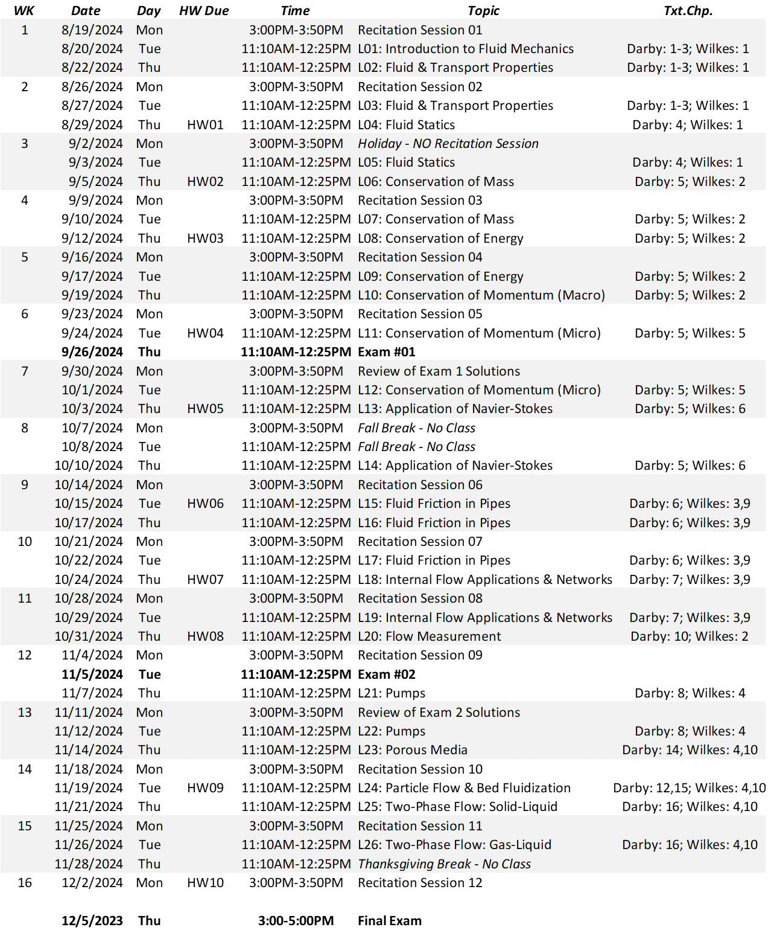

Slide 3
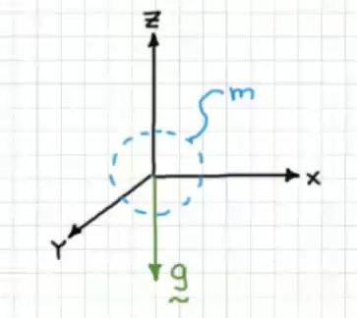



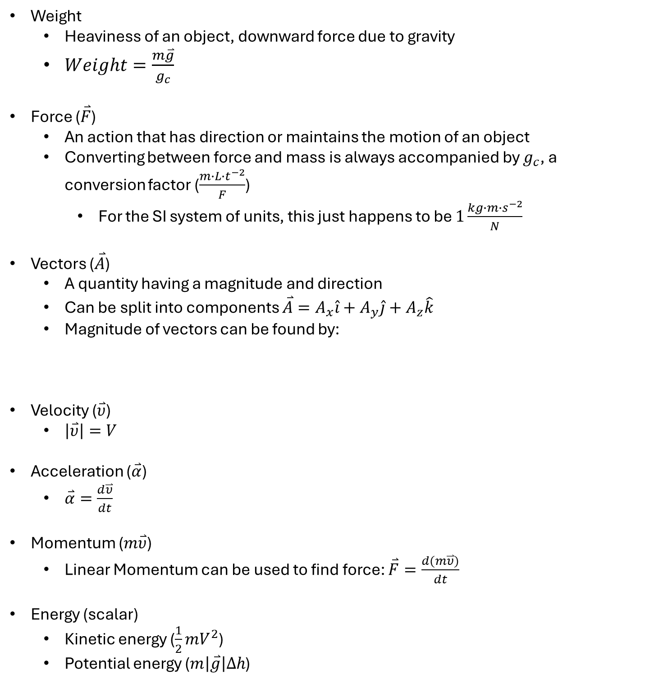
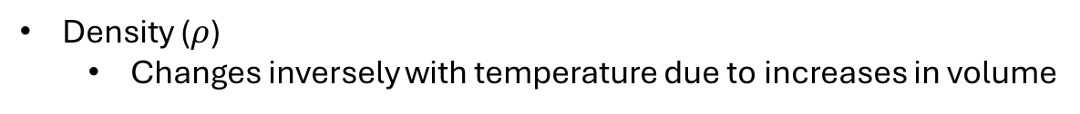
Review
Mass (m) and mass flow ($\frac{∂m}{∂t}=\dot{m}$)
Volume and volumetric flow ($\frac{∂volume}{∂t}=Q$)
In this course, Q is volumetric flow, not heat
Density ($ρ$)
Changes inversely with temperature due to increases in volume
Weight
Heaviness of an object, downward force due to gravity
$Weight=\frac{m\overset{⃑}{g}}{g_{c}}$
Force ($\overset{⃑}{F}$)
An action that has direction or maintains the motion of an object
Converting between force and mass is always accompanied by $g_{c}$, a conversion factor ($\frac{m∙L{∙t}^{−2}}{F}$)
For the SI system of units, this just happens to be $1\frac{kg∙m∙s^{−2}}{N}$
Vectors ($\overset{⃑}{A}$)
A quantity having a magnitude and direction
Can be split into components $\overset{⃑}{A}=A_{x}\hat{i}+A_{y}\hat{j}+A_{z}\hat{k}$
Magnitude of vectors can be found by:
Velocity ($\overset{⃑}{υ}$)
$\left|\overset{⃑}{υ}\right|=V$
Acceleration ($\overset{⃑}{α}$)
$\overset{⃑}{α}=\frac{d\overset{⃑}{υ}}{dt}$
Momentum ($m\overset{⃑}{υ}$)
Linear Momentum can be used to find force: $\overset{⃑}{F}=\frac{d(m\overset{⃑}{υ})}{dt}$
Energy (scalar)
Kinetic energy ($\frac{1}{2}mV^{2}$)
Potential energy ($m\left|\overset{⃑}{g}\right|Δh$)
$$\left|A\right|=\sqrt{A_{x}^{2}+A_{y}^{2}+A_{z}^{2}}$$

Slide 4
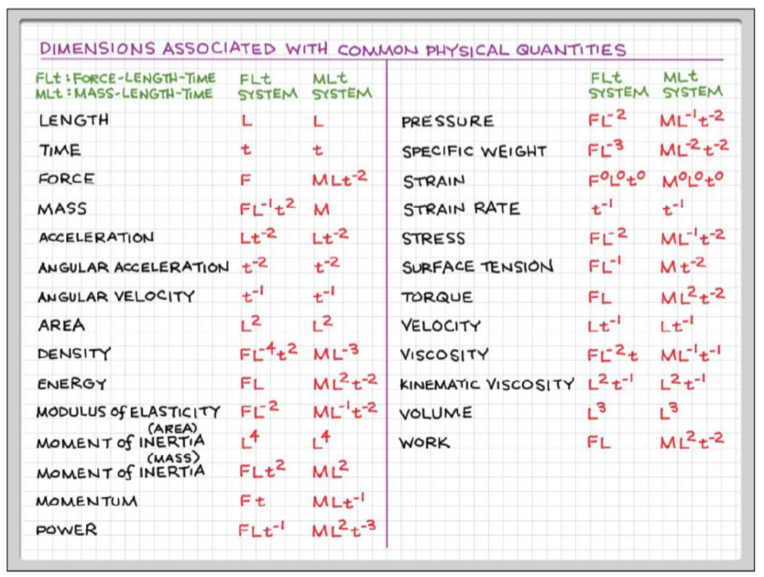
Introduction
What is a fluid?
You can classify something as a fluid or non-fluid based on how it reacts to a shear force (A force acting parallel to the surface)
Non-fluids can resist shear forces (solids)
Fluids deform under a shear force (liquids and gases)
States of Matter
Solids: have a lattice structure that holds them together, making them not deform
Liquids: held together by weaker forces, the forces are dependent on the separation distance of the molecules
Gases: spread far apart and have very weak interactions
Molecules collide with each other
Will not tend to fall when “poured” out of a cup
Modulus of elasticity tells how stiff something is
Kinematic viscosity is viscosity normalized by density (viscosity/density)

Slide 5
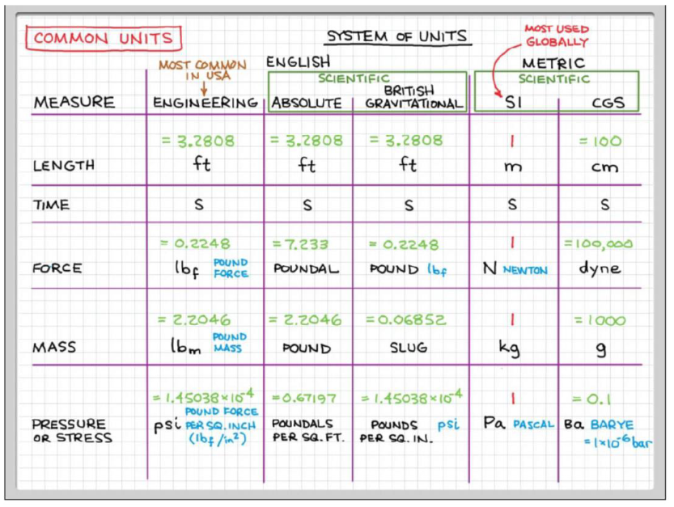
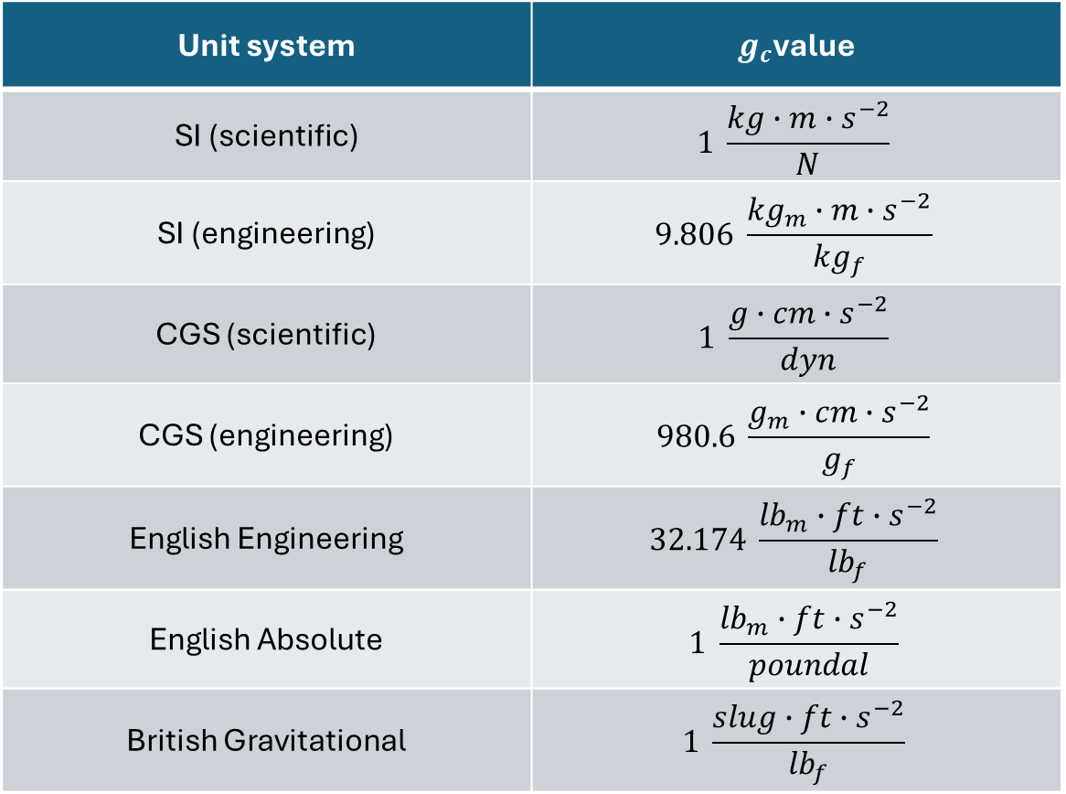
Some other common units are $g_{f}$ and ${kg}_{f}$, which are units of force that are normalized so that the weight of 1 kg is 1 ${kg}_{f}$
Unit system | $g_{c}$value
SI (scientific) | $$1 \frac{kg∙m∙s^{−2}}{N}$$
SI (engineering) | $$9.806 \frac{{kg}_{m}∙m∙s^{−2}}{{kg}_{f}}$$
CGS (scientific) | $$1 \frac{g∙cm∙s^{−2}}{dyn}$$
CGS (engineering) | $$980.6 \frac{g_{m}∙cm∙s^{−2}}{g_{f}}$$
English Engineering | $$32.174 \frac{{lb}_{m}∙ft∙s^{−2}}{{lb}_{f}}$$
English Absolute | $$1 \frac{{lb}_{m}∙ft∙s^{−2}}{poundal}$$
British Gravitational | $$1 \frac{slug∙ft∙s^{−2}}{{lb}_{f}}$$

