Slide 1
Course Info
Time: TR 11:10-12:25 AM
M 3:00-3:50 PM
Location: CHEN 106
Instructor: Dr. Martin Sentmanat
Office: CHEN 248
Phone: (979) 862-7687
Email: martin.sentmant@tamu.edu
Office Hours
M 10:00-11:00 AM
W 1:00-3:00 PM
Category | Date | Percentage
Homework | N/A | 10%
Daily Quizzes | N/A | 10%
Midterm 1 | Sep 27th | 25%
Midterm 2 | Nov 13th | 25%
Final | Dec 6th 8:00-10:00 | 30%

Slide 2
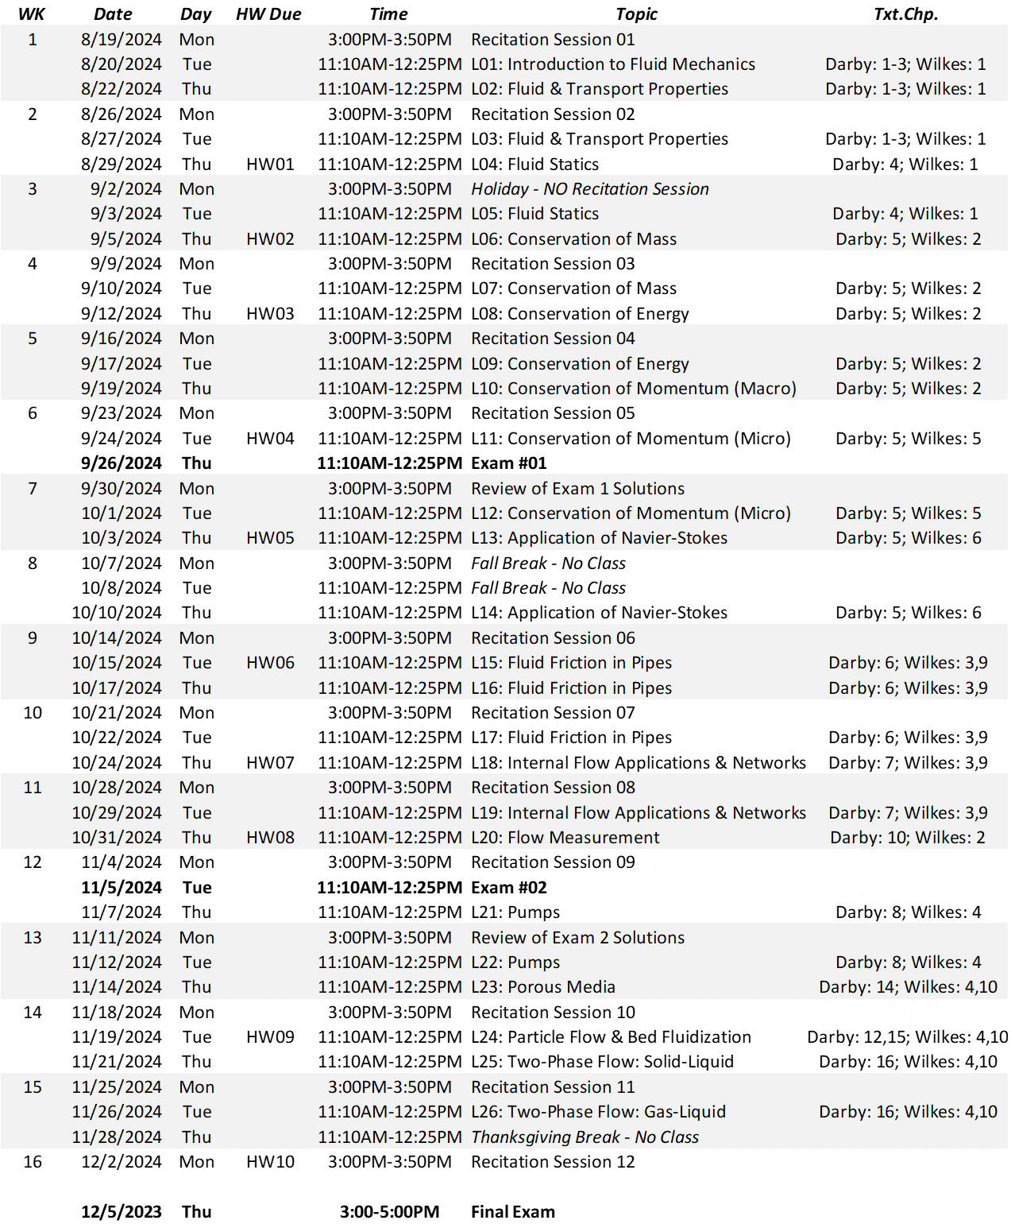

Slide 3
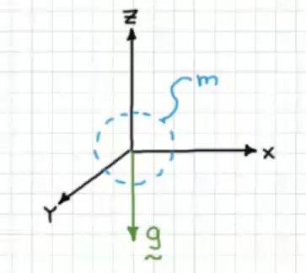



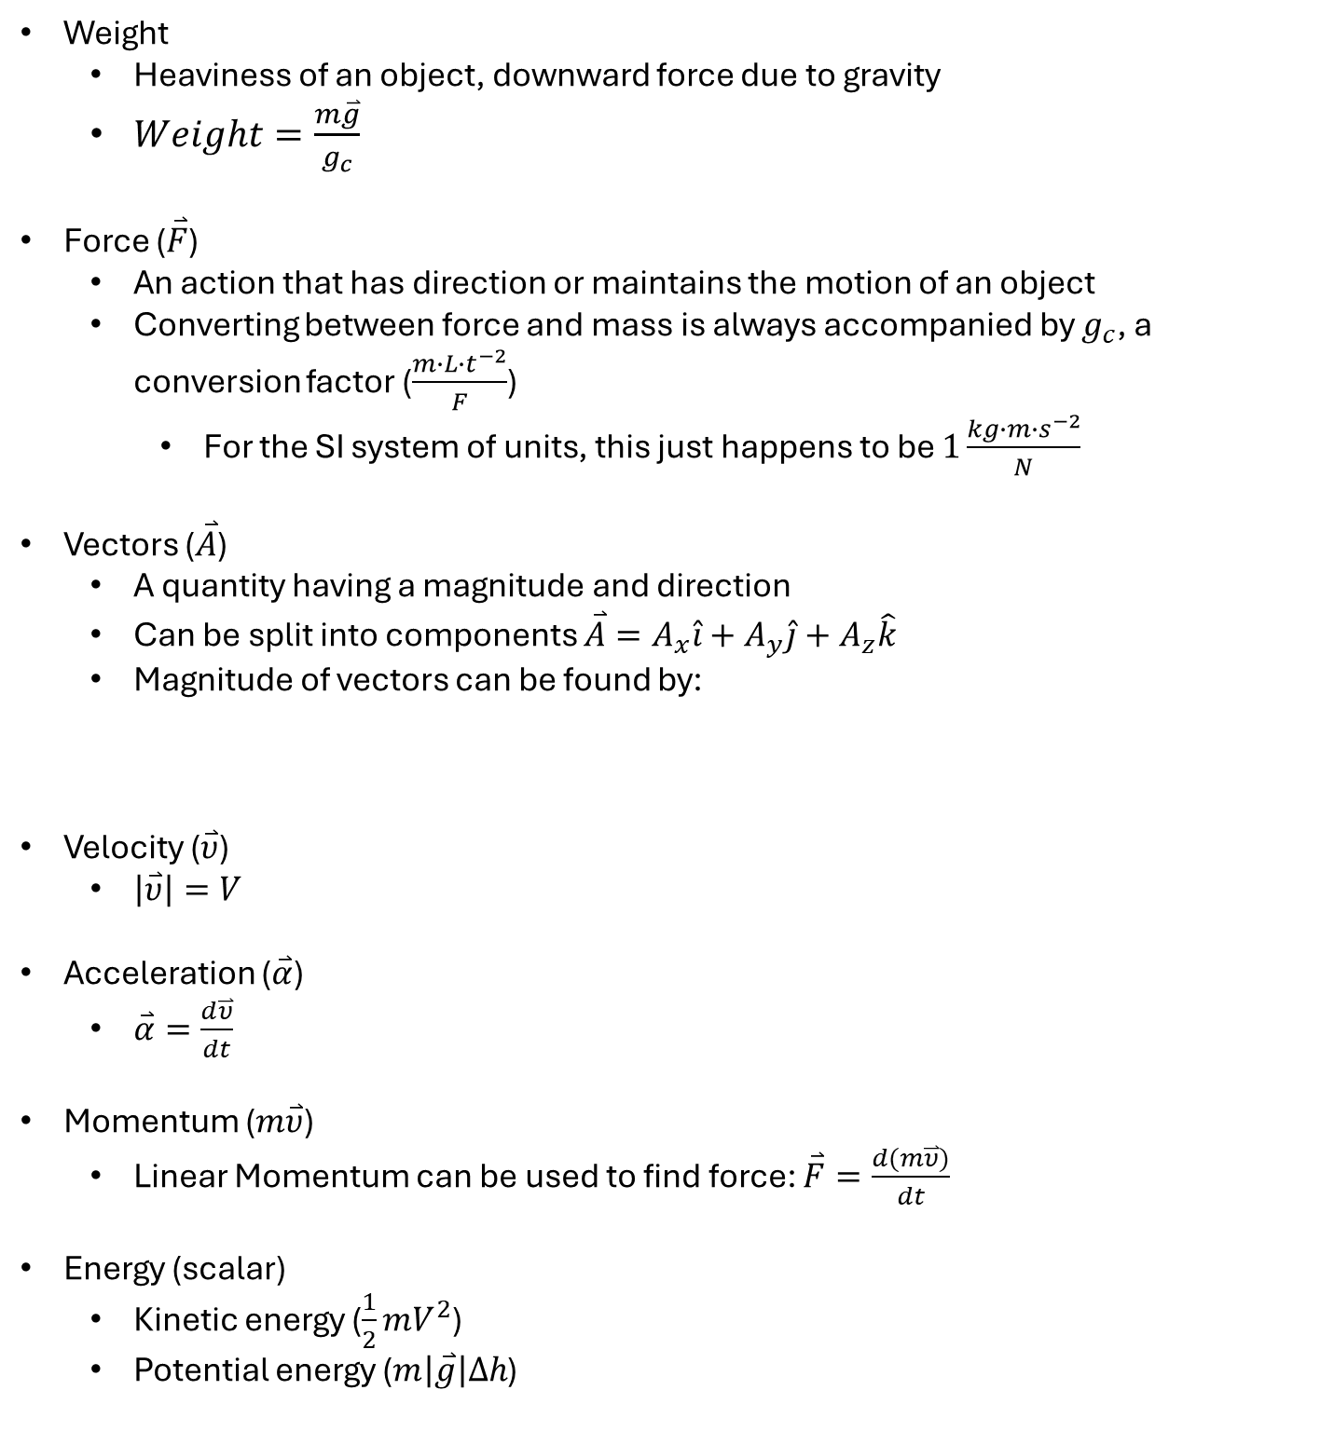
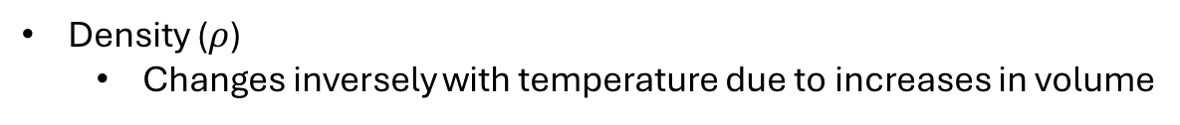
Review
Mass (m) and mass flow ($\frac{∂m}{∂t}=\dot{m}$)
Volume and volumetric flow ($\frac{∂volume}{∂t}=Q$)
In this course, Q is volumetric flow, not heat
Density ($ρ$)
Changes inversely with temperature due to increases in volume
Weight
Heaviness of an object, downward force due to gravity
$Weight=\frac{m\overset{⃑}{g}}{g_{c}}$
Force ($\overset{⃑}{F}$)
An action that has direction or maintains the motion of an object
Converting between force and mass is always accompanied by $g_{c}$, a conversion factor ($\frac{m∙L{∙t}^{−2}}{F}$)
For the SI system of units, this just happens to be $1\frac{kg∙m∙s^{−2}}{N}$
Vectors ($\overset{⃑}{A}$)
A quantity having a magnitude and direction
Can be split into components $\overset{⃑}{A}=A_{x}\hat{i}+A_{y}\hat{j}+A_{z}\hat{k}$
Magnitude of vectors can be found by:
Velocity ($\overset{⃑}{υ}$)
$\left|\overset{⃑}{υ}\right|=V$
Acceleration ($\overset{⃑}{α}$)
$\overset{⃑}{α}=\frac{d\overset{⃑}{υ}}{dt}$
Momentum ($m\overset{⃑}{υ}$)
Linear Momentum can be used to find force: $\overset{⃑}{F}=\frac{d(m\overset{⃑}{υ})}{dt}$
Energy (scalar)
Kinetic energy ($\frac{1}{2}mV^{2}$)
Potential energy ($m\left|\overset{⃑}{g}\right|Δh$)
$$\left|A\right|=\sqrt{A_{x}^{2}+A_{y}^{2}+A_{z}^{2}}$$

Slide 4
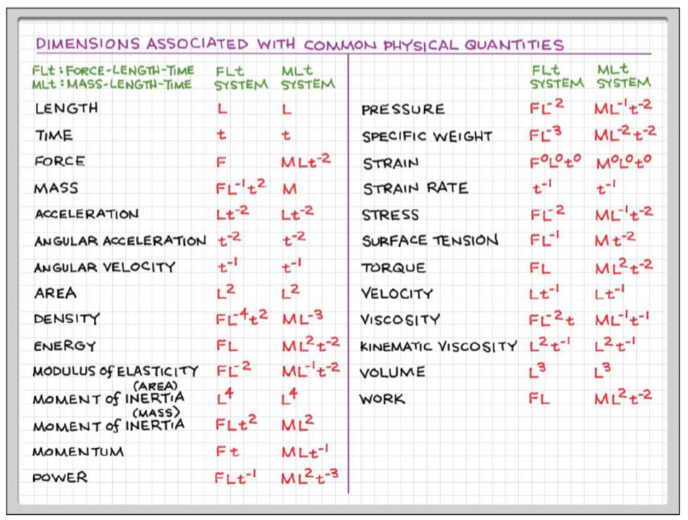


Introduction
What is a fluid?
You can classify something as a fluid or non-fluid based on how it reacts to a shear force (A force acting parallel to the surface)
Non-fluids can resist shear forces (solids)
Fluids deform under a shear force (liquids and gases)
States of Matter
Solids: have a lattice structure that holds them together, making them not deform
Liquids: held together by weaker forces, the forces are dependent on the separation distance of the molecules
Gases: spread far apart and have very weak interactions
Molecules collide with each other
Will not tend to fall when “poured” out of a cup
Modulus of elasticity tells how stiff something is
Kinematic viscosity is viscosity normalized by density (viscosity/density)
Force Conversion: $F=\frac{M∙L}{t^{2}}$
Mass Conversion: M$=\frac{F∙t^{2}}{L}$

Slide 5
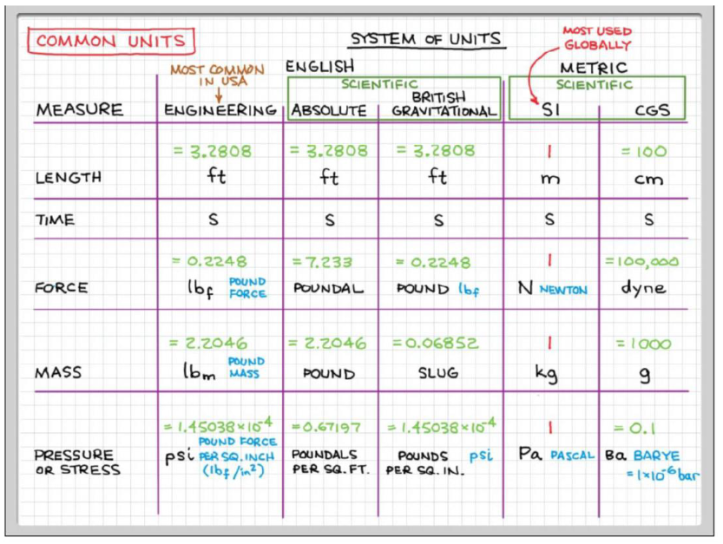
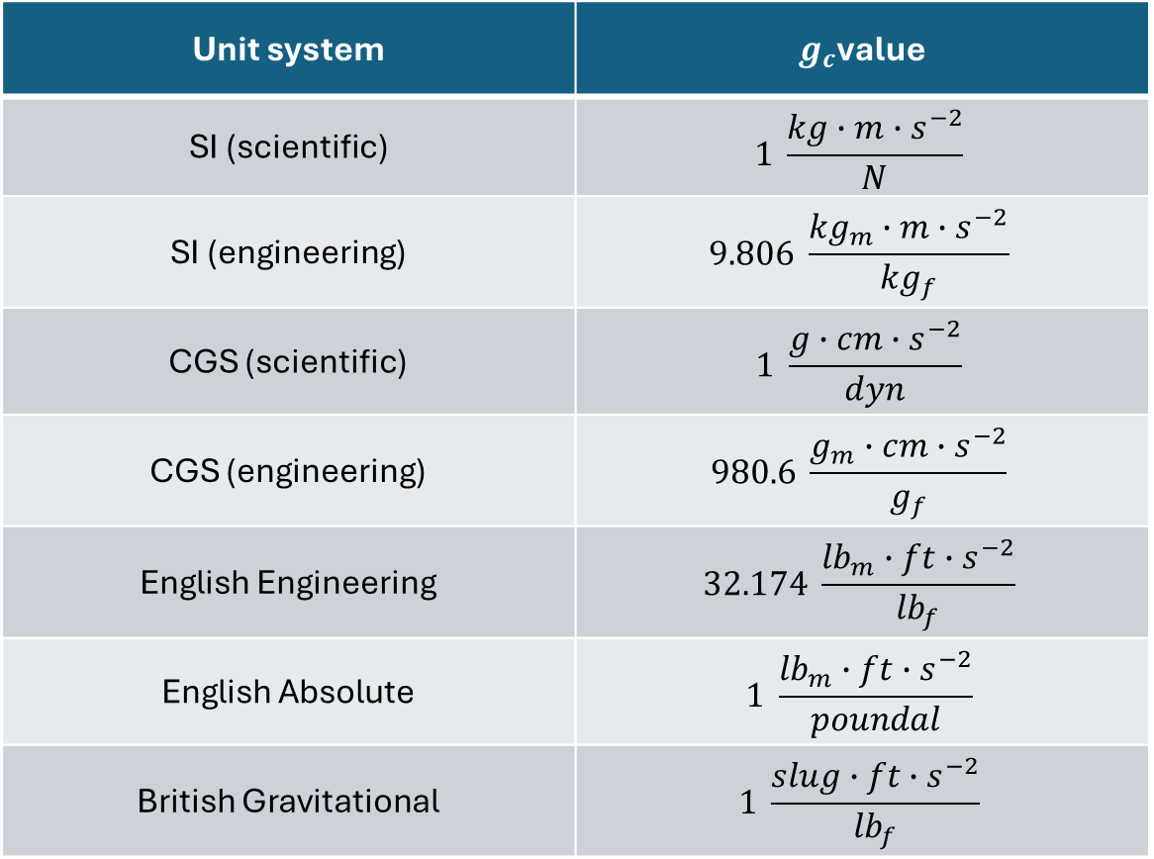
Some other common units are $g_{f}$ and ${kg}_{f}$, which are units of force that are normalized so that the weight of 1 kg is 1 ${kg}_{f}$
Unit system | $g_{c}$value
SI (scientific) | $$1 \frac{kg∙m∙s^{−2}}{N}$$
SI (engineering) | $$9.806 \frac{{kg}_{m}∙m∙s^{−2}}{{kg}_{f}}$$
CGS (scientific) | $$1 \frac{g∙cm∙s^{−2}}{dyn}$$
CGS (engineering) | $$980.6 \frac{g_{m}∙cm∙s^{−2}}{g_{f}}$$
English Engineering | $$32.174 \frac{{lb}_{m}∙ft∙s^{−2}}{{lb}_{f}}$$
English Absolute | $$1 \frac{{lb}_{m}∙ft∙s^{−2}}{poundal}$$
British Gravitational | $$1 \frac{slug∙ft∙s^{−2}}{{lb}_{f}}$$

Slide 6

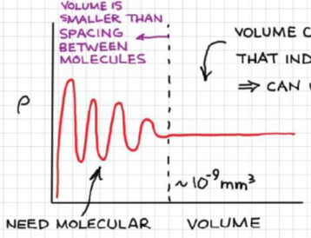
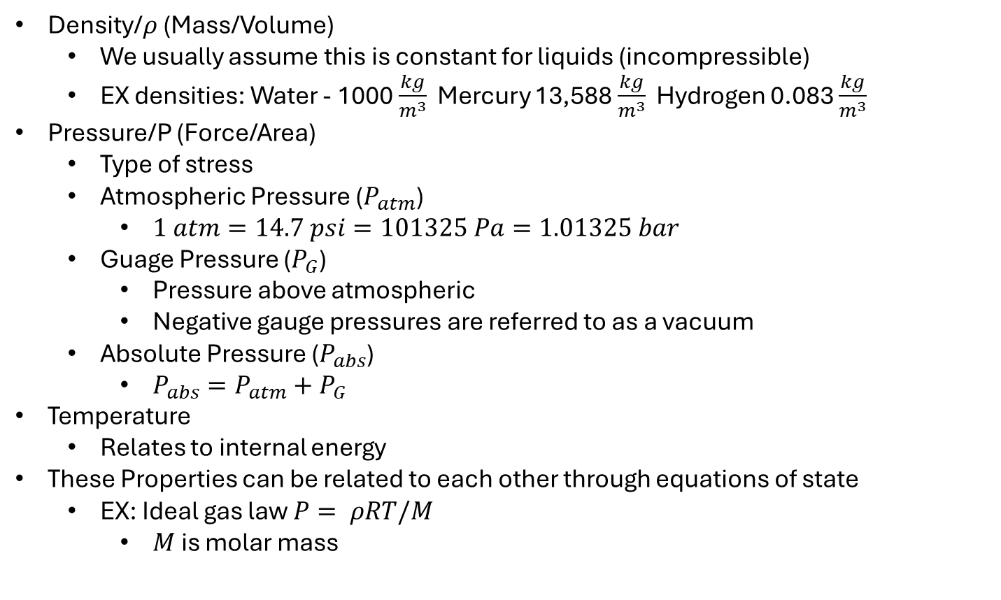
Basic Laws of Fluid Flows
Conservation of Mass
Conservation of Energy – 1st Thermo
Conservation of Momentum – 2nd Newton
Fluid Properties
Density/$ρ$ (Mass/Volume)
We usually assume this is constant for liquids (incompressible)
EX densities: Water - 1000 $\frac{kg}{m^{3}}$ Mercury 13,588 $\frac{kg}{m^{3}}$ Hydrogen 0.083 $\frac{kg}{m^{3}}$
Pressure/P (Force/Area)
Type of stress
Atmospheric Pressure ($P_{atm}$)
$1 atm=14.7 psi=101325 Pa=1.01325 bar$
Guage Pressure ($P_{G}$)
Pressure above atmospheric
Negative gauge pressures are referred to as a vacuum
Absolute Pressure ($P_{abs}$)
$P_{abs}=P_{atm}+P_{G}$
Temperature
Relates to internal energy
These Properties can be related to each other through equations of state
EX: Ideal gas law $P= ρRT/M$
$M$ is molar mass
Continuum Assumption
Fluid molecules aren’t confined to a lattice, and move around, so how do we deal with a volume in which the number of particles is constantly changing?
Only at extremely small sizes this makes a difference, so we can assume that values vary continuously through space (Continuum)
Material Classification
Materials can be classified based on how they respond to a shear force
In this class, we will only be focusing on Newtonian and Non-Newtonian fluids
Newtonian fluids have a constant viscosity, while Non-Newtonian fluids have viscosities that change

Slide 7
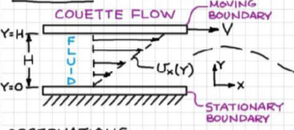
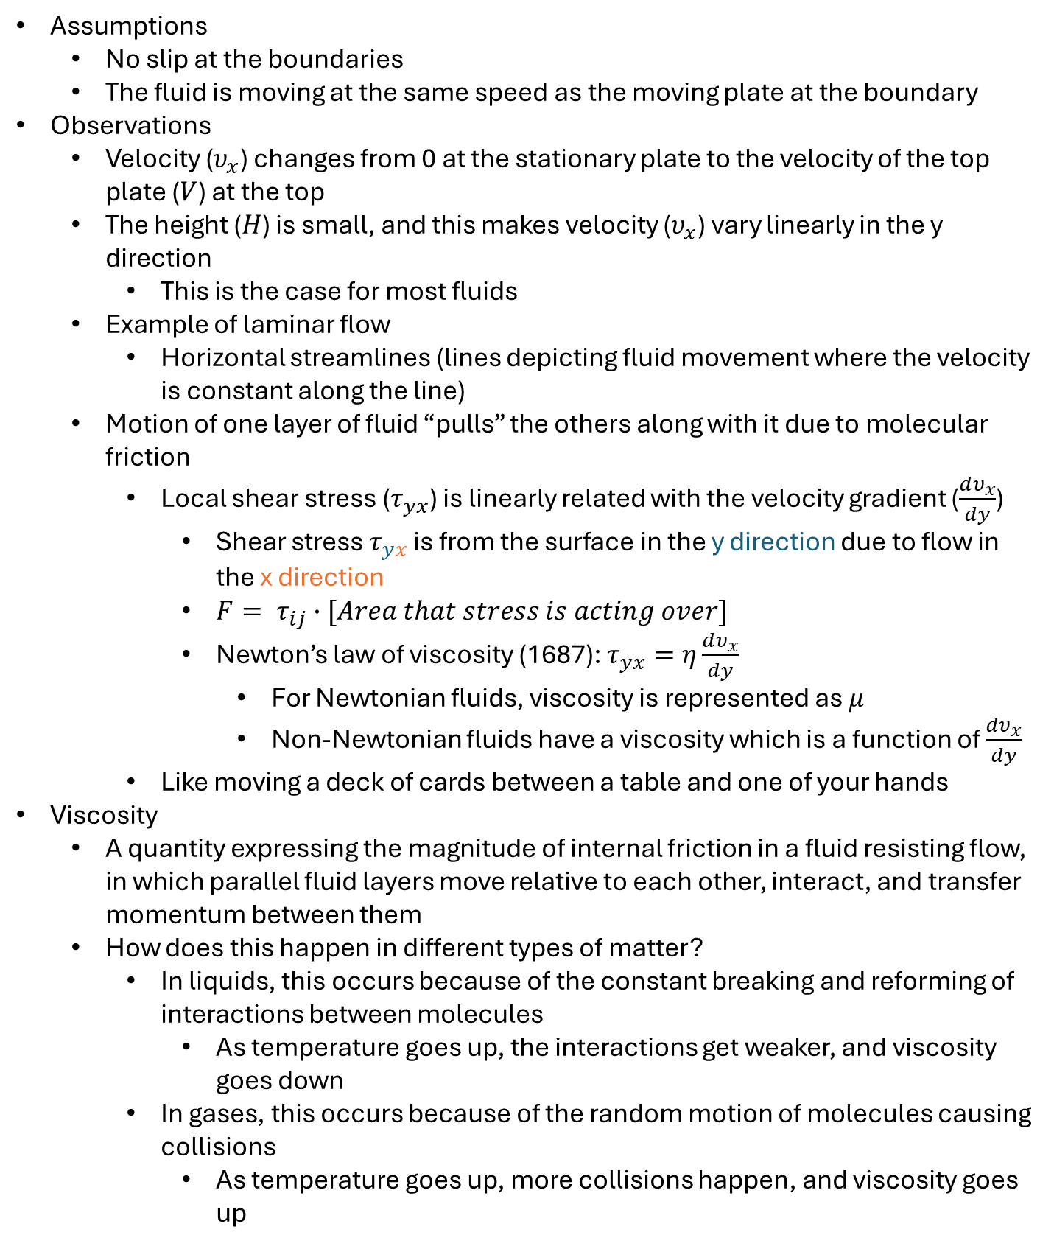
Transport Properties
Viscosity – resistance to flow
Couette Flow (drag flow)
Liquid between and stationary and moving plate in which flow is being caused by the moving plate
Assumptions
No slip at the boundaries
The fluid is moving at the same speed as the moving plate at the boundary
Observations
Velocity ($υ_{x}$) changes from 0 at the stationary plate to the velocity of the top plate ($V$) at the top
The height ($H$) is small, and this makes velocity ($υ_{x}$) vary linearly in the y direction
This is the case for most fluids
Example of laminar flow
Horizontal streamlines (lines depicting fluid movement where the velocity is constant along the line)
Motion of one layer of fluid “pulls” the others along with it due to molecular friction
Local shear stress ($τ_{yx}$) is linearly related with the velocity gradient ($\frac{dυ_{x}}{dy}$)
Shear stress $τ_{yx}$ is from the surface in the y direction due to flow in the x direction
$F= τ_{ij}∙[Area that stress is acting over]$
Newton’s law of viscosity (1687): $τ_{yx}=η\frac{dυ_{x}}{dy}$
For Newtonian fluids, viscosity is represented as $μ$
Non-Newtonian fluids have a viscosity which is a function of $\frac{dυ_{x}}{dy}$
Like moving a deck of cards between a table and one of your hands
Viscosity
A quantity expressing the magnitude of internal friction in a fluid resisting flow, in which parallel fluid layers move relative to each other, interact, and transfer momentum between them
How does this happen in different types of matter?
In liquids, this occurs because of the constant breaking and reforming of interactions between molecules
As temperature goes up, the interactions get weaker, and viscosity goes down
In gases, this occurs because of the random motion of molecules causing collisions
As temperature goes up, more collisions happen, and viscosity goes up

Slide 8
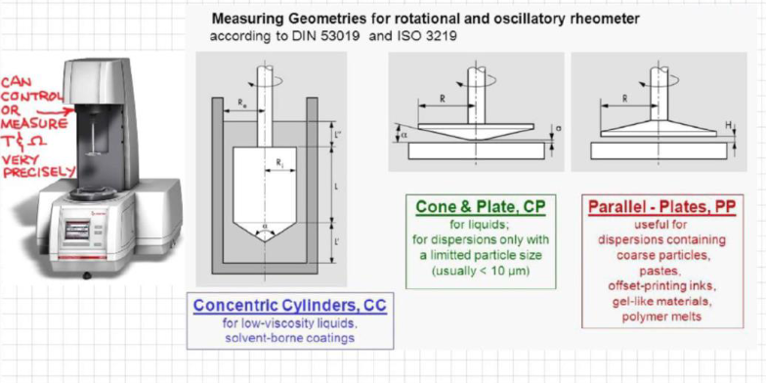
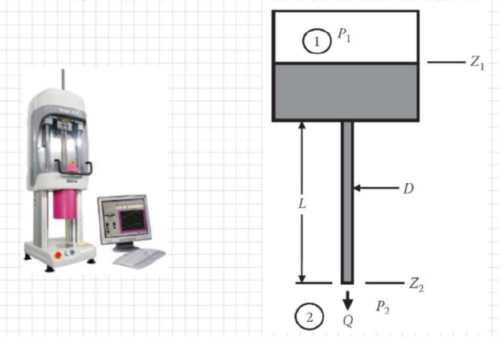
How is viscosity measured?
By how it responds to a simple deformation, where only one component of velocity is non-zero
Most often this is in the form of simple shear flow
The two types of simple shear flow are Couette flow and Poiseuille flow (pressure driven through a pipe)
Using Couette flow (Rotational viscometer/rheometer)
Fluid trapped between stationary rotating surfaces
Torque related to the viscosity of the fluid
Using Poiseuille Flow (Capillary viscometer/rheometer)
Fluid forced through a circular tube
Pressure related to viscosity

Slide 9
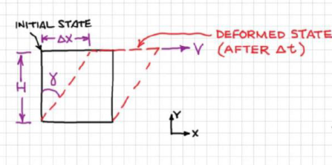

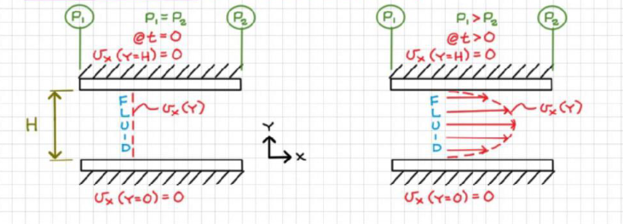

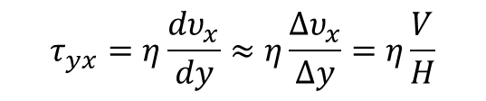

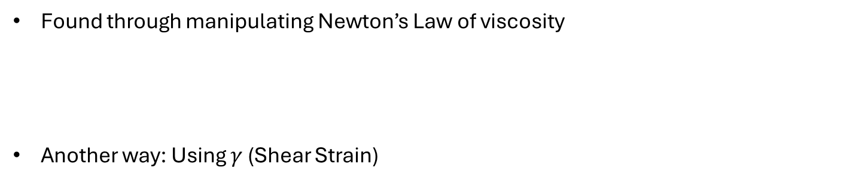



Finding Shear Stress
Found through manipulating Newton’s Law of viscosity
Another way: Using $γ$ (Shear Strain)
At the point where the fluid is in contact with the moving plate
$$τ_{yx}=η\frac{dυ_{x}}{dy}≈η\frac{∆υ_{x}}{∆y}=η\frac{V}{H}$$
$$\tan{γ}=\frac{∆x}{H}=\frac{V∆t}{H}$$
If $γ$ is small:
$$\tan{γ}≈γ→γ=\frac{V∆t}{H}$$
$$\frac{γ}{∆t}=\frac{V}{H}≈\frac{dγ}{dt}=\dot{γ}$$
So… $τ_{yx}=η\frac{dυ_{x}}{dy}=η\dot{γ}$
Often called the Shear Rate
Poiseuille Flow (pressure-driven flow)
(Quick detour)
No moving plates
Velocities at the plates are still 0 because of the no-slip assumption
Instead of a linear velocity gradient, it is parabolic

Slide 10
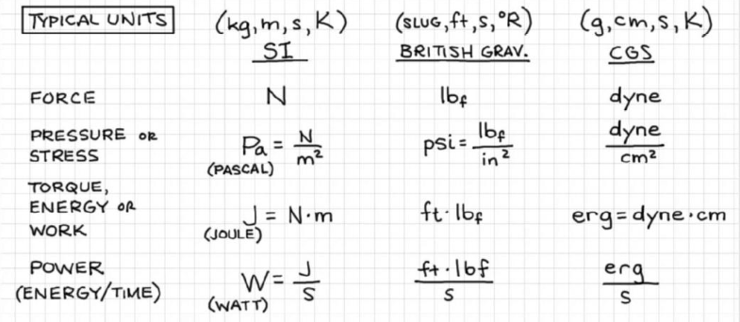
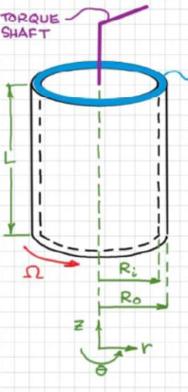
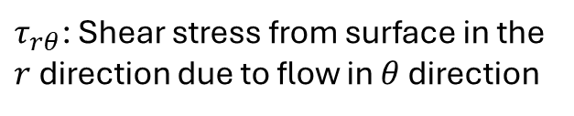
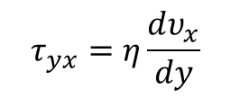
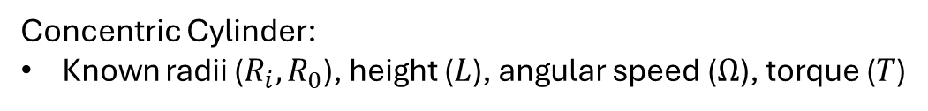

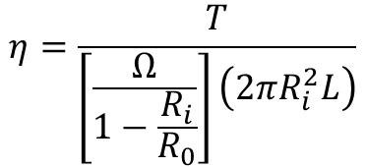


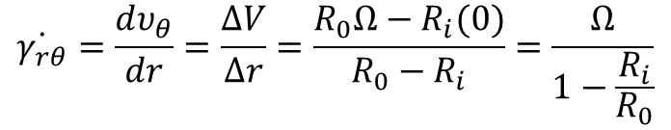
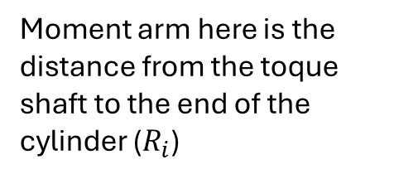
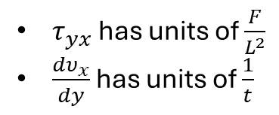


More Units
Determining Units for Viscosity using Newton’s Law of viscosity :
$$τ_{yx}=η\frac{dυ_{x}}{dy}$$
$τ_{yx}$ has units of $\frac{F}{L^{2}}$
$\frac{dυ_{x}}{dy}$ has units of $\frac{1}{t}$
So, $η$ has units of $\frac{F∙t}{L^{2}}=P∙t=\frac{M}{t∙L}$
Determining viscosity with Viscometers
Concentric Cylinder:
Known radii ($R_{i},R_{0}$), height ($L$), angular speed ($Ω$), torque ($T$)
Moment arm here is the distance from the toque shaft to the end of the cylinder ($R_{i}$)
$$T=F×Moment Arm$$
$$F=τ_{rθ}A$$
$τ_{rθ}$: Shear stress from surface in the $r$ direction due to flow in $θ$ direction
$$A=2πR_{i}L$$
$$τ_{rθ}=η\dot{γ_{rθ}}$$
$$\dot{γ_{rθ}}=\frac{dυ_{θ}}{dr}=\frac{ΔV}{Δr}=\frac{R_{0}Ω−R_{i}(0)}{R_{0}−R_{i}}=\frac{Ω}{1−\frac{R_{i}}{R_{0}}}$$
Substituting and rearranging…
$$η=\frac{T}{\left[\frac{Ω}{1−\frac{R_{i}}{R_{0}}}\right]\left(2πR_{i}^{2}L\right)}$$
Remember: only valid for small gaps

Slide 11

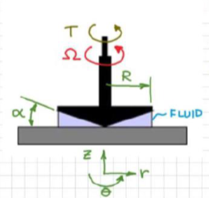
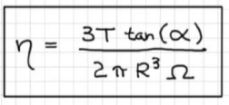
Cone and Plate (More commonly used)
So, the shear rate is uniform throughout the fluid
Alpha is usually smaller than $2^{o}$. Usually around $1^{o}$
Viscosity for Non-Newtonian Fluids

